Slide 1
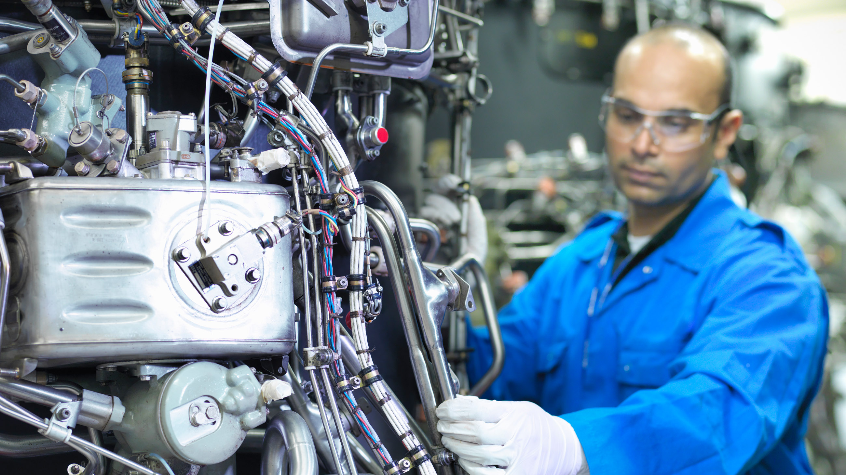

FaaS Performance Analysis
Jerry Wang
2015 July
Internal

Slide 2
My Task – click Edit button
For my task application, there is only one batch request to retrieve complete note. No authorization check is done in my task.
I checked the following six applications.
The following applications have authorization check when edit button is clicked:
My opportunity
My appointment
My lead
The following do NOT have authorization check:
My account
My contact
My task

Slide 3
My Task – authorization check
The current handling on authorization check result is: if checks is successful, navigate to edit page, or else display error message.
And any end user who is able to use Chrome development tool can manually change the ActionSuccessful to ‘X’ even if he didn’t have enough authorization in the backend.
So is this authorization check really necessary since it could somehow be bypassed. What if an unauthorized user has circumvented this check and continuously executed the code of opportunity save? Is there any authorization check embedded in CRM_ORDER_MAINTAIN?

Slide 4
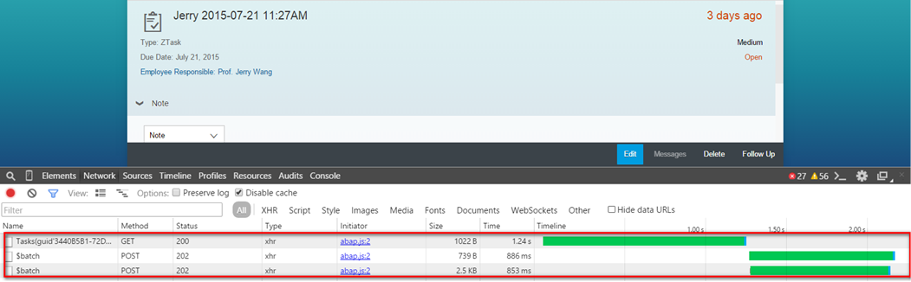
My Task – click one task to reach task detail view

Slide 5
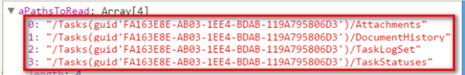
My Task – click one task to reach task detail view – three roundtrip
#1: get task data in header level.
#2: written in the callback of request #1, so it can only be sent once the response of #1 is back, which could clearly be observed in the timeline above.
The following 4 types of the task data are fetched in batch:
#3: get complex note customizing and transaction data
Jerry: check the possibility of merging these three roundtrips into one

Slide 6
Batch request(technical detail, user status, user priority )
Task list retrieval
t1
t2
Time

