Slide 1
Regular expression
(/^ (https?\:) \/\/(([^:\/?#]*) (?:\: ([0-9]+) ) ?) (\/[^?#]*)(\?[^#]*|)(#.*|)$/);

Slide 2
Saved query Incident
First roundtrip
Second roundtrip
t1
t2
t3
t4
t5
t6
t7
t8
1. Context node binding of node A ( Lead component controller ) and node B ( saved query)
3. Lead search view raises BEFORE_OUTPUT event ( via super class implementation)
6. Content of node C is merged to node A as t2. Since now C already has 1 entry, so after do_prepare_output , A, B and C have 5( from configuration )+ 1(load from saved query) = 6 entries ( to be exact, before super DPO, C = 1, after super DPO, C = 6)
2. Entity from view controller’s node C is added to node A.
Now A, B and C have exactly 5 entries ( defined in view configuration ). This is done in lead search view controller’s do_prepare_output method.
4. user’s saved query is loaded from DB and fill into node C ( 1 entry ).
8. User clicks save
button, validation is
done on node B ( 6 entries ) and C
( 1 entry ) – PASS!
5. User has changes saved query and save. The validation is done based on node B ( 5 entries and C ( 1 entry ). Failed!
7. after before_output event handler is executed, C has 1 entry, A has 5 + 1 = 6 entries. B has 6 entries as well due to context node binding.
Notes:
Test in QHD/504
do prepare output 里将search 的content 赋给adv. 此时saved query 还没load.在dpo 执行完后，五个default 的search parameter entry.
然后执行load saved query,将db 里的query 加载到内存里，绑到view controller 的node 上，这样就能显示在ui上。
当user 在ui 上编辑搜索参数并且点save 后，saved query component 中adv 的内容被save 到Db.
这里有可能产生错误，如果view controller 和saved query adv 没有绑定的话。
load query 出错的根源还是在于save query 的实现。只要这个问题解决了，load 也就不存在问题了。

Slide 3
Fields belongs to context node which is bound to BTPartner are changed in UI
It_partner is not initial when CRM_ORDER_MAINTAIN is called
Lv_proceed_partner = abap_true
CRM_PARTNER_DETERM_INITIAL_EC is called
Notes:
Partner determination

Slide 4
Is lv_value = 1?
No
Is lv_value = 2?
Yes
Yes
No

Slide 5
C_SalesContractItmFlfmtQ
I_SalesContractItemFlfmtCube
I_SalesContract: SC
I_SalesContractItem: SCI
P_SalesContractItemFlfmt: P_SCIF
I_SDDocStandardPartner: StandardPartner
I_SDDocItemStandardPartner: ItemStandardPartner
I_Employee: _ResponsibleEmployee

Slide 6
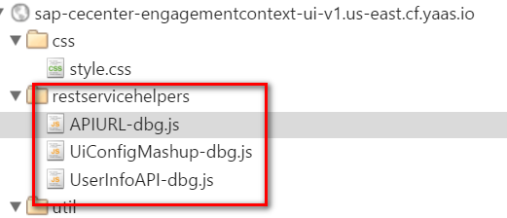
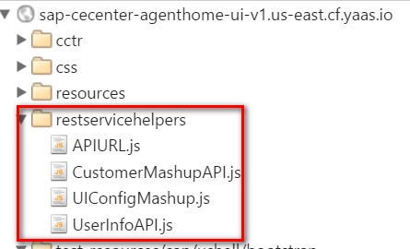

Slide 7

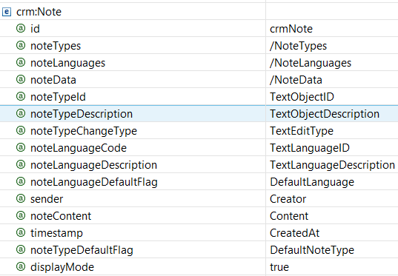

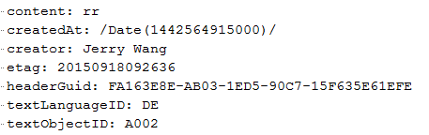

Slide 8
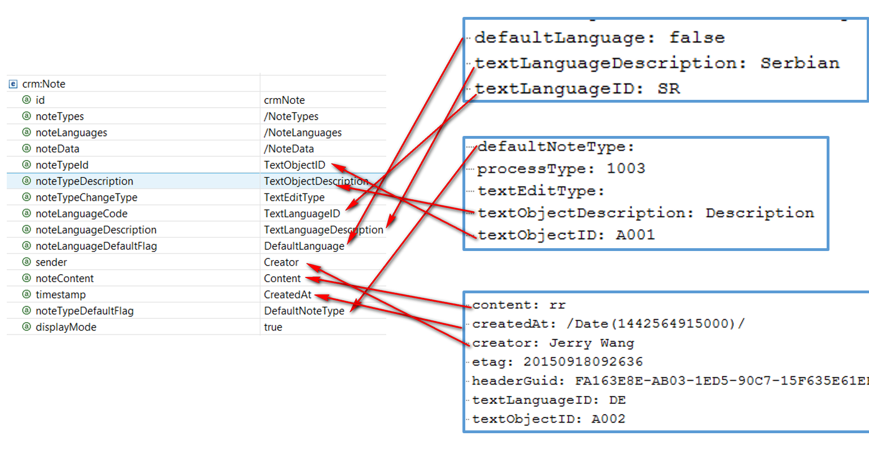

Slide 9
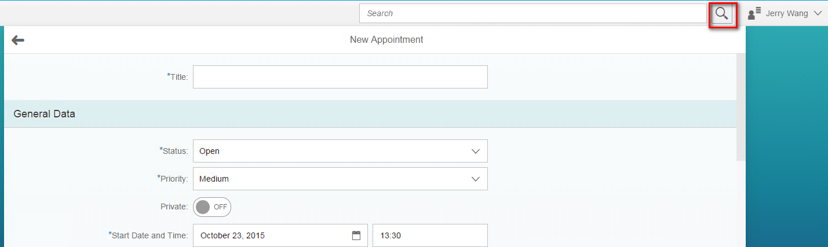
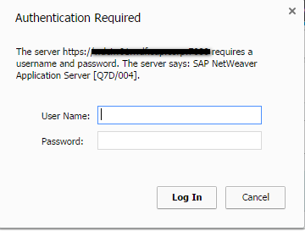

Slide 10
/(?:^\?|&)(.*?)=(.*?)(?=&|$)/g
(?:exp)不会改变正则表达式的处理方式，只是这样的组匹配的内容不会像前两种那样被捕获到某个组里面，也不会拥有组号
(?=exp)也叫零宽度正预测先行断言，它断言自身出现的位置的后面能匹配表达式exp。比如\b\w+(?=ing\b)，匹配以ing结尾的单词的前面部分(除了ing以外的部分)，如查找I'm singing while you're dancing.时，它会匹配sing和danc。

Slide 11
Note 1
Task A
Note 2
Note 3
Note A 1
Task A
Note B 1
Note A 2
Task B
Note B 2
Notes:
第一个难点是如何避免左边针对task的loop， 把复杂度从o(n²)降成o(n)。第二个难点是右边task note的loop里，取到每个note instance后，如何正确地将其写回到所属的task的DOCUMENTNOTES这个internal table里去。

Slide 12
1
2
3
4
5

Slide 13
does the transaction type has status profile?
No
Yes
Read user statuses assigned to that profile
Get all system statuses from C table
Do filtering according to status management internal logic
User status returned
System status returned

Slide 14

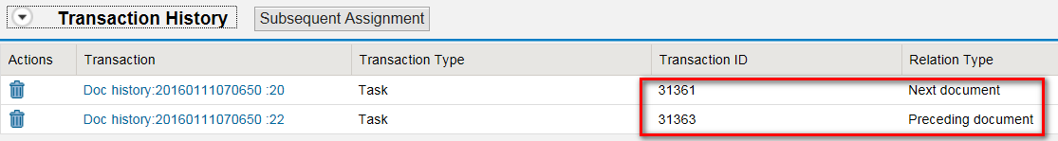

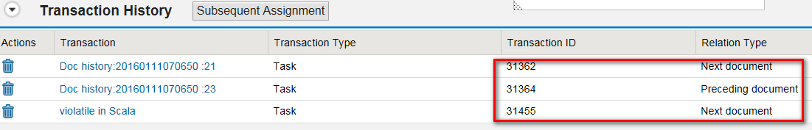

Slide 15
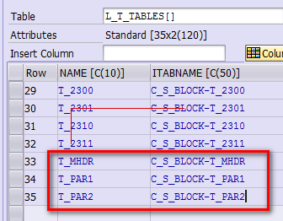


Slide 16
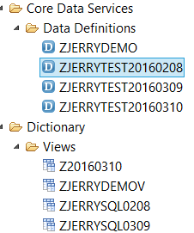

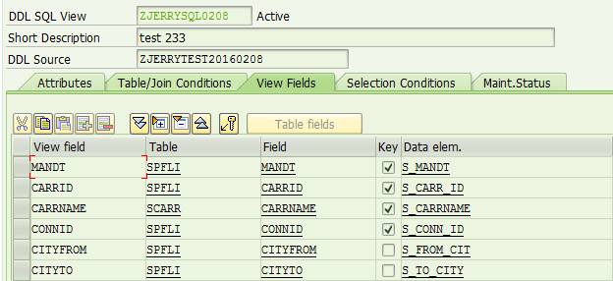

Slide 17
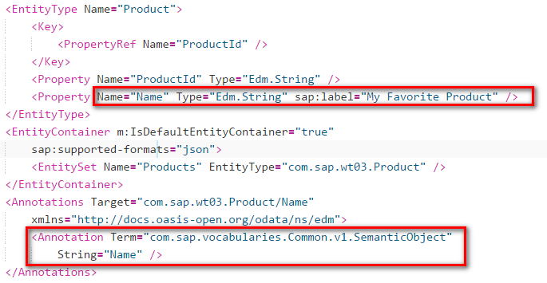
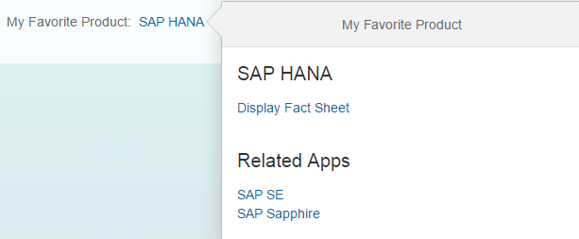

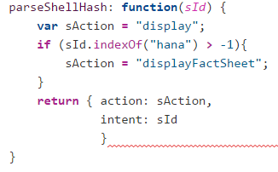
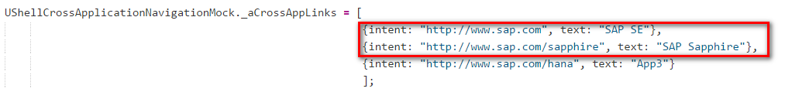
metadata.xml
Products.json
Application code

Slide 18
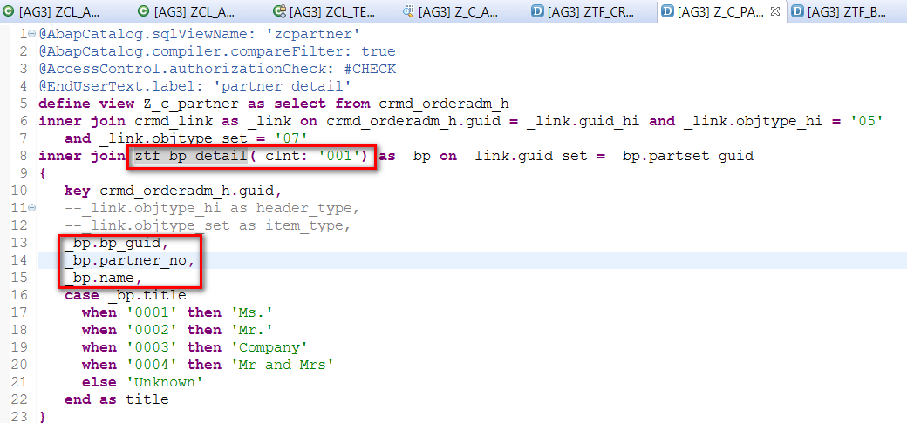
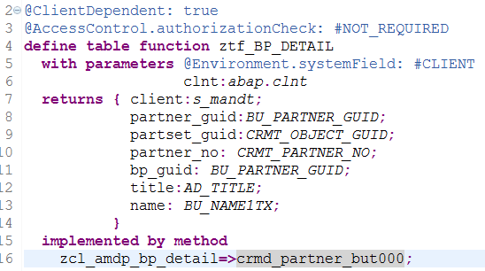

Slide 19
CDS view
guid
Order_id
Order_text
Post_date
Status
1:N
Order id
Order description
Post date
Status
List report table view

Slide 20
Consumption view
Zflight_Com
Zspfli_Root._Item
Zspfli_Root
association [0..*] to Zsflight_Child as _Item on $projection.carrid = _Item.carrid
and $projection.connid = _Item.connid
@ObjectModel.association.type: #TO_COMPOSITION_CHILD
_Item,
Zsflight_Child
define view Zsflight_Child as select from scounter
association [1..1] to Zspfli_Root as _root
on $projection.carrid = _root.carrid
Annotation defines here

Slide 21
Z_C_Service_Order_View
Z_i_Order_View
Z_C_Order_Item
Zorder_Sys_Status
Z_c_partner
Z_I_Item_Detail
CRMC_PROC_TYPE
CRMD_ORDERADM_H
CRMD_LINK
ztf_bp_detail
CRMD_ORDERADM_I
CRMD_SCHEDLIN
Z_I_Prod_Status
zcl_amdp_bp_detail
CDS view
CDS consumption view
CRM_JEST
Z_C_Status_Text
CRMD_PRODUCT_I
ABAP Database table
CDS Table function
TJ02
TJ02T
AMDP implementation
Notes:
Provide definitions of structural as well as transactional related aspects of the business data model
Represent semantic views on business data through the use of specific patterns that are completely independent of UI technologies.

Slide 22
Legend
CDS view
CDS consumption view
ABAP Database table
CDS Table function
AMDP implementation

Slide 23
UI5 Application
UI specific OData derived from CDS DDL
Gateway / OData
SADL framework
Annotations for UI in CDS DDL
CDS Consumption View
Annotations for BO Definition in CDS DDL
CDS BO View
Database table
Database table

Slide 24
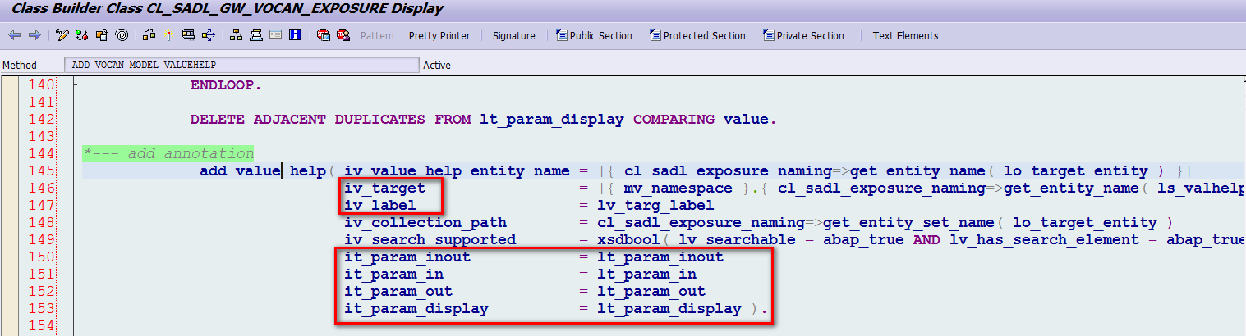
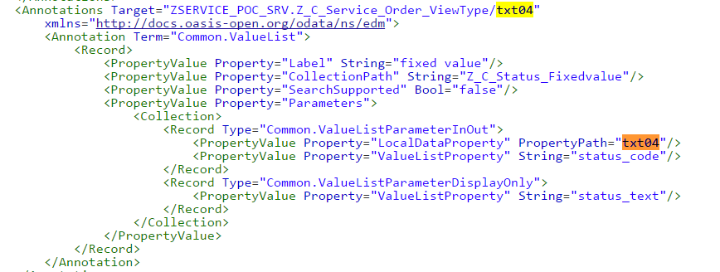

Slide 25
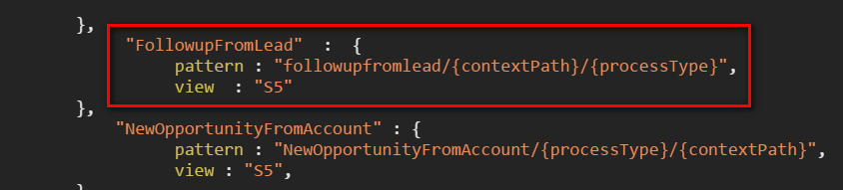
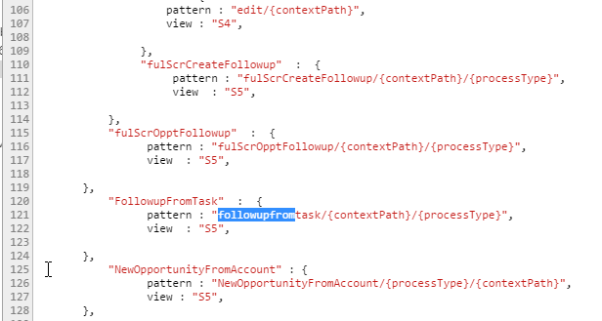

Slide 26
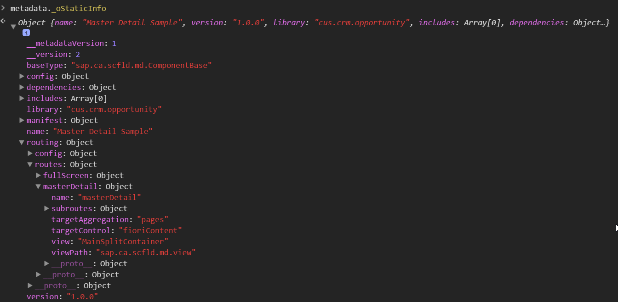

Slide 27

GET Z_SALESVOLUMEANALYSISQUERY(P_ExchangeRateType='M',P_DisplayCurrency='EUR')/Results?$filter=(( ( (BillingDocumentDateYear eq '2015') or
(BillingDocumentDateYear eq '2016') or (BillingDocumentDateYear eq '2017') ) and ( (BillingDocDateYearQuarter eq '1.2015') or (BillingDocDateYearQuarter eq '2.2015') or (BillingDocDateYearQuarter eq '4.2017') ) and ( (BillingDocDateYearMonth eq '02.2015') or (BillingDocDateYearMonth eq '10.2017') ) ) and ( (SalesOrganization eq '0001') ) and (BillingDocumentDateYear eq '2016‘ ))

Slide 28
Event
OPA test code
My Lead Code
5. Success callback of this.oModel.read
1.oInput.fireLiveChange("f");
2. this.oModel.read("/" + sEndPoint, null, true)
3. Items = oInput.getSuggestionItems()
4. items[0].getText();
time
t1
t2

Slide 29
Event
OPA test code
My Lead Code
3. Success callback of this.oModel.read
Matcher endless check
1.oInput.fireLiveChange("f");
2. this.oModel.read("/" + sEndPoint, null, true)
4. Items = oInput.getSuggestionItems()
5. items[0].getText();
t1
t2
time

Slide 30
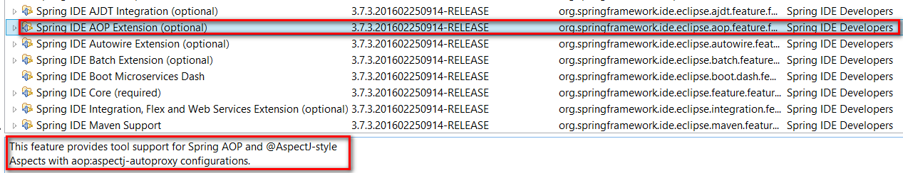
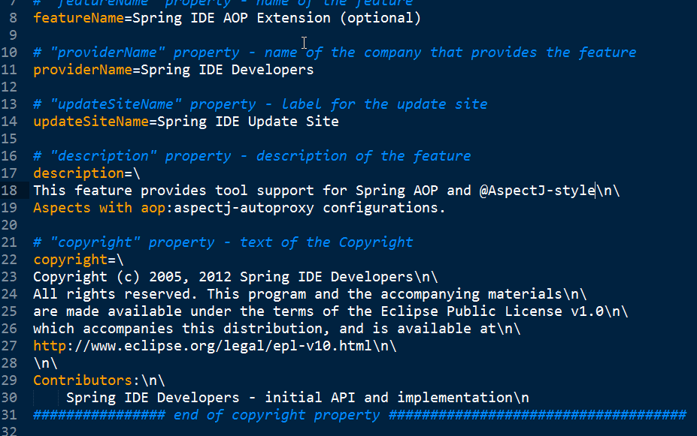

Slide 31
Method A
Business logic 1
Method B
Business logic 2
Method C
Business logic 3
Log
Performance trace
Authorization check

Slide 32
Method A
Authorization check
Log
Performance trace
Business logic 1
Method B
Authorization check
Log
Performance trace
Business logic 2
Method C
Authorization check
Log
Performance trace
Business logic 3

