Slide 1


Fiori Introduction
Jerry Wang
2016 Jan
Internal

Slide 2
Is it wrong to use a Boolean parameter to determine behavior
Discussion in stackoverflow
A developer defines a method with a Boolean as one of its parameters, and that method calls another, and so on, and eventually that Boolean is used, solely to determine whether or not to take a certain action.
One incident in Fiori team
Another incident 671830 2015

Slide 3
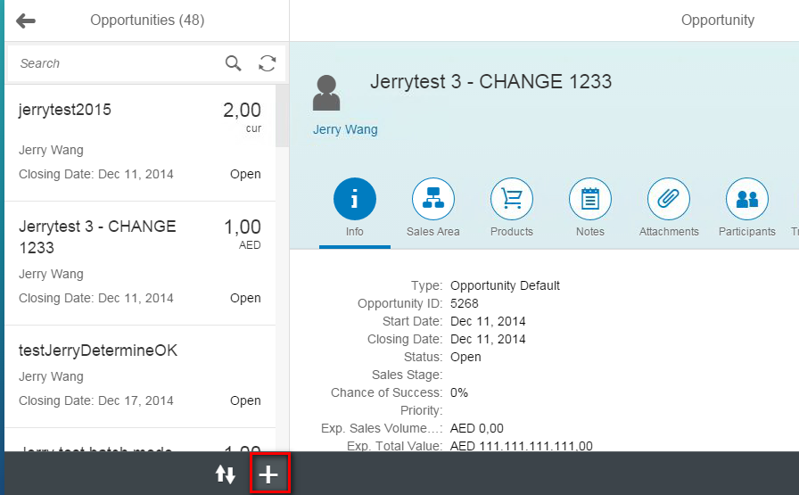
Create button in Toolbar

Slide 4
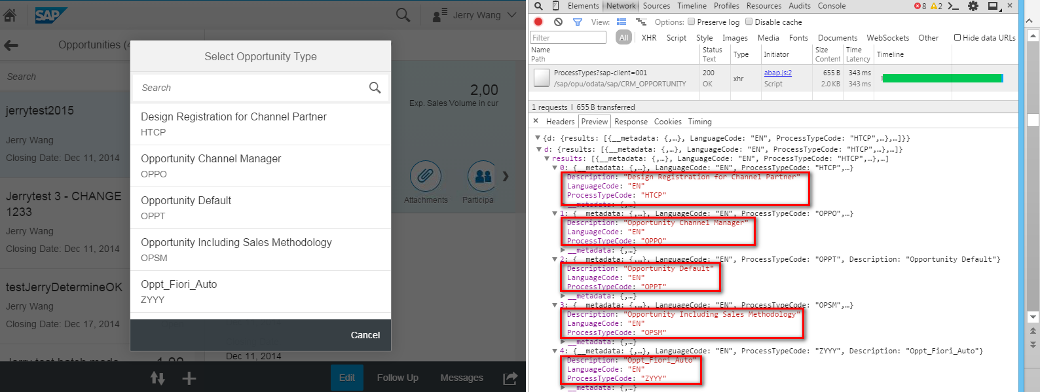
Transaction Type popup

Slide 5
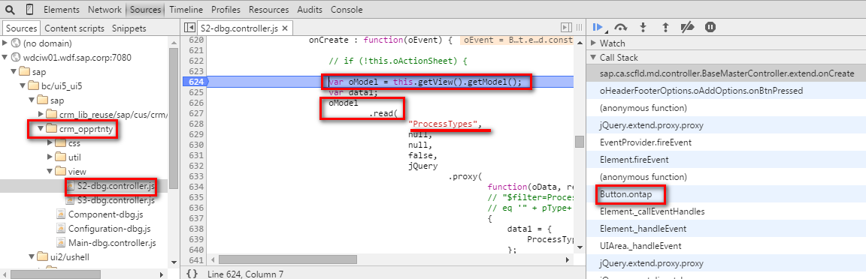
1. BSP Application sends OData Request

Slide 6
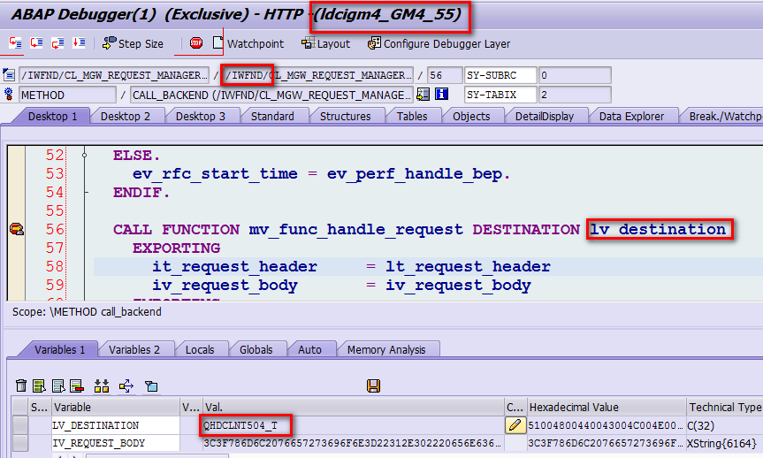
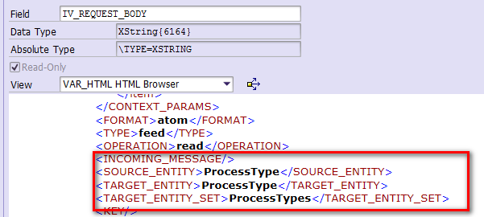
2. Gateway Frontend Add-on calls Trusted RFC to Backend

Slide 7
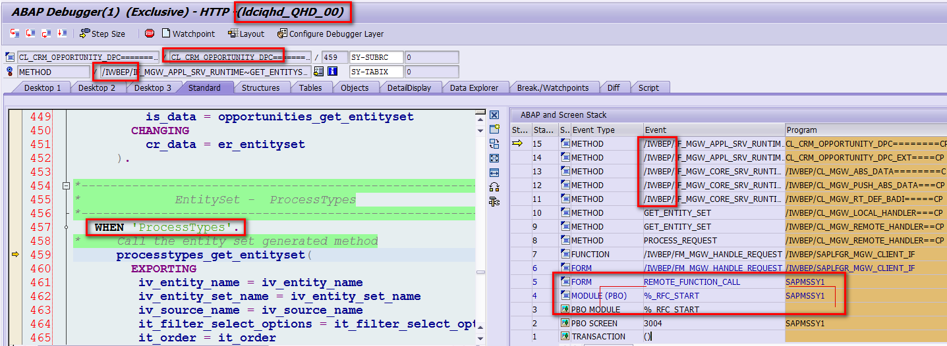
3. Gateway Backend Add-on Delegates to Service Provider

Slide 8
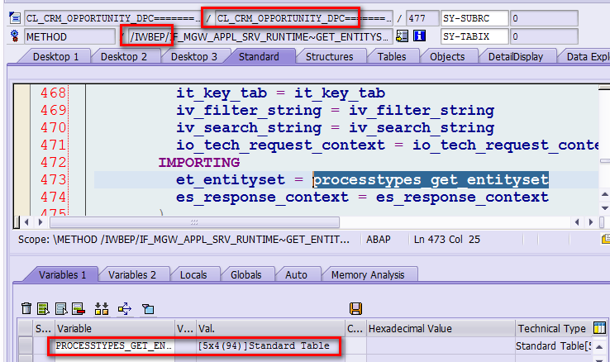
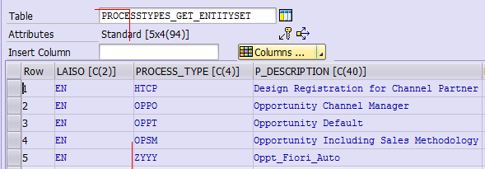
Response in ABAP Format

Slide 9
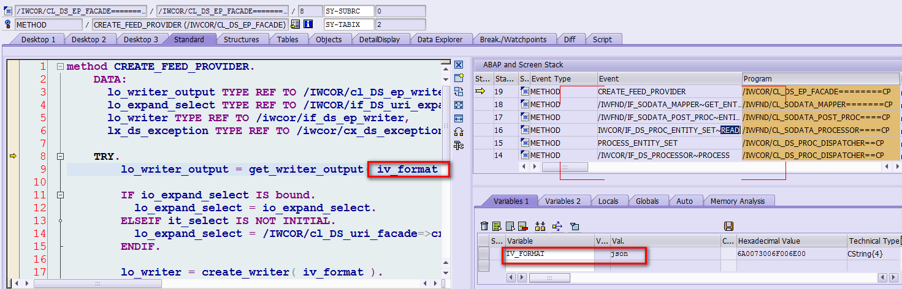
4. Gateway Frontend Add-on converts response to JSON format

Slide 10
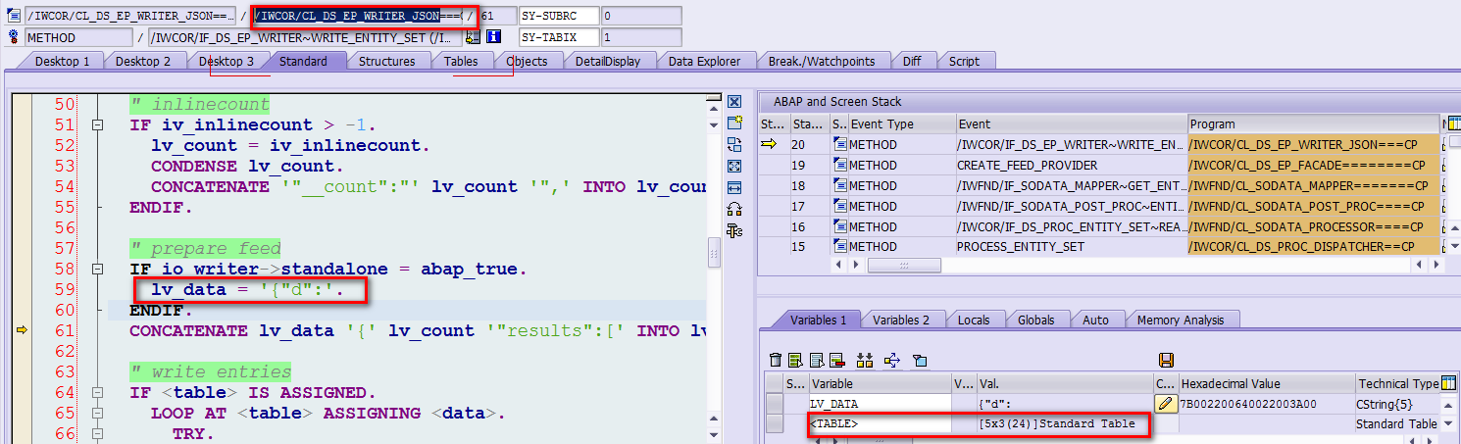
4. Gateway Frontend Add-on converts response to JSON format

