Slide 1

Reducing distracted driving caused by cell phone usage
Created by: Victor Hernandez, Rizzy Reyes, Anuja Upadhyay
Notes:
Introductions
ALL

Slide 2
Purpose
Dangers of distracted driving
Program that helps limit usage of phone
Implementation of program
Notes:
Our purpose today is to explain the dangers of distracted driving that is caused by phone usage we will be presenting a program to limit the usage of phone usage looking at how different groups are affected by being educated on the issue as well as receiving devices to limit phone usage.
First we will discuss the issue of distracted driving looking at data of the issue overall and then leaning to looking at cell phone usage as a specific cause. Next we will go over the program and how it will work, First looking at the program, then implementation, measuring its success and then the benefits from our program. Finally we would like to invite your questions.
Victor

Slide 3

Statistics
“In the U.S. in 2018, over 2,800 people were killed and an estimated 400,000 were injured in crashes involving a distracted driver.” (CDC,2020).
“According to TxDOT statistics released by AAA on Wednesday, Dallas County recorded 18 deadly crashes caused by distracted driving in 2017, a 20 percent increase from the 15 such crashes in 2016.” (TxDot,2019).
Notes:
Anuja

Slide 4
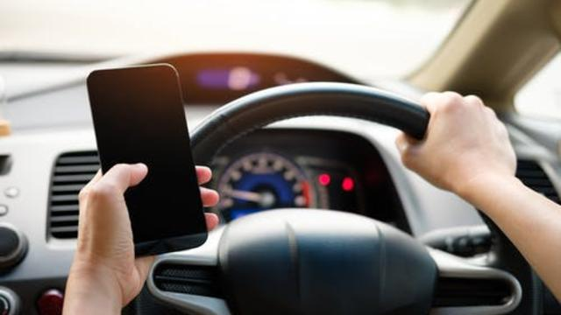
Issue of Distracted driving
How it's dangerous to driver and others
Accidents caused by distracted driving involving phones
How this has been tried to be solved
This Photo by Unknown author is licensed under CC BY-NC-ND.
Notes:
Anuja
“At any given time in 2018, an estimated 2.1% of all drivers on the road were visibly using a handheld device – a 0.1% increase from 2017.” (CDC, 2020). Which correlates to accidents caused by distracted driving.

Slide 5
Our Program
Presentation with regards to using devices and distracted driving.
One group with only presentation other with presentation and GPS provided.
Check ins for 2 years which is duration of program
Evaluate results
Notes:
Our program is aimed to help lower the number of distracted drivers by attempting to limit phone usage.
We plan on giving a presentation about the dangers of using a phone while driving by addressing risks to both the driver and others on the road. We will explain numbers we have found with the issue of distracted driving.
After this presentation we will want two test groups of 10 individuals each on group will only receive the presentation while the other will also receive the presentation but will also receive a GPS at no cost to lower phone dependance.
The program will consist of 20 users all which will be gathered from a high school which is where our program presentation will be introduced and users will be asked to participate as we want to focus on this population of young drivers.
These groups will then be placed into our 2 year program which will look at which group is most effective in reducing their phone usage, with check ins every 3 months to report on their progress.
At each check in we will be able to access if they have gotten in an accident or if their phone usage is down while on the road by asking if they had or had not used it while on the road.
From here we would be able to see which group was most successful and share these results to the public.

Slide 6

Implementation
Support from Texas government to make program free to users
Personnel and budget
Timeline and objectives for program
Notes:
For our program we will reach out to the Texas Government for financial support to make the program free to the users and at the same time to allow the State to share our results to the public.
The program will consist of 20 users which will be the two groups, and a group of around 5 people to prepare and present the presentation, and gather the data.
Our program will cost 1,500 to prepare the presentation, pay the staff and provide the GPS devices to the public.
We are looking at 3 years time to fully complete the program and get results. The first year will be used to develop our presentation as well as to get in contact with the state and collaborate with them. The following two years will be the actual time it will take to program to run its course. After this we will take the results to see if another group with more users may be needed.

Slide 7

How to measure success from results
Checkpoints
Data from GPS
Survey from participants
Notes:
Rizzy
To measure our success, we plan to create checkpoints every three months. These checkpoints will determine how well the GPS is working on how much the driver was able to stay off their phone. In addition to this, we will have a survey for the participants to measure how well they liked the product, their thoughts of it, and how we can make it better.

Slide 8
Program benefits users and stakeholders
Understand issue of distracted driving
Drivers who use their phone while driving
Results for users and stakeholders
Notes:
Rizzy
This program will benefit the users and stake holders because they will understand what difference a device can have on a driver, such as staying safer. The results will help the stakeholders understand the issues of distracted driving while using a cellular device and it will show how effective the program is for distracted drivers. Overall, This will help them implement the change needed which is minimizing the amount of times the driver looks at their phone.

Slide 9
Conclusion
Use of program
What happens next?
Notes:
This is the end of our presentation we would like to highlight our main points with regards to distracted driving with the usage of phones as there are many avoidable accidents that are caused by this and how our program could try and reduce the usage of phones. If our proposed program is accepted by the state we could get started at the beginning of next year to start and make our presentation about how the usage of phones causes distracted driving. Within the next year you would see the two groups of our program start and by the end of 2023 we would have results to present to the state and the public.
ALL

Slide 10

Questions or comments?
Notes:
ALL

Slide 11
References
Distracted Driving. (2020, October 26). Retrieved November 16, 2020, from https://www.cdc.gov/transportationsafety/distracted_driving/index.html?CDC_AA_refVal=https%3A%2F%2Fwww.cdc.gov%2Fmotorvehiclesafety%2Fdistracted_driving%2Findex.html
TxDOT: Deadly Distracted Driving Crashes Up 20 Percent In Dallas County. (2019, January 30). Retrieved November 17, 2020, from https://dfw.cbslocal.com/2019/01/30/txdot-deadly-distracted-driving-crashes-up-dallas/

