Slide 1

Classification of Machine Failure
Group 3
Mentors:
* Parth
* Venkata Mukesh
06 March 2022

Slide 2

Team Members
Thakur Aashish Singh
Sachin
Priya Dharshini
Muhammed Shameem T.P.M
Pooja Ravindra Bhosale
Kumar Prince

Slide 3


Business Problem:
In industries, re-evaluating their maintenance schedules is necessary for this digitalization era as smart as possible for production enhancements. Predictive maintenance offers great opportunities to businesses for a smarter and more digital facility.
Objective:
Using this dataset our objective is to predict when the machine is more likely to fail.

Slide 4
Introduction
All machines, sooner or later, fail, but with a variety of effects. Companies require an effective maintenance policy to avoid costly outages and to mitigate the harm caused by breakdowns. One of the most sophisticated ways is "Predictive Maintenance," which is one of available strategies and resources.
Types of Maintenances
Reactive Maintenance
Preventive Maintenance
Predictive Maintenance

Slide 5
Reactive Maintenance
Earlier, individuals used to perform the receptive upkeep, which meant that actions were taken after the equipment had broken down.
• While reactive maintenance has no upfront expenditures, it ends up being quite costly in terms of repair costs.
Preventive Maintenance
Then people looked at preventative maintenance, which involved regular equipment checks to limit degradation and lessen the likelihood of failure.
• However, it still came with a medium-range maintenance and repair cost, causing businesses to risk conducting too much or too little maintenance.

Slide 6
Predictive Maintenance
Predictive Maintenance is the answer to all these above given problems.
Predictive Maintenance is a type of condition-based maintenance in which maintenance is only performed when certain conditions are met and before the equipment fails. We can monitor the trends of machine performance using automation, machine learning, and real-time data, and once unhealthy tendencies are discovered, we can estimate when maintenance should be performed to replace/repair the damaged parts to avoid future costly failures.
It is expected to save more money than conventional or time-based preventative maintenance. Thus, this is popular among three types of maintenances.

Slide 7
Dataset Dictionary
UID: unique identifier ranging from 1 to 10000
Product ID: consisting of a letter L, M, or H for low (50% of all products), medium (30%) and high (20%) as product quality variants and a variant-specific serial number
Air temperature [K]: generated using a random walk process later normalized to a standard deviation of 2 K around 300 K
Process temperature [K]: generated using a random walk process normalized to a standard deviation of 1 K, added to the air temperature plus 10 K.
Rotational speed [rpm]: calculated from a power of 2860 W, overlaid with a normally distributed noise
Torque [Nm]: torque values are normally distributed around 40 Nm with a Ïƒ = 10 Nm and no negative values.
Tool wear [min]: The quality variants H/M/L add 5/3/2 minutes of tool wear to the used tool in the process. and a
‘Machine failure' label that indicates, whether the machine has failed in this particular datapoint for any of the following failure modes are true.

Slide 8
The machine failure consists of five independent failure modes given below and If at least one of these five failure modes is set to true, the process fails, and the “Machine Failure” label is set to true.
Tool wear failure (TWF): the tool will be replaced of fail at a randomly selected tool wear time between 200 â€“ 240 mins (120 times in our dataset). At this point in time, the tool is replaced 69 times, and fails 51 times (randomly assigned).
Heat dissipation failure (HDF): heat dissipation causes a process failure, if the difference between air- and process temperature is below 8.6 K and the toolâ€™s rotational speed is below 1380 rpm. This is the case for 115 data points.
Power failure (PWF): the product of torque and rotational speed (in rad/s) equals the power required for the process. If this power is below 3500 W or above 9000 W, the process fails, which is the case 95 times in our dataset.
Overstrain failure (OSF): if the product of tool wear and torque exceeds 11,000 minNm for the L product variant (12,000 M, 13,000 H), the process fails due to overstrain. This is true for 98 datapoints.
Random failures (RNF): each process has a chance of 0,1 % to fail regardless of its process parameters. This is the case for only 5 datapoints, less than could be expected for 10,000 datapoints in our dataset.

Slide 9
Project Architecture / Project Flow
Project Flow can be defined by the following steps
Exploratory Data Analysis
Data Visualization
Data Preprocessing
Outlier Treatment
Feature Selection
Balancing the im-balanced data
Partition Series
Model building
Comparison of Performance
Deployment

Slide 10
Exploratory Data Analysis (EDA) and
Visualizations

Slide 11
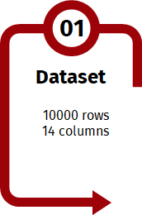
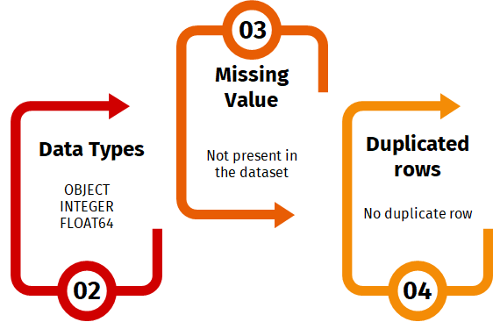
Inferences from Data-Set

Slide 12
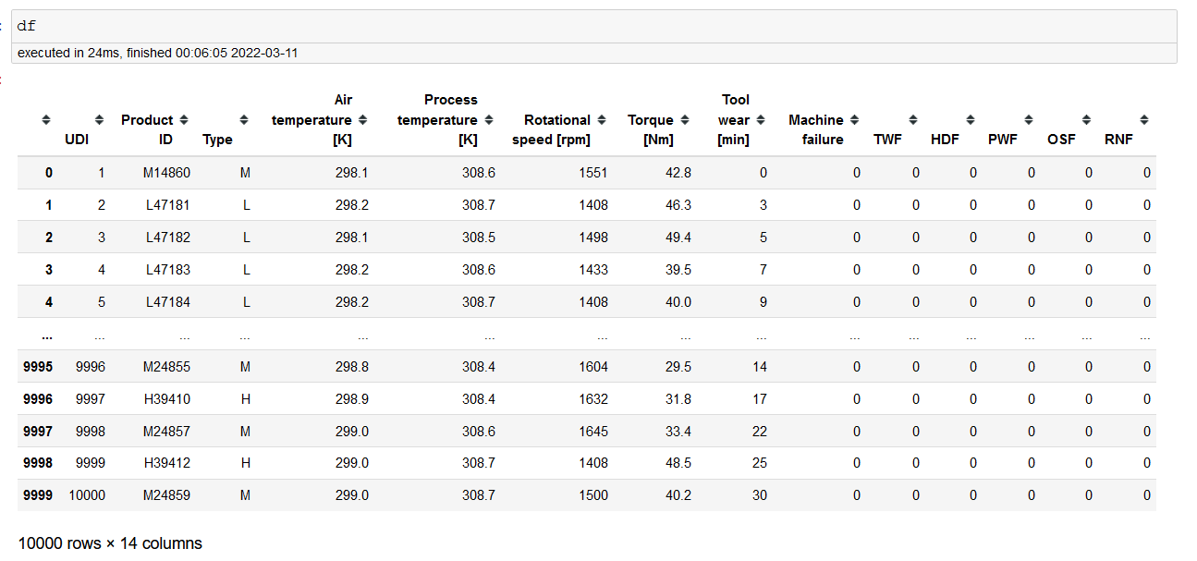

Slide 13
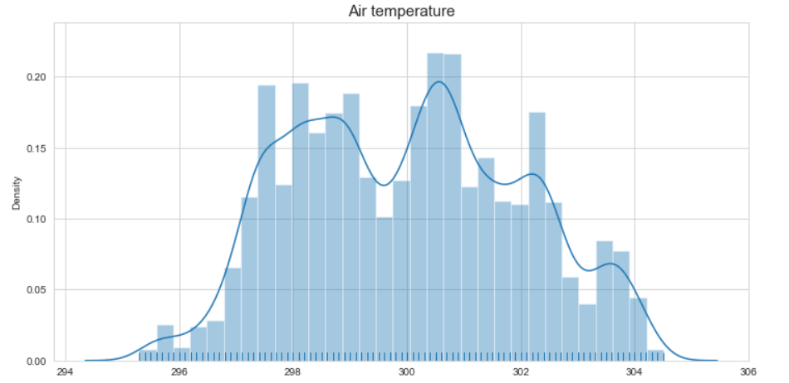
In the above diagram, It can be seen that the Air Temperature show quite consistent data distribution over the wear time. Most of the data in Air Temperature resides around 300 Kelvin.

Slide 14
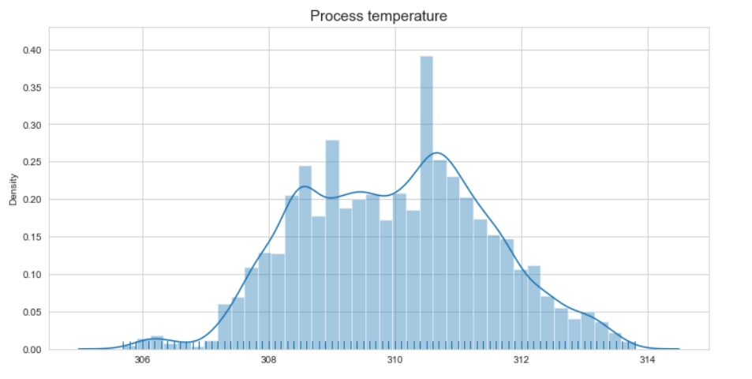
In the above diagram, It can be seen that the Process Temperature show quite consistent data distribution over the wear time. Most of the data in Process Temperature resides around 310 Kelvin.

Slide 15
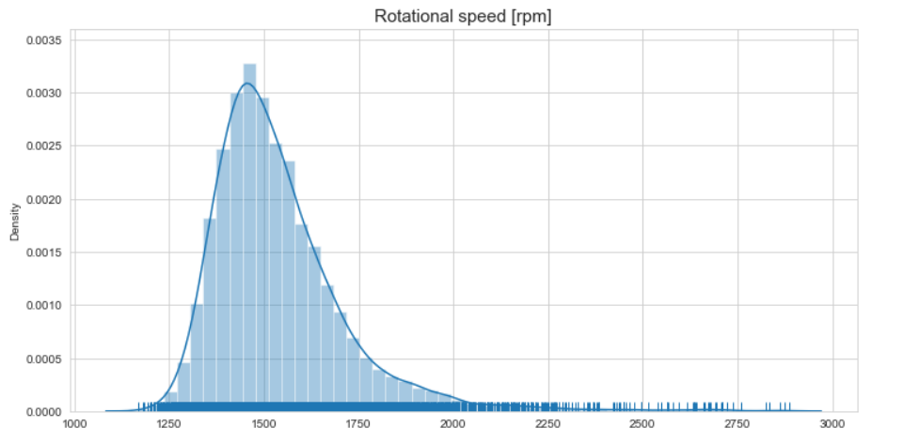
In the above figure, it is clearly visible that for Rotational Speed it can be noted that the most of data reside at the speed of 1500 RPM

Slide 16
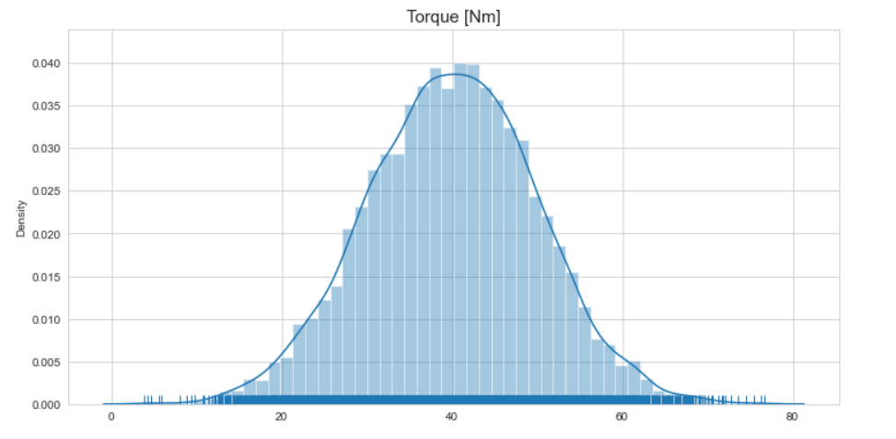
In the above figure, it is clearly visible that for Torque it can be noted that the most of data reside at the value of 40 Nm.
Note: Any values deviated from the accumulated region may be classified as “Abnormal”.

Slide 17
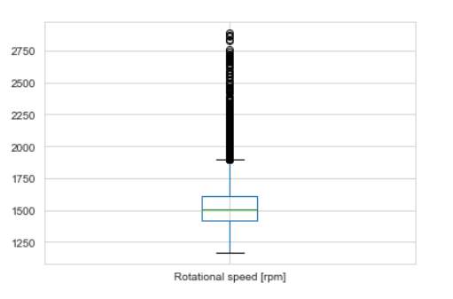
In the above Box Plot, It can be observed that Rotational Speed [rpm] has many outliers starting from speed around ~1770 to ~2800 rpm.

Slide 18
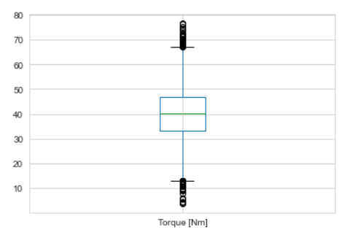
In the above Box Plot, It can be observed that Torque [Nm] has few outliers starting from around ~1 to ~15 Nm and ~67 to ~78 Nm.

Slide 19
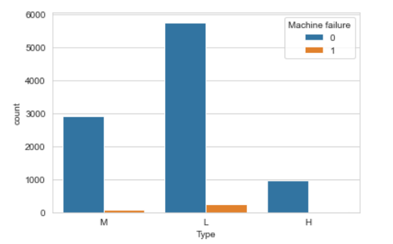
Product ID: consisting of a letter L, M, or H for low (50% of all products), medium (30%) and high (20%) as product quality variants and a variant-specific serial number.
Type column has 3 types of product variants in this dataset and we can see that machine Type L has higher tendency to fail.

Slide 20
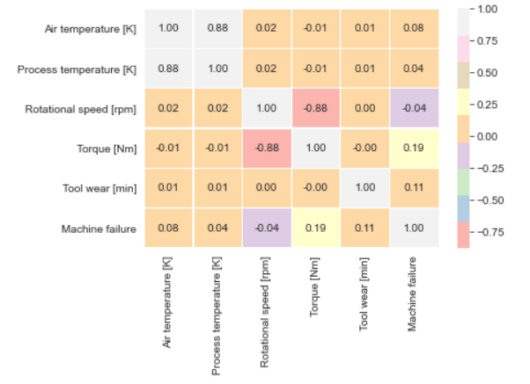
In the above heat map it can observed as Process_temperature and Air_temperature are highly positively correlated whereas, Torque and Rotational_speed are highly negatively correlated. In addition, RPM and Machine failure are also highly negatively correlated.

Slide 21
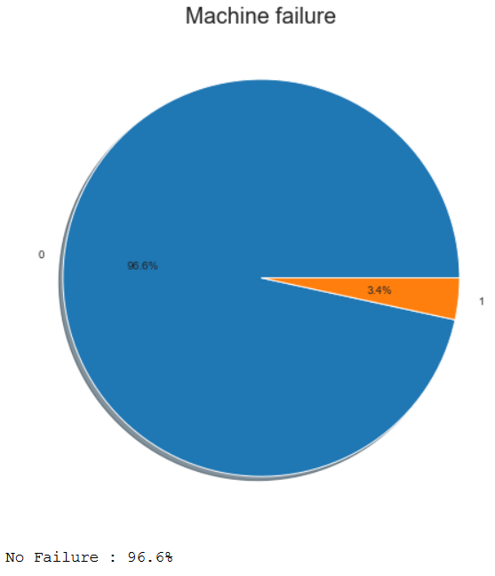
Here, if at least one of the failure modes is true, the process fails and the 'machine failure' label is set to 1 as per given data dictionary.
The above pie chart depicts as dataset is consisting of the machine failure of 3.4% of the whole dataset and no machine failure is 96.6%.

Slide 22
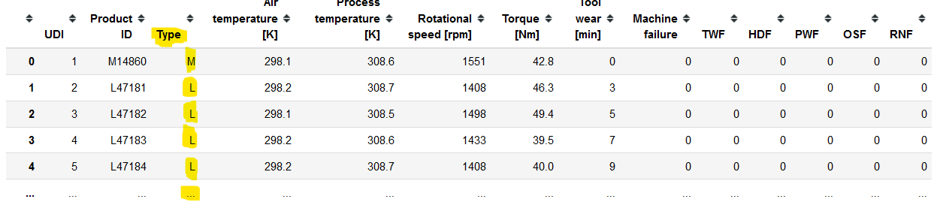
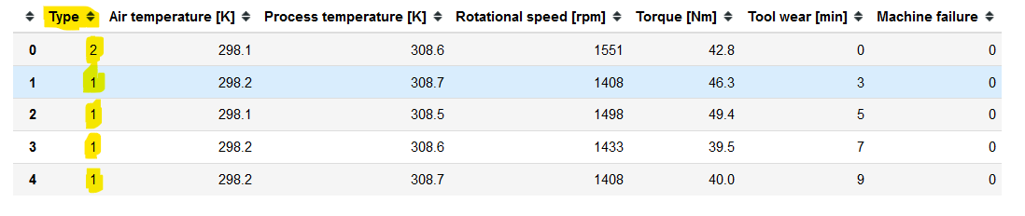
Data Pre-processing
Converting Categorical data to numerical data using Label Encoder from SKLearn.
As the Type column is Categorical in nature. Hence, it is necessary to convert it to numerical data for further analysis.

Slide 23
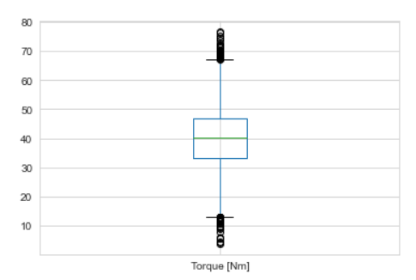
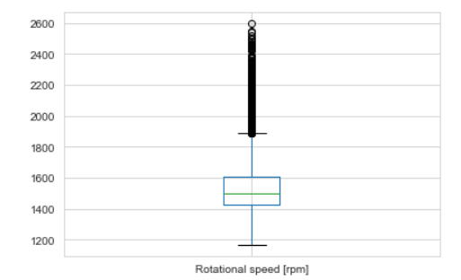
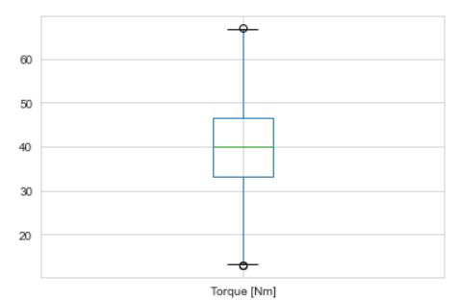
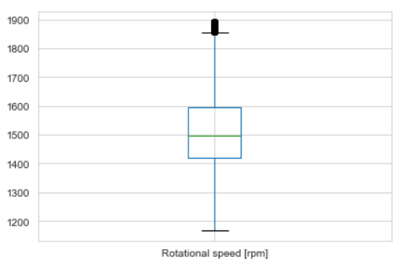
Outlier Treatment
The dataset has few outliers in Torque and RPM columns which needs to be treated. Hence, we decided to delete outliers in dataset which resulted in imbalanced dataset and now the dataset has 9529 rows × 14 columns.

Slide 24
Feature Selection

Slide 25
Dimensionality Reduction Techniques
1) Amount of Variation : As the columns TWF, HDF, PWF, OSF, RNF in dataset has very low variation as these features have mostly the same value. If we use these features then the model is not going to learn anything from it. Hence, we will be dropping these columns.
2) Pairwise Correlation : RPM (Rotational Speed) highly negatively correlated with Torque. So, we will drop this feature and another reason is as follows;
3) Correlation (with the Target) : As RPM (Rotational Speed) has very low correlation with Machine failure. As we can observe same in Heat Map. Therefore, it is not going to be useful for the model (prediction). Hence, we dropped this feature too.
4) Furthermore, columns like UDI and Product ID may not contribute to the prediction performance. As these are unique features to identify sequence and product. Thus, these two columns will also be removed.
5) We also have highly positive correlation between Process_temperature and Air_temperature. However, we have experimented by removing one feature at a time but the model score and accuracy is not good with removal of anyone of these features. So, we decided to keep these 2 feature in dataset as they give good model accuracy. – This step was taken after experimenting with the features multiple times.

Slide 26
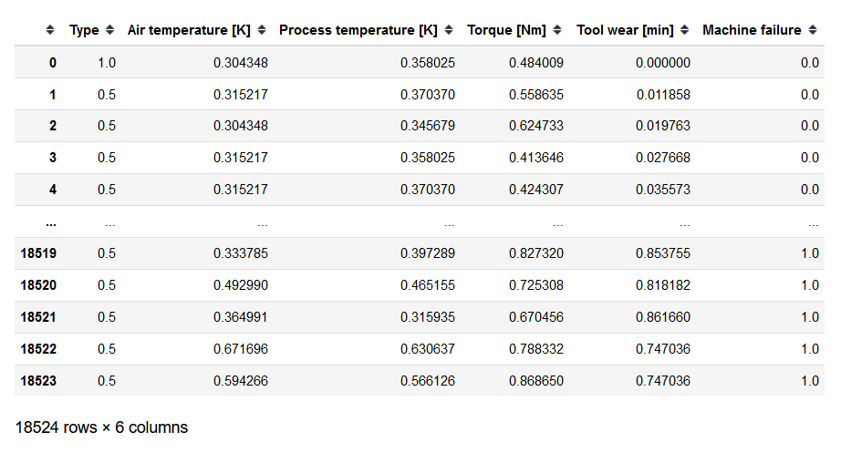
Finally, This is the snippet of dataset after treatment of outliers, up sampling and normalization. below are the features which will be used in further process of model building and predictions.

Slide 27
Balancing the im-balanced data

Slide 28
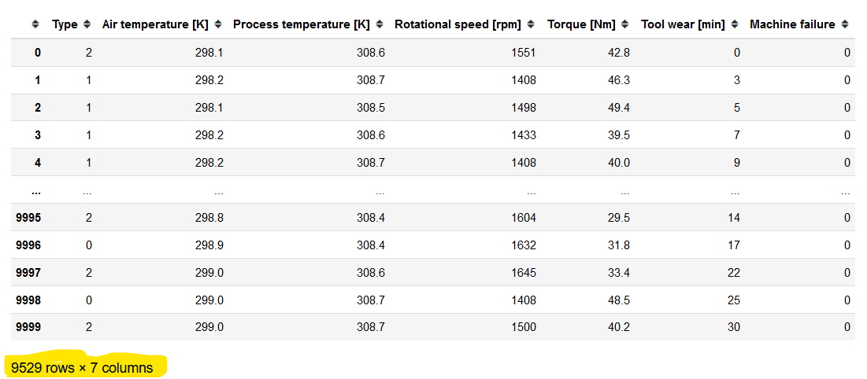
Balancing the dataset.
Removal of outlier resulted in im-balanced data. Can be seen below.
Thus, It is necessary for us to balance the dataset for preparing good machine learning model. As, im-balanced data will affect negatively and decreases the score and accuracy of our machine learning model.

Slide 29
Most used 7 Techniques to Handle Imbalanced Data:
1. Use the right evaluation metrics
2. Resample the training set
2.1. Under-sampling
2.2. Over-sampling
3. Use K-fold Cross-Validation in the right way
4. Ensemble different resampled datasets
5. Resample with different ratios
6. Cluster the abundant class
7. Design your own models
Note: We decided to use the Over-sampling or Up-sampling Resample the training set technique for our Machine Learning model.

Slide 30
Over-sampling or Up-sampling
Oversampling is used when the quantity of data is insufficient. It tries to balance dataset by increasing the size of rare samples. Rather than getting rid of abundant samples, new rare samples are generated by using e.g. repetition, bootstrapping or SMOTE (Synthetic Minority Over-Sampling Technique).
Note that there is no absolute advantage of one resampling method over another. Application of these two methods depends on the use case it applies to and the dataset itself. A combination of over- and under-sampling is often successful as well.
In SMOTE (Synthetic Minority Oversampling Technique) we synthesize elements for the minority class, in the vicinity of already existing elements. There are a variety of other methods in the imblearn package for both under-sampling(Cluster Centroids, NearMiss, etc.) and oversampling(ADASYN and bSMOTE).

Slide 31
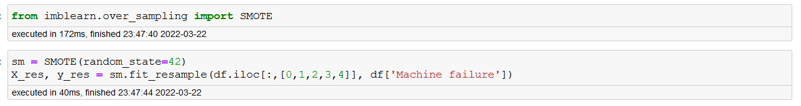
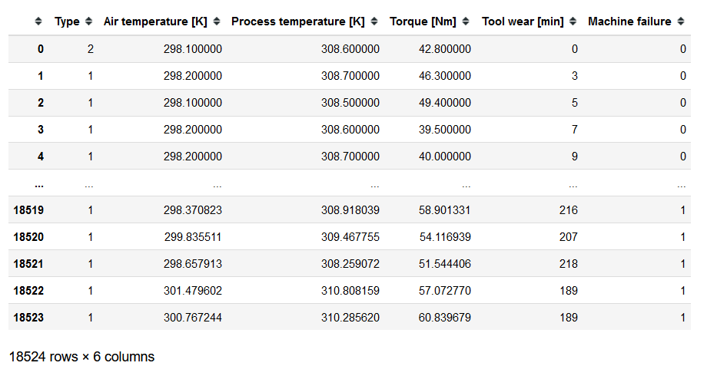
It is visible in the above pictures that our new dataset has 18524 rows × 6 columns . However, now the dataset is not normalized. Hence, normalising the dataset for good model accuracy and score.

Slide 32
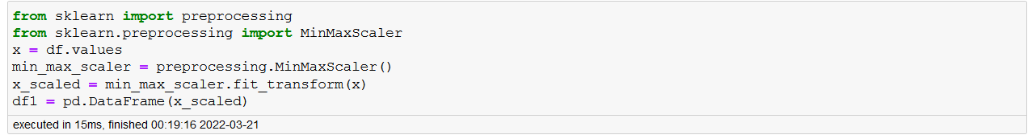
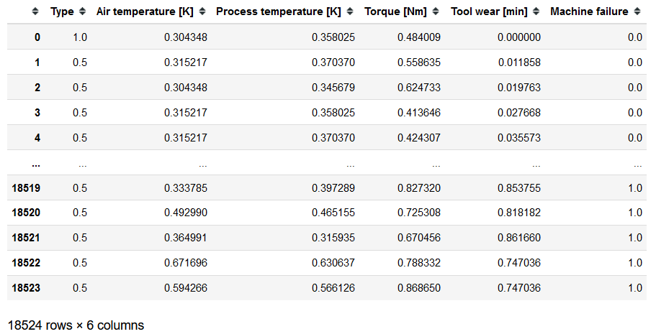
Normalizing the dataset

Slide 33
Partition Series

Slide 34
Splitting the dataset
We decided to split the data into 2 parts as 80% and 20%. We will be using 80% as training dataset to train the model and 20% as testing dataset for testing the machine learning model.

Slide 35
Model Building

Slide 36
Model: We have used balanced dataset in all algorithms as a good accuracy and f1 scores are observed in balanced dataset
Data set details : 18524 rows × 6 columns
Data Partition details : Train 80% and Test 20%
Algorithms :
Naïve Bayes (Multinomial)
Naïve Bayes (Gaussian)
Decision Tree
Adaboosting
Gradient boosting
KNN
SVM
Random Forest

Slide 37
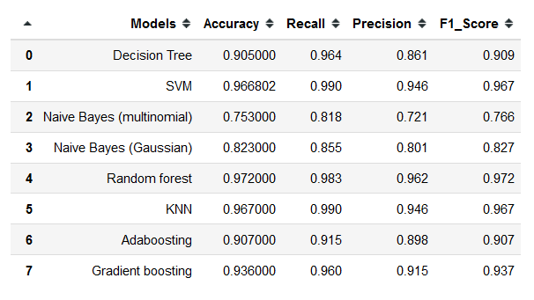
Model Results Comparison
Table consisting of different models with results using balanced dataset
As Random Forest has highest Accuracy and F1 Score we will choose this model for deployment.

Slide 38
Model Deployment using Streamlit

Slide 39
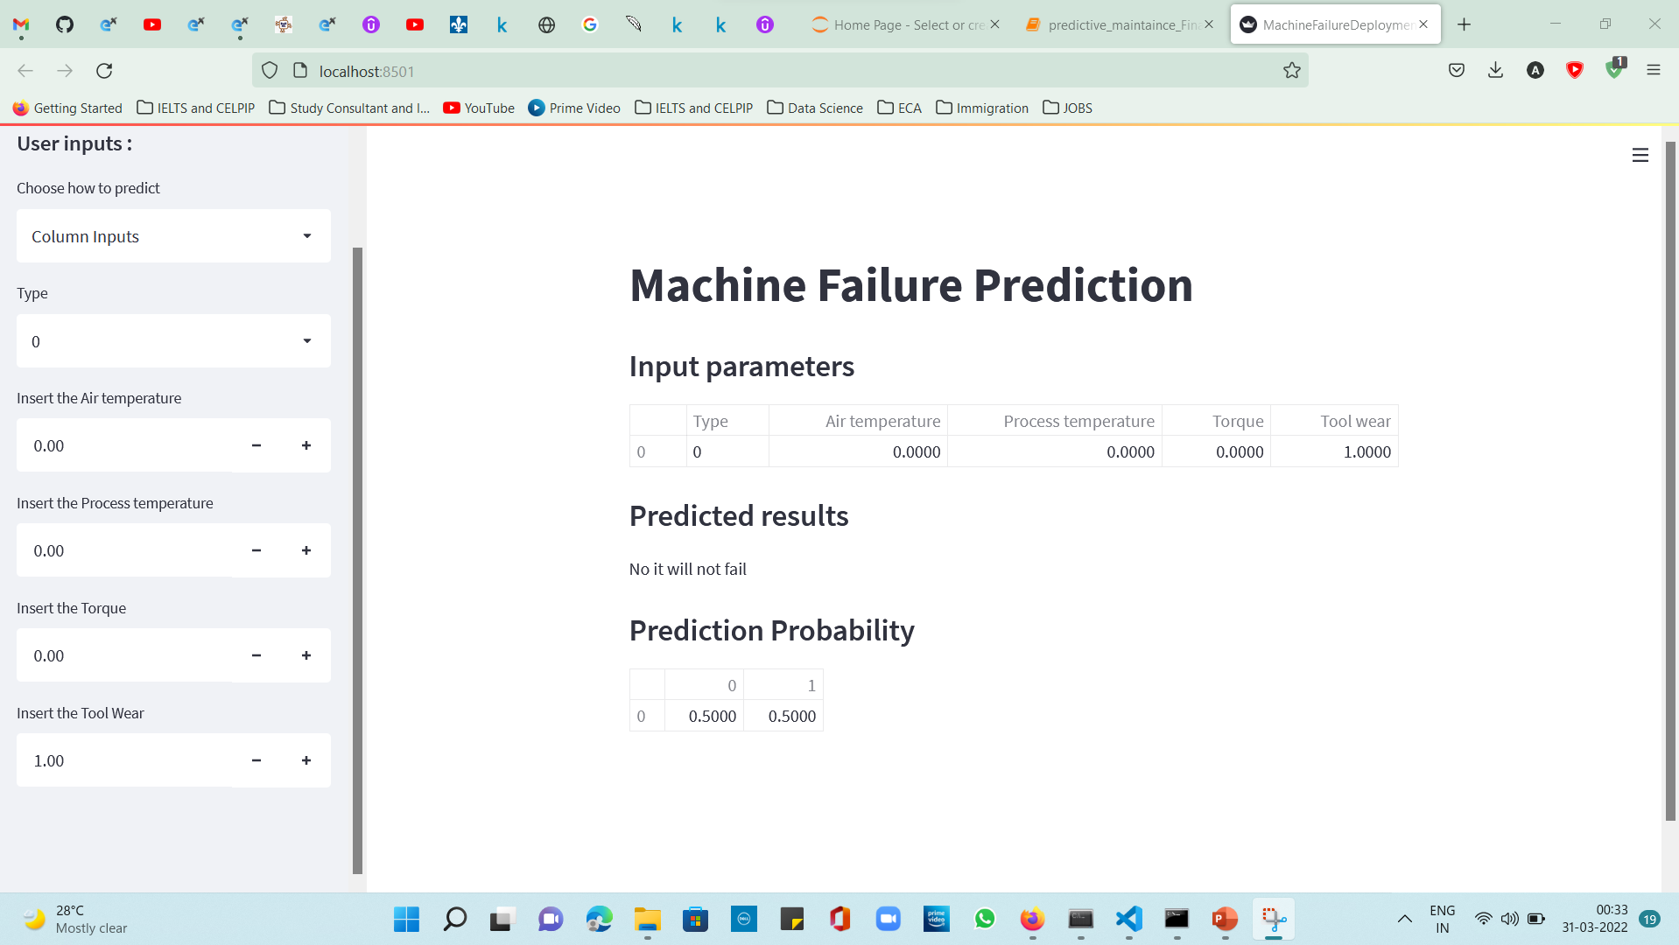

Slide 40
Challenges faced?
Dataset was having many columns consisting of necessary and unnecessary data.
Dataset was also consisting of outliers.
After removal of outliers dataset was imbalanced hence needed to balance dataset as it was giving not efficient.
Feature selection was very difficult as some features were having highly positive and highly negative variance. Hence, experimental techniques were done to overcome.
We tried using Streamlit cloud app to deploy but due to several errors we were unable to do so.
How did you overcome?
Unnecessary data columns were dropped.
Outliers were treated by removing them and balancing the dataset by SMOTE.
Balanced dataset was having huge inconsistent values hence dataset was normalized by MinMaxScaler.
Experimental techniques were used to select best features for Model building.

Slide 41
Thank you

