Slide 1
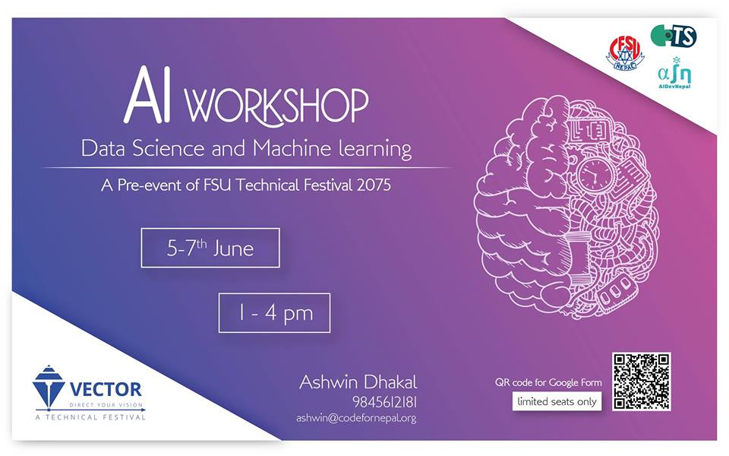

Slide 2
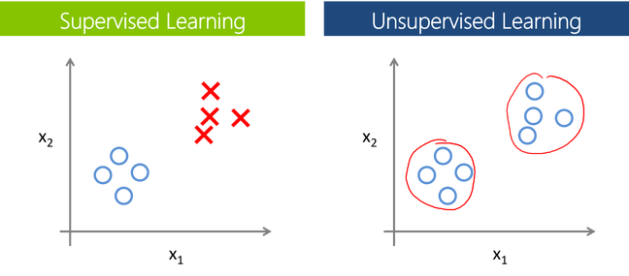
Machine Learning
Notes:
Supervised: bacha wala unsupervised: sin(8)/sin(0)=infinity

Slide 3
Are Machine Learning, Deep Learning and Artificial intelligence same !

Slide 4
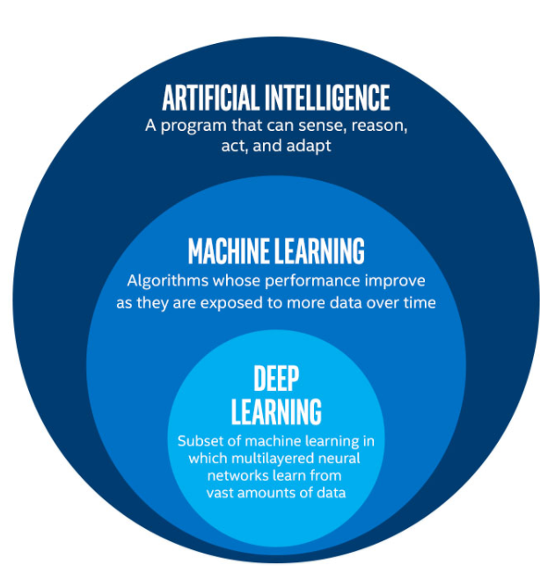
Offline chrome game
What we do
Artificial Neural Network

Slide 5
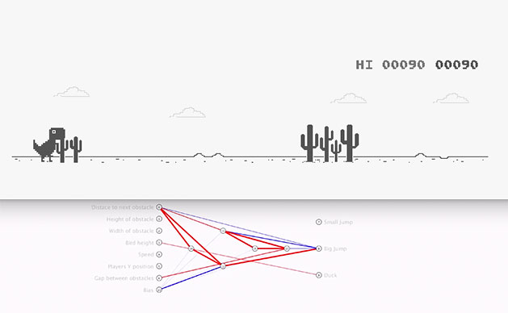
How this works !

Slide 6
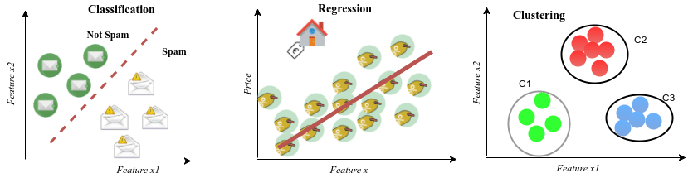
Machine Learning
Classification clustering regression
Notes:
Classificartion: engineer and medical-----clustering (alu ko bora ani bich ma sun aayo ---outlier regression - astrology

Slide 7

Q & A session

Slide 8

Python Session

Slide 9
Q & A session

