Slide 1

Applying Conjoint Analysis to Quantify Customer Preferences for Enhanced Pricing and Product Strategy
Aashish Paudel
PROC 5830 Pricing
Webster University
October 10, 2025

Slide 2
INTRODUCTIOn & purpose
Modern Businesses face challenges in pricing and product strategy.
Conjoint analysis quantifies how consumers value product attributes.
The autotime industry was selected for this research where specifically mid-size sedan cars were evaluated.
Objectives of the study:
Identify top-value car attributes.
Examine preference differences across segments
Use insights to enhance pricing and product strategy.

Slide 3
METHODOlogy
Approach: Choise-Based Conjoint Analysis (CBC)
Sample: 800 responses from which 756 valid responses were used (10,584 observations).
Attributes: Price, Fuel Efficiency, Safety score, Technology, Brand, Warranty
Analysis: Hierarchical Bayes Estimation for individual-level utilities.
Case Study: Mid-size sedan Market

Slide 4
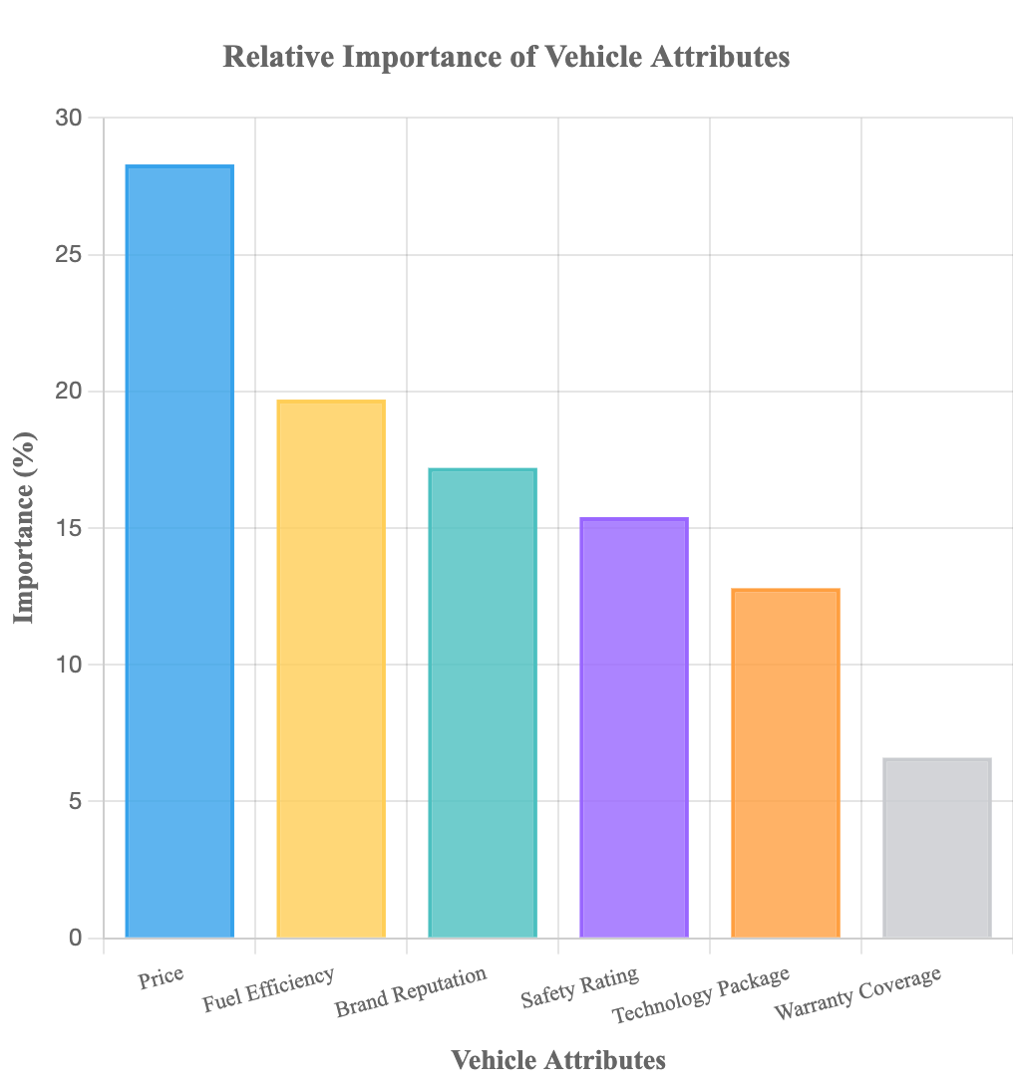
findings
Most important attributes:
Price = 28.3%
Fuel Efficiency = 19.7%
Brand Reputation = 17.2%
Other insights:
Customers value fuel efficiency more
Premium brands and advanced safety features increases the utility
Warranty = lowest importance at 6.6%

Slide 5
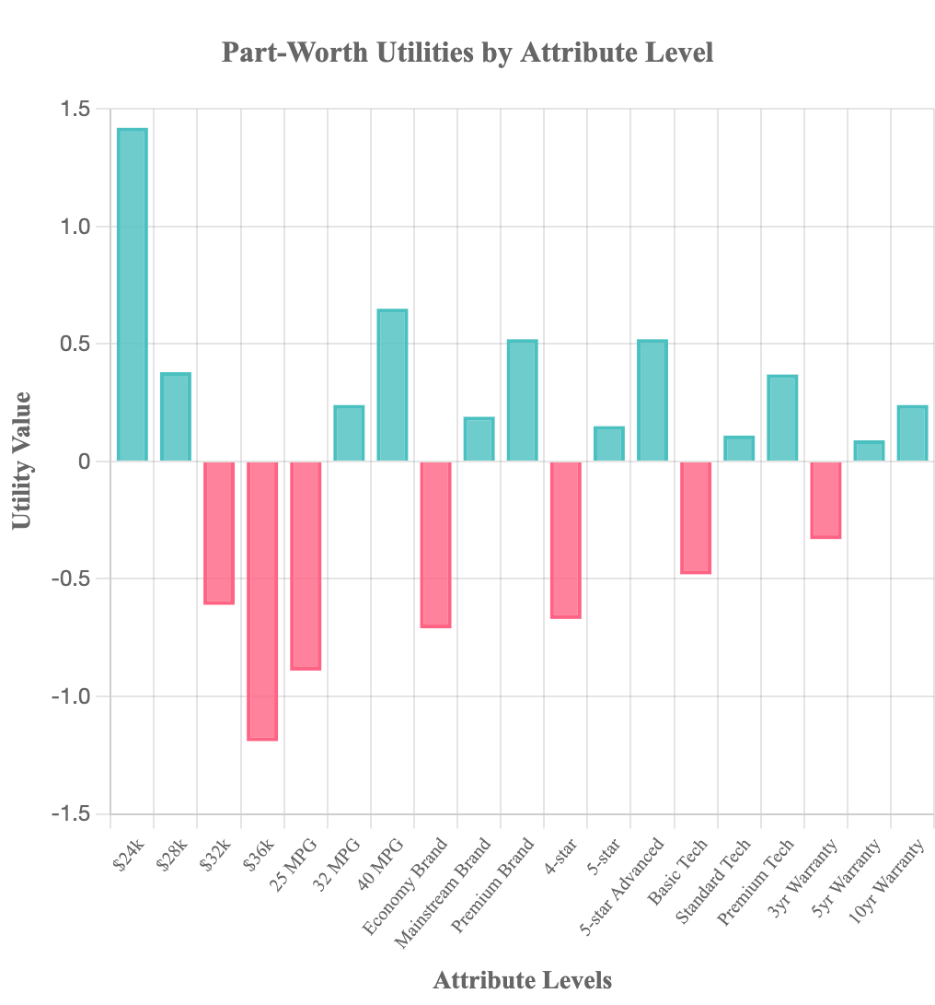
Strategic insights
Willingness-to-pay (WTP):
+$2,369 for 40 MPG
+$1,892 for premium brand
$1831 for advanced safety
Implications:
Introduce fuel efficient car models at premium pricing.
Highlight safety, brand reputation and fuel efficienncy if nice in marketing.
Use conjoint analysis for market simulation and revenue optimization.

Slide 6
conclusion
Conjoint analaysis can help businesses with data driven decision making in pricing, marketing and product strategies.
Reveals customer trade-offs across multiple features.
Acts as a bridge between the consumer insights for strategic decisions
Future research will include integration of EVs, autonomous cars and real world data.

