Slide 1
Environment: An Introduction
Dr. Prasenjit Adak

Slide 2
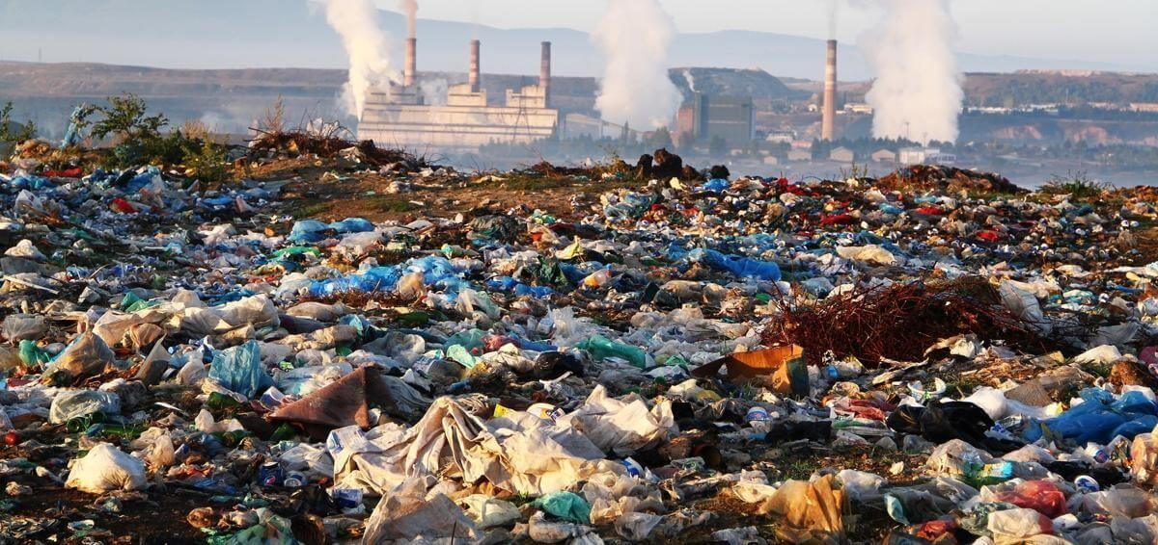
What We Have Done!

Slide 3
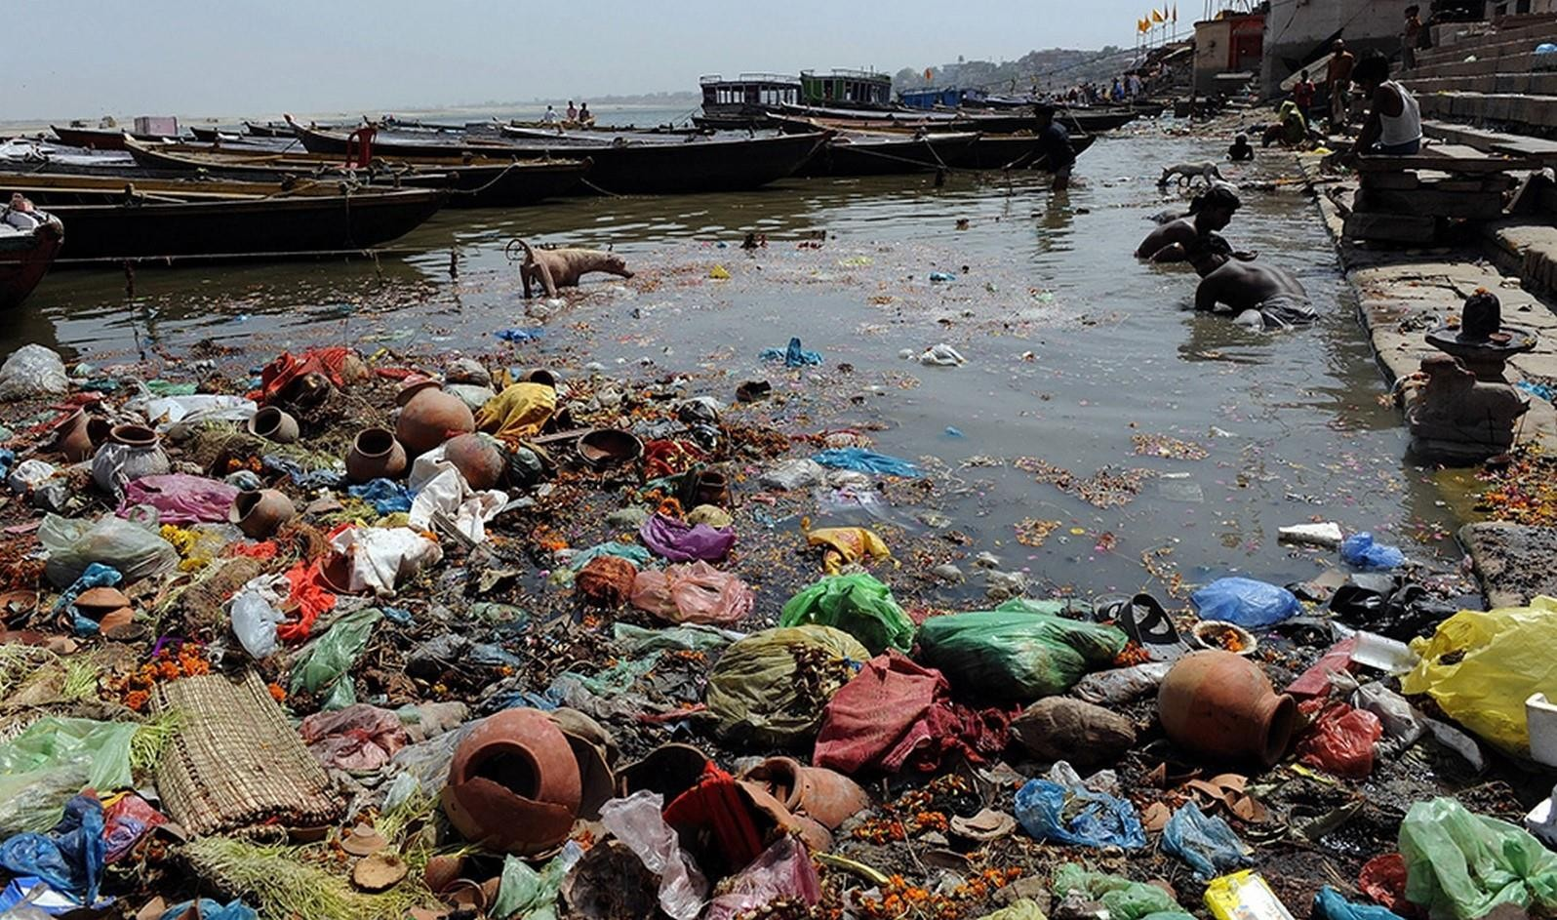
What We Have Done!

Slide 4
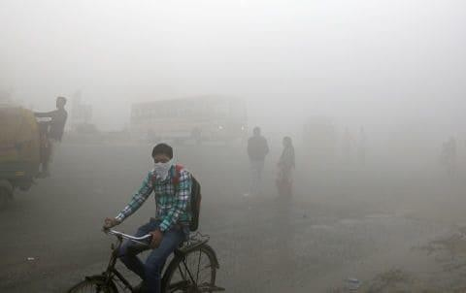
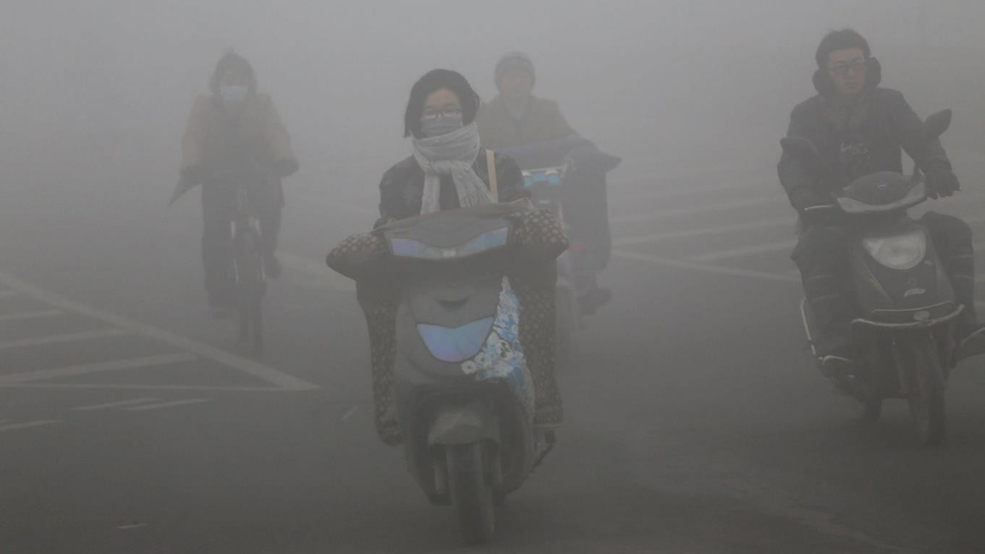
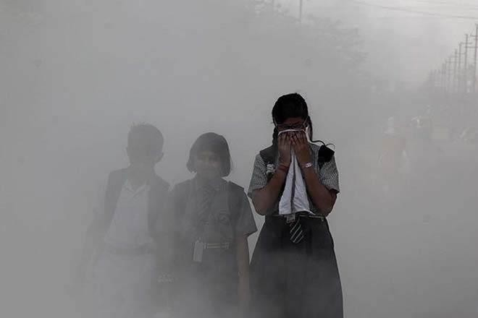
What We Have Done!

Slide 5
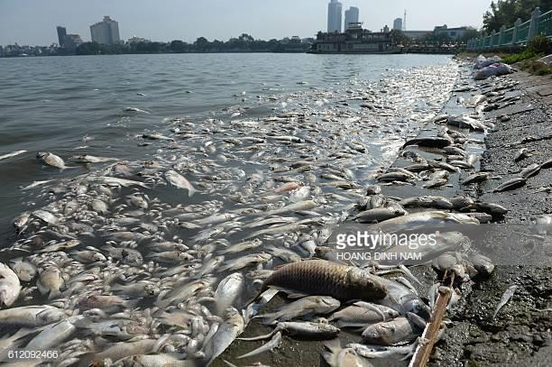
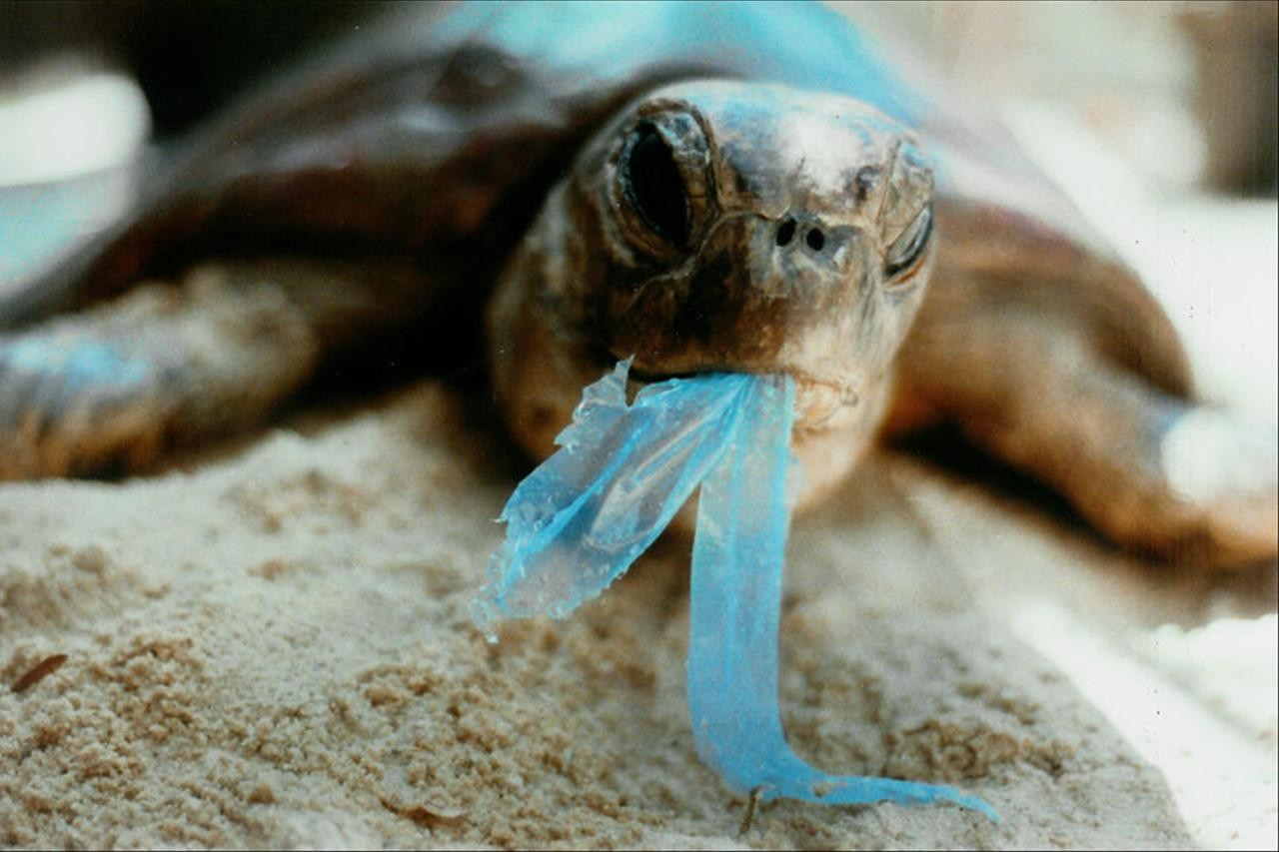
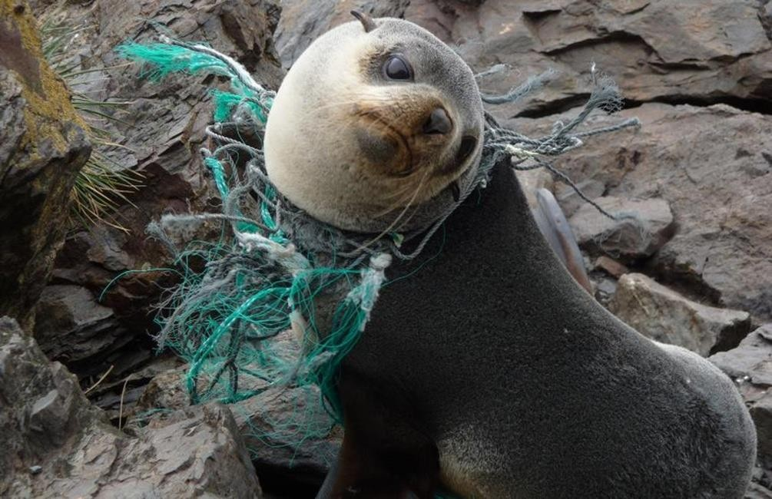
What We Have Done!

Slide 6
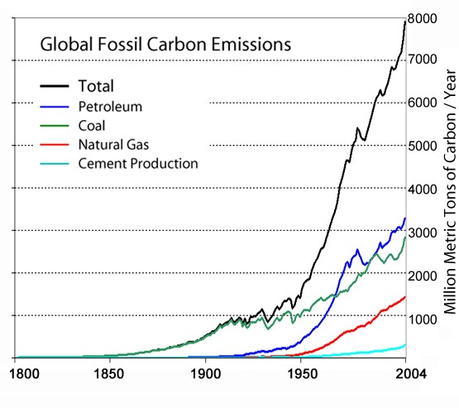
What We Have Done!

Slide 7
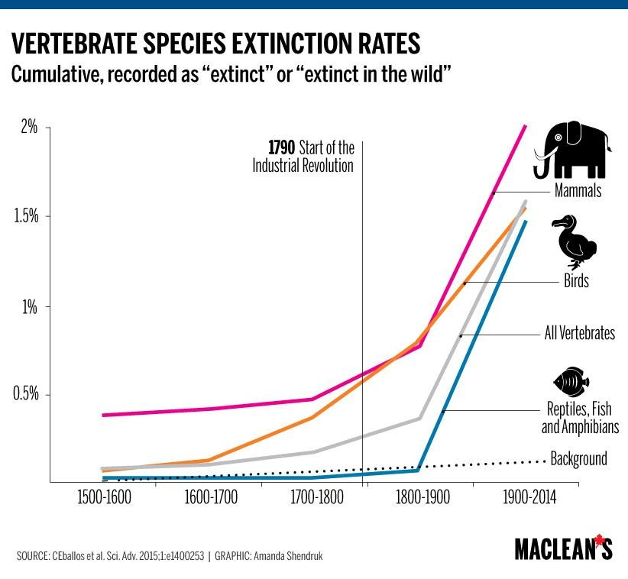
What We Have Done!

Slide 8

What We Have Done!
“For what I've done I start again
And whatever pain may come Today this ends
I'm forgiving what I've done”
- Linkin Park

Slide 9
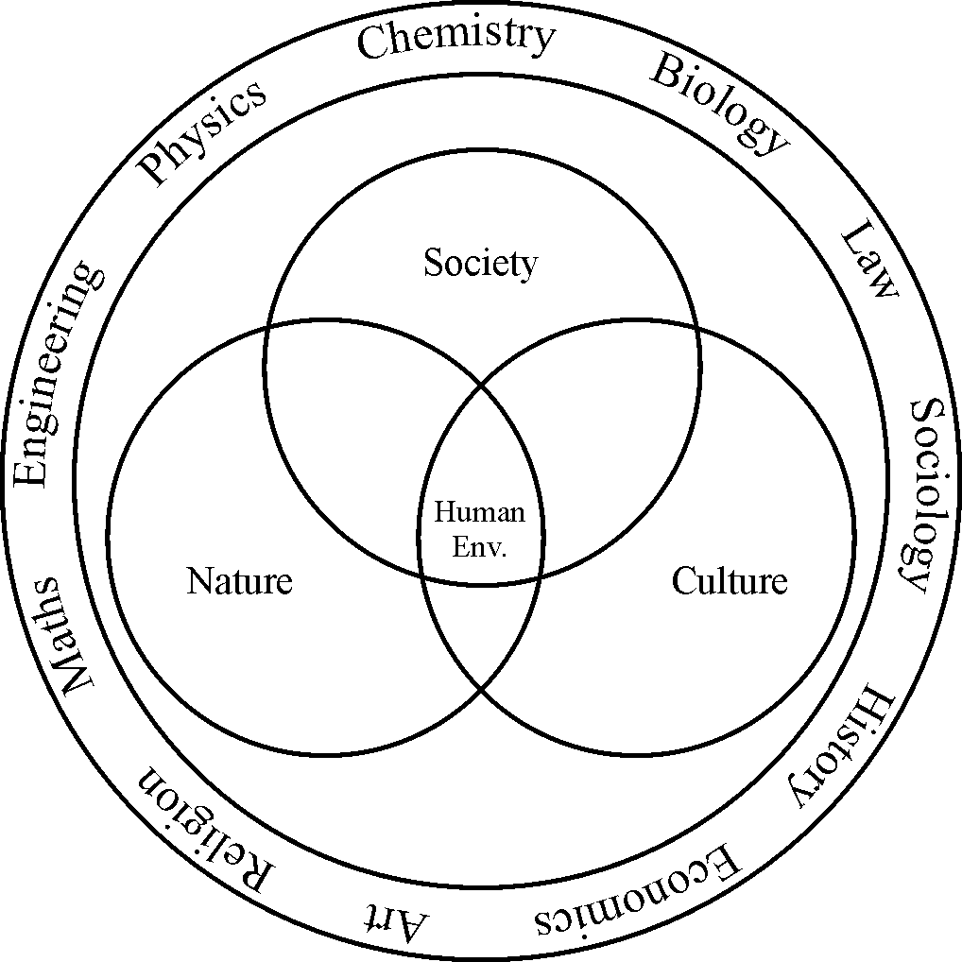
Why we are studying this subject?
“Environmental Studies” is a Multidisciplinary subject.

Slide 10
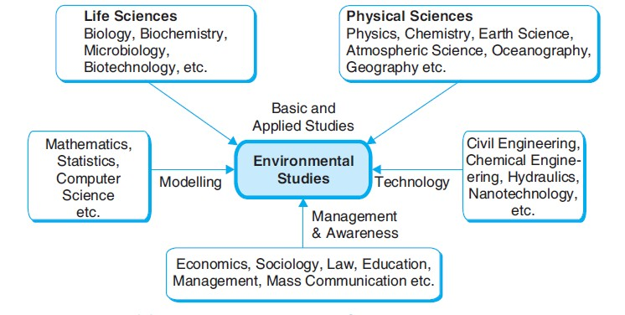
Multidisciplinary Nature of Environmental Studies

Slide 11
They are not the same
Environmental Studies
It is a broad interdisciplinary field of study which studies
the interaction of human beings with the environment.
Environmental Science
It is an interdisciplinary academic field that integrates physical, chemical and biological sciences to address the environmental problems.
Environmental Engineering
It is the application of science and engineering principles to improve the quality of environment to provide healthy living conditions.

Slide 12
Importance of Environmental Studies
To get basic knowledge of our surroundings.
To develop skills for identifying and solving environmental
problems in our surroundings.
World population is increasing at an alarming rate especially in developing countries.
The natural resources endowment in the earth is limited.
The methods and techniques of exploiting natural resources are
advanced.
The resources are over-exploited and there is no foresight of leaving the resources to the future generations.
The urban area, coupled with industries, is major sources of
pollution.
The pollution and degraded environment seriously affect the
health of all living things on earth , including man.
Education and training are needed to save the biodiversity and
species extinction.

Slide 13
Importance of Environmental Studies
To maintain ecological balance and to strive to achieve
sustainable development.
To educate people for their duties towards environmental protection.

Slide 14
Scope of Environmental Studies
Ecosystem and Biodiversity protection
Natural resource conservation
Environmental pollution control
Environmental management
Industry
Research and development
Social development
Environmental journalism
Environmentalist / Consultant
Green advocacy
Green marketing

Slide 15
What is environment?
Everything that surrounds and affects living organism is called Environment.
It is the sum total of all social, economical
, biological , physical and chemical factors which constitute the surroundings of humans, who are both the creators and moulders of the environment.

Slide 16
Types of Environment
Natural Environment
Components such as air, water, soil, land, forest, wildlife, flora , fauna, etc. constitute the Natural Environment.
Anthropogenic Environment
Alteration of the natural environment to serve specific uses by the human beings is termed as Anthropogenic Environment. For eg agricultural field is an anthropogenic environment and so are the gardens and aquaculture farms.

Slide 17
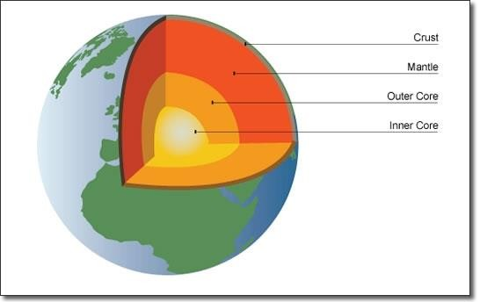
Spheres of Earth
Lithosphere (Land)
The lithosphere is made up of all the hard and solid land mass on the earth’s surface, the semi-solid rocks (molten materials) underneath the earth crust, and the liquid rocks in the inner core of the earth. Lithosphere is further divided into sub-spheres namely the crust, the mantle, the outer core, and the inner core. The rock materials are divided into three primary categories based on how they are formed namely igneous rocks, sedimentary rocks, and metamorphic rocks.

Slide 18
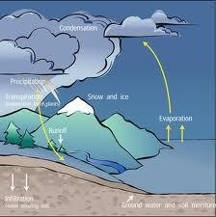
Spheres of Earth
Hydrosphere (Water)
The hydrosphere includes all the gaseous, liquid, and solid water of the planet earth. The natural earth features depicting the hydrosphere are the rivers, streams, lakes, seas, oceans and the water vapor. Glaciers, which are the slowly moving masses of ice, are also part of the hydrosphere. The earth’s temperature is highly influenced by the hydrosphere. The glaciers, icebergs, and icecaps are also categorically called the cryosphere.

Slide 19
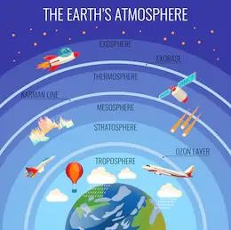
Spheres of Earth
Atmosphere (Air)
All the air in the atmosphere makes up the atmosphere. The atmosphere is a mixture of nitrogen (about 78%), oxygen (about 21%), and other gasses (about 1%) such as carbon dioxide (0.039%), argon (0.93%) and the rest are trace gases (krypton, neon, helium , and xenon).
layers of the atmosphere include the troposphere, mesosphere, thermosphere, and the exosphere.

Slide 20
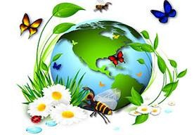
Spheres of Earth
Biosphere (Living Things)
All the living things in the planet are categorized under the biosphere. In this view, the biosphere includes all of the animals, plants, and microorganisms of earth. Biosphere interact with the physical aspects of the earth including the hydrosphere, lithosphere, and the atmosphere. Deserts, forests, grasslands, aquatic, tundra, and chaparral are the six main biomes that are present in the biosphere.

