Slide 1
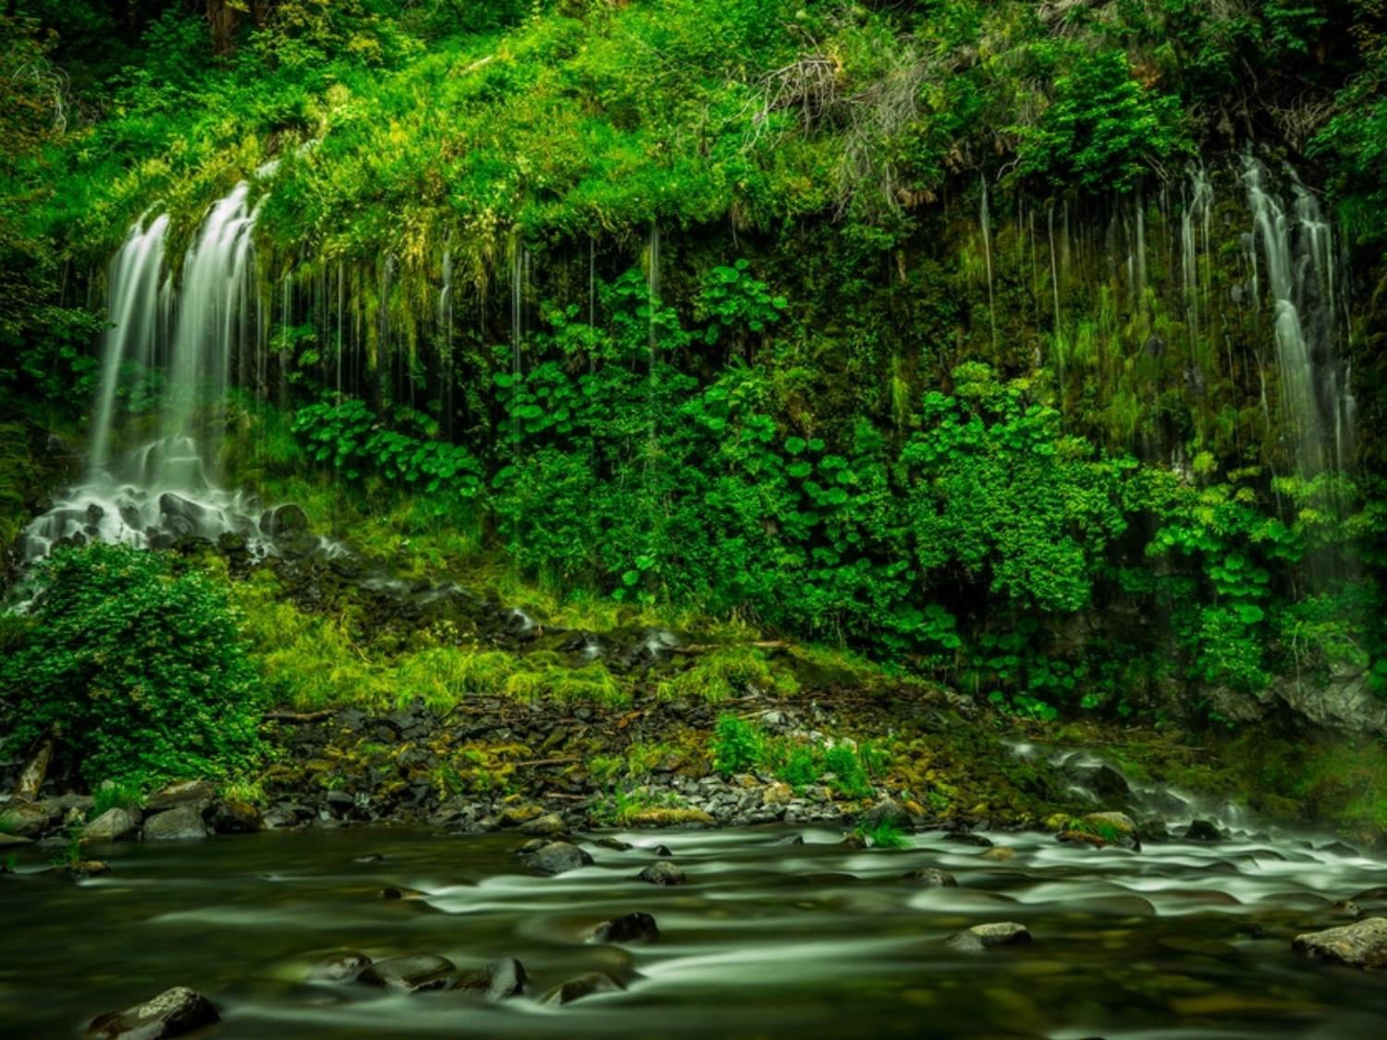
Current Environmental Problems,
Environmental Legislation
Dr. Prasenjit Adak

Slide 2
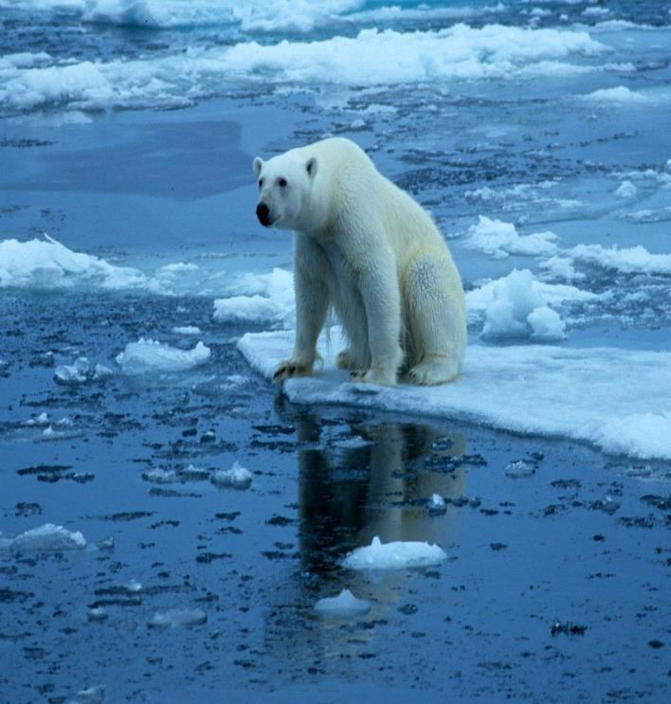
Current Environmental issues
Greenhouse effect and Global
Warming
The term greenhouse effect is used to indicate a heat-trapping process caused by gases such as carbon dioxide, and water vapour which are transparent to incoming solar radiations but re-emit the infrared radiations from Earth's surface.
Global warming is a long-term rise in the average temperature of Earth as a whole as a result of greenhouse effect.
This P₁P_{2/}T₀₃s/h₁o₉uld be used as reference only. Reading books (mentioned in syllabus) is mandatory for the preparation of the examinations.

Slide 3
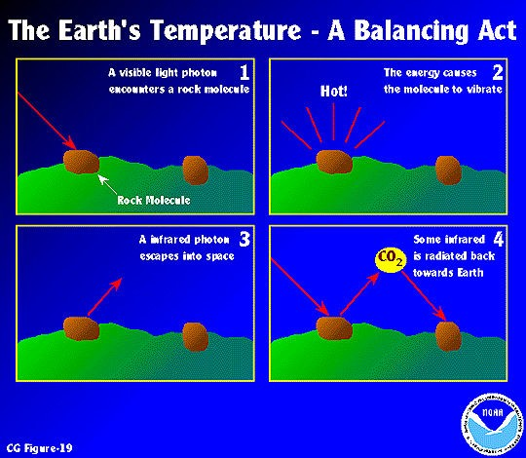
Current Environmental issues
Process
High energy wavelengths hit
the earths surface
Incoming energy is converted to heat
Longer, infrared wavelengths hit greenhouse gas molecules in the atmosphere
Greenhouse gas molecules in the atmosphere emit infrared radiation back towards earth
This P₁P_{2/}T₀₃s/h₁o₉uld be used as reference only. Reading books (mentioned in syllabus) is mandatory for the preparation of the examinations.

Slide 4
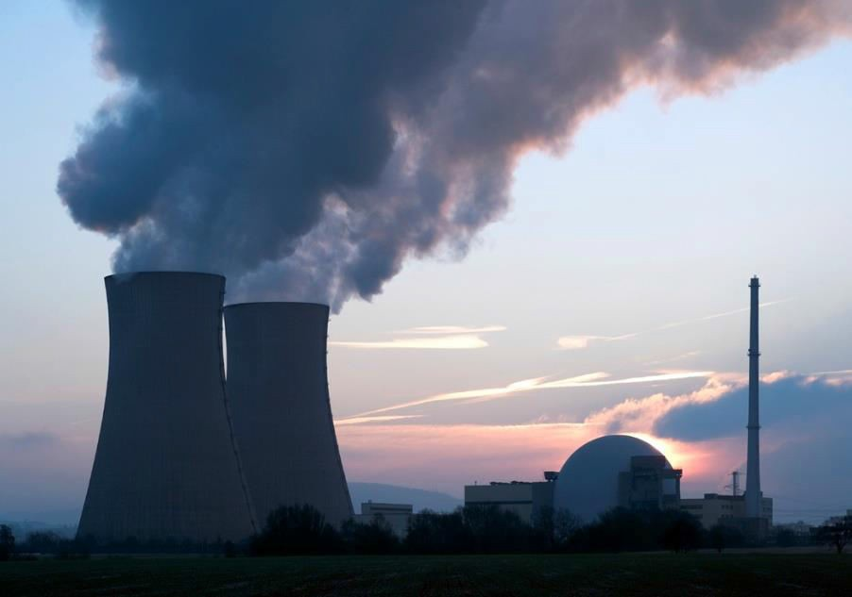
Greenhouses Gases
Some common greenhouse gases
Carbon dioxide
Methane
Nitrous oxide
Chlorofluoro carbons
Causes of greenhouse gases
Fossil-fuel burning
Industrial processes
Deforestation
Livestock
Biomass burning
Coal mining
This P₁P₂T_{/0}s₃ho_{/1}ul₉d be used as reference only. Reading books (mentioned
in syllabus) is mandatory for the preparation of the examinations.

Slide 5
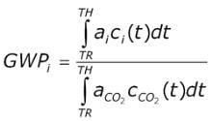
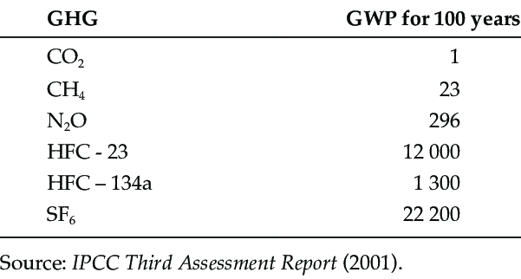
Global Warming Potential (GWP)
Where,
a_{i} is the instantaneous radiative forcing due to the release of a unit mass of trace gas, i, into the atmosphere, at time TR, C_{i} is the amount of that unit mass remaining in the atmosphere at time, t, after its release and TH is TR plus the time horizon over which the calculation is performed
This PPT should be used as reference only. Reading books (mentioned in syllabus) is mandatory for the preparation of the examinations.

Slide 6
Effects of CO₂ increase
Air and the Earth’s surface may grow warmer.
The stratosphere may become cooler.
Temperate and polar regions may become warmer leading to the reduction in the ice cover of the earth.
Rainfall may be higher than what it is present in
the temperate regions.
The greater amount of evaporation due to excess warmth .
This P₁P₂T_{/0}s₃ho_{/1}ul₉d be used as reference only. Reading books (mentioned
in syllabus) is mandatory for the preparation of the examinations.

Slide 7
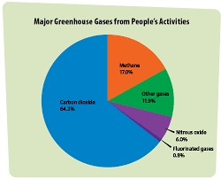
Emission of Greenhouses Gases
This PPT should be used as reference only. Reading books (mentioned in syllabus) is mandatory for the preparation of the examinations.

Slide 8
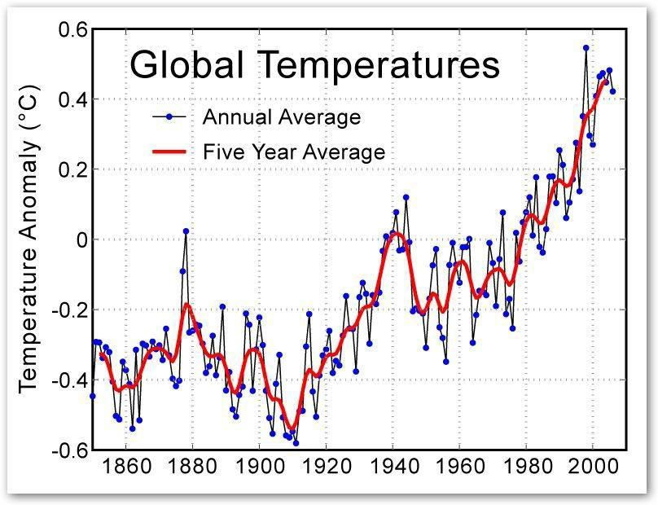
Emission of Greenhouses Gases
This PPT should be used as reference only. Reading books (mentioned in syllabus) is mandatory for the preparation of the examinations.

Slide 9
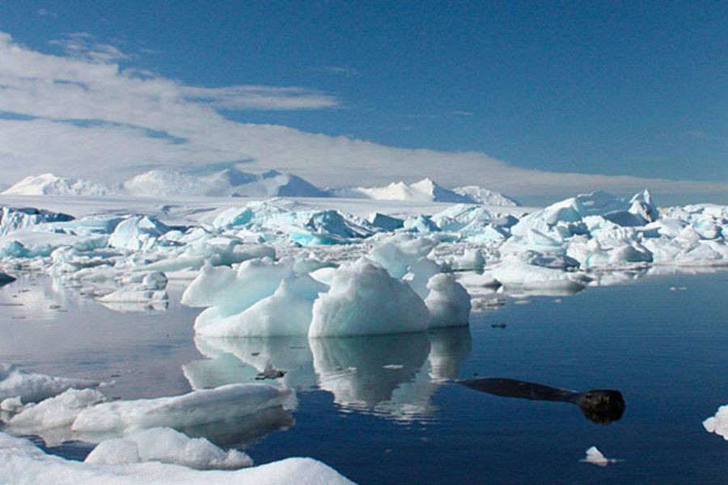
Environmental Effects of
Global warming
Climate change
Rise in sea level
Reduced agricultural production
Storms
Adverse effects on
human health
Loss of
ecosystems and
biodiversity
This P₁P₂T_{/0}s₃ho_{/1}ul₉d be used as reference only. Reading books (mentioned
in syllabus) is mandatory for the preparation of the examinations.

Slide 10
Control measures of Global
warming
Reduction in the use of fossil fuels
Shifting to the renewable energy sources that
do not emit greenhouse gases
Increasing the use of energy efficient and cleaner production technologies and practices
Reducing deforestation, adopting better forest management practices, and undertaking aforestation to sequester carbon
This P₁P₂T_{/0}s₃ho_{/1}ul₉d be used as reference only. Reading books (mentioned
in syllabus) is mandatory for the preparation of the examinations.

Slide 11
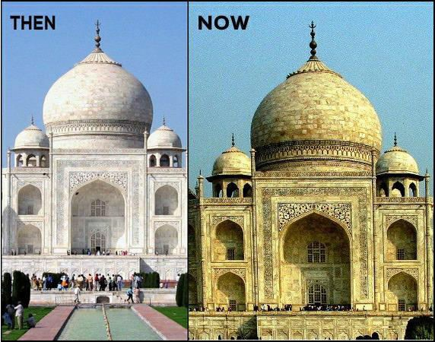
Acid Rain
Acid rain refers to a condition in which natural precipitation becomes
acidic after reacting chemically with pollutants in the air.
Causes of Acid Rain
Burning of the fuel as well as the use of nuclear weapons leading to
the evolution of
large amounts of sulphur dioxide (SO₂) and nitrogen
dioxide (NO₂), which get converted to sulphurous acid and nitric acid, respectively.
Effects of Acid rain
Reduction in population of flora and fauna
Damage to terrestrial ecosystems
Corrosion of buildings
Effect on human beings
This P₁P₂T_{/0}s₃ho_{/1}ul₉d be used as reference only. Reading books (mentioned
in syllabus) is mandatory for the preparation of the examinations.

Slide 12
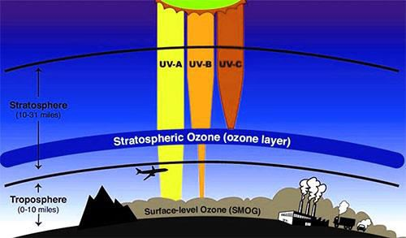

Ozone Layer and Its Depletion
The decrease in the concentration of ozone (O₃) in stratosphere is known as ozone layer depletion.
This P₁P₂T_{/0}s₃ho_{/1}ul₉d be used as reference only. Reading books (mentioned
in syllabus) is mandatory for the preparation of the examinations.

Slide 13
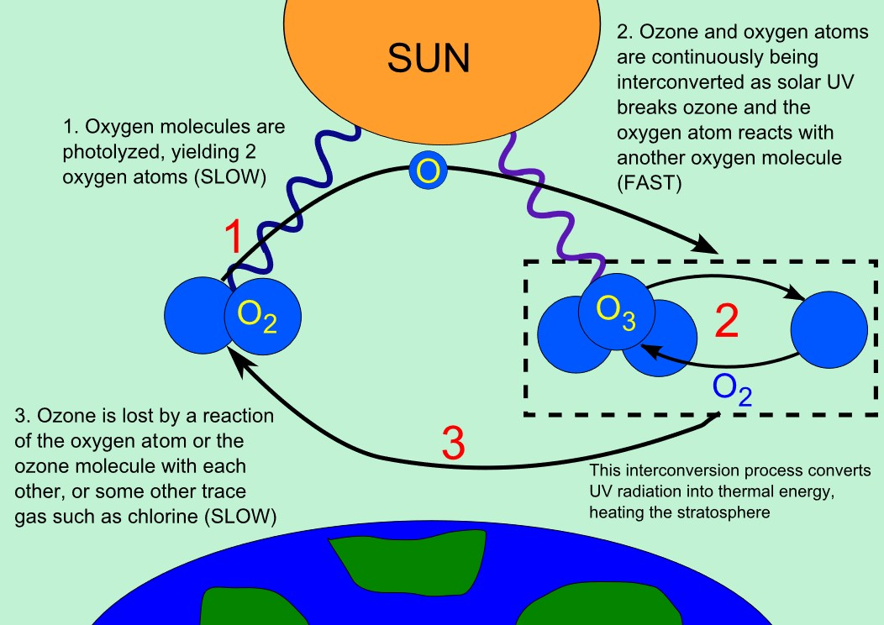
This PPT should be used as reference only. Reading books (mentioned in syllabus) is mandatory for the preparation of the examinations.

Slide 14
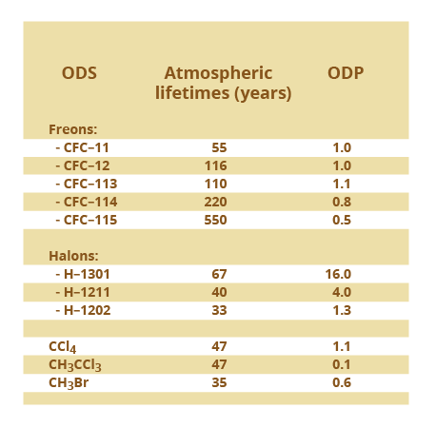
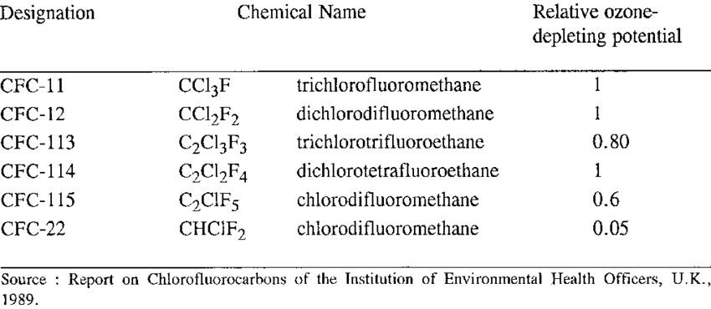
Ozone Depleting Potential (ODP)
Dobson Unit (DU) = 2.6867 x 10²⁰ molecules per
meter square
This PPT should be used as reference only. Reading books (mentioned in syllabus) is mandatory for the preparation of the examinations.

Slide 15
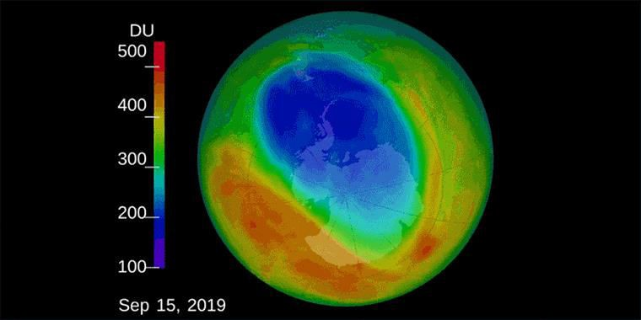
Ozone Hole
The thinning of ozone layer or reduction in concentration of ozone especially over the area of Antarctic continent is known as ozone hole, which covers approximately seven million square kilometer.
This PPT should be used as reference only. Reading books (mentioned in syllabus) is mandatory for the preparation of the examinations.

Slide 16
The Environment
Protection act 1986
Objective- It provides for the protection and
conservation of the Environment.
To protect the forests and wildlife in the country.
To improve the quality of life by protection of
environment.
To co-ordinate the activities of the various regulatory agencies already in existence.
To appoint environment officers to check
environmental pollution.
Establishing environmental laboratories.
This PPT should be used as reference only. Reading books (mentioned in syllabus) is mandatory for the preparation of the examinations.

Slide 17
Air (Prevention and Control
of Pollution) Act of 1981
Objective- It provides the prevention , control and abatement of air pollution. Provisions of the Act has to be implemented by Central Pollution Control Board along with the state board.
Functions-
setting of the air quality standards, collecting data on air pollution, organizing training, awareness programmes, establishing laboratories
Specify air pollution control areas and set standard for vehicle emissions.
Penalties for violation of its provisions. Applies to all.
This PPT should be used as reference only. Reading books (mentioned in syllabus) is mandatory for the preparation of the examinations.

Slide 18
Pollutant
Time Weighted
Average
Concentration in Ambient Air
Industrial, Residential, Rural and Other Areas
Ecologically Sensitive Area (notified by Central Government)
Sulphur Dioxide (SO₂),
µg/m³
Annual*
24 hours**
50 80
20 80
Nitrogen Dioxide (NO₂),
Annual*
40 80
30 80
µg/m³
24 hours**
Particulate Matter (size less than 10 µm)
or PM₁₀ µg/m³
Annual*
24 hours**
60 100
60 100
Particulate Matter (size less than 2.5
µm) or PM_{2.5} µg/m³
Annual*
24 hours**
40 60
40 60
Ozone (O₃) µg/m³
8 hours*
1 hour**
100 180
100 180
Lead (Pb)
µg/m³
Annual* 24 hours**
0.50 1.0
0.50 1.0
Carbon Monoxide (CO) mg/m³
8 hours*
1 hour**
02 04
02 04
Ammonia (NH₃) µg/m³
Annual* 24 hours**
100 400
100 400
Benzene (C₆H₆) µg/m³
Annual*
5
5
Benzo(a)Pyrene (BaP)- particulate phase only,
ng/m³
Annual*
1
1
Arsenic(As), ng/m³
Annual*
6
60
This PPT should be used as reference only. in syllabus) is mandatory for the preparatio
Reading books (ment n of the examinations.
ioned
Nickel (Ni),
Annual*
20
20
ng/m³

Slide 19
Water (Prevention and
Control of Pollution) Act 1974
Objective-
It prevents, controls and provides maintenance or restoration of wholesomeness of water.
Provisions of the Act has to be implemented by Central
Pollution Control Board being a main agency.
Functions-
Establishes standards of the water quality and effluent
Polluting industries must seek the permission to
discharge the waste into effluent bodies.
This PPT should be used as reference only. Reading books (mentioned in syllabus) is mandatory for the preparation of the examinations.

Slide 20
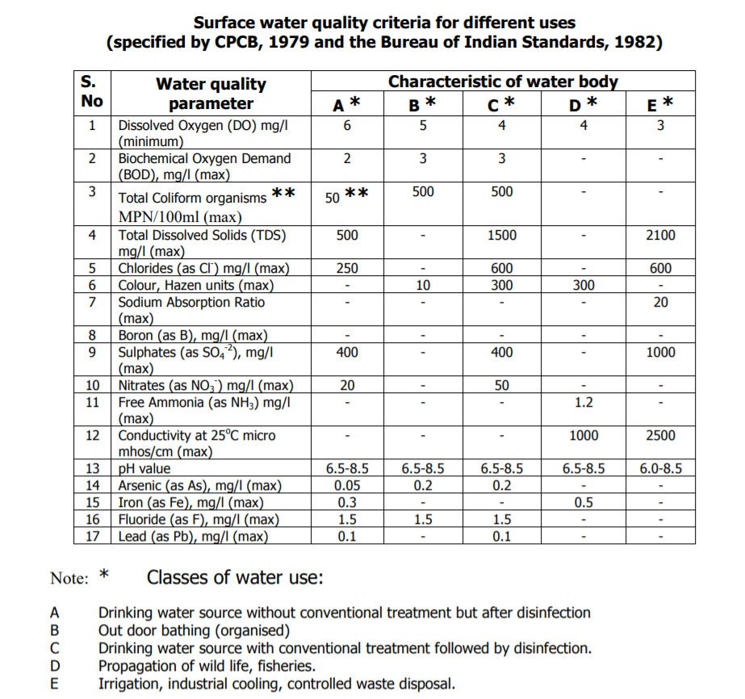
This PPT should be used as reference only. Reading books (mentioned in syllabus) is mandatory for the preparation of the examinations.

Slide 21
Wildlife Protection Act of 1972
Objective- Wildlife protection Act of 1972 defines wildlife to include any bird or animal and aquatic or land vegetation, form part of any habitat.
Function-
Under the Act, Central government work with state governments to regulate or prohibit the conversion of forest in agriculture or urban land.
Protection against natural hazards
Maintenance of water supply in water bodies present in Forest.
Protection of lines of communication and transportation

Slide 22
Forest Conservation Act of
1980
Objective- It provides for the protection and conservation of
the forests.
Under the Act, a state government may regulate or prohibit in any forest the clearing of land for cultivation, pasturing of cattle, or clearing the vegetation for any purpose.
Function-
Protection against natural hazards
Maintenance of water supply in aquifers.
Protection of lines of communication and transportation
Preservation of public health.
Mandatory for land owner.

Slide 23
Environmental protocols
Montreal Protocol (1987)
The Montreal Protocol is a global agreement to protect the stratospheric ozone layer
by phasing out the production and consumption of ozone-depleting substances (ODS).
Objective: to protect the ozone layer by phasing out the production of a number of substances believed to be responsible for ozone depletion
Convention on Biological Diversity (CBD) (1993)
The Convention on Biological Diversity (CBD) is an international agreement adopted at the Earth Summit in 1992.
Objectives:
conservation of biodiversity
sustainable use of biodiversity
equitable sharing of the benefits arising from the use of genetic resources
Kyoto Protocol (1997)
The Kyoto Protocol to the United Nations Framework Convention on climate change is an amendment to the international treaty on climate change.
Objective: Stabilization of greenhouse gas concentrations in the atmosphere
This P₁P_{2/}T₀₃s/h₁o₉uld be used as reference only. Reading books (mentioned in syllabus) is mandatory for the preparation of the examinations.

Slide 24

Issues involved in enforcement of Environmental Laws
Illiteracy
Growing population
Ignorance
Economic reasons
Insufficiency of laws
This P₁P_{2/}T₀₃s/h₁o₉uld be used as reference only. Reading books (mentioned in syllabus) is mandatory for the preparation of the examinations.

Slide 25
Thank You
This PPT should be used as reference only. Reading books (mentioned in syllabus) is mandatory for the preparation of the examinations.

