Slide 1
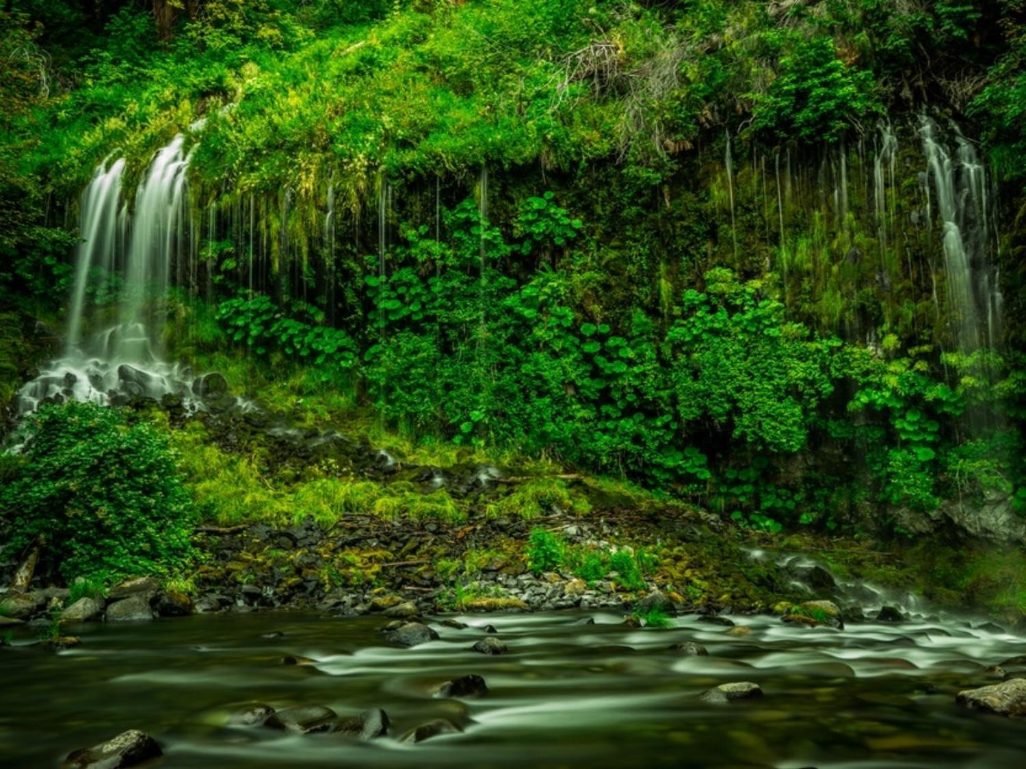
SUSTAINABLE DEVELOPMENT
Dr. Sandip Singh

Slide 2
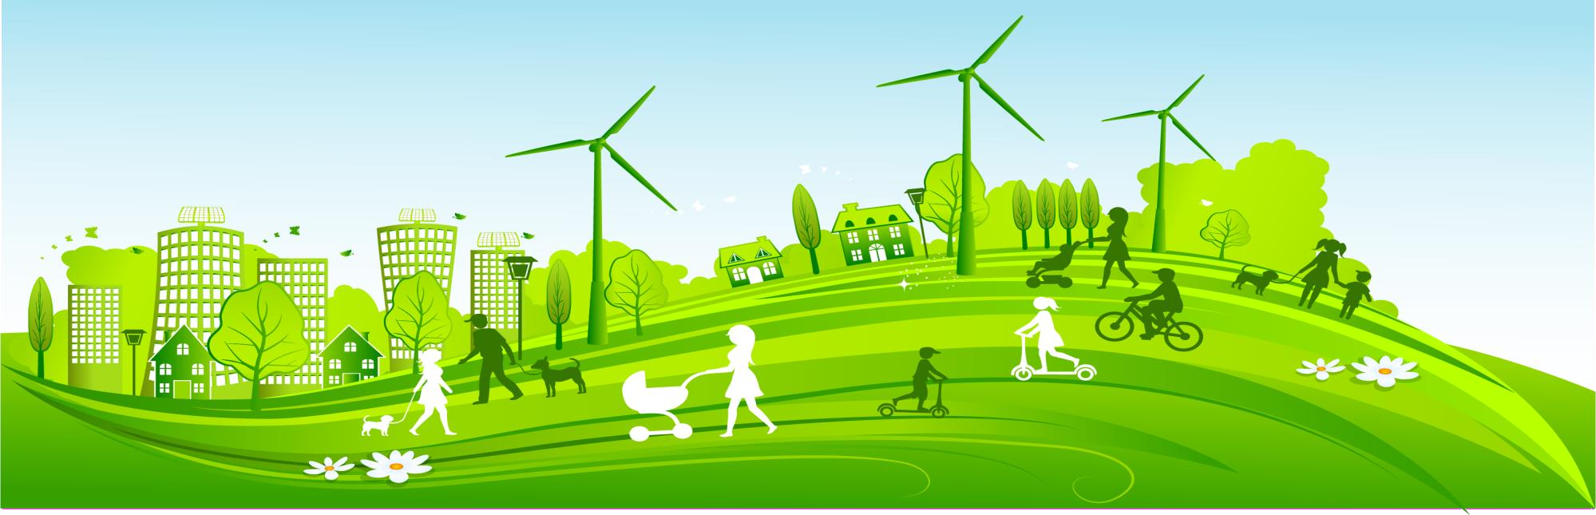
What is Sustainability?
Sustainability focuses on meeting the needs of the present without compromising the ability of future generations to meet their needs.

Slide 3
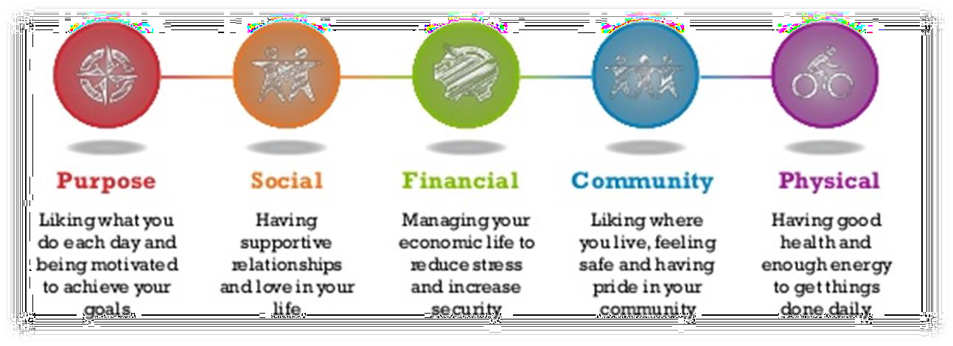
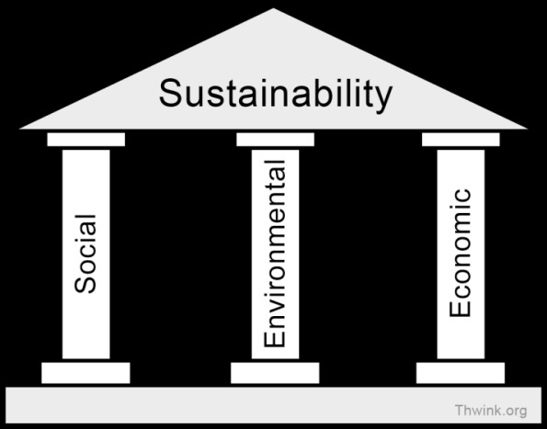
What is Sustainability?
Environmental
Economic
Social
Three pillars of Sustainability

Slide 4
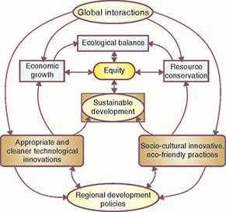
What is Sustainability?
Multidimensional model for sustainable
development
This PPT should be used as reference only. Reading books (mentioned
in syllabus) is mandatory for the preparation of the examinations.

Slide 5
From unsustainable to sustainable development
Does it protect our biodiversity?
Does it prevent soil erosion?
Does it slow down population growth?
Does it increase forest cover?
Does it cut off the emissions of CFC, SO_{x}, NO_{x} and CO₂ ?
Does it reduce waste generation and does it bring benefits to all?

Slide 6

Was Thanos Right?
This universe is finite, its resources, finite. If life is left
unchecked, life will cease to exist.
- Thanos (Infinity War)

Slide 7
the key aspects for sustainable development
Inter-generational equity
minimize any adverse impacts on resources and environment
stop over-exploitation of resources, reduce waste discharge and emissions and maintain ecological balance
Intra-generational equity
minimize the wealth gaps within and between nations
The technology should address to the problems of the developing countries
producing drought tolerant varieties for uncertain climates
vaccines for infectious diseases
clean fuels for domestic and industrial use

Slide 8
Measures for Sustainable Development
Using appropriate technology
Reduce, Reuse, Recycle approach
Prompting environmental education and awareness
Resource utilization as per carrying capacity
Implementing effective planning for Population Control
Less dependence on non-renewable natural resources

Slide 9
Carrying capacity
The carrying capacity of a biological species in an environment is the maximum population size of the species that the environment can sustain indefinitely, given the food, habitat, water, and other necessities available in the environment.
Carrying capacity has two basic components
Supporting capacity (the capacity to regenerate)
Assimilative capacity (the capacity to tolerate different stresses)

Slide 10
Sustainable Development Goals
Set of seventeen pointer targets that all the countries which are members of the UN agreed to work upon for the better future of the country.
An intergovernmental agreement formulated to act as post-2015 Development agenda in Rio+20 conference in 2012.
A group of 17 goals with 169 targets and 304 indicators, as proposed by the United Nation General Assembly’s Open Working Group on Sustainable Development Goals to be achieved by 2030.

Slide 11






The political process
1992: Agenda 21 (Rio)
2002: World Summit on Sustainable Development
2012: The Future we Want (Rio+20)
2015: Sustainable Development Goals

Slide 12
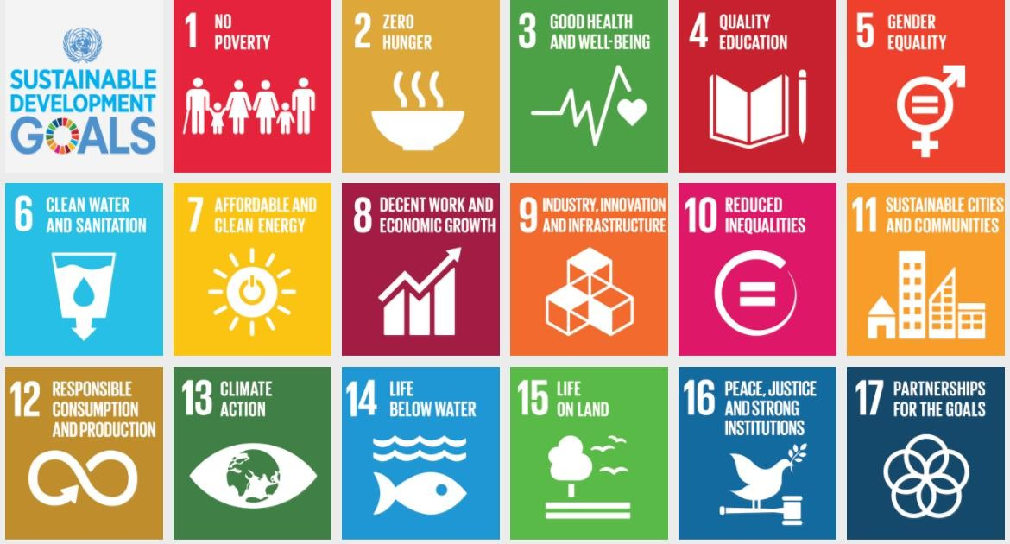
SDG Indicators

Slide 13
17 goals under the Sustainable Development Goals
End poverty in all its forms everywhere
End hunger, achieve food security and improved nutrition and promote sustainable agriculture
Ensure healthy lives and promote well being for all at all stages
Ensure inclusive and equitable quality education and promote lifelong learning opportunities for all
Achieve gender equality and empower all women and girls
Ensure availability and sustainable management of water and sanitation for all
Ensure access to affordable, reliable, sustainable and modern energy for all

Slide 14
17 goals under the Sustainable Development Goals
Promote sustained, inclusive and sustainable economic growth, full and productive employment and decent work for all
Built resilient infrastructure, promote inclusive and sustainable industrialization and foster innovation
Reduce inequalities within and among countries
Make cities and human settlements inclusive, safe, resilient and sustainable
Ensure sustainable consumption and production pattern
Take urgent actions to combat climate change and its impact

Slide 15
17 goals under the Sustainable Development Goals
Conserve and sustainably use the oceans, seas and marine resources
Protect, restore and promote sustainable use of terrestrial ecosystems, sustainably managed forests, combat desertification and halt and reverse land degradation and halt biodiversity loss
Promote peaceful and inclusive societies for sustainable development, provide access to justice for all and build effective, accountable and inclusive institutions at all levels
Strengthen the means of implementation and revitalize the global partnership for sustainable development

Slide 16
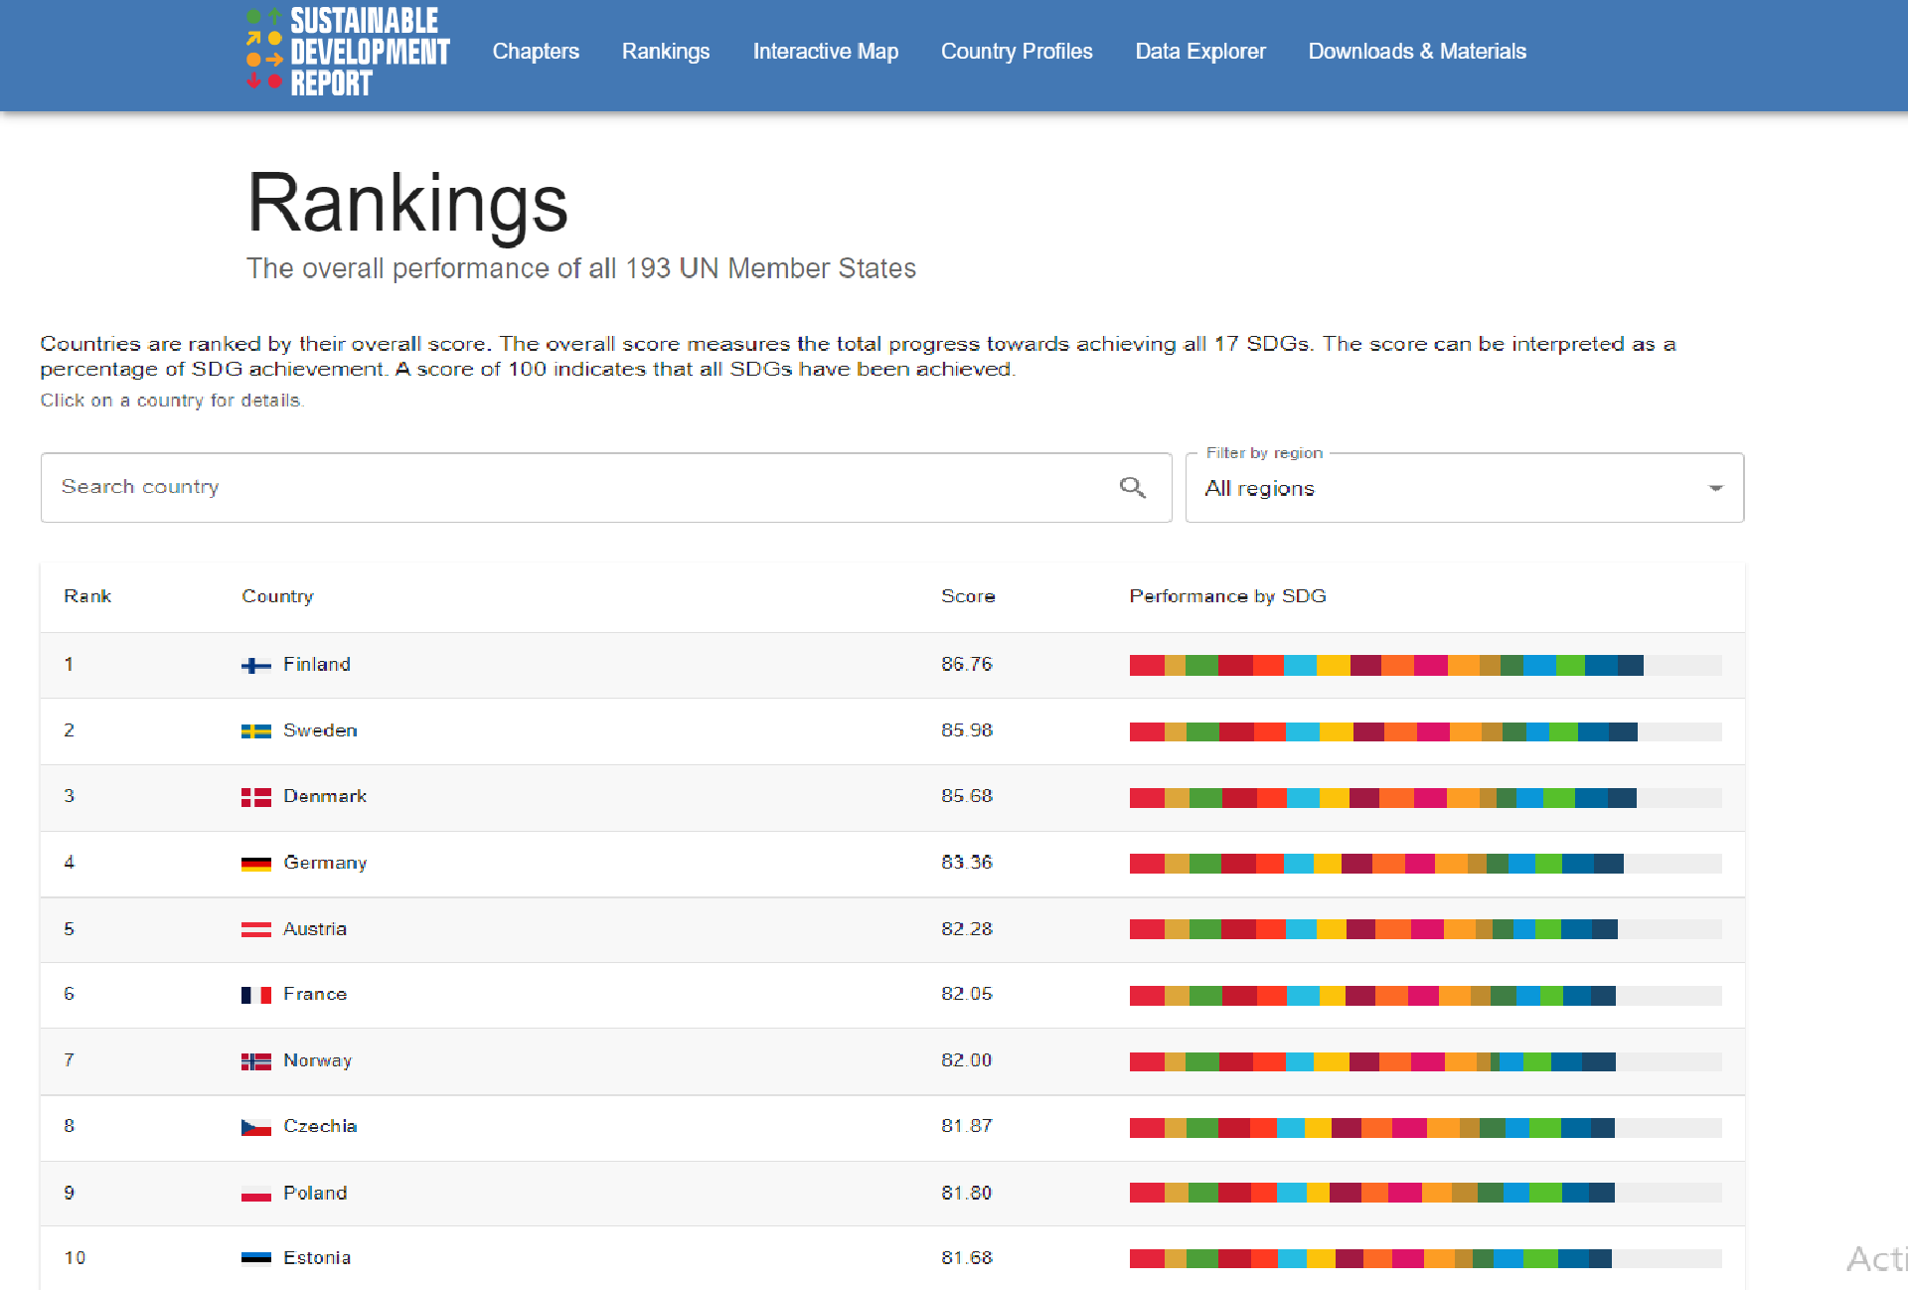

Slide 17
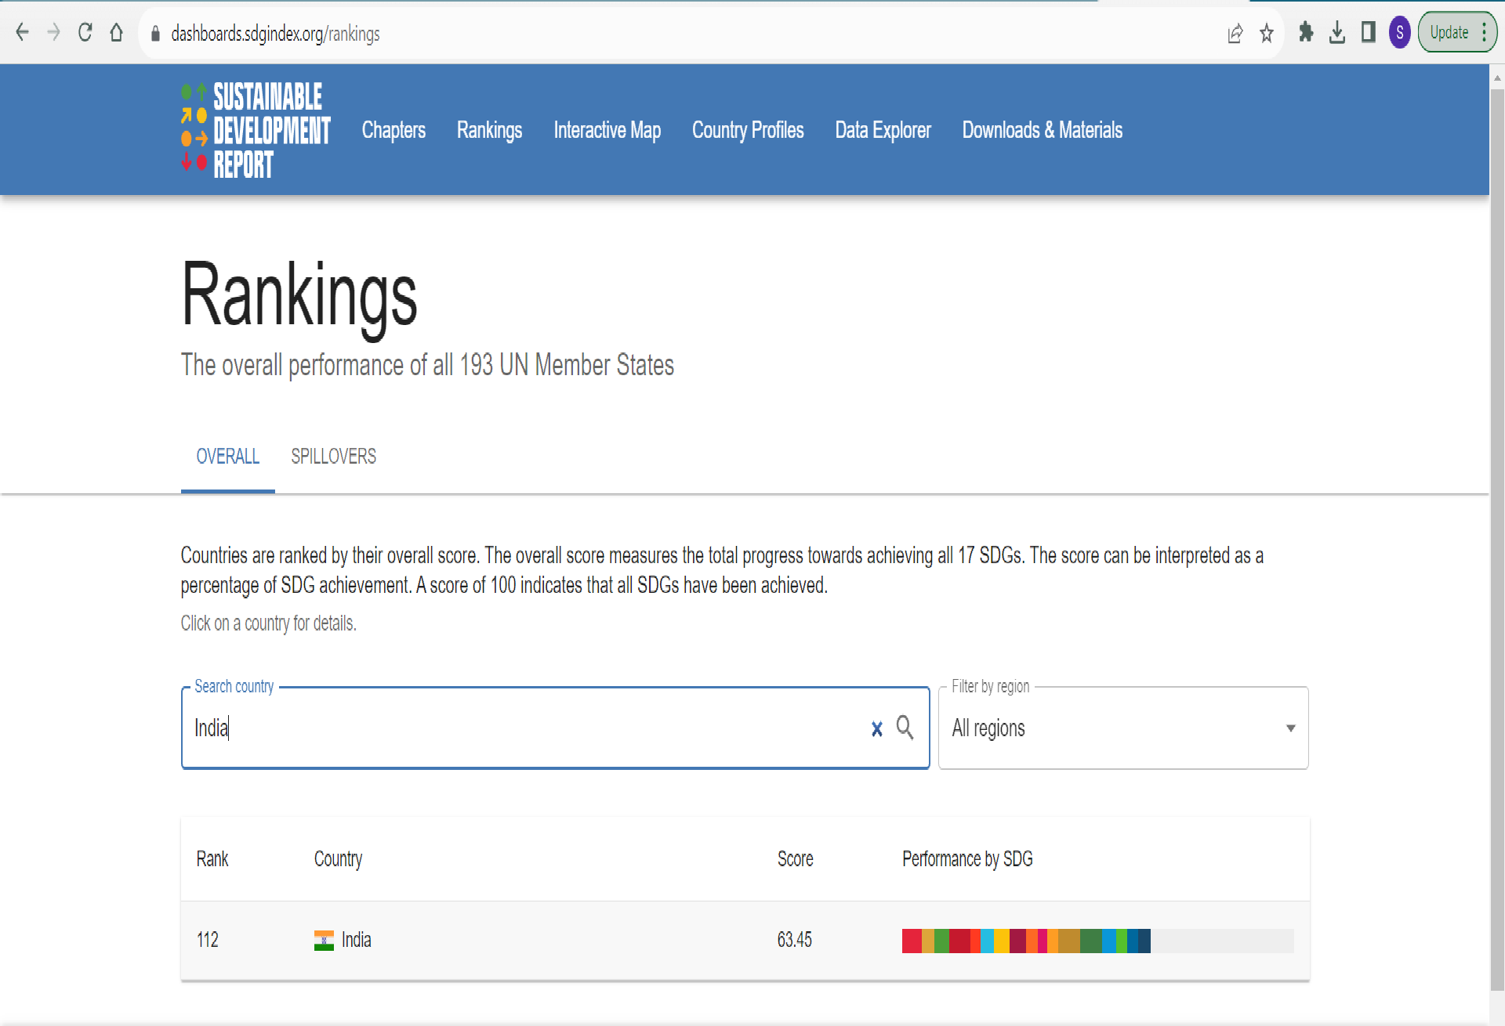

Slide 18
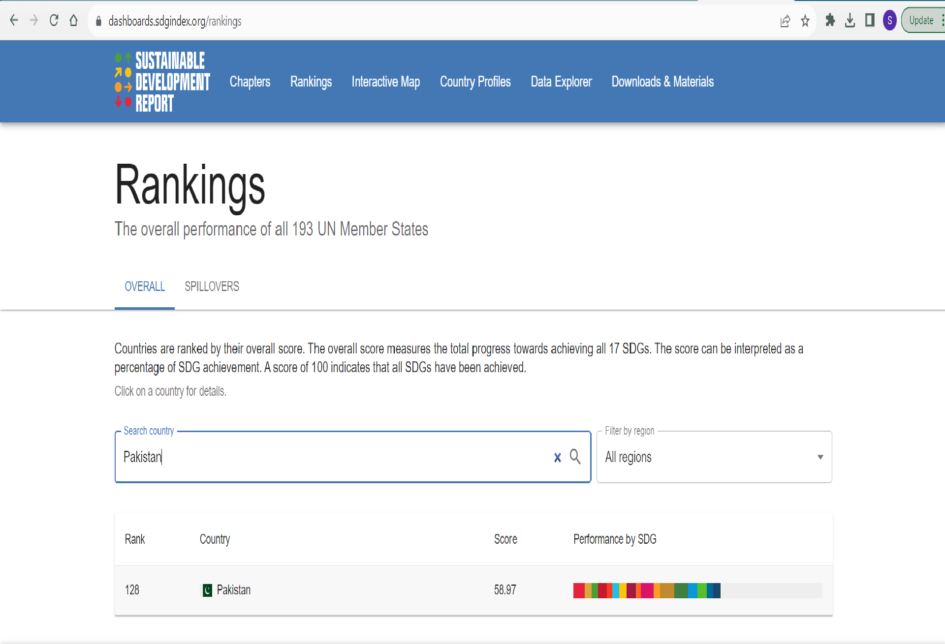

Slide 19


Slide 20
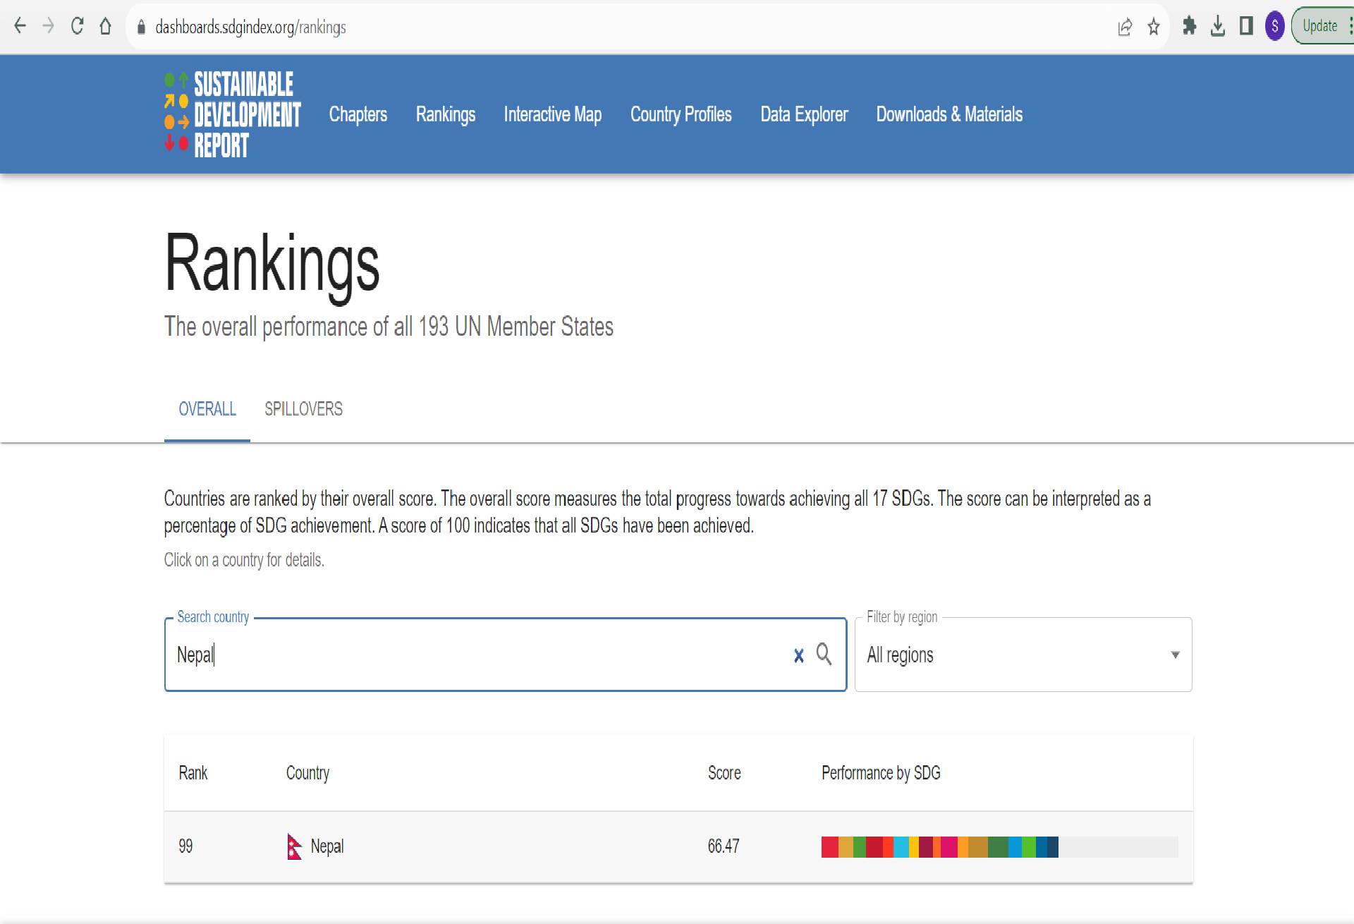

Slide 21


Slide 22
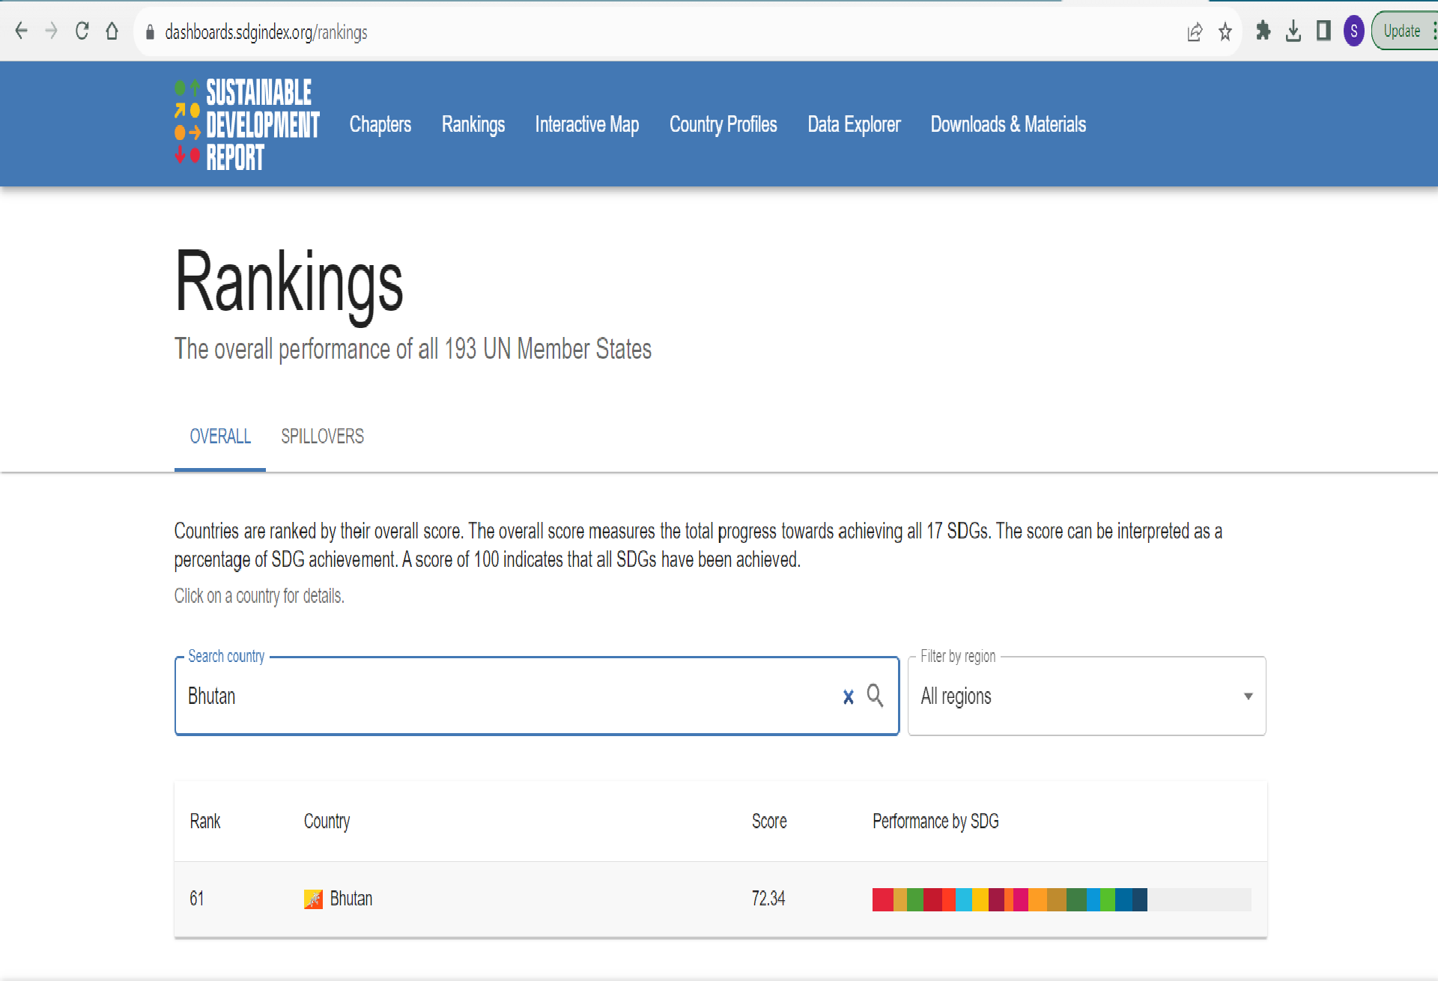

Slide 23
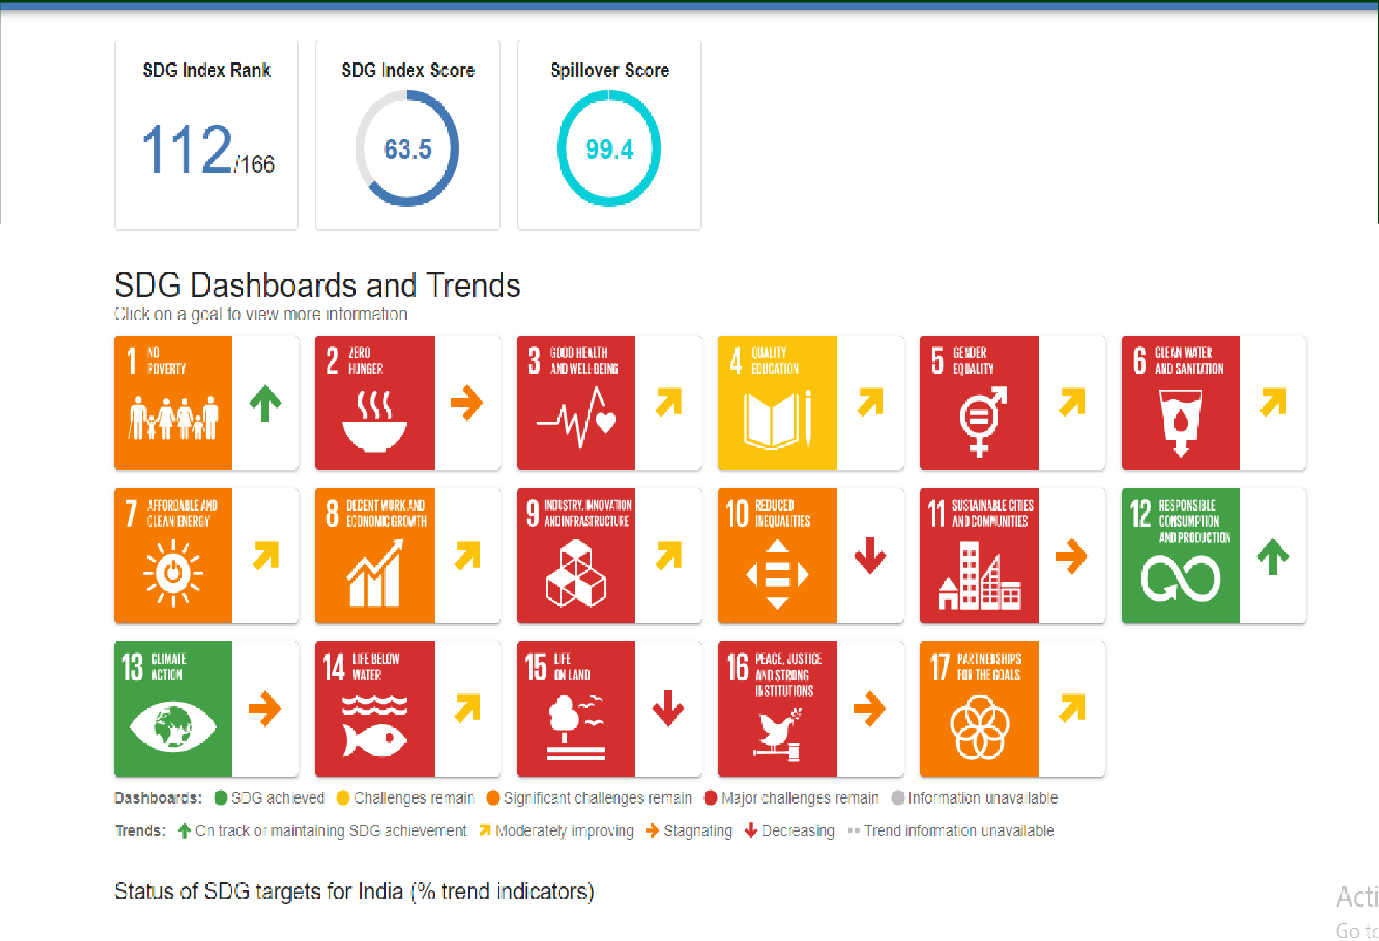

Slide 24
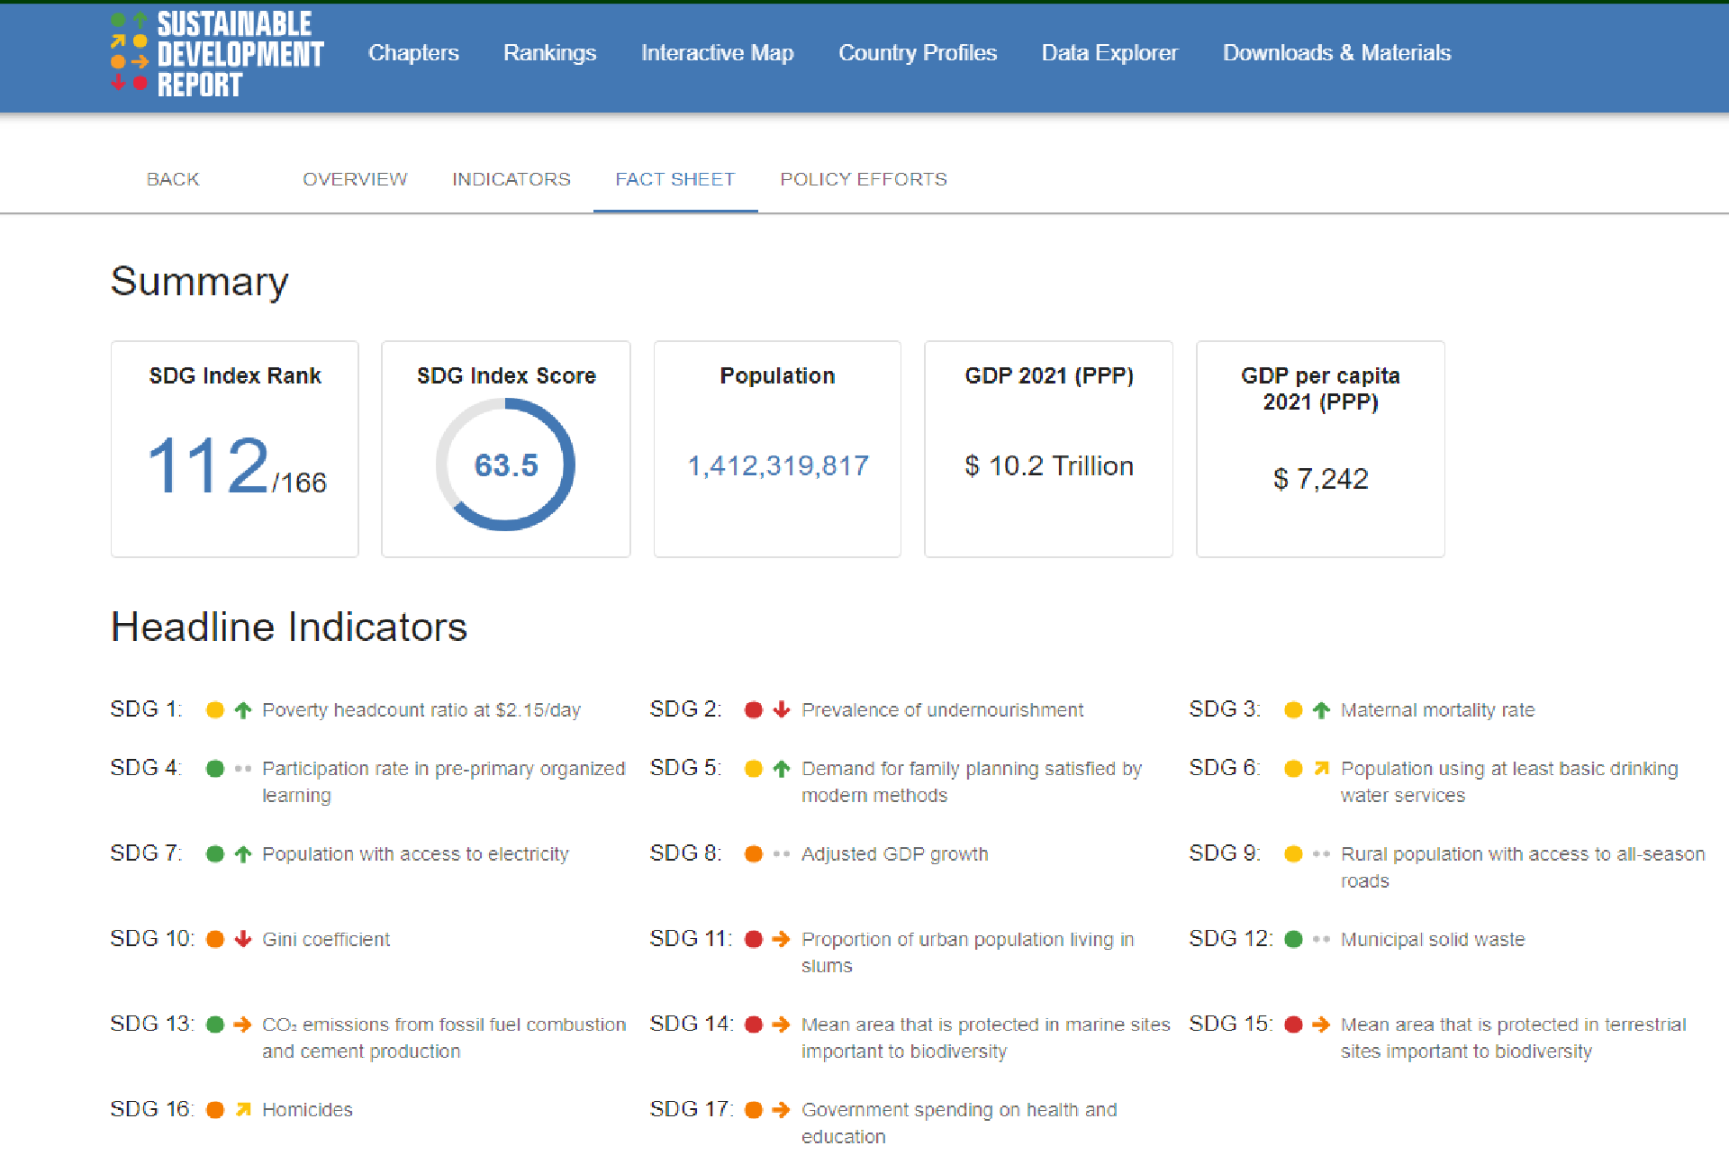

Slide 25
Problems of Sustainable Development
Disagreements between stakeholders
Problem between different communities(Development, economic growth)
Uncertainty
Global environmental issue
Consumption and life style
Comparison between developed and undeveloped
countries.
Arguments over cause and responsibility
Pollution, Global warming etc.

Slide 26
Urban Problems Related To Energy
Residential and commercial lighting
Transportation means including automobiles and public transport for moving from residence to workplace
Modern life-style using a large number of electrical gadgets in everyday life
Industrial plants using a big proportion of energy.
A large amount of waste generation which has to be disposed off properly using energy based techniques
Control and prevention of air and water pollution
which need energy dependent technologies

Slide 27
Water Conservation
Decreasing run-off losses
Reducing evaporation losses
Storing water in soil
Reducing irrigation losses
Re-use of water
Preventing wastage of water
Increasing block pricing

Slide 28
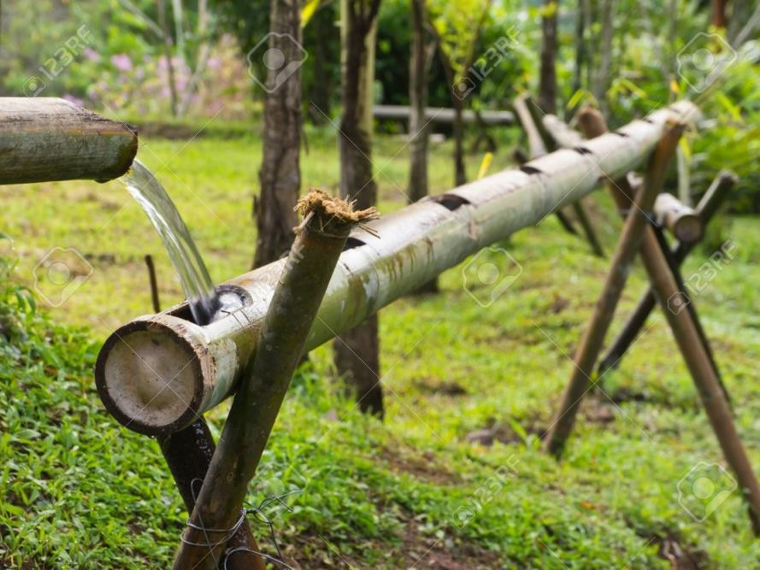
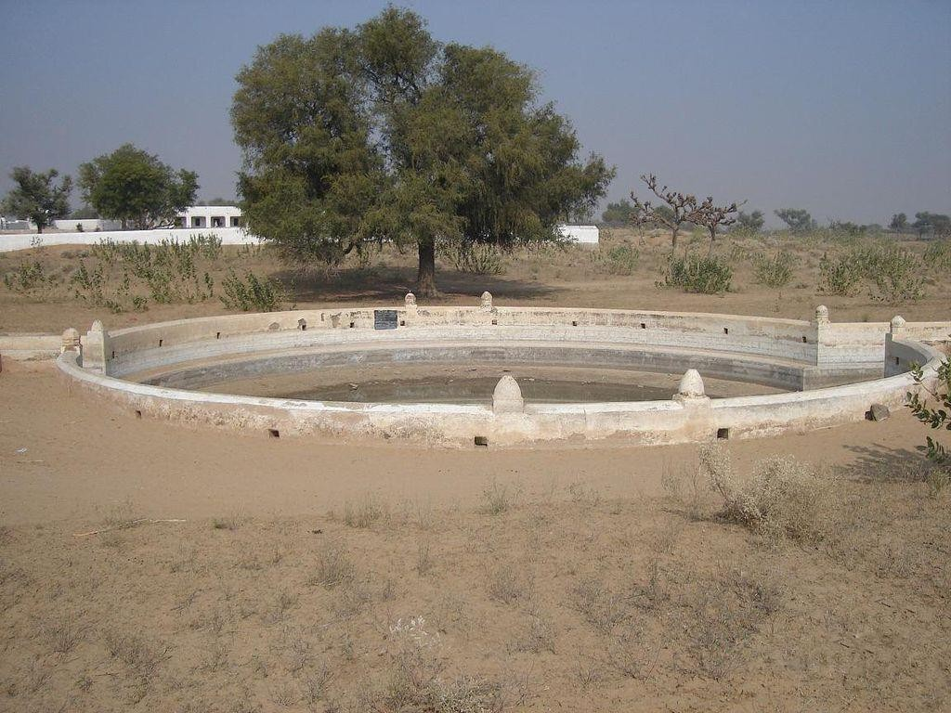
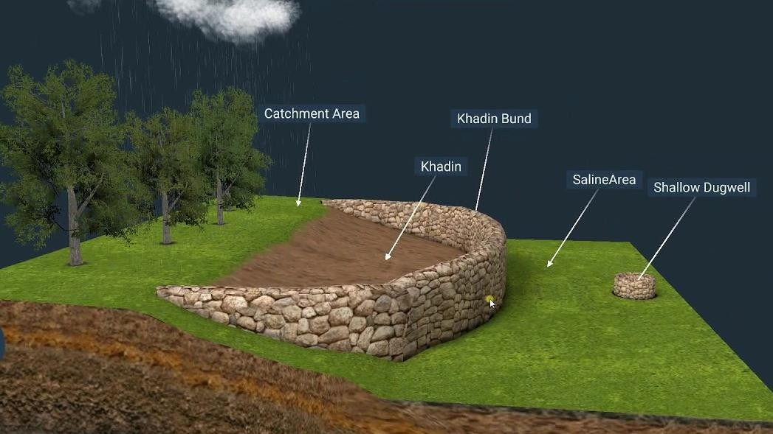
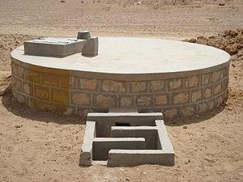
Rainwater Harvesting
Khadin Johad Tanka

Slide 29
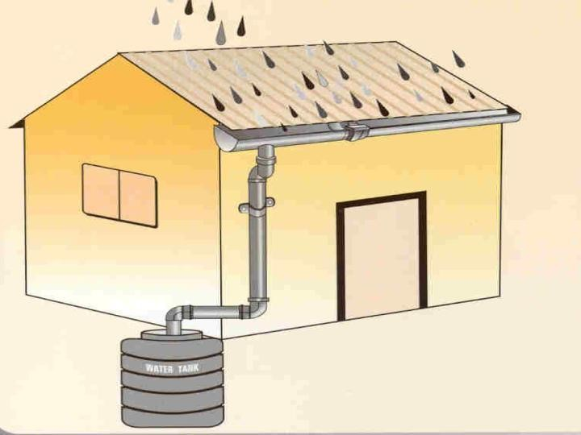
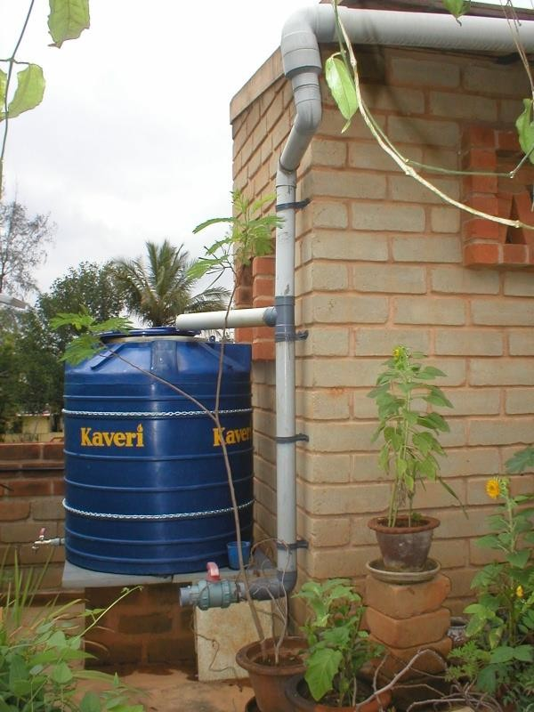
Rainwater Harvesting
Modern Rainwater Harvesting

Slide 30
Rainwater Harvesting
Objectives of Rain Water Harvesting:
Rain water harvesting fulfill the demand of water in domestic, industrial, and agricultural sectors.
It helps to raise the water table by recharging ground water.
It helps in minimizing ground water pollution.
The proper harvesting of rain water reduces soil erosion, flooding
and run off. It reduces the incidence of floods.
Techniques of Rainwater Harvesting
This can be done by constructing special structures like dug wells,
percolation pits, lagoons, check dams, tanks, etc.
Broadly there are two ways of harvesting rainwater:
Surface runoff harvesting
Roof top rainwater harvesting

Slide 31
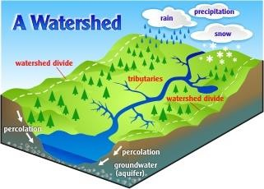
Watershed Management
A watershed is an area of land that drains to a common location. A watershed can vary in size, they can represent the area draining to a small stream to the entire area draining to an ocean

Slide 32
Watershed Management
Benefits of Watershed Management
Ensure ecological balance
Stabilize income even under unfavorable weather conditions.
Minimize the risks of drought, landslides floods, and help to
reduce erosion and sediment production.
Proper utilization of marginal or waste lands through alternate land use systems
Maximize productivity per unit area, per unit time and per unit of
water.
Scope for beneficial developmental activities like domestic water supply, irrigation, hydropower generation, etc.
Develop rural areas in the region with clear plans for improving
the economy of the region

Slide 33
Thank You

