Slide 1
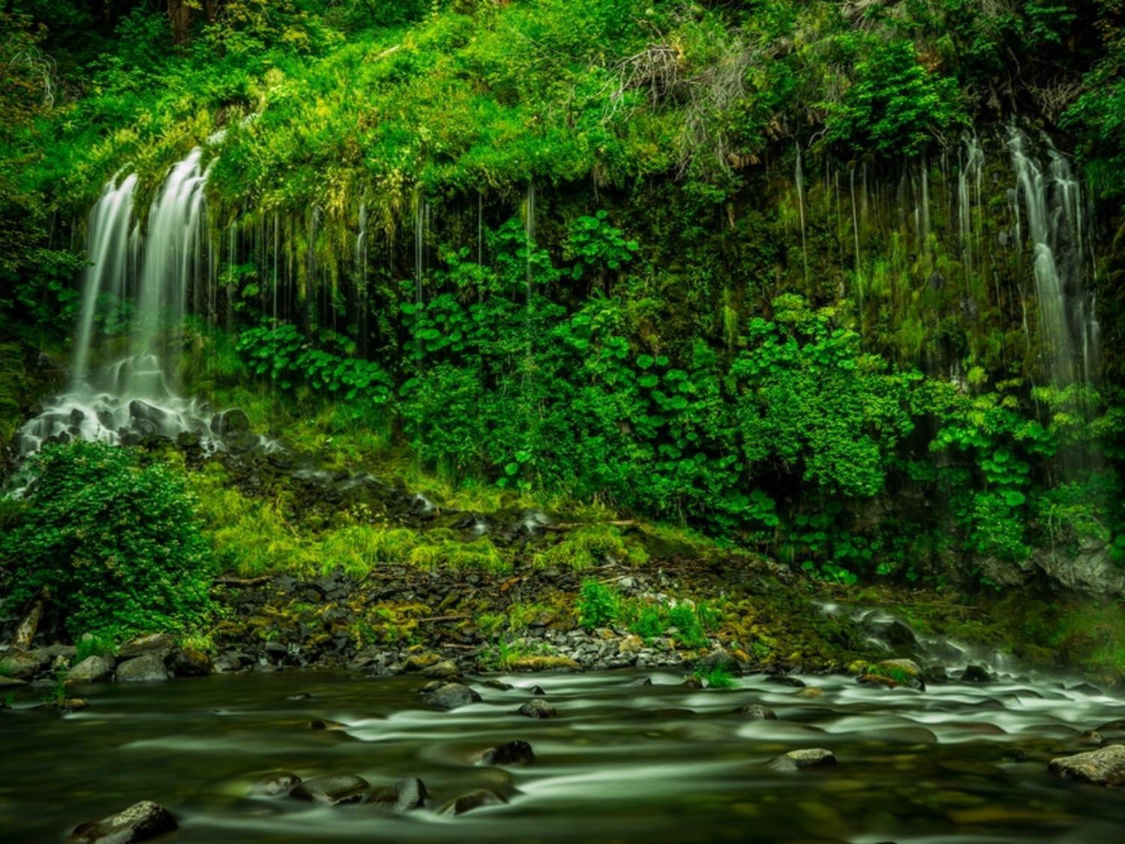
Environmental Pollution - 1
Dr. Prasenjit Adak

Slide 2
Pollution
Pollution is the introduction of contaminants into the natural environment that cause adverse change. Pollution can take the form of chemical substances or energy, such as noise, heat or light.
Pollutants, the components of pollution. They can be either foreign substances/energies or naturally occurring contaminants.

Slide 3
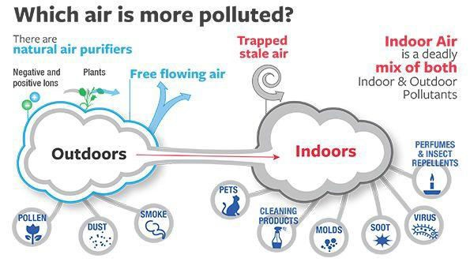
Air Pollution
Air pollution Air pollution is said to exist if the levels of gases, solids, or liquids present in the atmosphere are high enough to harm humans, other organisms, or materials.
Indoor Air Pollution
Outdoor Air Pollution

Slide 4
Air Pollution
Types of Air Pollutants
Primary
harmful chemicals that are released directly from a source into the atmosphere.
Examples: Particulate matter such as soil particles, lead, and asbestos, Oxides of carbon and nitrogen and sulphur dioxide, Hydrocarbons like methane and benzene
Secondary
produced from chemical reactions involving the
primary pollutants.
Example: Ozone, Sulphur trioxide, PAN (Peroxy Acetyl Nitrate), Photochemical smog

Slide 5
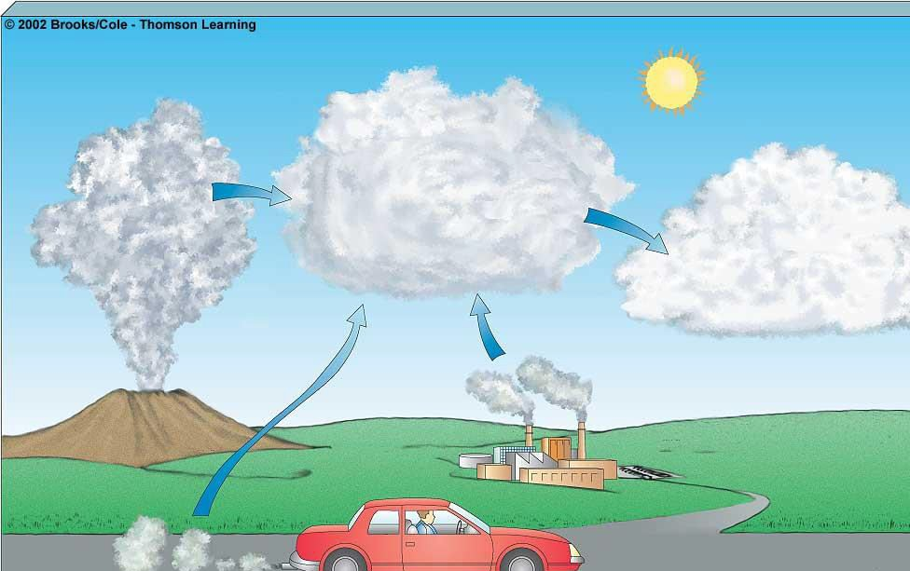
This PPT should be used as reference only. Reading books (mentioned in syllabus) is mandatory for the preparation of the examinations.
Primary Pollutants
CO CO₂
SO₂ NO NO₂
Secondary Pollutants
SO₃
Most hydrocarbons
Most suspended particles
HNO₃ H₂SO₄ H₂O₂ O₃
Most NO₃
–
and
SO₄
2 –
salts
Mobile Sources
Natural
Stationary

Slide 6
Air Pollution
Major Air Pollutants
Carbon Monoxide
Product by incomplete combustion of fuel such as natural gas, coal or wood. Vehicular exhaust is a major source of carbon monoxide.
Causes carboxyhaemoglobin
Carbon Dioxide
A greenhouse gas emitted from combustion but is also a gas vital to
living organisms. It is a natural gas in the atmosphere.
CFCs
Source: Refrigerators, air conditioners, foam shaving cream, spray cans and cleaning solvents
Destroy ozone layer
Ozone
Ground level ozone (O₃) formed from NO_{x} and VOCs. Ozone (O₃)
Damages skin and many materials, constituent of smog

Slide 7
Air Pollution
Major Air Pollutants
Nitrogen oxides
Especially nitrogen dioxide are emitted from high temperature combustion. Nitrogen dioxide is the chemical compound with the formula N02. It is responsible for photochemical smog, acid rain etc.
Sulphur dioxide
SO₂ is produced by volcanoes and in various industrial processes. Since coal and petroleum often contain sulphur compounds, their combustion generates sulphur dioxide. Further oxidation of SO₂,
usually in the presence of a catalyst such as NO₂, forms H₂SO₄, and
thus acid rain.
Suspended Particulate Matter (SPM)
Particulates, alternatively referred to as particulate matter (PM) or fine particles, are tiny particles of solid or liquid suspended in a gas. Sources of particulate matter can be manmade or natural. Increased levels of fine particles in the air are linked to health hazards such as heart disease, altered lung function and lung cancer.

Slide 8
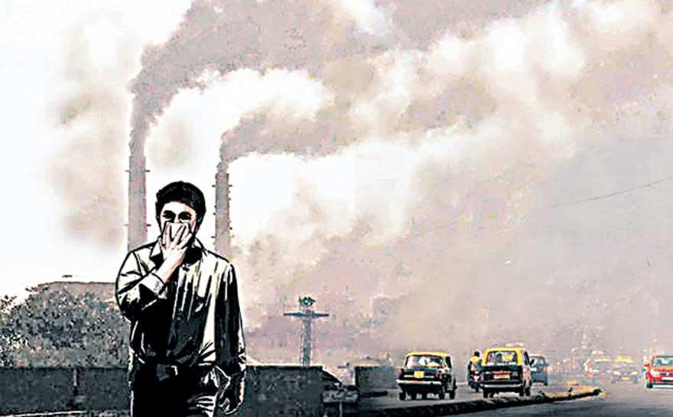
Air Pollution
Causes of Air Pollution
Natural Causes
Natural disasters like volcanic eruption, cyclones, forest fires, microbes(CH₄)
Natural emissions from animals, decaying organic matter
Anthropogenic (Man made) Causes
Industrial emissions
Automobiles
Thermal power stations
Nuclear explosions
Nuclear power plants
Agricultural activities
Disposal of garbage
Mining activities

Slide 9
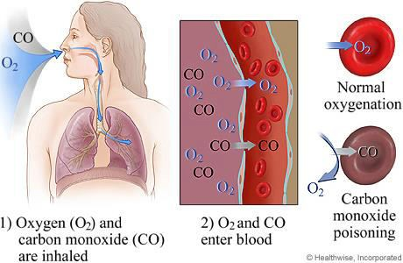
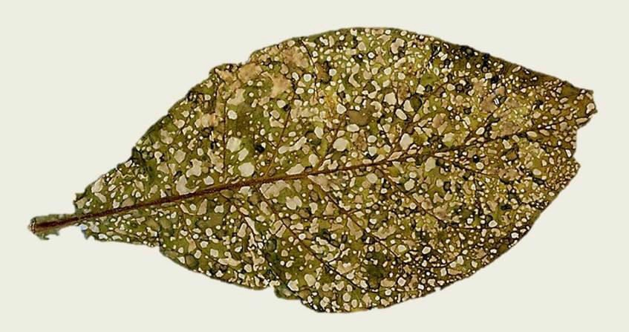
Air Pollution
Effects of Air Pollution
Effects on Human Health
Carboxyhaemoglobin
Inflammation of lungs
Damage to respiratory system, and blood vascular system,
Cancer
Effects on Plants
Bleaching of the leaf pigment
Development of necrotic spots
Premature falling of leaves
Effects on Climate
Greenhouse effect and global
warming
Acid rain
Ozone (O3) layer depletion
This PPT should be used as reference only. Reading books (mentioned in syllabus) is mandatory for the preparation of the examinations.

Slide 10
Air Pollution
Prevention and control of air pollution
Air pollution can be prevented by
Adopting cleaner technologies,
Reducing pollution at the source,
Implementing laws and regulations to make people pollute less,
Introducing appropriate transportation policies
Making cleaner and fuel-efficient vehicles
Air pollution can be controlled by
Various Air Pollution Control (APC) devices
Sprinkling water on soil that is being evacuated during road construction
This PPT should be used as reference only. Reading books (mentioned in syllabus) is mandatory for the preparation of the examinations.

Slide 11
Air Pollution
Air Pollution Control (APC) devices
Particulate Matter
Cyclone separator
Bag house filter
Scrubbers
Electrostatic precipitators
Gaseous pollutants (Adsorption and Absorption)
Venturi scrubbers
Packed bed scrubbers
Spray towers

Slide 12
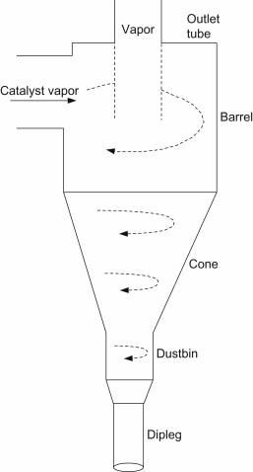
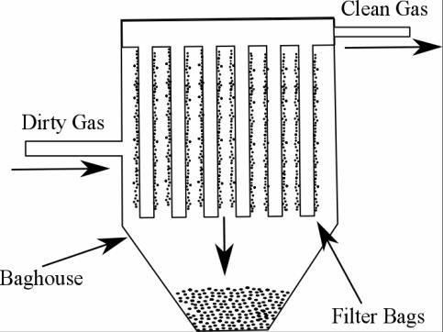
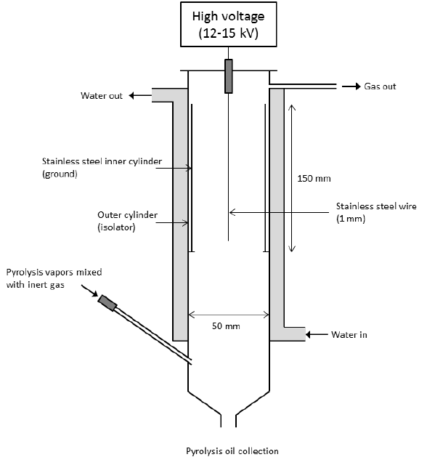
Air Pollution Control Devices
Baghouse Filter
Cyclone
separator
Electrostatic Precipitator
This PPT should be used as reference only. Reading books (mentioned in syllabus) is mandatory for the preparation of the examinations.

Slide 13
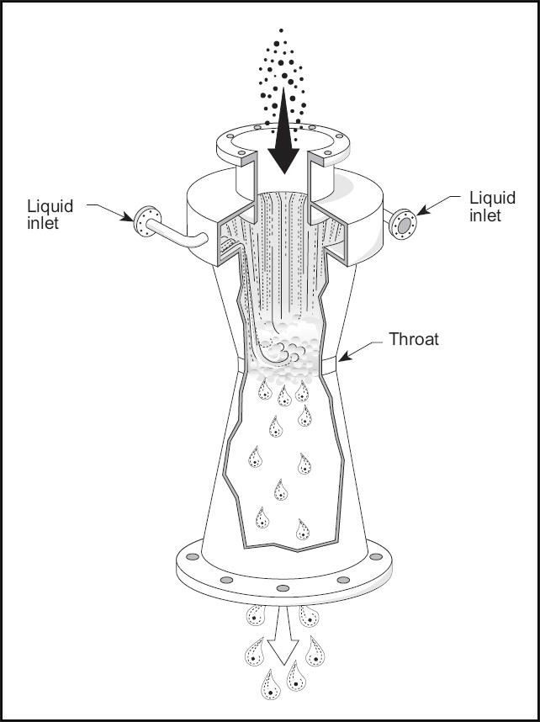
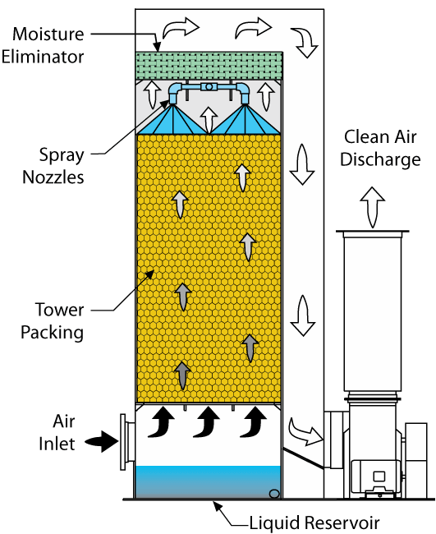
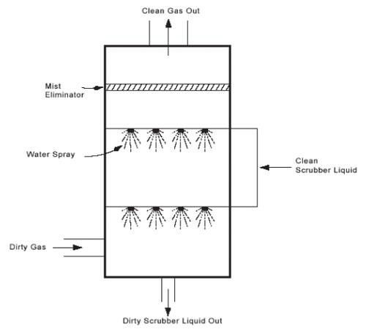
Air Pollution Control Devices
Venturi Scrubber
Packed bed
Scrubber
Spay Tower
This PPT should be used as reference only. Reading books (mentioned in syllabus) is mandatory for the preparation of the examinations.

Slide 14
Ill Effects of Fireworks
Fire Hazards: Fireworks can set fire to huts, heaps of dry grass and even houses.
Noise Pollution: Firecrackers make more noise than
the allowed decibel limit.
Air Pollution: Components of the smog caused by firecrackers are harmful when inhaled. Such as,
Copper causes irritation in the respiratory tract. Cadmium
causes anemia.
Lead in the body has a harmful effect on the nervous system.
Magnesium: Magnesium and zinc fumes cause metal fume fever.
Smokes from fireworks causes reduced visibility.
This PPT should be used as reference only. Reading books (mentioned in syllabus) is mandatory for the preparation of the examinations.

Slide 15
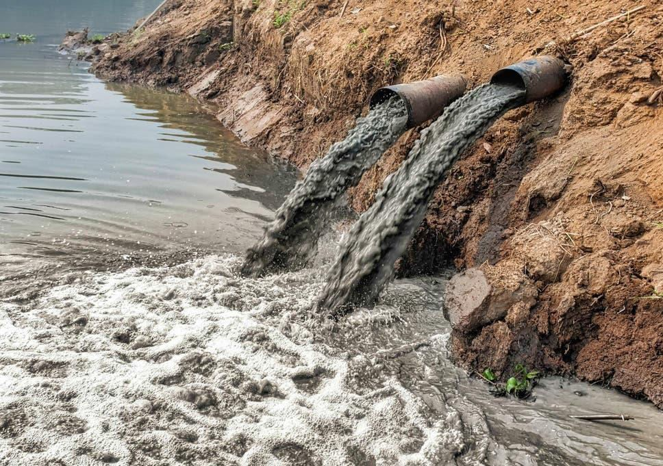
Water Pollution
The addition of various organic and inorganic substances that change the physical and chemical properties of water thereby leading to detrimental effects on living organisms and reducing water usability is termed as water pollution.

Slide 16
Causes of Water Pollution
Natural Causes-
Soil erosion due to rain, floods, high speed wind.
Deposition of dead and decaying remains of plants and animals.
Man-made Causes-
Sewage and other wastes: Includes papers, cloth, soap, detergents, waste.
Industrial waste: effluents such as oil, grease, plastic, metals, acids and other toxic chemicals.
Agricultural waste: fertilizers, pesticides.
Human activities: bathing, washing clothes (use of synthetic
detergents).
Customs and traditions: disposal of dead bodies, immersion of idols of gods.

Slide 17
Sources of water pollutants
Point sources
Pollutants enter the water at a single point. Examples: sewage treatment plant and factories. These can be regulated through law.
Non point source
pollutants enter the water over large areas. Examples: Surface run off, mining wastes, municipal wastes, acid rain and soil erosion

Slide 18
Water Pollutants and its effects
Sediments: Excessive amounts of soil particles carried by flowing water, when there is severe soil erosion. Sediments cloud the water and reduces photosynthesis, destroys feeding ground of fishes, clogs reservoirs and channels.
Oxygen-demanding wastes (BOD and COD): Organic waste such as animal manure and plant debris that are decomposed by bacteria, from sewage, animal feedlots, paper mills, and food processing facilities. These bacteria deplete the oxygen and causes death of fish.
Infectious microorganisms (Pathogens): Parasitic worms, viruses and bacteria from infected organisms as well as human and animal wastes. They are responsible for water borne diseases.
Synthetic chemicals: Synthetic chemicals from industrial effluents, surface runoff, and cleaning agents. These chemicals causes health problems for humans and harm fishes.

Slide 19
Water Pollutants and its effects
Inorganic nutrients: Substances like nitrogen and phosphorus from animal waste, plant residues, and fertilizer runoff. These nutrients causes eutrophication.
Radioactive substances: Wastes from nuclear power plants, nuclear weapons production, mining and refining uranium and other ores. Such substances causes cancer and birth defects.
Thermal pollution: Hot water from industrial processes. Heat lowers oxygen demand and makes aquatic life more vulnerable to diseases, parasites. Thermal shock in aquatic organisms.

Slide 20
Effects of Water Pollution
Effect on human health
Infectious diseases can be spread through contaminated water. These water- borne diseases are caused by bacteria (Typhoid, Cholera, diarrhoea etc. ) or by viruses (Infectious Hepatitis)
Pesticides – can damage the nervous system and cause cancer.
Mercury – Minamata disease
Chlorides can cause reproductive and endocrinal damage.
Nitrates – are especially dangerous to babies that drink formula milk. It
restricts the amount of oxygen in the brain and cause the “blue baby” syndrome.
Lead – can accumulate in the body and damage the central nervous system.
Arsenic – causes liver damage, skin cancer and vascular diseases
Flourides - in excessive amounts can make your teeth yellow and cause damage to the spinal cord.

Slide 21
Effects of Water Pollution
Effects on animals
Loss of aquatic biodiversity: Harmful chemicals and pollutants in water effect survival of aquatic organisms
Effects on plants
Eutrophication of water bodies: Nitrate and phosphate fertilizer used to increase nitrogen and phosphate content of soil goes in water and increases the growth of certain plants on surface of water body.
Polluted water contains high concentration of heavy metals
becomes toxic for plants.

Slide 22
Pollution of Groundwater
Excessive extraction of groundwater leads to the natural pollution of groundwater. Examples are fluoride and arsenic contamination.
Groundwater receives pollutants from septic tanks, landfills, hazardous waste dumps, and underground tanks containing petrol, oil, chemicals, etc.

Slide 23
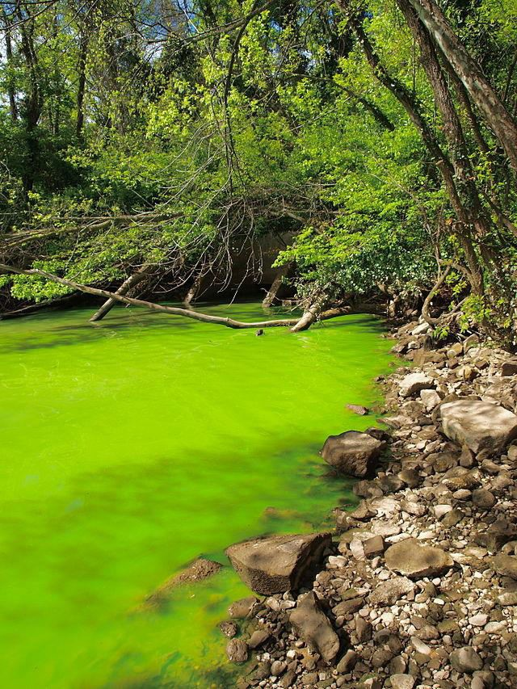
Eutrophication
Enrichment of a standing water body by nutrients, such as phosphorus and nitrogen.
Increased photosynthetic
activity.
Excessive algae die, they fall to the bottom and gets decomposed. This process requires dissolved oxygen, some fish species die.

Slide 24
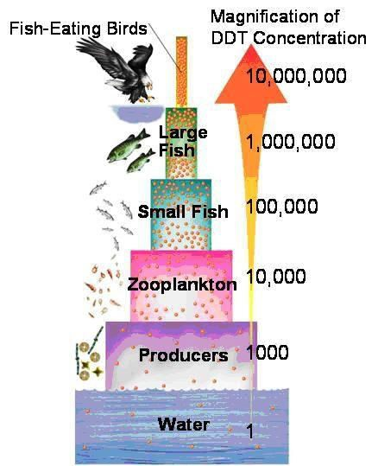
Biomagnification
Biomagnification is the increase in concentration of a substance, such as the pesticide, that occurs in a food chain. The pollutant enters the first organism in a food chain. When the second organism in the chain consumes the first one, the pollutant too moves into the second organism.
As we go up the levels of the ecological pyramid, there is energy loss. Hence, at each succeeding level, the predator consumes more of the prey. As a result, the organisms at higher levels have greater concentrations of the pollutant.
▪

Slide 25
Control of Water Pollution
Treatment of domestic and industrial waste in order to
reduce toxicity.
Control on excess use of fertilizers and pesticides in agriculture
Human activities such as bathing, washing ; throwing
dead bodies should be stopped.
Non- biodegradable waste material such as plastic should not be disposed in water bodies.
Strict enforcement of rules
Public awareness

Slide 26
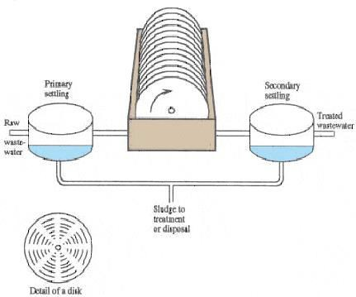
Waste water treatment
Primary treatment
Grit removal
Sedimentation
Floatation
Secondary treatment
Trickling filters
Activated sludge process
Rotating biological contactor
Tertiary treatment
Chlorination
Anaerobic treatment
Hydrolysis, Acidogenesis, Acetogenesis, Metanogenesis

Slide 28
Thermal Pollution
Causes of thermal pollution
Heat producing industries (thermal power plants, nuclear power plants, refineries, steel mills etc.)
Effects of Thermal Pollution
The dissolved oxygen content of water is decreased.
The composition of flora and fauna changes
Metabolic activities of aquatic organisms increase at high temperature and require more oxygen, whereas oxygen level falls under thermal pollution.
Toxicity of pesticides, detergents and chemicals in the effluents
increases with increase in temperature
High temperature becomes a barrier for oxygen penetration into deep cold waters

Slide 29
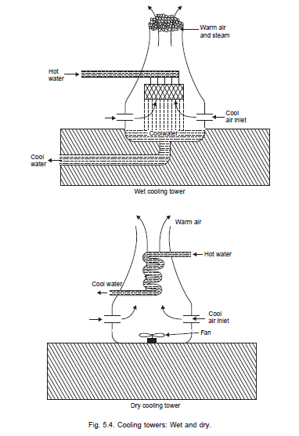
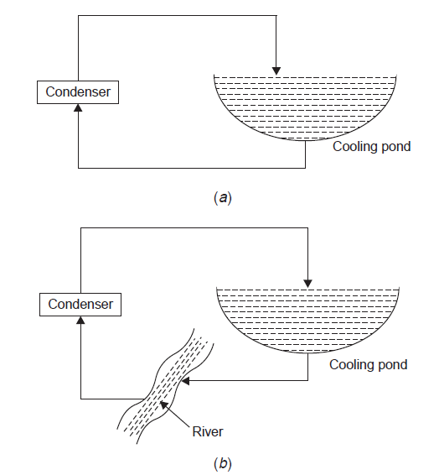
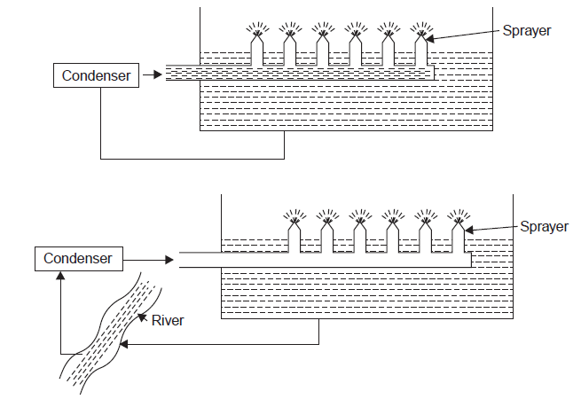
Thermal Pollution
Control of
Thermal Pollution
Cooling ponds
Cooling towers
Cooling Ponds
Spray Ponds
Cooling Towers
Wet cooling tower
Dry cooling tower

Slide 30
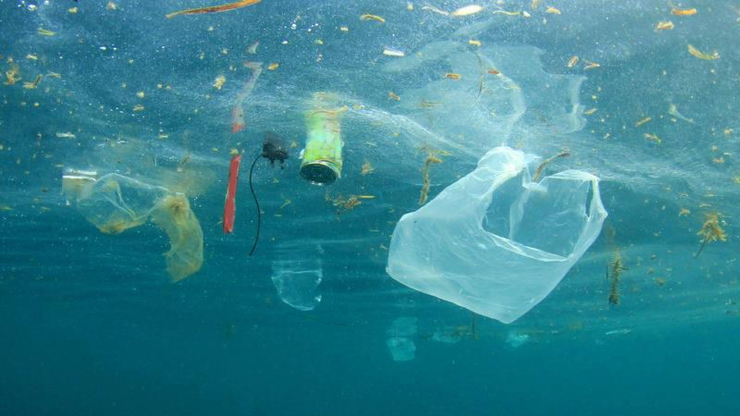
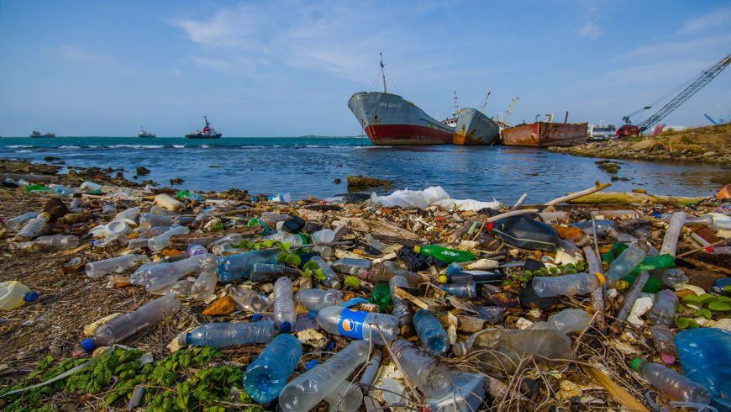
Marine Pollution
Sources of marine
pollution
Rivers, Catchment area, coastline, oil drilling and shipment.
Pollutants
sewage sludge, industrial effluents, synthetic detergents, agrochemicals, solid wastes, plastics, metals and waste heat

Slide 31
Control of Marine Pollution
Toxic materials from the industrial plants should not be discharged in coastal water.
Run off from non-point source should be controlled.
Sewer overflow should be prevented.
Oil and grease from the service stations should be reused.
Oil balast should not be dumped into the sea.
Developmental activities in the coastal region should be minimized.

Slide 32
To be continued...
This PPT should be used as reference only. Reading books (mentioned in syllabus) is mandatory for the preparation of the examinations.

