Slide 1
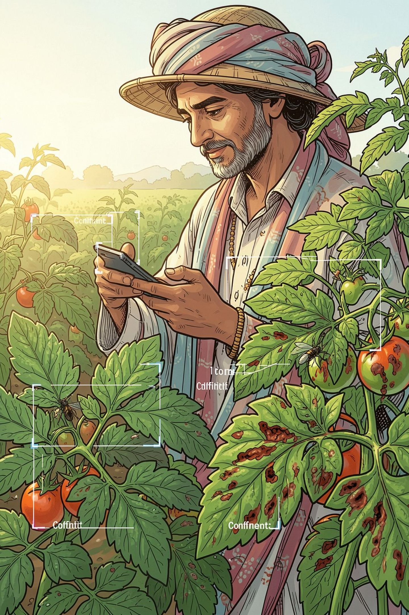
Smart India Hackathon 2026
CropGuard AI
AI-Powered Early Detection & Management of Crop Diseases and Pest Infestations
Problem Statement ID: SIH26131
Problem: Early detection and management of crop diseases and pest infestations
Theme: Agriculture, FoodTech & Rural Development
PS Category: Software
Top-right: Smart India Hackathon 2026 visual
Organization: Government of Maharashtra / Maharashtra State Innovation Society
Department: Department of Skills, Employment, Entrepreneurship and Innovation
Team: [INSERT TEAM NAME] — ID: [INSERT TEAM ID]
Members: [INSERT TEAM MEMBERS]

Slide 2
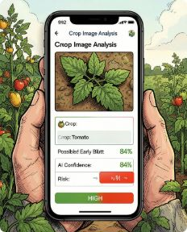
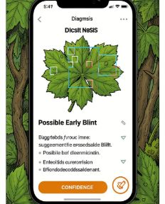
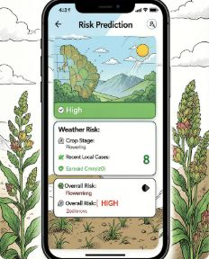
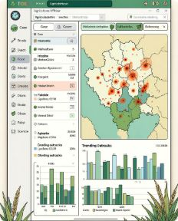
Approach Details
How we solve the given problem
CropGuard AI combines image-based disease/pest detection with weather, crop, soil, historical, and geospatial data to identify emerging risks and deliver actionable guidance to farmers and officials.
Farmer — Image Upload
AI Diagnosis
Image-based detection (computer vision)
Key features
Demo values labeled: DEMO / PROTOTYPE DATA
AI-based crop disease identification from images
Pest detection & pest-trap integration
Weather-based disease/pest risk forecasting
Crop stage & variety-aware risk analysis
Soil and environmental context
Geospatial hotspot detection
Multilingual farmer advisories (EN/HI/MR)
IPM guidance, expert validation and lab referral
Follow-up crop monitoring & surveillance dashboard
Risk Prediction
Officer Dashboard
Weather + crop + soil + history → risk
Surveillance, hotspot map, assignments

Slide 3

Workflow Demo
Farmer
Expert
Admin
Top labels: FARMER → EXPERT / EXTENSION OFFICER → ADMIN
Design note: Mobile UI mockups for Farmer, Expert, Officer shown; demo values labeled SIMULATED DATA.

Slide 4


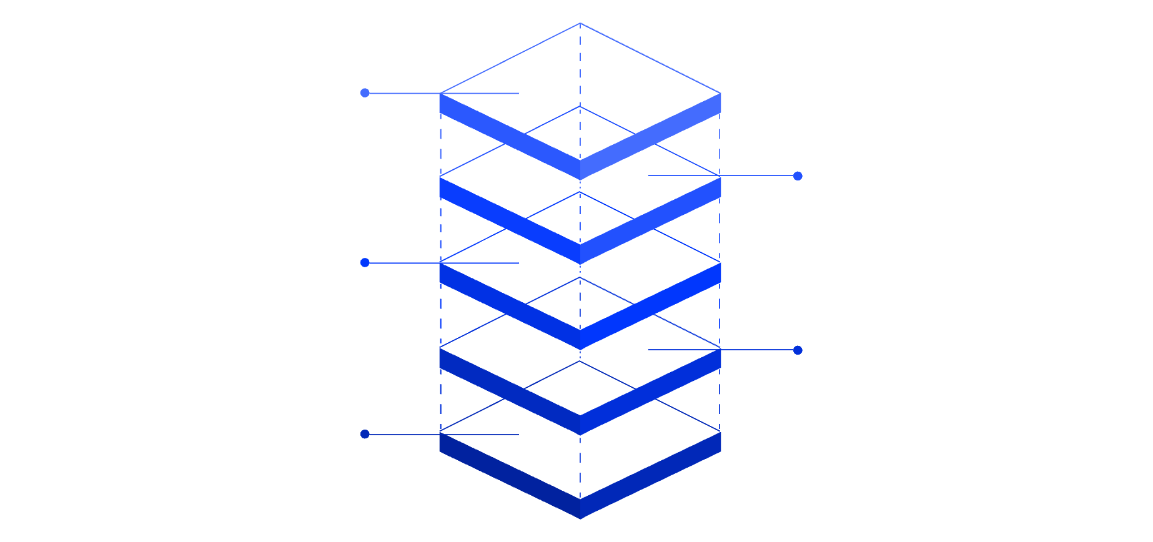




Technical Approach
Tech stack (MVP → Production)
Frontend
Streamlit • Python (prototype)
System architecture
Backend
FastAPI • Python
Advisory & Review
Recommendations and experts
Risk Fusion
AI / ML
Combine models and GIS
PyTorch • Torchvision • OpenCV • EfficientNet / MobileNet • YOLO • Scikit-learn • XGBoost
Risk Engine
Weather, soil, history inputs
Image AI Engine
Data
Computer vision diagnosis
SQLite (MVP) → PostgreSQL + PostGIS; Pandas, JSON/CSV
Farmer App
Submit images and location
Maps & GIS
Note: CV is primary diagnosis engine; LLMs only used for multilingual interfaces / text formatting, not for diagnosis.
Folium • Leaflet / MapLibre • spatial analytics
Deployment
Docker • Cloud-ready

Slide 5
Feasibility & Viability
Feasibility
Challenges
Strategies
AI Image Detection
Poor image quality: blur, shadows, cluttered backgrounds
Limited connectivity in rural areas
Similar symptoms across causes (disease vs nutrient stress)
Limited local labeled field data
False predictions — need validation
Farmer adoption & usability
Leverage open datasets & pretrained CV models
Offline-Friendly
Local caching & sync when online
Weather Risk Prediction
Weather APIs provide environmental signals
Confidence Thresholds
Route low-confidence to experts
GIS Hotspot Mapping
Location-tagged cases identify clusters
Human-in-the-Loop
Low-Cost Deployment
Expert validation & lab referral
Smartphone + software MVP
Local Data Collection
Human-in-the-Loop
Use confirmed cases to improve models
Expert review for low-confidence/critical cases
Multilingual UI
English, Marathi, Hindi; simple UX
Controlled Advisory
Validated IPM guidance; no ad-hoc chemical dosing

Slide 6
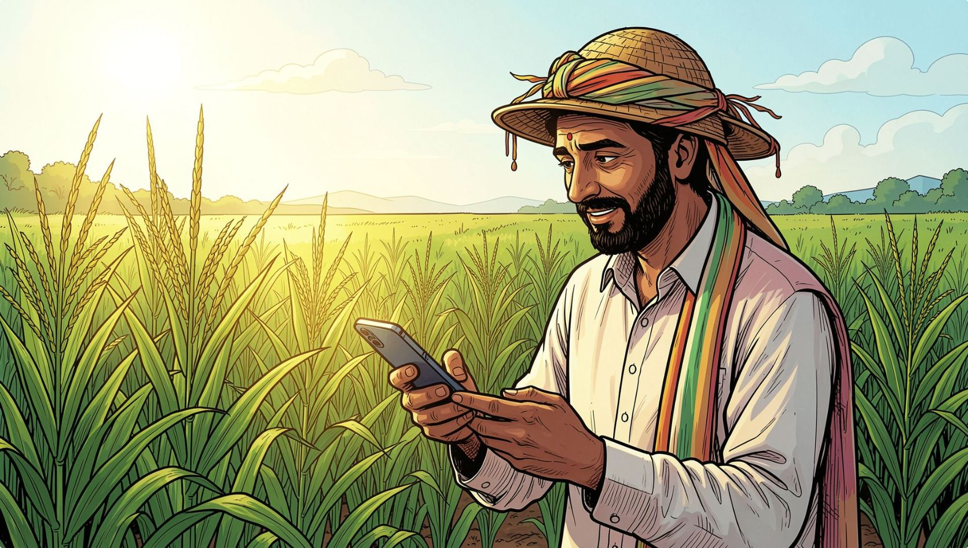






Impact & Benefits
Chain: Detect Early ↓ Predict Risk ↓ Act Quickly ↓ Monitor ↓ Learn ↓ Prevent Future Outbreaks
From individual farm diagnosis to district-level agricultural intelligence.
EARLIER DISEASE DETECTION
REDUCED CROP LOSS
Identify problems before they spread
Timely advisories enable targeted action
TARGETED INPUT USE
FASTER EXTENSION RESPONSE
Reduce unnecessary pesticide use via IPM
Prioritize high-risk locations and cases
REGIONAL SURVEILLANCE
BETTER FARMER ACCESS
Hotspot mapping for district-level planning
Multilingual, simple, actionable advisories

Slide 7

Research & References
Key datasets, open-source projects and literature relevant to CropGuard AI:
PlantVillage Dataset — plant disease image dataset for automated diagnosis research
https://github.com/spMohanty/PlantVillage-Dataset
https://github.com/shubhajitml/crop-disease-detector
https://github.com/MindDock/crop-pest-detection
DLCPD-25 Dataset — crop disease & pest research
Machine Learning literature on detection & forecasting of crop diseases and pests (agriculture journals)
BOLLWM Dataset — bollworm images from Indian smallholder environments
Aphid Dataset — sorghum aphid image dataset
Prototype technologies: Python • Streamlit • PyTorch • OpenCV • Scikit-learn • Folium • SQLite • Weather API
Final message: CropGuard AI — Detect Early. Predict Risk. Act Smart.

