Slide 1
TEAM NORTHLIGHT · BUILD WITH GEMMA: MARGADARSHAN
VERSE.
Live captions in Nepali, Maithili and English.
Every moment, made clear.
◉ AUDIO OFF · SAY NOTHING
Notes:
SLIDE 1 | 0:00-0:25 | SILENT. Walk to centre. Look at the room. Then MOUTH clearly, with no sound at all: 'Hello. My name is Praful Bhatt. Thank you for having us.' Full mouth movement, normal pace, unhurried. Then hold still and let the silence run about four seconds. Do not smile, do not explain. The discomfort is the point. Advance.

Slide 2
Nobody heard that.
Some of you tried to read my lips. Lip-reading tops out around 30% accuracy.
That was ten seconds. Now make it a lecture. A news broadcast.
A doctor reading you your results.
Notes:
SLIDE 2 | 0:25-0:45 | NOW SPEAK. First words of the pitch, said plainly: 'Nobody heard that. Some of you tried to read my lips. Almost nobody got it -- lip-reading is about 30% accurate on a good day.' Pause. 'That was ten seconds. Now make it a lecture. A news broadcast. A doctor reading your test results.' Advance.

Slide 3
SAME SILENCE · SAME SENTENCE
Hello. My name is Praful Bhatt.
Thank you for having us.
LIVE
One difference.
Notes:
SLIDE 3 | 0:45-1:05 | SILENT AGAIN. Point at the caption bar, then MOUTH the exact same sentence with no sound: 'Hello. My name is Praful Bhatt. Thank you for having us.' This time they read along and get every word. Let it land two seconds. Then speak: 'Same silence. Same sentence. One difference.' Advance.

Slide 4
That is the whole
product.
Speech goes in. Readable captions come out, in the language the room needs.
We got one big thing wrong about who needs it.
We only found out because we asked.
Notes:
SLIDE 4 | 1:05-1:20. 'That is the entire product. But here is the part we got wrong, and we only found out because we asked.' Say 'we got wrong' without flinching -- it sets up the next two slides, which are the strongest in the deck.

Slide 5
SO WE ASKED THE PEOPLE WHO WOULD HAVE TO LIVE WITH IT
NDFN · NFDN · Shruti Nepal · AFAN · Access Planet
“Captions alone cannot fully convey the linguistic structure, grammar, cultural context and richness of Nepali Sign Language.”
National Federation of the Deaf Nepal · replied the same morning
“Captions should not be considered a replacement for sign language interpretation.”
Kushal Neupane · National Federation of the Disabled Nepal
Notes:
SLIDE 5 | 1:20-1:40. 'We were building a generic Nepali captioning tool. Before we committed, we emailed five disability organisations. Two answered the same morning, and both told us the same thing.' Then read the NDFN quote, or a tight version of it. Do NOT read both quotes word for word -- you will lose 15 seconds. Read NDFN, summarise NFDN.

Slide 6
SO WE NARROWED IT
A captioning app for Deaf people
SERVED TODAY BY
almost nothing in Nepali
Captions for people
who read to listen
nothing at all in Maithili
Hard of hearing. Late-deafened. Deafblind users whose assistive tech reads text.
Maithili: second most spoken language in Nepal
Notes:
SLIDE 6 | 1:40-2:00 | THE CREDIBILITY SLIDE. 'Deaf people whose first language is sign language need an interpreter, not subtitles. So we narrowed the project. Verse is not a Deaf accessibility product. It is for hard-of-hearing people, people who lost hearing later in life, and deafblind users whose assistive tech reads text. That group grows with age, and it is served by almost nothing in Nepali and nothing at all in Maithili.' Hit MAITHILI hard.

Slide 7
EVERYONE WE TALKED TO, IN ONE DAY
1
NDFN national Deaf federation, WFD member. Scoped us correctly.
2
Kushal Neupane, NFDN 30-minute call. Confirmed the use case. Offered to facilitate a pilot.
3
Saugat Singh, KU NSL recognition thesis with Kavre School for the Deaf. Gave us caption data.
4
Bipesh Raj Subedi, KU ILPRL edge cases in Nepali language processing.
Users session with hard-of-hearing participants: booked for tomorrow.
Notes:
SLIDE 7 | 2:00-2:20. 'We did not stop at email. Half an hour on a call with NFDN, who confirmed the use case and offered to facilitate a pilot. Two KU researchers on data and edge cases. And we are sitting down with actual hard-of-hearing users -- tomorrow. One day after this deadline.' The 'tomorrow' line is your proof this outlives the hackathon. Land it.

Slide 8

THE BUILD
Speech in.
Captions out.
Nepali, Maithili or English audio to a timed .srt / .vtt file.
Same language, or translated into either of the other two.
Notes:
SLIDE 8 | 2:20-2:35. 'This is Verse. Audio in, timed caption file out -- srt or vtt. Same language, or translated into either of the other two.' Keep it short, the picture does the work.

Slide 9
GEMMA 4 IS NOT A COMPONENT. IT IS THE SYSTEM.
Audio in. Captions out.
Nothing in between.
9
behaviours from one adapter: 3 transcription, 6 translation directions. Selected by instruction, not by a router.
No Whisper. No cloud speech API. Take Gemma out and there is nothing left to demo.
Notes:
SLIDE 9 | 2:35-2:55 | THE GEMMA SLIDE. This is 30% of the score. 'Gemma 4 E4B is not a component of Verse, it IS Verse. Audio goes into Gemma and captions come out. No Whisper. No cloud speech API. If you took Gemma out there would be nothing left to demo.' Then: 'One adapter does nine jobs -- three transcription, six translation directions -- selected by instruction, not by a router. That only works because Gemma takes audio and follows instructions in the same model.'

Slide 10
HOW IT IS TRAINED
LoRA fine-tune
Gemma 4 E4B, audio-native, via Transformers + PEFT
1
Multitask mix
captioning and speech translation trained together, not bolted on after
2
Kept balanced
no task allowed to dominate. Nine good behaviours, not one plus eight demos.
3
E4B on purpose
edge-deployable. A clinic should not ship a patient's appointment to a cloud API.
4
Notes:
SLIDE 10 | 2:55-3:15. 'It is a LoRA fine-tune of Gemma 4 E4B, trained on one multitask mix so captioning and speech translation are learned together rather than bolted together afterwards. The hard part was keeping the mix balanced -- a model that transcribes Nepali well and translates Maithili badly is not one system, it is a demo.' Then the E4B line: 'We chose the edge-deployable variant on purpose -- classrooms and clinics, where you should not be shipping a medical appointment to a cloud API.'

Slide 11
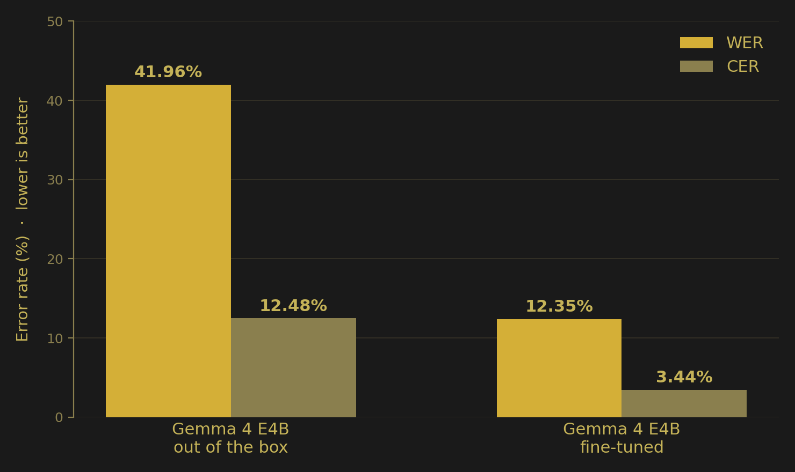
SAME HELD-OUT CLIPS · BOTH MODELS · IDENTICAL DECODING
41.96%
↓
12.35%
WORD ERROR RATE, LOWER IS BETTER
71%
72%
LESS WORD ERROR
LESS CHAR ERROR
At 42% you get captions you cannot trust. At 12% you get captions you can follow.
Notes:
SLIDE 11 | 3:15-3:40 | THE NUMBER. 'Same held-out clips, both models, identical decoding. Out of the box, Gemma 4 gets 41.96% word error. Fine-tuned, 12.35%. That is a 71% cut in word error and 72% in character error.' Pause. 'At 42% you get captions you cannot trust. At 12% you get captions you can follow. That gap is what this project is for.'

Slide 12
HOW THE NUMBER WAS MEASURED
One model, measured
against itself.
Same clips, both models, identical decoding. Held out of training, and not picked after we saw the results. No number off a training curve.
The accuracy columns are 100 minus the error rate. Readable indicators, not classification accuracy. We label them rather than let them be misread.
Notes:
SLIDE 12 | 3:40-3:50 | THE TRUST SLIDE. Say it fast and without apology: 'That is one model measured against itself. Same clips, both models, identical decoding, held out of training, and we did not pick the clips after seeing the results. And the accuracy figures are just a hundred minus the error rate -- readable indicators, not classification accuracy.' This buys back every number on the previous slide.

Slide 13
WHAT HAPPENS AFTER TODAY
→
NFDN has offered to facilitate the pilot
→
Hard-of-hearing user session: tomorrow
→
Then real-time streaming captions
→
Then on-device, in a district clinic, with no internet at all
Thank you.
LIVE
Notes:
SLIDE 13 | 3:50-4:00 | CLOSE. Do NOT say 'thank you for listening'. Close on momentum: 'The pilot pathway already exists. NFDN offered to facilitate it. We meet hard-of-hearing users tomorrow. Next is streaming captions, then on-device, so a Maithili speaker in a district clinic gets captions with no internet at all.' Then MOUTH silently, one last time: 'Thank you.' Let them read it off the screen. Stop talking.

