Slide 1
Cse3501-review(1II)
Name registration_nO
AASHISH RAJ - 18BIT0113
V.Pavan nikhil - 18BIT0196
R.V.R SRINIVAS - 18BIT0007

Slide 2
Gathering the information and structure of the data base using logically incorrect queries
INTRODUCTION:
SQL injection is a technique where the attacker injects an input in the query in order to change the structure of the query intended by the programmer and gaining the access of the database which results modification or deletion of the user’s data. In the injection it exploits a security vulnerability occurring in database layer of an application. SQL injection attack is the most common attack in websites in these days. Some malicious codes get injected to the database by unauthorized users and get the access of the database due to lack of input validation. Input validation is the most critical part of software security that is not properly covered in the design phase of software development life-cycle resulting in many security vulnerabilities. This paper presents the techniques for detection and prevention of SQL injection attack. There are no any known full proof defences available against such type of attacks. In this paper we have made a website based on charity works to donate funds as it contains the information of all the account details and there history of donations.

Slide 3
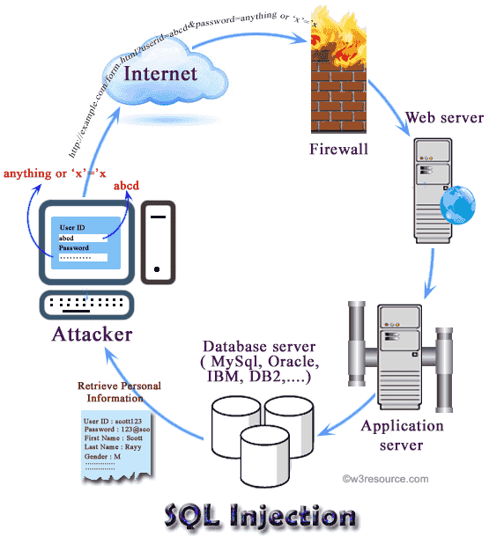
What is SQL injection?
SQL injection is a technique (like other web attack mechanisms) to attack data driven applications. This attack can bypass a firewall and can affect a fully patched system. The attacker takes the advantage of poorly filtered or not correctly escaped characters embedded in SQL statements into parsing variable data from user input. The attacker injects arbitrary data, most often a database query, into a string that’s eventually executed by the database through a web application (e.g. a login form).
Through SQL Injection attacker can obtain unauthorized access to a database and can create, read, update, alter, or delete data stored in the back-end database. a SQL injection attack gives access to sensitive information such as social security numbers, credit card number or other financial data.

Slide 4
Why SQL injection?
-Identify injectable parameters. - Identify the database type and version. - Discover database schema. - Extracting data. - Insert, modify or delete data. - Denial of service to authorized users by locking or deleting tables. - Bypassing authentication. - Privilege escalation. - Execute remote commands by calling stored functions within the DBMS which are reserved for administrators.

Slide 5
SQL injection method
Here are some methods through which SQL statements are injected into vulnerable systems - Injected through user input. - Injection through cookie fields contains attack strings. - Injection through Server Variables. - Second-Order Injection where hidden statements to be executed at another time by another function.

Slide 6
Vulnerabilities
In computer security, a vulnerability is a weakness which allows an attacker to reduce a system's information assurance. Web-based forms allow some access to the back-end database to allow entry of data and a response, this kind of attack bypasses firewalls and endpoint defenses. Any web form, even a simple logon form or search box (where a user can input data), might provide access to back-end database by means of SQL injection
The common reason that an application is vulnerable to SQL injection is improper filtering and lack of validation for user input. Input forms are quite common to collect data from a user. So, practically it is not feasible to close all the entry points to bar SQL injection. To prevent attacks developers must apply proper filtration/validation on all forms.

Slide 7
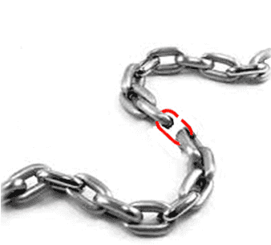
Vulnerable Applications
-Almost all SQL databases are potentially vulnerable such as MS SQL Server, DB2, Oracle, PostgreSQL, MySQL, MS Access, Sybase, Informix, etc – Accessed through applications using : ASP, JSP, PHP Perl and CGI scripts that access databases XML, XSL and XSQL JavaScript Database specific web applications Many other

Slide 8
Web Server Technology
Web servers are computers that deliver Web pages. Every Web server has an IP address and possibly a domain name this sends a request to the Web server The server then fetches and sends it to your browser. The Web server stores all of the files necessary to display Web pages on the computer.
While passing data to server side form a web page, often GET method is used to append user supplied data at the end of the URL (e.g. example.com?q=userid&p=password). For an attacker, this opens an opportunity to obtain the values passed in this fashion and do some malicious stuff.

Slide 9
Types of SQL injection
-- Tautology-based SQL Injection -- Piggy-backed Queries / Statement Injection -- Union Query -- Illegal/Logically Incorrect Queries -- Inference -- Stored Procedure Injection

Slide 10
Logically Incorrect Queries
Purpose :
Identify injectable parameters
Identify database
Extract data
In this type of injection an attacker is trying gather information about the type and structure of the back-end database of a Web application. The attack is considered as a preliminary step for further attacks. If an incorrect query is sent to a database, some application servers return the default error message and the attacker takes the advantage of this weakness. They inject code in vulnerable or injectable parameters which creates syntax, type conversion, or logical error. Through type error, one can identify the data types of certain columns. Logical error often exposes the names of tables and columns.

Slide 11
Tools and technologies to be used for the project
A WEBSITE FOR CHARITY DONATION
FRONT END: USING HTML, CSS, JAVASCRIPT, BOOTSTRAP, JQUERY,
BACKEND: PHP, MYSQL

Slide 12
PROPOSED METHOD:
We will use various logical incorrect queries to attack a website and get access to its information
The logical queries used will be based on logic gates such as OR, XOR, AND, NOT.
We will try to make the SQL statement used for login to get the result as true so that we can login into the website.
We will make the logical incorrect queries such that the SQL statements produce true value even if we don’t know the username and password

Slide 13
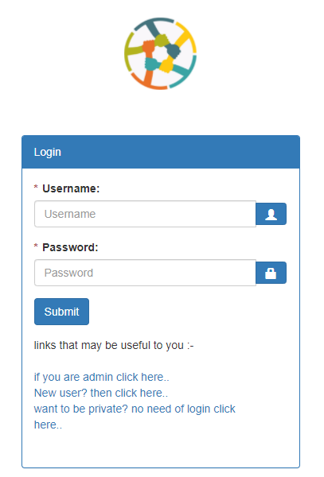
Structure of login pages and its input
Here we have two input values
USERNAME: It will have the value of name of the user
2. PASSWORD: It will have the password for the corresponding username.

Slide 14

DATABASE FOR LOGIN
figure 1: User table
QUERY TO GET LOGIN:
SELECT * FROM users WHERE u_name =“user1” AND u_pass =“user1"

Slide 15
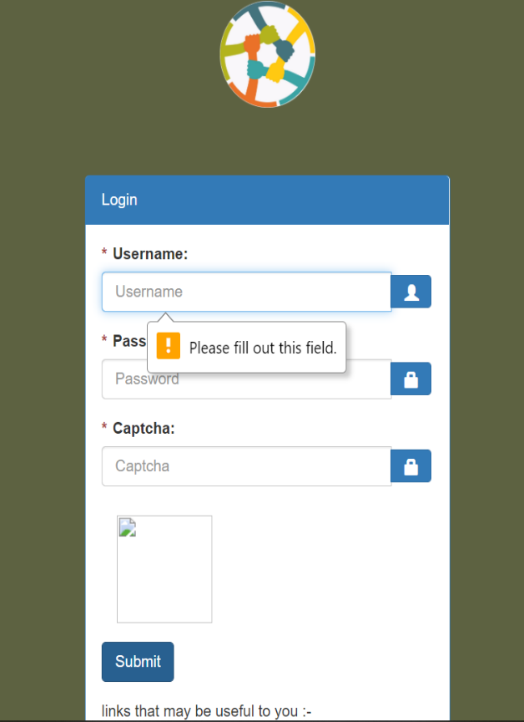
LOGIN PAGE WITH CAPTCHA

Slide 16
PROPOSED APPROACH AND QUERIES
Using OR operator
We will first close the string of the SQL string statement and then we will add an TRUE statement with OR which will eventually join the whole SQL statement and we’ll get the output of that query as TRUE or we can say that the query produces results.
The proposed value to be added in password column " or ""="
SQL RESULTING STATEMENT:
SELECT * FROM users WHERE u_name ="fasd” AND u_pass ="" or ""=""

Slide 17
ANALYSING QUERY for OR operator
SELECT * FROM users WHERE u_name ="fasd” AND u_pass ="" or ""=""
Here the query will produce true result only if we after WHERE we get the Boolean value as true
The precedence order in SQL is operated left to right, that means operation start evaluating from left

Slide 18
ANALYSING QUERY for OR operator
So lets break the QUERY:
SELECT * FROM users
WHERE
u_name ="fasd” -> This value will always return false as we considered that we don’t know the username of the person
AND
u_pass ="“ -> This value will also always return false as we just ended the string to be entered in password column
or
""="“ -> This will always return true as this input is provided by us

Slide 19
ANALYSING QUERY for OR operator
1st val | 2nd val | 3rd val | Result
1 | 1 | 1 | TRUE
1 | 1 | 0 | TRUE
1 | 0 | 1 | TRUE
1 | 0 | 0 | FALSE
0 | 1 | 1 | TRUE
0 | 1 | 0 | FALSE
0 | 0 | 1 | TRUE
0 | 0 | 0 | FALSE
So the combined Boolean result will be
u_name ="fasd” AND u_pass ="“ or ""="“
FALSE AND FALSE OR TRUE
So solving it:
FALSE AND FALSE= FALSE
Query reduces to:
FALSE OR TRUE
We know FALSE OR TRUE= TRUE 1st val AND 2nd val OR 3rd val
Therefore the value we got as a result is TRUE.

Slide 20
ANALYSING QUERY for OR operator
SELECT * FROM users WHERE u_name ="fasd” AND u_pass ="" or ""=""
As we discussed above for the query:
SELECT * FROM users WHERE u_name ="fasd” AND u_pass ="“
This will be constant for every Query and
u_name ="fasd” AND u_pass ="“
Will give always false as a result
The only thing which is dependent in our query is the value or ""="“

Slide 21
ANALYSING QUERY for OR operator
There can be another way to use the same OR query by using comment.
This statement in the username field:
" or ""="" –
And in password any thing can be written as its going to be comment it out.
The resulting SQLstatement we will get after this will be
SELECT * FROM users WHERE u_name ="" or ""="" -- AND u_pass ="FASDF"
The whole underlined part will be commented and the part executed will whole become true and return some value for the result.

Slide 22
ANALYSING QUERY for OR operator
So the combined Boolean result will be
u_name ="” or ""="“
FALSE OR TRUE
So solving it:
FALSE OR TRUE 1st val OR 2nd val
We know FALSE OR TRUE= TRUE
Therefore the value we got as a result is TRUE.
1st val | 2nd val | Result
1 | 1 | TRUE
1 | 0 | TRUE
0 | 1 | TRUE
0 | 0 | FALSE

Slide 23
PROPOSED APPROACH AND QUERIES
2. Using XOR operator
We will first close the string of the SQL string statement and then we will add an TRUE statement with XOR which will eventually join the whole SQL statement and we’ll get the output of that query as TRUE or we can say that the query produces results.
The proposed value to be added in password column " xor ""="
SQL RESULTING STATEMENT:
SELECT * FROM users WHERE u_name ="fasd” AND u_pass ="" xor ""=""

Slide 24
ANALYSING QUERY for XOR operator
SELECT * FROM users WHERE u_name ="fasd” AND u_pass ="" xor ""=""
Here the query will produce true result only if we after WHERE we get the Boolean value as true
The precedence order in SQL is operated left to right, that means operation start evaluating from left

Slide 25
ANALYSING QUERY for XOR operator
So lets break the QUERY:
SELECT * FROM users
WHERE
u_name ="fasd” -> This value will always return false as we considered that we don’t know the username of the person
AND
u_pass ="“ -> This value will also always return false as we just ended the string to be entered in password column
xor
""="“ -> This will always return true as this input is provided by us

Slide 26
ANALYSING QUERY for XOR operator
1st val | 2nd val | 3rd val | Result
1 | 1 | 1 | FALSE
1 | 1 | 0 | TRUE
1 | 0 | 1 | TRUE
1 | 0 | 0 | FALSE
0 | 1 | 1 | TRUE
0 | 1 | 0 | FALSE
0 | 0 | 1 | TRUE
0 | 0 | 0 | FALSE
So the combined Boolean result will be
u_name ="fasd” AND u_pass ="“ xor ""="“
FALSE AND FALSE XOR TRUE
So solving it:
FALSE AND FALSE= FALSE
Query reduces to:
FALSE XOR TRUE
We know FALSE OR TRUE= TRUE 1st val AND 2nd val XOR 3rd val
Therefore the value we got as a result is TRUE.

Slide 27
ANALYSING QUERY for XOR operator
SELECT * FROM users WHERE u_name ="fasd” AND u_pass ="" xor ""=""
As we discussed above for the query:
SELECT * FROM users WHERE u_name ="fasd” AND u_pass ="“
This will be constant for every Query and
u_name ="fasd” AND u_pass ="“
Will give always false as a result
The only thing which is dependent in our query is the value xor ""="“

Slide 28
ANALYSING QUERY for XOR operator
There can be another way to use the same XOR query by using comment.
This statement in the username field:
" xor ""="" –
And in password any thing can be written as its going to be comment it out.
The resulting SQLstatement we will get after this will be
SELECT * FROM users WHERE u_name ="" xor ""="" -- AND u_pass ="FASDF"
The whole underlined part will be commented and the part executed will whole become true and return some value for the result.

Slide 29
ANALYSING QUERY for XOR operator
So the combined Boolean result will be
u_name ="” xor ""="“
FALSE OR TRUE
So solving it:
FALSE XOR TRUE 1st val XOR 2nd val
We know FALSE XOR TRUE= TRUE
Therefore the value we got as a result is TRUE.
1st val | 2nd val | Result
1 | 1 | FALSE
1 | 0 | TRUE
0 | 1 | TRUE
0 | 0 | FALSE

Slide 30
PROPOSED APPROACH AND QUERIES
3. Using NOT operator with OR operator
Taking NOT operator into consideration, we will make a wrong logical value i.e. which will generate false as a result, so the result after NOT of false will be true and we will combine this result with OR gate, getting the whole SQL statement result as true.
The proposed value to be added in password column " or not "a"="
SQL RESULTING STATEMENT:
SELECT * FROM users WHERE u_name ="fasd” AND u_pass ="" or not “a"=""

Slide 31
ANALYSING QUERY for OR with NOT operator
So lets break the QUERY:
SELECT * FROM users
WHERE
u_name ="fasd” -> This value will always return false as we considered that we don’t know the username of the person
AND
u_pass ="“ -> This value will also always return false as we just ended the string to be entered in password column
or not
“a"="“ -> This will always return false as this input is provided by us

Slide 32
ANALYSING QUERY for OR with NOT operator
1st val | 2nd val | 3rd val | Result
1 | 1 | 0 | TRUE
1 | 1 | 1 | TRUE
1 | 0 | 0 | TRUE
1 | 0 | 1 | FALSE
0 | 1 | 0 | TRUE
0 | 1 | 1 | FALSE
0 | 0 | 0 | TRUE
0 | 0 | 1 | FALSE
So the combined Boolean result will be
u_name ="fasd” AND u_pass ="“ or not “a"="“
FALSE AND FALSE OR NOT FALSE
So solving it:
FALSE AND FALSE= FALSE
Query reduces to:
FALSE OR NOT FALSE
Also precedence of NOT is higher than OR,so
NOT FALSE = TRUE
We know FALSE OR TRUE= TRUE 1st val AND 2nd val OR NOT 3rd val
Therefore the value we got as a result is TRUE.

Slide 33
ANALYSING QUERY for OR with NOToperator
There can be another way to use the same OR query by using comment.
This statement in the username field:
" or not “a"="" –
And in password any thing can be written as its going to be comment it out.
The resulting SQLstatement we will get after this will be
SELECT * FROM users WHERE u_name ="" or not “a"="" -- AND u_pass ="FASDF"
The whole underlined part will be commented and the part executed will whole become true and return some value for the result.

Slide 34
ANALYSING QUERY for OR with NOT operator
So the combined Boolean result will be
u_name ="” or not “a"="“
FALSE OR TRUE
So solving it:
FALSE OR NOT FALSE 1st val OR NOT 2nd val
Also precedence of NOT is higher than OR,so
NOT FALSE = TRUE
We know FALSE OR TRUE= TRUE
Therefore the value we got as a result is TRUE.
1st val | 2nd val | Result
1 | 0 | TRUE
1 | 1 | TRUE
0 | 0 | TRUE
0 | 1 | FALSE

Slide 35
PROPOSED APPROACH AND QUERIES
4. Using NOT operator with XOR operator
Taking NOT operator into consideration, we will make a wrong logical value i.e. which will generate false as a result, so the result after NOT of false will be true and we will combine this result with XOR gate, getting the whole SQL statement result as true.
The proposed value to be added in password column " xor not "a"="
SQL RESULTING STATEMENT:
SELECT * FROM users WHERE u_name ="fasd” AND u_pass ="" xor not “a"=""

Slide 36
ANALYSING QUERY for XOR with NOT operator
So lets break the QUERY:
SELECT * FROM users
WHERE
u_name ="fasd” -> This value will always return false as we considered that we don’t know the username of the person
AND
u_pass ="“ -> This value will also always return false as we just ended the string to be entered in password column
xor not
“a"="“ -> This will always return false as this input is provided by us

Slide 37
ANALYSING QUERY for XOR with NOT operator
1st val | 2nd val | 3rd val | Result
1 | 1 | 0 | FALSE
1 | 1 | 1 | TRUE
1 | 0 | 0 | TRUE
1 | 0 | 1 | FALSE
0 | 1 | 0 | TRUE
0 | 1 | 1 | FALSE
0 | 0 | 0 | TRUE
0 | 0 | 1 | FALSE
So the combined Boolean result will be
u_name ="fasd” AND u_pass ="“ xor not “a"="“
FALSE AND FALSE XOR NOT FALSE
So solving it:
FALSE AND FALSE= FALSE
Query reduces to:
FALSE XOR NOT FALSE
Also precedence of NOT is higher than XOR,so
NOT FALSE = TRUE
We know FALSE XOR TRUE= TRUE 1st val AND 2nd val XOR NOT 3rd val
Therefore the value we got as a result is TRUE.

Slide 38
ANALYSING QUERY for XOR with NOT operator
There can be another way to use the same XOR query by using comment.
This statement in the username field:
" xor not “a"="" –
And in password any thing can be written as its going to be comment it out.
The resulting SQLstatement we will get after this will be
SELECT * FROM users WHERE u_name ="" xor not “a"="" -- AND u_pass ="FASDF"
The whole underlined part will be commented and the part executed will whole become true and return some value for the result.

Slide 39
ANALYSING QUERY for XOR with NOT operator
So the combined Boolean result will be
u_name ="” xor not “a"="“
FALSE OR TRUE
So solving it:
FALSE OR NOT FALSE 1st val XOR NOT 2nd val
Also precedence of NOT is higher than XOR,so
NOT FALSE = TRUE
We know FALSE OR TRUE= TRUE
Therefore the value we got as a result is TRUE.
1st val | 2nd val | Result
1 | 0 | FALSE
1 | 1 | TRUE
0 | 0 | TRUE
0 | 1 | FALSE

Slide 40
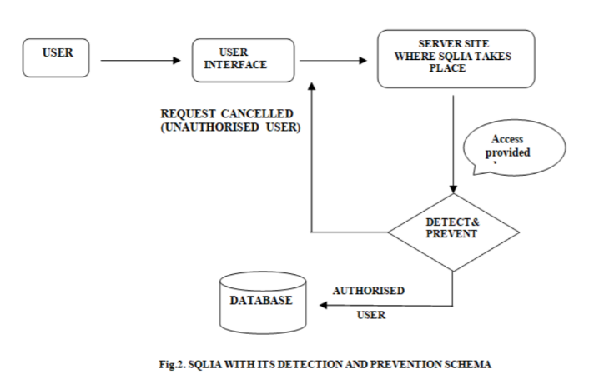
PREVENTION AND DETECTION
During detection and prevention of SQLIA,when the user requested the needed data after passing through the user interface the request is send to the server site .If there is no attack takes place the only authorised user can fetch the needed data .Now a days due to SQLIA the unauthorised user can also fetch the data and other important and confidential details by just adding some query string or by editing the existing query.
We can overcome this unauthorised attempt by testing the string through the SQLIA detection and prevention methods as shown
With user input channels being the main vector for SQL injection attacks, most of the defensive methods involve controlling and vetting user input for attack patterns

Slide 41
PREVENTION AND DETECTION
Here are several measures that can ensure user input safety.
Never trust user input
The first rule of thumb about user input is “don’t trust and verify,” which effectively means all forms of the user input should be considered malicious unless proved otherwise. This accounts not only for simple input boxes such as text areas and text boxes but for everything else as well — such as hidden inputs, query string parameters, cookies, and file uploads
Use command parameters
A better alternative to escaping would be to use command parameters. Command parameters are defined by adding placeholder names in SQL commands, which will later be replaced by user input

Slide 42
PREVENTION AND DETECTION
Validate input string on the server side
This is one of the most important steps to preventing SQL injection. Any data that a user can provide, whether via a web form, file, API, or other application needs to be cleansed and validated. This process will check user input for invalid characters, unacceptable length, or any other abnormalities prior to processing or storing it on any production systems.
The simplest step is for the application UI to detect invalid characters and provide instant feedback. Our example form from earlier provided a solid example of this behavior:
it provided a clear error message as to why my input was unacceptable. Username and password fields are often the dubious targets for this treatment, but realistically, ALL freeform input should be scrutinized for validity. include built-in features that will automatically evaluate user input for malicious content on page postbacks. But they can be circumvented by hackers with enough nerves and subtlety, so you should nonetheless run user input through your security check procedures. You can never be too cautious.

Slide 43
PREVENTION AND DETECTION
4. Explicitly cast your input
This tip is for languages such as PHP, which are weakly typed, which means you do not usually define data types for variables, and the language automatically takes care of converting different data types between each other.
Explicit casts can act as a shortcut to escaping input where non-string types are involved. So, if you’re expecting the user to input an int for the age parameter, you can ensure the safety of the input with the following code in PHP

Slide 44
PROTECTING WEBSITE FROM THESE ATTACKS
Checking the username and password in another page, so that the SQL error is not showed in the login page.
Using another approach for the SQL query, instead of checking the both username and password in the same query, we can split it in two queries:
First checking any row exists with this username
If yes then check that the password is same as the retrieved one or not
This will help to prevent the logic to be true in the password checking time.
Converting the string of input values into mysqli_real_escape_string() function as it, escapes special characters in a string for use in an SQL query, taking into account the current character set of the connection.
This function is used to create a legal SQL string that can be used in an SQL statement

Slide 45
INDIVIDUAL CONTRIBUTION
AASHISH RAJ
Made logical incorrect Queries For XOR, OR NOT, XOR NOT operators.
Analysed every logical queries and showed how it is actually using vulnerability of SQL.
Made the website vulnerable to show SQL attack by logically incorrect queries and then provided method to remove the vulnerability from the website.
Made the whole ppt and 80% of the document.
V. Pavan Nikhil
Made logical incorrect Queries For OR operator
Added points for SQL injection
Made the charity website
R.V.R SRINIVAS
Made website backend

Slide 46
THANK YOU

