Slide 1
Database Engineering
Notes:
A database-management system (DBMS) is a collection of interrelated data and a set of programs to access those data. The collection of data, usually referred to as the database, contains information relevant to an enterprise. The primary goal of a DBMS is to provide a way to store and retrieve database information that is both convenient and efficient.
Database systems are designed to manage large bodies of information. Management of data involves both defining structures for storage of information and providing mechanisms for the manipulation of information. In addition, the database system must ensure the safety of the information stored, despite system crashes or attempts at unauthorized access. If data are to be shared among several users, the system must avoid possible anomalous results.
Because information is so important in most organizations, computer scientists have developed a large body of concepts and techniques for managing data. These concepts and technique form the focus of this subject.
The first chapter briefly introduces the principles of database systems.

Slide 2
Drawbacks of File-processing system
Data redundancy and inconsistency
Multiple file formats, duplication of information in different files
Difficulty in accessing data
Need to write a new program to carry out each new task
Data isolation — multiple files and formats
Integrity problems
Integrity constraints (e.g. account balance > 0) become part of program code
Hard to add new constraints or change existing ones
2
Notes:
• Data redundancy and inconsistency. Since different programmers create the files and application programs over a long period, the various files are likely to have different formats and the programs may be written in several programming languages. Moreover, the same information may be duplicated in several places (files). For example, the address and telephone number of a particular customer may appear in a file that consists of savings-account records and in a file that consists of checking-account records. This redundancy leads to higher storage and access cost. In addition, it may lead to data inconsistency; that is, the various copies of the same data may no longer agree. For example, a changed customer address may be reflected in savings-account records but not elsewhere in the system.
• Difficulty in accessing data. Suppose that one of the bank officers needs to find out the names of all customers who live within a particular postal-code area. The officer asks the data-processing department to generate such a list. Because the designers of the original system did not anticipate this request, there is no application program on hand to meet it. There is, however, an application program to generate the list of all customers. The bank officer has now two choices: either obtain the list of all customers and extract the needed information manually or ask a system programmer to write the necessary application program. Both alternatives are obviously unsatisfactory. Suppose that such a program is written, and that, several days later, the same officer needs to trim that list to include only those customers who have an account balance of $10,000 or more. As expected, a program to generate such a list does not exist. Again, the officer has the preceding two options, neither of which is satisfactory. The point here is that conventional file-processing environments do not allow needed data to be retrieved in a convenient and efficient manner. More responsive data-retrieval systems are required for general use.
• Data isolation. Because data are scattered in various files, and files may be in different formats, writing new application programs to retrieve the appropriate data is difficult.
• Integrity problems. The data values stored in the database must satisfy certain types of consistency constraints. For example, the balance of a bank account may never fall below a prescribed amount (say, $25). Developers enforce these constraints in the system by adding appropriate code in the various application programs. However, when new constraints are added, it is difficult to change the programs to enforce them. The problem is compounded when constraints involve several data items from different files.

Slide 3
Data Abstraction
Physical Level - This is the lowest level of data abstraction. It describes how data is actually stored in database. You can get the complex data structure details at this level
Logical Level - This is the middle level of 3-level data abstraction architecture. It describes what data is stored in database
View Level - Highest level of data abstraction. This level describes the user interaction with database system.
3
Notes:
For the system to be usable, it must retrieve data efficiently. The need for efficiency has led designers to use complex data structures to represent data in the database. Since many database-systems users are not computer trained, developers hide the complexity from users through several levels of abstraction, to simplify users’ interactions with the system:

Slide 4
At physical level these records can be described as blocks of storage (bytes, gigabytes, terabytes etc.) in memory. These details are often hidden from the programmers. At the logical level these records can be described as fields and attributes along with their data types, their relationship among each other can be logically implemented. The programmers generally work at this level because they are aware of such things about database systems.
At view level, user just interact with system with the help of GUI and enter the details at the screen, they are not aware of how the data is stored and what data is stored; such details are hidden from them.

Slide 5
Introduction and Database Modeling using ER Model
[Module – 1]
WCE - TY (CSE) – CS 307: Database Engineering
Subject Teacher: Dr. Smriti Bhandari

Slide 6
Database Modeling using Entity -Relationship Model
Entity Sets
Relationship Sets
Mapping Constraints
Keys
E-R Diagram
Design Issues
Extended E-R Features
Specialization
Generalization
Aggregation
Design of an E-R Database Schema
Reduction of an E-R Schema to Tables
6

Slide 7
Entity Sets
A database is modeled as:
a collection of entities,
relationship among entities
An entity is an object that exists and is distinguishable from other objects
Example: specific person, company, event, plant
Entities have attributes
Example: people have names and addresses
An entity set is a set of entities of the same type that share the same properties.
Example: set of all persons, companies
7
Notes:
Each entity has a value for each of its attributes. For instance, a particular customer entity may have the value 321-12-3123 for customer-id.
For each attribute, there is a set of permitted values, called the domain, or value set, of that attribute. The domain of attribute customer-name might be the set of all text strings of a certain length. Similarly, the domain of attribute loan-number might be the set of all strings of the form “L-n” where n is a positive integer.

Slide 8
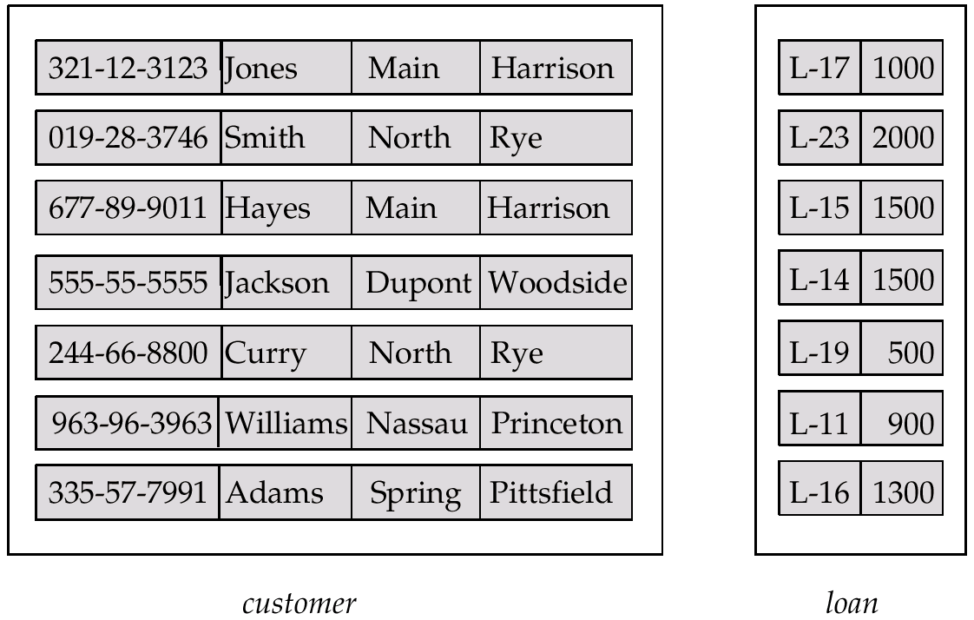
Entity Sets customer and loan
customer-id customer- customer- customer- loan- amount name street city number
8
Notes:
A database thus includes a collection of entity sets, each of which contains any number of entities of the same type.
Each entity can be described by a set of (attribute, data value) pairs, one pair for each attribute of the entity set. For example, a particular customer entity may be described by the set {(customer-id, 677-89-9011), (customer-name, Hayes), (customer-street, Main), (customer-city, Harrison)}

Slide 9
Attributes
An entity is represented by a set of attributes, that is descriptive properties possessed by all members of an entity set
Domain – the set of permitted values for each attribute
Example:
customer = (customer-id, customer-name, customer-street, customer-city) loan = (loan-number, amount)
9
Notes:
• Simple and composite attributes. In our examples thus far, the attributes have been simple; that is, they are not divided into subparts. Composite attributes, on the other hand, can be divided into subparts (that is, other attributes). For example, an attribute name could be structured as a composite attribute consisting of first-name, middle-initial, and last-name.
• Single-valued and multivalued attributes. The attributes in our examples all have a single value for a particular entity. For instance, the loan-number attribute for a specific loan entity refers to only one loan number. Such attributes are said to be single valued. There may be instances where an attribute has a set of values for a specific entity. Consider an employee entity set with the attribute phone-number. An employee may have zero, one, or several phone numbers, and different employees may have different numbers of phones. This type of attribute is said to be multivalued.
• Derived attribute. The value for this type of attribute can be derived from the values of other related attributes or entities. For instance, let us say that the customer entity set has an attribute loans-held, which represents how many loans a customer has from the bank. We can derive the value for this attribute by counting the number of loan entities associated with that customer. As another example, suppose that the customer entity set has an attribute age, which indicates the customer’s age. If the customer entity set also has an attribute date-of-birth, we can calculate age from date-of-birth and the current date. Thus, age is a derived attribute. In this case, date-of-birth may be referred to as a base attribute, or a stored attribute. The value of a derived attribute is not stored, but is computed when required.
An attribute takes a null value when an entity does not have a value for it.

Slide 10
Attribute Types
Simple and composite attributes
Single-valued and multi-valued attributes
E.g. multivalued attribute: phone-numbers
Derived attributes
Can be computed from other attributes
E.g. age, given date of birth
10

Slide 11
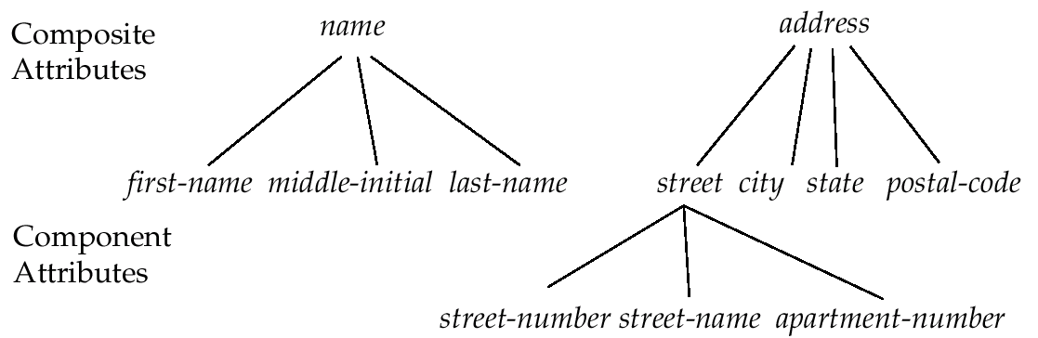
Composite Attributes
11

Slide 12
Relationship
A relationship is an association among several entities
Example:
Hayes depositor A-102 customer entity relationship set account entity
12

Slide 13
Relationship Sets
A relationship set is a set of relationships of the same type. Formally, it is a mathematical relation on n ≥ 2 entities, each taken from entity sets
If E₁, E₂,…,E_{n} are entity sets, then a relationship set R is a subset of
{(e₁, e₂, … e_{n}) | e₁ ∈ E₁, e₂ ∈ E₂, …, e_{n} ∈ E_{n}} where (e₁, e₂, …, e_{n}) is a relationship
The association between entity sets is referred to as participation; that is, the entity sets E₁, E₂, . . .,E_{n} participate in relationship set R.
13

Slide 14
Mapping Cardinalities
Express the number of entities to which another entity can be associated via a relationship set.
Most useful in describing binary relationship sets.
For a binary relationship set the mapping cardinality must be one of the following types:
One to one
One to many
Many to one
Many to many
14

Slide 15
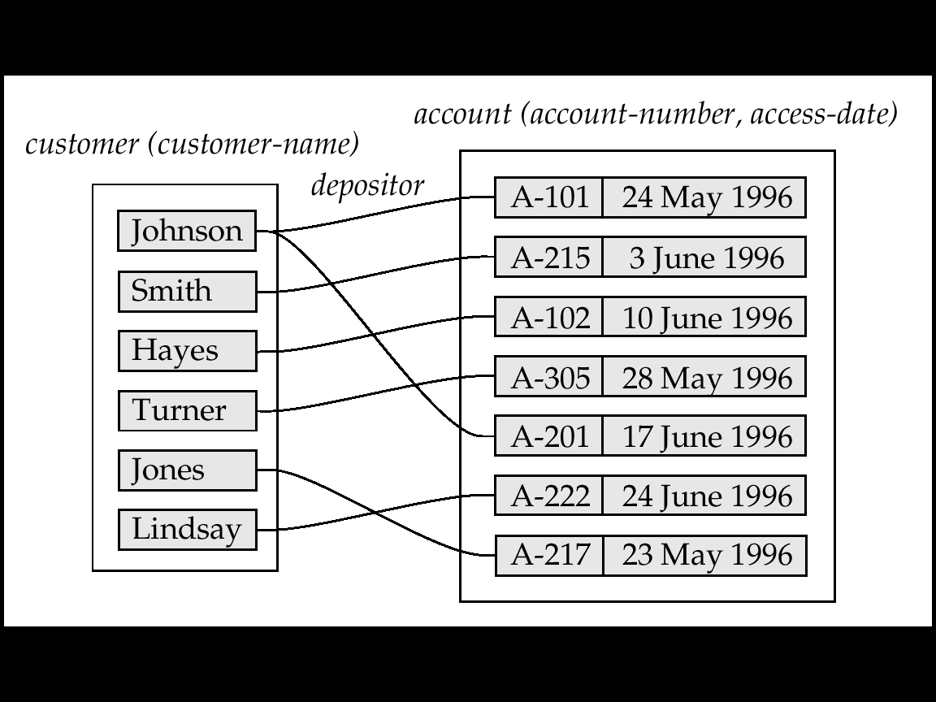
Mapping Cardinalities affect ER Design
Can make access-date an attribute of account, instead of a relationship attribute, if each account can have only one customer
i.e., the relationship from account to customer is many to one, or equivalently, customer to account is one to many
15

Slide 16
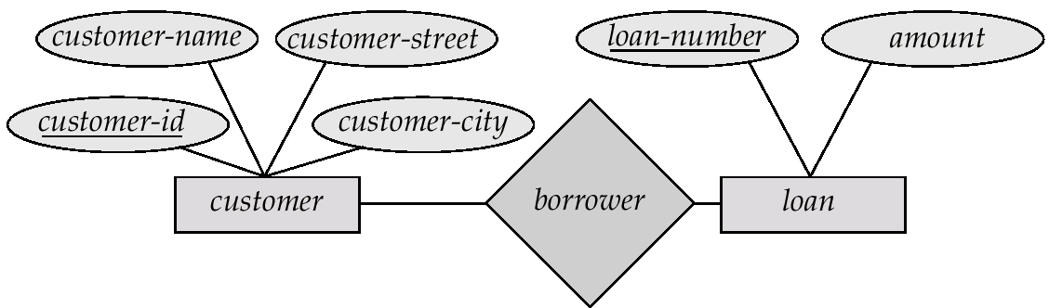
E-R Diagrams
Rectangles represent entity sets.
Diamonds represent relationship sets.
Lines link attributes to entity sets and entity sets to relationship sets.
Ellipses represent attributes
Double ellipses represent multivalued attributes.
Dashed ellipses denote derived attributes.
Underline indicates primary key attributes
16

Slide 17
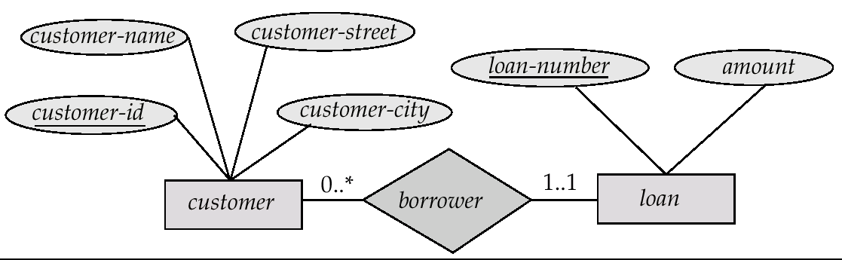
Alternative Notation for Cardinality Limits
Cardinality limits can also express participation constraints
Customer can have zero or more loans
Each loan must have exactly one associated customer
Minimum value of 1 => total participation of entity set in the relationship set
Maximum value of 1 => entity participates in at most one relationship
Maximum value * => no limit
1..* => double line
17

Slide 18
Keys
Key is used to identify a set of attributes that suffice to distinguish entities from each other. Keys uniquely identify the entity
A super key of an entity set is a set of one or more attributes whose values uniquely determine each entity
customer_id is super key of customer
Customer_id and customer_name is superkey of customer
A candidate key of an entity set is a minimal super key
customer-id is candidate key of customer
account-number is candidate key of account
Although several candidate keys may exist, one of the candidate keys is selected to be the primary key. The primary key should be chosen such that its attributes are never, or very rarely changed
18

Slide 19
Extended E-R Features
Specialization
Generalization
Aggregation

Slide 20
Specialization
Top-down design process; we designate subgroupings within an entity set that are distinctive from other entities in the set.
These subgroupings become lower-level entity sets that have attributes or participate in relationships that do not apply to the higher-level entity set.
Depicted by a triangle component labeled ISA (E.g. customer “is a” person).
Attribute inheritance – a lower-level entity set inherits all the attributes and relationship participation of the higher-level entity set to which it is linked.
20

Slide 21
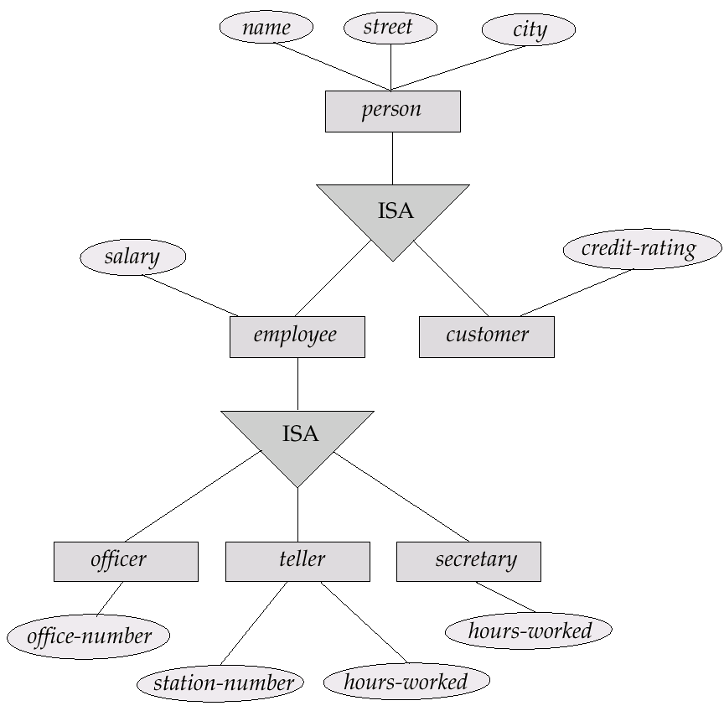
Specialization Example
21

Slide 22
Generalization
A bottom-up design process – combine a number of entity sets that share the same features into a higher-level entity set.
Specialization and generalization are simple inversions of each other; they are represented in an E-R diagram in the same way.
The terms specialization and generalization are used interchangeably.
22

Slide 23
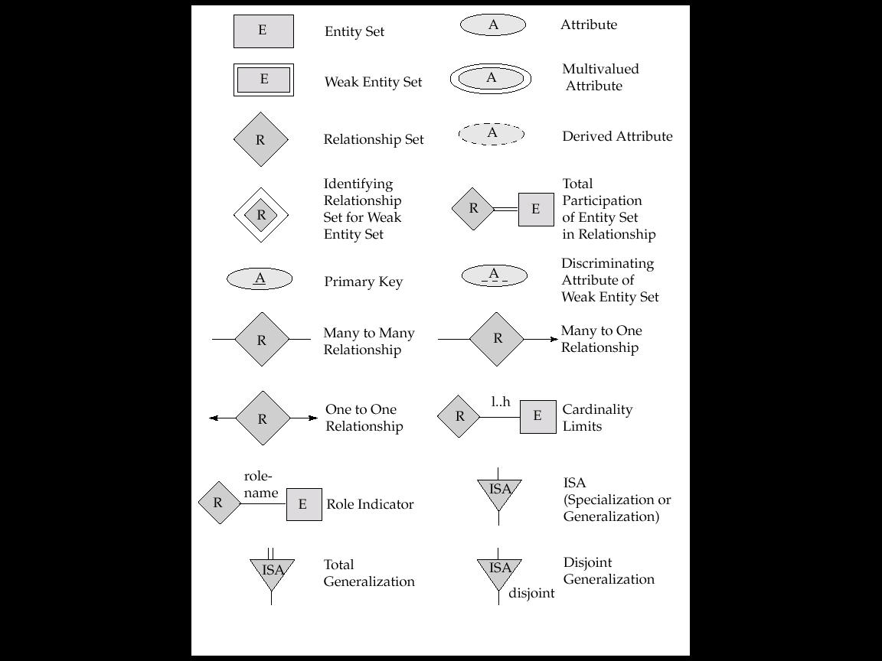
Summary of Symbols Used in E-R Notation
23

Slide 24
Summary of Symbols (Cont.)
24

Slide 25
Database design for Banking Enterprise
Data Requirements
The bank is organized into branches. Each branch is located in a particular city and is identified by a unique name. The bank monitors the assets of each branch.
Bank customers are identified by their customer-id values. The bank stores each customer’s name, and the street and city where the customer lives. Customers may have accounts and can take out loans. A customer may be associated with a particular banker, who may act as a loan officer or personal banker for that customer.
Bank employees are identified by their employee-id values. The bank administration stores the name and telephone number of each employee, the names of the employee’s dependents, and the employee-id number of the employee’s manager. The bank also keeps track of the employee’s start date and, thus, length of employment.
25

Slide 26
Database design for Banking Enterprise
Data Requirements (contd.)
The bank offers two types of accounts—savings and checking accounts. Accounts can be held by more than one customer, and a customer can have more than one account. Each account is assigned a unique account number. The bank maintains a record of each account’s balance, and the most recent date on which the account was accessed by each customer holding the account. In addition, each savings account has an interest rate, and overdrafts are recorded for each checking account.
A loan originates at a particular branch and can be held by one or more customers. A loan is identified by a unique loan number. For each loan, the bank keeps track of the loan amount and the loan payments. Although a loan-payment number does not uniquely identify a particular payment among those for all the bank’s loans, a payment number does identify a particular payment for a specific loan. The date and amount are recorded for each payment.
26

Slide 27
Database design for Banking Enterprise
Entity sets designation
The branch entity set, with attributes branch-name, branch-city, and assets.
The customer entity set, with attributes customer-id, customer-name, customer-street; and customer-city. A possible additional attribute is banker-name.
The employee entity set, with attributes employee-id, employee-name, telephone-number, salary, and manager. Additional descriptive features are the multivalued attribute dependent-name, the base attribute start-date, and the derived attribute employment-length.
Two account entity sets—savings-account and checking-account—with the common attributes of account-number and balance; in addition, savings-account has the attribute interest-rate and checking-account has the attribute overdraft-amount.
The loan entity set, with the attributes loan-number, amount, and originating-branch.
The weak entity set loan-payment, with attributes payment-number, payment-date, and payment-amount.
27

Slide 28
Database design for Banking Enterprise
Relationship sets designation
borrower, a many-to-many relationship set between customer and loan.
loan-branch, a many-to-one relationship set that indicates in which branch a loan originated. Note that this relationship set replaces the attribute originating-branch of the entity set loan.
loan-payment, a one-to-many relationship from loan to payment, which documents that a payment is made on a loan.
depositor, with relationship attribute access-date, a many-to-many relationship set between customer and account, indicating that a customer owns an account.
cust-banker, with relationship attribute type, a many-to-one relationship set expressing that a customer can be advised by a bank employee, and that a bank employee can advise one or more customers. Note that this relationship set has replaced the attribute banker-name of the entity set customer.
works-for, a relationship set between employee entities with role indicators manager and worker; the mapping cardinalities express that an employee works for only one manager and that a manager supervises one or more employees. Note that this relationship set has replaced the manager attribute of employee.
28

Slide 29
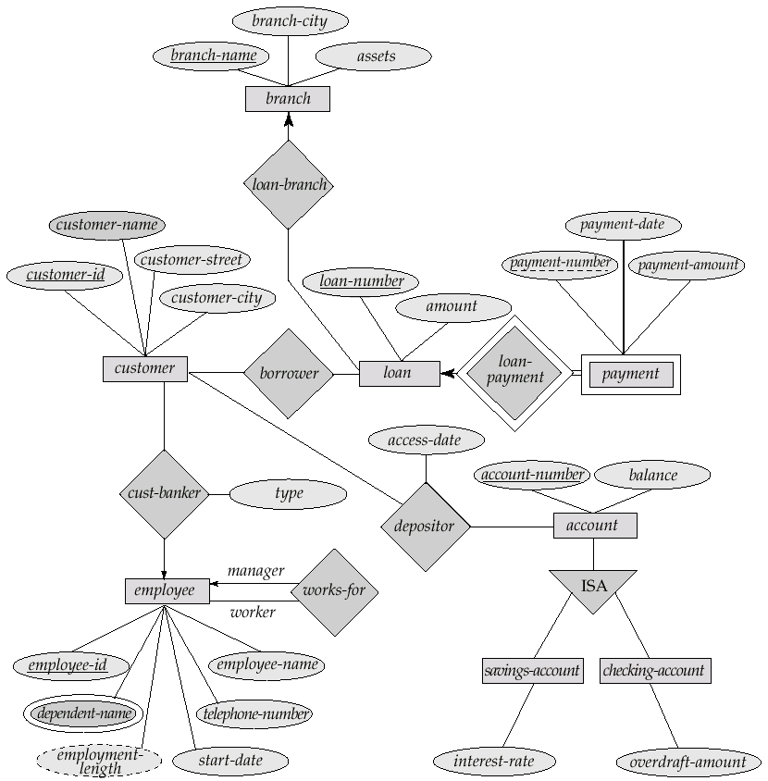
E-R Diagram for a Banking Enterprise
29

Slide 30
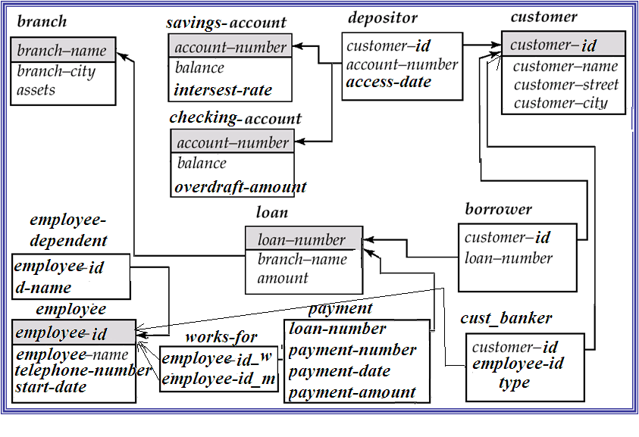
Schema Diagram for the Banking Enterprise

Slide 31
Data Modeling and SQL
[Module – 2]
WCE - TY (CSE) – CS 307: Database Engineering
Subject Teacher: Dr. Smriti Bhandari

Slide 32
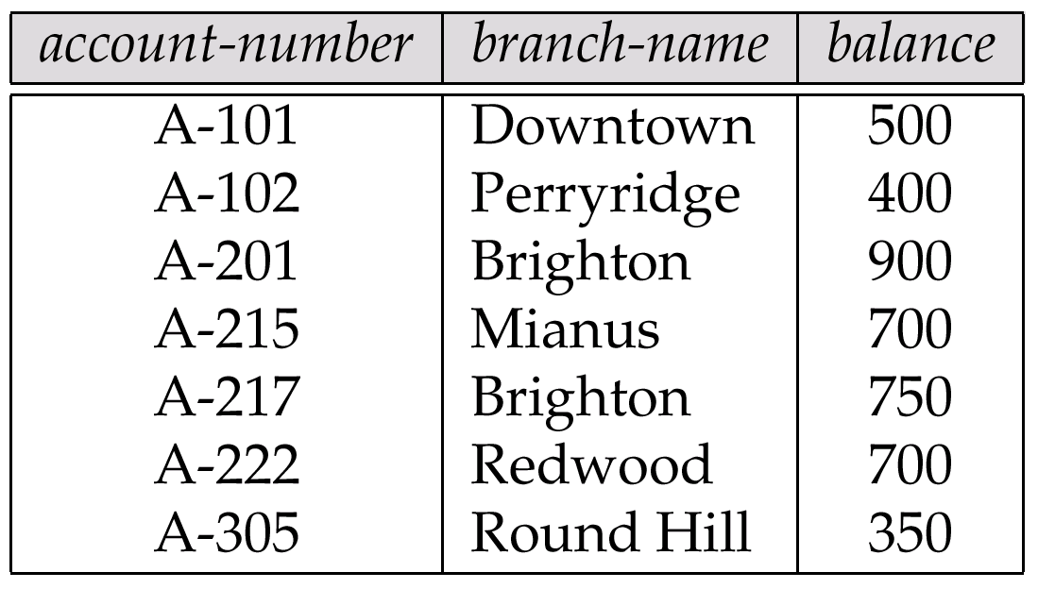
Example of a Relation
Attributes
Domain – set of permitted values for each attribute

Slide 33
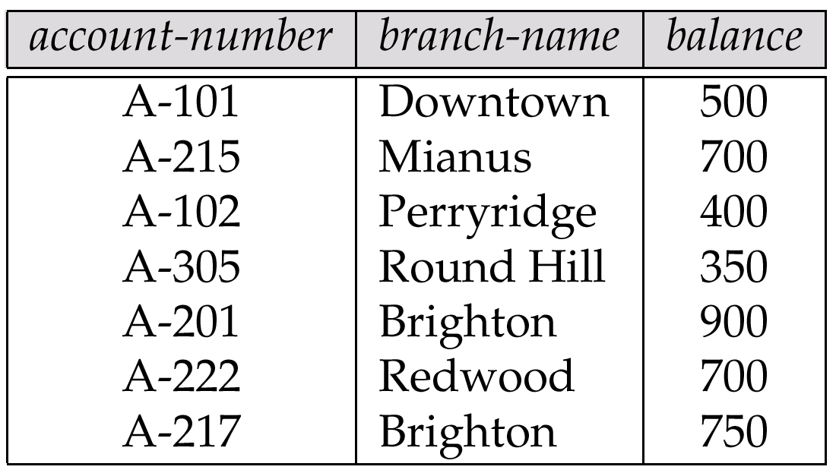
Relations are Unordered
Order of tuples is irrelevant (tuples may be stored in an arbitrary order)
E.g. account relation with unordered tuples

Slide 34
Structured Query Language (SQL)

Slide 35
SQL
Basic Structure
Set Operations
Aggregate Functions
Null Values
Nested Subqueries
Derived Relations
Views
Modification of the Database
Joined Relations
Data Definition Language
Embedded SQL, ODBC and JDBC
Notes:
1

Slide 36
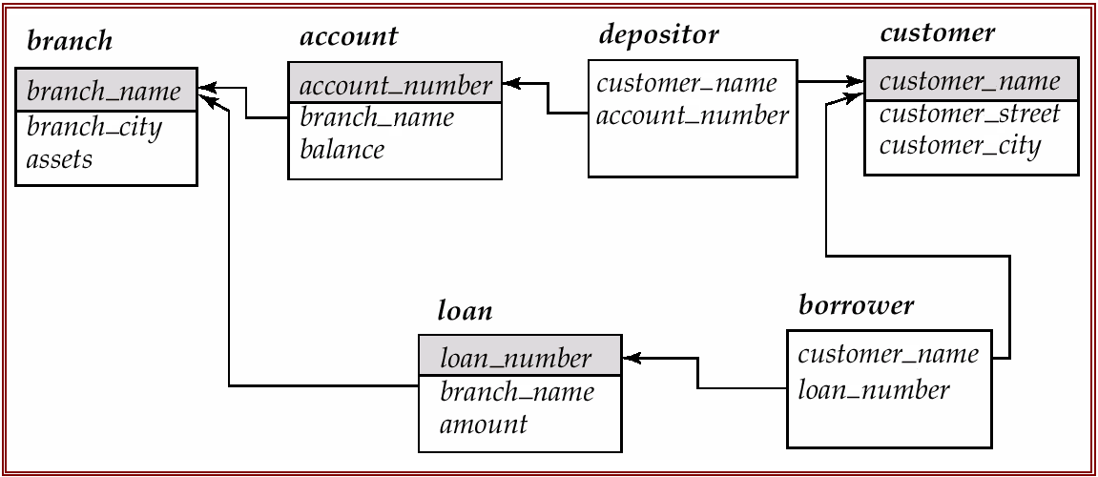
Schema Used in Examples

Slide 37
Basic Structure
SQL is based on set and relational operations with certain modifications and enhancements
A typical SQL query has the form: select A₁, A₂, ..., A_{n} from r₁, r₂, ..., r_{m} where P
A_{i}s represent attributes
r_{i}s represent relations
P is a predicate.
This query is equivalent to the relational algebra expression.
∏_{A1, A2, ..., An}(σ_{P} (r₁ x r₂ x ... x r_{m}))
The result of an SQL query is a relation.
Notes:
2

Slide 38
The select Clause
The select clause list the attributes desired in the result of a query
corresponds to the projection operation of the relational algebra
E.g. find the names of all branches in the loan relation select branch_name from loan
In the “pure” relational algebra syntax, the query would be:
∏_{branch-name}(loan)
NOTE: SQL does not permit the ‘-’ character in names,
Use, e.g., branch_name instead of branch-name in a real implementation.
NOTE: SQL names are case insensitive, i.e. you can use capital or small letters.
Notes:
3

Slide 39
The select Clause (Cont.)
SQL allows duplicates in relations as well as in query results.
To force the elimination of duplicates, insert the keyword distinct after select.
Find the names of all branches in the loan relations, and remove duplicates
select distinct branch_name from loan
The keyword all specifies that duplicates not be removed.
select all branch_name from loan
Notes:
4

Slide 40
The select Clause (Cont.)
An asterisk in the select clause denotes “all attributes”
select * from loan
The select clause can contain arithmetic expressions involving the operation, +, –, ∗, and /, and operating on constants or attributes of tuples.
The query:
select loan_number, branch_name, amount ∗ 100 from loan
would return a relation which is the same as the loan relations, except that the attribute amount is multiplied by 100.
Notes:
5

Slide 41
The where Clause
The where clause specifies conditions that the result must satisfy
corresponds to the selection predicate of the relational algebra.
To find all loan number for loans made at the Perryridge branch with loan amounts greater than $1200. select loan_number from loan where branch_name = ‘Perryridge’ and amount > 1200
Comparison results can be combined using the logical connectives and, or, and not.
Comparisons can be applied to results of arithmetic expressions.
Notes:
6

Slide 42
The where Clause (Cont.)
SQL includes a between comparison operator
E.g. Find the loan number of those loans with loan amounts between $900 and $1200 (that is, ≥$900 and ≤$1200)
select loan_number from loan where amount between 900 and 1200
Notes:
7

Slide 43
The from Clause
The from clause lists the relations involved in the query
corresponds to the Cartesian product operation of the relational algebra.
Find the Cartesian product borrower x loan select ∗ from borrower, loan
Find the name, loan number and loan amount of all customers having a loan at the Perryridge branch.
select customer_name, borrower.loan_number, amount from borrower, loan where borrower.loan_number = loan.loan_number and branch_name = ‘Perryridge’
Notes:
8

Slide 44
The Rename Operation
The SQL allows renaming relations and attributes using the as clause: old-name as new-name
Find the name, loan number and loan amount of all customers; rename the column name loan_number as loan-id.
select customer_name, borrower.loan_number as loan_id, amount from borrower, loan where borrower.loan_number = loan.loan_number
Notes:
9

Slide 45
Tuple Variables
Tuple variables are defined in the from clause via the use of the as clause.
Find the customer names and their loan numbers for all customers having a loan at some branch.
select customer_name, T.loan_number, S.amount from borrower as T, loan as S where T.loan_number = S.loan_number
select customer_name, T.loan_number, S.amount from borrower T, loan S where T.loan_number = S.loan_number
In Oracle
Notes:
10

Slide 46
Tuple Variables
Find the names of all branches that have greater assets than some branch located in Brooklyn.
select distinct T.branch_name from branch as T, branch as S where T.assets > S.assets and S.branch_city = ‘Brooklyn’
select distinct T.branch_name from branch T, branch S where T.assets > S.assets and S.branch_city = ‘Brooklyn’
In Oracle
Notes:
10

Slide 47
String Operations
SQL includes a string-matching operator for comparisons on character strings. Patterns are described using two special characters:
percent (%). The % character matches any substring.
underscore (_). The _ character matches any character.
SQL expresses patterns by using the like comparison operator.
Find the names of all customers whose street includes the substring “Main”.
select customer_name from customer where customer_street like ‘%Main%’
‘Perry%’ matches any string beginning with “Perry”.
‘_ _ _’ matches any string of exactly three characters
‘_ _ _%’ matches any string of at least three characters

Slide 48
String Operations
Match the name “Main%”
like ‘Main\%’ escape ‘\’
SQL allows us to search for mismatches instead of matches by using the not like comparison operator
SQL supports a variety of string operations such as
concatenation (using “||”)
converting from upper to lower case (and vice versa)
finding string length, extracting substrings, etc.

Slide 49
Ordering the Display of Tuples
List in alphabetic order the names of all customers having a loan in Perryridge branch
select distinct customer_name from borrower, loan where borrower loan_number = loan.loan_number and branch_name = ‘Perryridge’ order by customer_name
We may specify desc for descending order or asc for ascending order, for each attribute; ascending order is the default.
E.g. order by customer_name desc

Slide 50
Set Operations
Find all customers who have a loan, an account, or both:
select customer_name from depositor union (select customer_name from borrower)
Find all customers who have both a loan and an account.
select customer_name from depositor intersect (select customer_name from borrower)
Find all customers who have an account but no loan.
select customer_name from depositor except (select customer_name from borrower)
select customer_name from depositor
minus
(select customer_name from borrower)
In Oracle

Slide 51
Aggregate Functions
These functions operate on the multiset of values of a column of a relation, and return a value
avg: average value min: minimum value max: maximum value sum: sum of values count: number of values

Slide 52
Aggregate Functions (Cont.)
Find the average account balance at the Perryridge branch.
select avg (balance) from account where branch_name = ‘Perryridge’
Find the number of tuples in the customer relation.
select count (*) from customer
Find the number of depositors in the bank.
select count (distinct customer_name) from depositor

Slide 53
Aggregate Functions – Group By
Find the number of depositors for each branch.
select branch_name, count (distinct customer_name) from depositor, account where depositor.account_number = account.account_number group by branch_name
Note: Attributes in select clause outside of aggregate functions must appear in group by list

Slide 54
Aggregate Functions – Having Clause
Find the names of all branches where the average account balance is more than $650.
select branch_name, avg (balance) from account group by branch_name having avg (balance) > 650
Note: predicates in the having clause are applied after the formation of groups whereas predicates in the where clause are applied before forming groups

Slide 55
Use of Having and Where
Find the average balance for each customer who lives in Harrison and has at least three accounts
select depositor.customer_name, avg (balance) from depositor, account, customer
where depositor.account_number = account.account_number and depositor.customer_name = customer.customer_name and customer_city = ’Harrison’
group by depositor.customer_name
having count (distinct depositor.account_number) >= 3

Slide 56
Null Values
It is possible for tuples to have a null value, denoted by null, for some of their attributes
null signifies an unknown value or that a value does not exist.
The predicate is null can be used to check for null values.
E.g. Find all loan number which appear in the loan relation with null values for amount.
select loan_number from loan where amount is null
The result of any arithmetic expression involving null is null
E.g. 5 + null returns null
However, aggregate functions simply ignore nulls
more on this shortly

Slide 57
Nested Subqueries
SQL provides a mechanism for the nesting of subqueries.
A subquery is a select-from-where expression that is nested within another query.
A common use of subqueries is to perform tests for set membership, set comparisons, and determine cardinality.

Slide 58
Set Membership - Example Query
Find all customers who have both an account and a loan at the bank.
Using Intersect
select customer_name from depositor intersect (select customer_name from borrower)
Using Set Membership - IN
select distinct customer_name from borrower where customer_name in (select customer_name from depositor)

Slide 59
Set Membership - Example Query
Find all customers who have a loan at the bank but do not have an account at the bank
Using Except
select customer_name from borrower except (select customer_name from depositor)
Using Set Membership – NOT IN
select distinct customer_name from borrower where customer_name not in (select customer_name from depositor)

Slide 60
Set Membership - Example Query
Find all customers who have both an account and a loan at the Perryridge branch
select distinct customer_name from borrower, loan where borrower.loan_number = loan.loan_number and branch_name = ‘Perryridge’ and (branch_name, customer_name) in (select branch_name, customer_name from depositor, account where depositor.account_number = account.account_number)
(Schema used in this example)

Slide 61
Set Comparison – Example Query
Find all branches that have greater assets than some branch located in Brooklyn.
select distinct T.branch_name from branch as T, branch as S where T.assets > S.assets and S.branch_city = ‘Brooklyn’
The phrase “greater than at least one” is represented in SQL by > some
select branch_name from branch where assets > some (select assets from branch where branch_city = ‘Brooklyn’)
generates the set of all asset values for all branches in Brooklyn
Notes:
The > some comparison in the where clause of the outer select is true if the assets value of the tuple is greater than at least one member of the set of all asset values for branches in Brooklyn.

Slide 62
Set Comparison - Example Query
Find the names of all branches that have greater assets than all branches located in Brooklyn.
select branch_name from branch where assets > all (select assets from branch where branch_city = ‘Brooklyn’)
The construct > all
corresponds to the phrase “greater than all”

Slide 63
Example Query
Find all customers who have both an account and a loan at the bank
select distinct customer_name from borrower
where exists (select * from depositor where
depositor.customer_name = borrower.customer_name)

Slide 64
Example Query
Find all customers who have an account at all branches located in Brooklyn.
select distinct S.customer_name from depositor as S where not exists ( (select branch_name from branch where branch_city = ‘Brooklyn’) except (select R.branch_name from depositor as T, account as R where T.account_number = R.account_number and S.customer_name = T.customer_name))
finds all the branches at which customer S.customer_name has an account
finds all the branches in Brooklyn
The outer select takes each customer and tests whether the set of all branches at which that customer has an account contains the set of all branches located in Brooklyn
Note that X – Y = Ø ⇔ X ⊆ Y
(Schema used in this example)
Note: Cannot write this query using = all and its variants

Slide 65
Test for Absence of Duplicate Tuples
The unique construct tests whether a subquery has any duplicate tuples in its result.
Find all customers who have at most one account at the Perryridge branch.
select T.customer_name
from depositor as T
where unique (
select R.customer_name from account, depositor as R where T.customer_name = R.customer_name and R.account_number = account.account_number and account.branch_name = ‘Perryridge’)
(Schema used in this example)

Slide 66
Example Query
Find all customers who have at least two accounts at the Perryridge branch.
select distinct T.customer_name
from depositor T
where not unique (
select R.customer_name
from account, depositor as R
where T.customer_name = R.customer_name and
R.account_number = account.account_number and
account.branch_name = ‘Perryridge’)
(Schema used in this example)

Slide 67
Modification of the Database – Deletion
We can delete only whole tuples; we cannot delete values on only particular attributes
delete from r where P
where P represents a predicate and r represents a relation. The delete statement first finds all tuples t in r for which P(t) is true, and then deletes them from r.
The where clause can be omitted, in which case all tuples in r are deleted.

Slide 68
Modification of the Database – Deletion
Delete all account records at the Perryridge branch
delete from account where branch_name = ‘Perryridge’
Delete all accounts at every branch located in Needham city.
delete from depositor where account_number in (select account_number from branch, account where branch_city = ‘Needham’ and branch.branch_name = account.branch_name)
delete from account where branch_name in (select branch_name from branch where branch_city = ‘Needham’)
(Schema used in this example)

Slide 69
Modification of the Database – Insertion
Add a new tuple to account
insert into account values (‘A-9732’, ‘Perryridge’,1200)
or equivalently insert into account (branch_name, balance, account_number) values (‘Perryridge’, 1200, ‘A-9732’)
Add a new tuple to account with balance set to null
insert into account values (‘A-777’,‘Perryridge’, null)

Slide 70
Modification of the Database – Updates
Increase all accounts with balances over $10,000 by 6%, all other accounts receive 5%.
Write two update statements:
update account set balance = balance ∗ 1.06 where balance > 10000
update account set balance = balance ∗ 1.05 where balance ≤ 10000
The order is important

Slide 71
Joined Relations
Join operations take two relations and return as a result another relation.
These additional operations are typically used as subquery expressions in the from clause
Join condition – defines which tuples in the two relations match, and what attributes are present in the result of the join.
Join type – defines how tuples in each relation that do not match any tuple in the other relation (based on the join condition) are treated.
Join Types
Join Conditions
inner join
left outer join
right outer join
full outer join
natural
on <predicate>
using (A₁, A₂, ..., A_{n})

Slide 72
Joined Relations – Datasets for Examples
Relation loan
loan_number
branch_name
amount
L-170
L-230
L-260
Downtown
Redwood
Perryridge
3000
4000
1700
Relation borrower
customer_name
loan_number
Jones
Smith
Hayes
L-170
L-230
L-155
Note: borrower information missing for L-260 and loan information missing for L-155

Slide 73
Joined Relations – Examples
loan inner join borrower on loan.loan_number = borrower.loan_number
loan_number
branch_name
amount
customer_name
loan_number
L-170
L-230
Downtown
Redwood
3000
4000
Jones
Smith
L-170
L-230
select * from loan join borrower on loan.loan_number = borrower.loan_number
In Oracle

Slide 74
Joined Relations – Examples
loan left outer join borrower on loan.loan_number = borrower.loan_number
loan_number
branch_name
amount
customer_name
loan_number
L-170
L-230
L-260
Downtown
Redwood
Perryridge
3000
4000
1700
Jones
Smith
null
L-170
L-230
null
select * from loan left outer join borrower on loan.loan_number = borrower.loan_number
In Oracle

Slide 75
Natural Join
The ordering of the attributes in the result of a natural join :
The join attributes (that is, the attributes common to both relations) appear first, in the order in which they appear in the left-hand-side relation.
Next come all non-join attributes of the left-hand-side relation, and finally all non-join attributes of the right-hand-side relation.

Slide 76
Joined Relations – Examples
loan natural inner join borrower
select * from loan natural inner join borrower
loan_number
branch_name
amount
customer_name
L-170
L-230
Downtown
Redwood
3000
4000
Jones
Smith
loan natural right outer join borrower
select * from loan natural right outer join borrower
loan_number
branch_name
amount
customer_name
L-170
L-230
L-155
Downtown
Redwood
null
3000
4000
null
Jones
Smith
Hayes

Slide 77
Joined Relations – Examples
loan full outer join borrower using (loan_number)
select * from loan natural full outer join borrower
select * from loan join borrower using (loan_number)
loan_number
branch_name
amount
customer_name
L-170
L-230
L-260
L-155
Downtown
Redwood
Perryridge
null
3000
4000
1700
null
Jones
Smith
null
Hayes

Slide 78
Joined Relations – Examples
Find all customers who have either an account or a loan (but not both) at the bank.
select distinct customer_name from (depositor natural full outer join borrower) where account_number is null or loan_number is null

Slide 79
Data Definition Language (DDL)
Allows the specification of not only a set of relations but also information about each relation, including:
The schema for each relation.
The domain of values associated with each attribute.
Integrity constraints
The set of indices to be maintained for each relations.
Security and authorization information for each relation.
The physical storage structure of each relation on disk.

Slide 80
Domain Types in SQL
char(n). Fixed length character string, with user-specified length n.
varchar(n). Variable length character strings, with user-specified maximum length n.
int. Integer (a finite subset of the integers that is machine-dependent).
smallint. Small integer (a machine-dependent subset of the integer domain type).
numeric(p,d). Fixed point number, with user-specified precision of p digits, with n digits to the right of decimal point.
real, double precision. Floating point and double-precision floating point numbers, with machine-dependent precision.
float(n). Floating point number, with user-specified precision of at least n digits.
Null values are allowed in all the domain types. Declaring an attribute to be not null prohibits null values for that attribute.
create domain construct in SQL-92 creates user-defined domain types
create domain person-name char(20) not null

Slide 81
Create Table Construct
An SQL relation is defined using the create table command:
create table r (A₁ D₁, A₂ D₂, ..., A_{n} D_{n}, (integrity-constraint₁), ..., (integrity-constraint_{k}))
r is the name of the relation
each A_{i} is an attribute name in the schema of relation r
D_{i} is the data type of values in the domain of attribute A_{i}
Example:
create table branch (branch_name char(15) not null, branch_city char(30), assets integer)

Slide 82
Integrity Constraints in Create Table
not null
primary key (A₁, ..., A_{n})
check (P), where P is a predicate
Example: Declare branch-name as the primary key for branch and ensure that the values of assets are non-negative.
create table branch (branch_name char(15), branch_city char(30) assets integer, primary key (branch_name), check (assets >= 0))
primary key declaration on an attribute automatically ensures not null in SQL-92 onwards, needs to be explicitly stated in SQL-89

Slide 83
Database Design
[Module – 3]

Slide 84
Database Design
Importance of a good schema design
Motivation for normal forms
Dependency theory - Functional dependencies (FD)
Closure of a set of FD's,
Definitions of 1NF, 2NF, 3NF and BCNF
Decompositions and desirable properties of them
Multi-valued dependencies and 4NF
Join dependencies and definition of 5NF.

Slide 85
Relational Database Design
Goal of Relational Database Design is to generate a set of relational schemas
That allows us to store information without unnecessary redundancy
Also allows us to retrieve information easily
The grouping of attributes is important to form "good" relation schemas

Slide 86
Semantics of the attributes
GUIDELINE 1:
Informally, each tuple in a relation should represent one entity or relationship instance. (Applies to individual relations and their attributes).
Attributes of different entities (CUSTOMERs, BRANCHEs, LOANs) should not be mixed in the same relation
Only foreign keys should be used to refer to other entities
Entity and relationship attributes should be kept apart as much as possible.
Design a schema that can be explained easily relation by relation. The semantics of attributes should be easy to interpret.

Slide 87
Reducing the NULL values in the tuples
GUIDELINE 3:
Relations should be designed such that their tuples will have as few NULL values as possible
Attributes that are NULL frequently could be placed in separate relations (with the primary key)
Reasons for nulls:
Attribute not applicable or invalid
Attribute value unknown (may exist)
Value known to exist, but unavailable

Slide 88
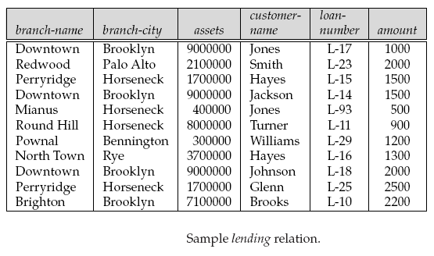
Example
Design the database that represents information regarding various branches of the bank, customers and their loans
Lending-schema = (branch-name, branch-city, assets, customer-name, loan-number, amount)

Slide 89
Relational Database Design
Approach
To design schemas that are in an appropriate normal form
Need additional information about real-world enterprise that we are modeling
A relational schema is in normal form when it satisfies certain desirable properties
The process of normalization consists of analyzing relations to meet increasingly more stringent normal forms leading to progressively better groupings of attributes
Normal forms are defined in terms of functional dependencies and other types of data dependencies

Slide 90
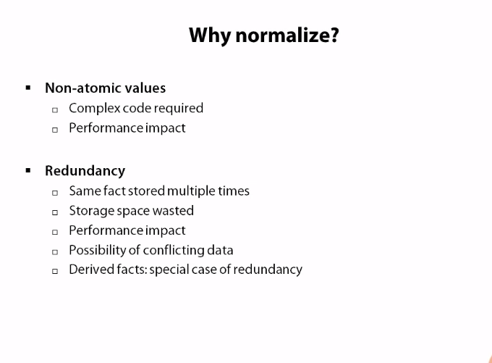
Modification Anamolies
If we store player name, player upcoming tournament,
and player phone no. in a single table, and player decides
Not to participate in a given tournament, so we need to remove
That row, and hence we also loose player’s phone no

Slide 91
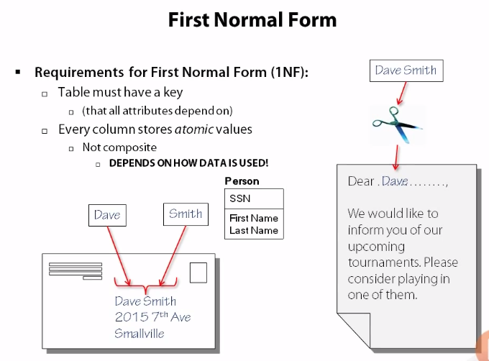
Key should be minimal set of candidate key
Atomic attributes – (first name, last name), non automic – full name
Automic – (day, month, year), non automaic date – 09/09/1994
Automic attrinutes are relative to the use case,
if every time we nned date and never ues day, month
Then the entire date can be atomic attribute. (depends on the use case)

Slide 92
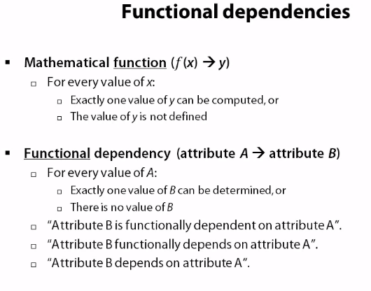

Slide 93
Closure of Functional Dependencies (Cont.)
The set of all functional dependencies logically implied by F is the closure of F.
We denote the closure of F by F⁺.
We can find all of F⁺ by applying Armstrong’s Axioms:
if β ⊆ α, then α → β (reflexivity)
if α → β, then γ α → γ β (augmentation)
if α → β, and β → γ, then α → γ (transitivity)
These rules are
sound (generate only functional dependencies that actually hold) and
complete (generate all functional dependencies that hold)

Slide 94
Closure of Functional Dependencies (Cont.)
We can further simplify manual computation of F⁺ by using the following additional rules.
If α → β holds and α → γ holds, then α → β γ holds (union)
If α → β γ holds, then α → β holds and α → γ holds (decomposition)
If α → β holds and γ β → δ holds, then α γ → δ holds (pseudotransitivity)
The above rules can be inferred from Armstrong’s axioms.
[Exercise: Prove above rules]

Slide 95
Example
R = (A, B, C, G, H, I) F = { A → B A → C CG → H CG → I B → H}
some members of F⁺
A → H
by transitivity from A → B and B → H
AG → I
by augmenting A → C with G, to get AG → CG and then transitivity with CG → I
CG → HI
from CG → H and CG → I : “union rule” can be inferred from
definition of functional dependencies,

Slide 96
Exercise
Assume that AB → C, C → D and D → A are simultaneously satisfied by a relation r(R) where R = {A, B, C, D}. What are the candidate keys of this relation?
AB → A, AB → B
by reflexivity
AB → D
by transitivity from AB → C and C → D
AB → C (given)
AB is a candidate key of the relation r because it functionally determines any other attribute of r
A set of attributes of r is a candidate key of r if and only if the set functionally determines every attribute of the relation.

Slide 97
Example of Attribute Set Closure
R = (A, B, C, G, H, I)
F = {A → B A → C CG → H CG → I B → H}
(AG)⁺
1. result = AG
2. result = ABCG (A → B and A → C)
3. result = ABCGH (CG → H and CG ⊆ ABCG)
result = ABCGHI (CG → I and CG ⊆ ABCGH)
Closure of AG is - (AG) ⁺ = ABCGHI

Slide 98
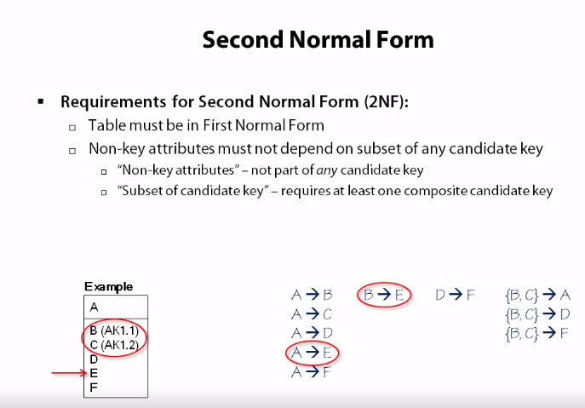
In this e.g. {A} and {B,C} are candidate keys
Non key attribute means non candidate attribute
Acc. To 2nd req. Non candidate key (E) is dependent
on subset (B) of candidate key {B,C}
So this is not in 2NF form

Slide 99
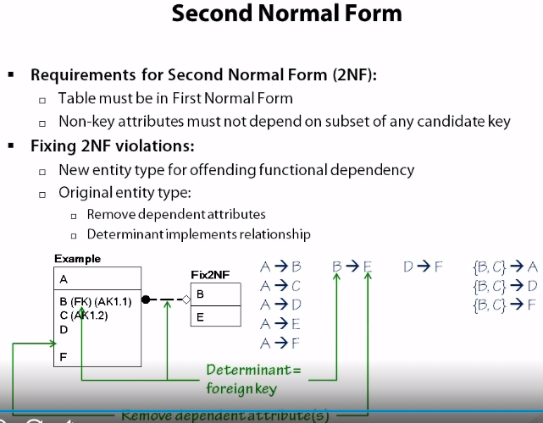
To convert it onto 2NF (Here B->E is offending functional dependency)
non candidate attributes of offending dep. (E) are moved in a separate table
B becomes primary key of new table and foreign key of the existing table
Again we need to perform @NF check on the new table

Slide 100
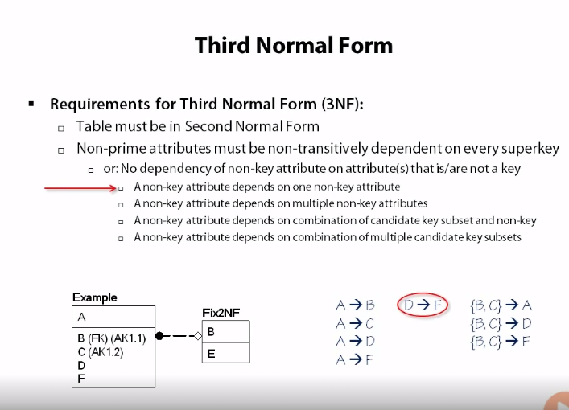
Here A and BC are super keys
Acc. To 2nd req. D->F violates the rule as non-prime attribute (F)
is not dependent on superkey (A or BC)

Slide 101
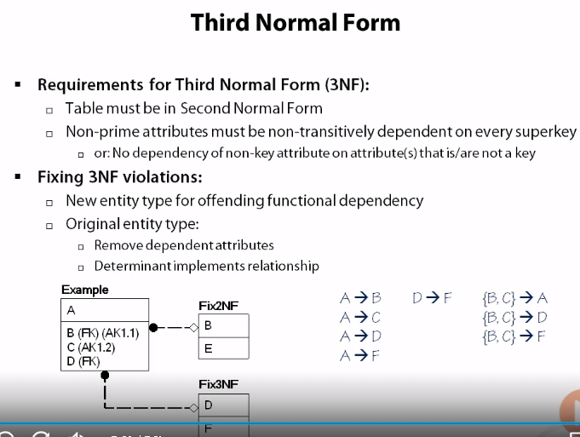
Converting to 3NF is same as that for 2NF
(i.e, create new table, add foreign keys)

Slide 102
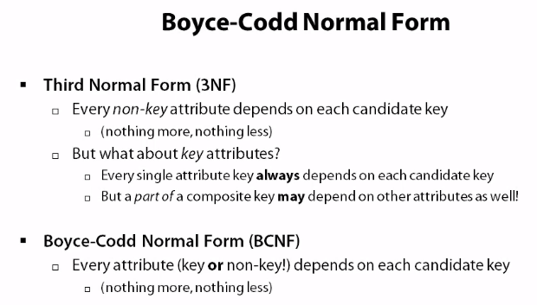
BCNF can’t always be achieved
There is another (Elementary key normal form (EKNF))
Which is less strict version of BCNF, here only some key
Attributes need to depend on each candidate key
Instead of all

Slide 103
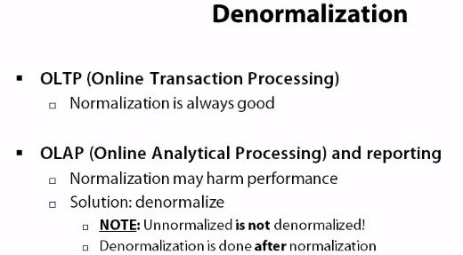
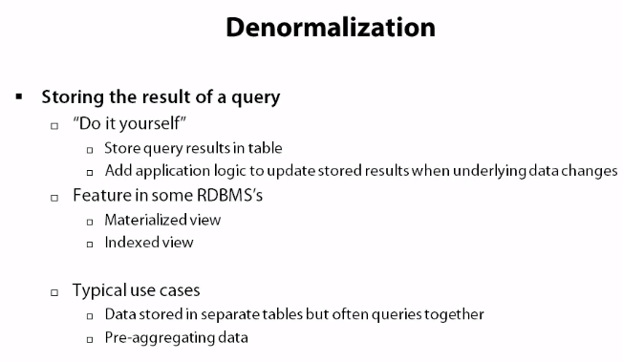

Slide 104
DB design steps
Req. Gathering
Create ER diagram
Convert ER diagram to Relational tables
Identify functional dependencies
Normalize the relations
Modify ER after normalization
Create tables in DB
SQL queries
Do Indexing

Slide 105
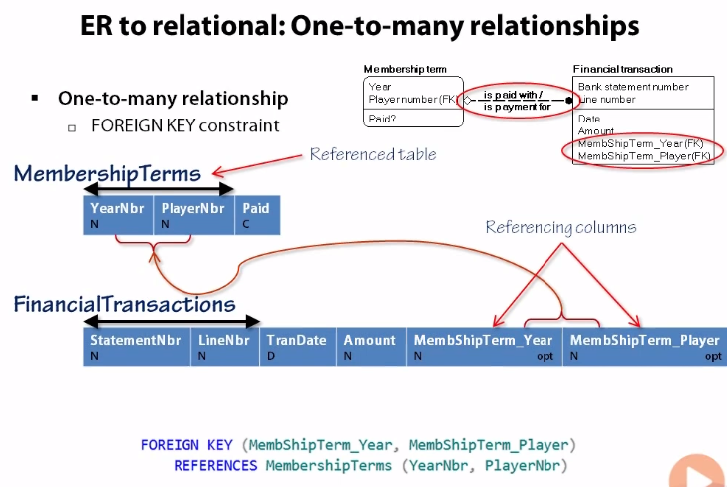
ER to Relational steps
Create table for each entity
For (one to many)relations use foreign keys

Slide 106
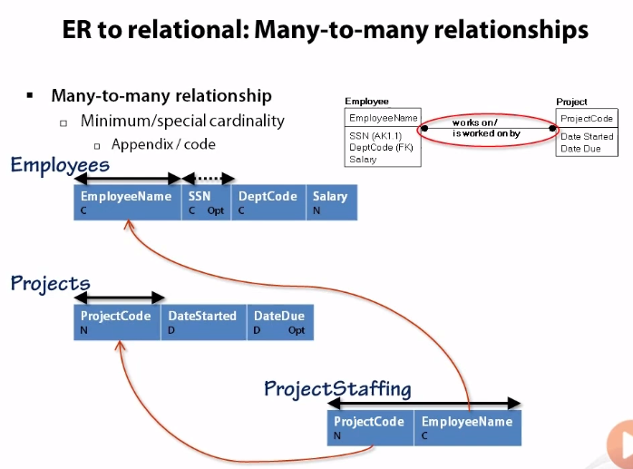
ER to Relational steps
For (many to many)relations we need to create a separate table
Primary keys of both reference tables are added as foreign keys in the new table

Slide 107
Data Storage and Indexing
[Module – 4]
WCE - TY (CSE) – CS 307: Database Engineering
Subject Teacher: Dr. Smriti Bhandari

Slide 108
Indexing - Basic Concepts
Indexing mechanisms used to speed up access to desired data.
E.g., index of a book, author catalog in library
Search Key - attribute or set of attributes used to look up records in a file.
An index file consists of records (called index entries) of the form
Index files are typically much smaller than the original file
Two basic kinds of indices:
Ordered indices: search keys are stored in sorted order
Hash indices: search keys are distributed uniformly across “buckets” using a “hash function”.
search-key
pointer

Slide 109
Ordered Indices
In an ordered index, index entries are stored sorted on the search key value. E.g., author catalog in library.
Primary index: If the file is sequentially ordered then the primary index is an index whose search key also defines the sequential order of the file.
Also called clustering index
The search key of a primary index is usually but not necessarily the primary key.
Secondary index: an index whose search key specifies an order different from the sequential order of the file.
Also called non-clustering index
Index-sequential file: ordered sequential file with a primary index on the search key.

Slide 110
Ordered Indices
An index record or index entry consists of a search-key value, and pointers to one or more records with that value as their search-key value.
The pointer to the record consists of
Identifier of the disk block
Offset within the disk block to identify the record within the block
Types of ordered indices
Dense Index
Sparse Index

Slide 111
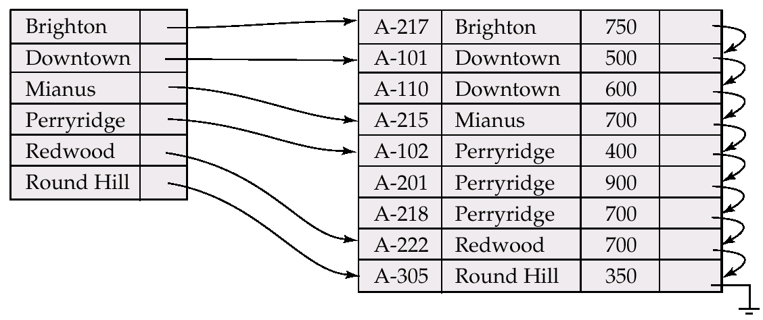
Dense Index Files
Dense index — Index record appears for every search-key value in the file.

Slide 112
Sparse Index Files
Sparse Index: contains index records for only some search-key values.
Applicable when records are sequentially ordered on search-key
To locate a record with search-key value K we:
Find index record with largest search-key value < = K
Search file sequentially starting at the record to which the index record points
Requires less space and less maintenance overhead for insertions and deletions.
Generally slower than dense index for locating records.
Good tradeoff: sparse index with an index entry for every block in file, corresponding to least search-key value in the block.

Slide 113
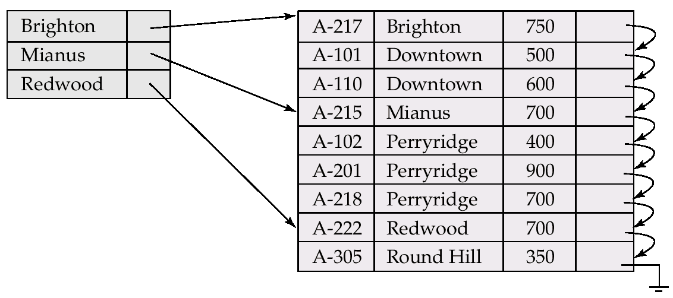
Example of Sparse Index Files

Slide 114
Multilevel Index
The index itself may become too large for efficient processing.
Example
assume that a file has 1,00,000 records with 10 records stored per block
Assume one index record per block then the index has 10,000 records
As index records are smaller than data records, assume that 100 index records fit on a block ➔ index occupies 100 blocks
Such large indices are stored as sequential files on disk ➔ search for an entry needs several block reads
Binary search may be used : still has large cost
If index occupies b blocks then binary search requires as many as ⎡log₂b⎤ block reads.
For 100 block index, it requires 7 block reads.
Assuming a block read needs 30 ms, the search will take 210 ms => long.

Slide 115
Multilevel Index
If primary index does not fit in memory, access becomes expensive.
To reduce number of disk accesses to index records, treat primary index kept on disk as a sequential file and construct a sparse index on it.
outer index – a sparse index of primary index
inner index – the primary index file
If even outer index is too large to fit in main memory, yet another level of index can be created, and so on.
Indices at all levels must be updated on insertion or deletion from the file.

Slide 116
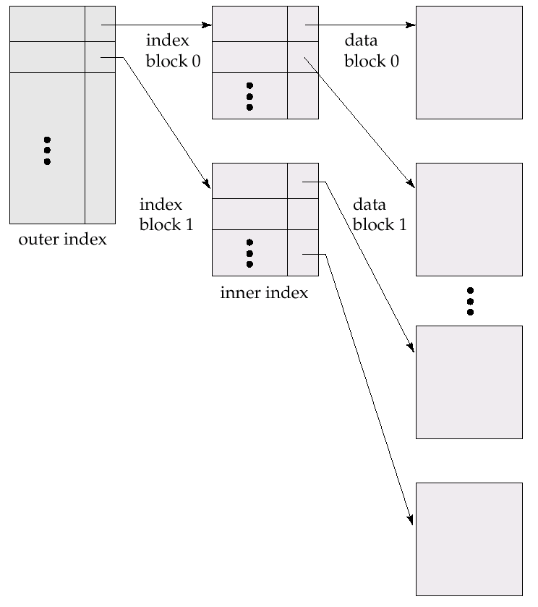
Multilevel Index (Cont.)

Slide 117
Index Update: Insertion
Perform a lookup using the search-key value appearing in the record to be inserted.
Next action depends on type of index
Dense indices:
If the search-key value does not appear in the index, insert it at appropriate position.
Otherwise
If the index record stores pointers to all records with the same search-key value, the system adds a pointer to the new record to the index record.
Otherwise, the index record stores a pointer to only the first record with the search-key value. The system then places the record being inserted after the other records with the same search-key values.

Slide 118
Index Update: Deletion
Locate the record
Next action depends on type of index
Dense indices:
If deleted record was the only record in the file with its particular search-key value, the search-key is deleted from the index also.
Otherwise
If the index record stores pointers to all records with the same search-key value, the system deletes the pointer to the deleted record from the index record
If index record stores a pointer to only the first record with the search-key value and if the deleted record is the first one with the search-key value, the system updates the index record to point to the next record.

Slide 119
Index Update: Deletion
Sparse indices :
If the index does not contain an index record with the search-key value of the deleted record, nothing needs to be done to the index.
Otherwise
If the deleted record was the only record with its search key, the system replaces the corresponding index record with an index record for the next search-key value (in search-key order). If the next search-key value already has an index entry, the entry is deleted instead of being replaced.
if the index record for the search-key value points to the record being deleted, the system updates the index record to point to the next record with the same search-key value.
Multilevel insertion (as well as deletion) algorithms are simple extensions of the single-level algorithms

Slide 120
Secondary Indices
Frequently, one wants to find all the records whose values in a certain field (which is not the search-key of the primary index) satisfy some condition.
Example 1: In the account database stored sequentially by account number, we may want to find all accounts in a particular branch
Example 2: as above, but where we want to find all accounts with a specified balance or range of balances
We can have a secondary index with an index record for each search-key value i.e. secondary index must be dense
Index record points to a bucket that contains pointers to all the actual records with that particular search-key value.

Slide 121
Primary and Secondary Indices
Secondary indices have to be dense.
Secondary indices offer substantial benefits when searching for records.
When a file is modified, every index on the file must be updated, Updating indices imposes overhead on database modification.
Sequential scan using primary index is efficient, but a sequential scan using a secondary index is expensive
each record access may fetch a new block from disk

Slide 122
B⁺-Tree Index Files
B⁺-tree indices are an alternative to indexed-sequential files.
Disadvantage of indexed-sequential files: performance degrades as file grows, since many overflow blocks get created. Periodic reorganization of entire file is required.
Advantage of B⁺-tree index files: automatically reorganizes itself with small, local, changes, in the face of insertions and deletions. Reorganization of entire file is not required to maintain performance.
Disadvantage of B⁺-trees: extra insertion and deletion overhead, space overhead.
Advantages of B⁺-trees outweigh disadvantages, and they are used extensively.

Slide 123
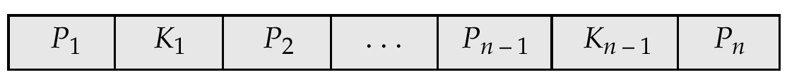
B⁺-Tree Node Structure
Typical node
K_{i} are the search-key values
P_{i} are pointers to children (for non-leaf nodes) or pointers to records or buckets of records (for leaf nodes).
The search-keys in a node are ordered
K₁ < K₂ < K₃ < . . . < K_{n–1}

Slide 124
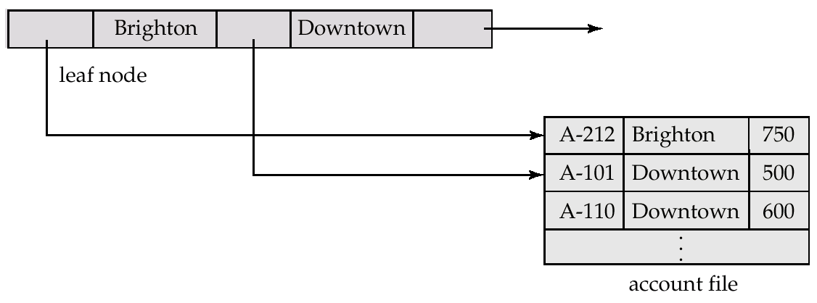
Leaf Nodes in B⁺-Trees
Properties of a leaf node:
For i = 1, 2, . . ., n–1, pointer P_{i} either points to a file record with search-key value K_{i}, or to a bucket of pointers to file records, each record having search-key value K_{i}. Only need bucket structure if search-key does not form a primary key.
A leaf node has between ⎡(n–1)/2 ⎤ and n–1 values
If L_{i}, L_{j} are leaf nodes and i < j, L_{i}’s search-key values are less than or equal to L_{j}’s search-key values
P_{n} points to next leaf node in search-key order
Pointer to next leaf node

Slide 125
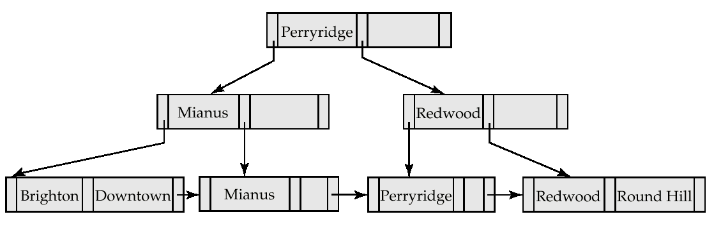
Queries on B⁺-Trees : Example
Find all records for Search-key value= ‘Mianus’

Slide 126
Updates on B⁺-Trees: Insertion
Find the leaf node in which the search-key value would appear
If the search-key value is already there in the leaf node, record is added to file and if necessary a pointer is inserted into the bucket.
If the search-key value is not there, then add the record to the main file and create a bucket if necessary. Then:
If there is room in the leaf node, insert (key-value, pointer) pair in the leaf node
Otherwise, split the node (along with the new (key-value, pointer) entry) as discussed in the next slide.

Slide 127
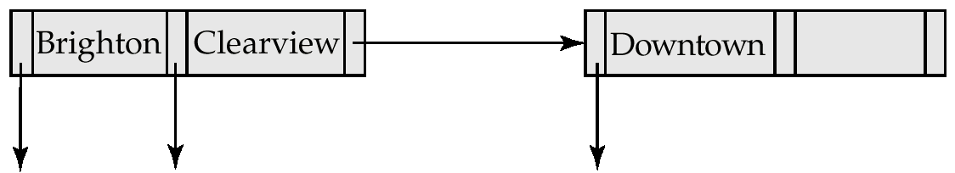
Updates on B⁺-Trees: Insertion (Cont.)
Splitting a node:
take the n(search-key value, pointer) pairs (including the one being inserted) in sorted order. Place the first ⎡ n/2 ⎤ in the original node, and the rest in a new node.
let the new node be p, and let k be the least key value in p. Insert (k,p) in the parent of the node being split. If the parent is full, split it and propagate the split further up.
The splitting of nodes proceeds upwards till a node that is not full is found. In the worst case the root node may be split increasing the height of the tree by 1.
Result of splitting node containing Brighton and Downtown on inserting Clearview

Slide 128

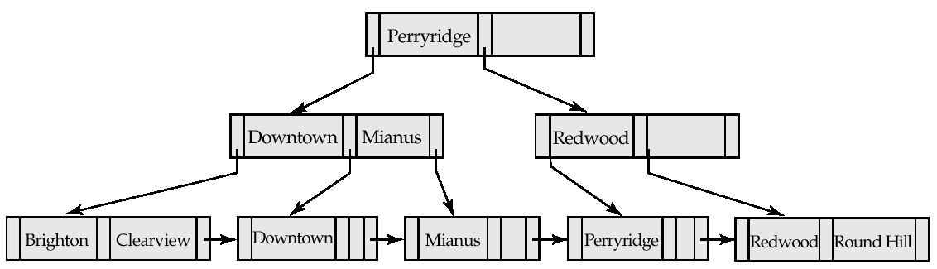
Updates on B⁺-Trees: Insertion
B⁺-Tree before and after insertion of “Clearview”

Slide 129
Exercise - 1
Construct a B+-tree for the following set of key values:
(2, 3, 5, 7, 11, 17, 19, 23, 29, 31)
Assume that the tree is initially empty and values are added in ascending order. Construct B+-trees for the cases where the number of pointers that will fit in one node is as follows:
Four
Six

Slide 130
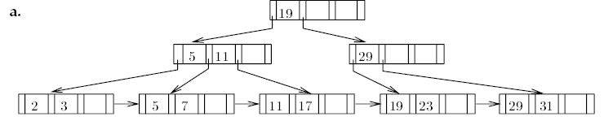
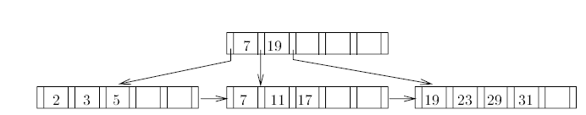
Solution

Slide 131
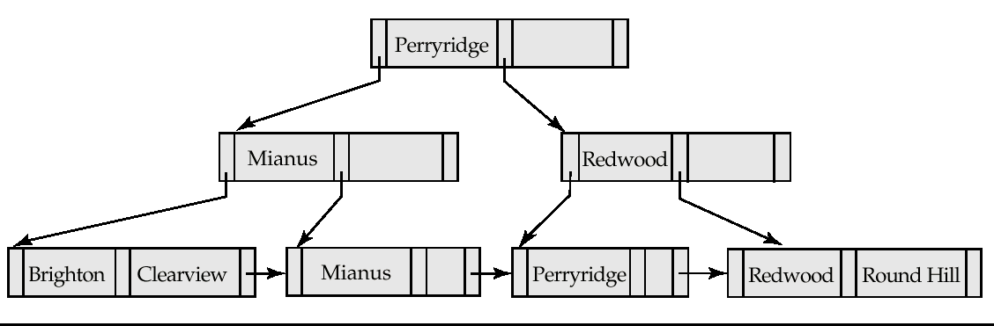
Examples of B⁺-Tree Deletion
Before and after deleting “Downtown”
The removal of the leaf node containing “Downtown” did not result in its parent having too little pointers. So the cascaded deletions stopped with the deleted leaf node’s parent.

Slide 132
Static Hashing
A bucket is a unit of storage containing one or more records (a bucket is typically a disk block).
In a hash file organization we obtain the bucket of a record directly from its search-key value using a hash function.
Hash function h is a function from the set of all search-key values K to the set of all bucket addresses B.
Hash function is used to locate records for access, insertion as well as deletion.
Records with different search-key values may be mapped to the same bucket; thus entire bucket has to be searched sequentially to locate a record.

Slide 133
Example of Hash File Organization (Cont.)
Hash file organization of account file, using branch-name as key (See figure in next slide.)
There are 10 buckets,
The binary representation of the i^{th} character is assumed to be the integer i.
The hash function returns the sum of the binary representations of the characters modulo 10
E.g. h(Perryridge) = 5 h(Round Hill) = 3 h(Brighton) = 3
[Perryridge] = [16+5+18+18+25+18+9+4+7+5]=[125]
h(Perryridge)=125 modulo 10 = 5

Slide 134
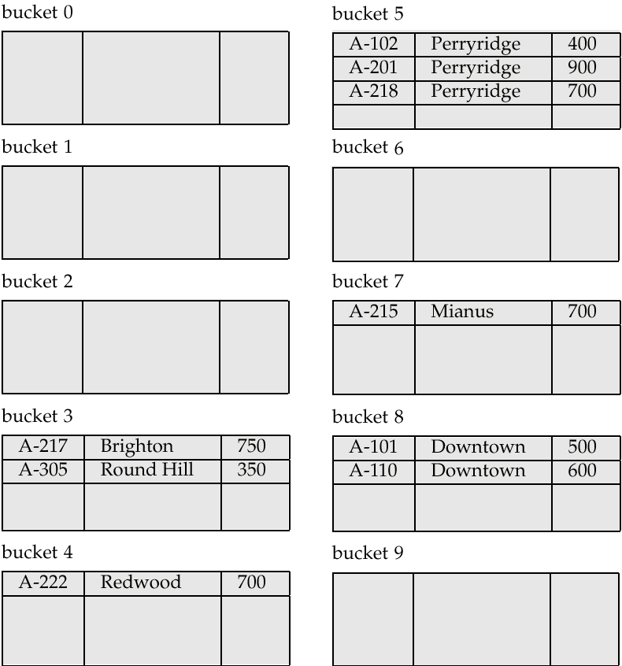
Example of Hash File Organization
Hash file organization of account file, using branch-name as key (see previous slide for details).

Slide 135
Hash Functions
Worst hash function maps all search-key values to the same bucket ➔ access time proportional to the number of search-key values in the file.
An ideal hash function is uniform, i.e., each bucket is assigned the same number of search-key values from the set of all possible values.
Ideal hash function is random, so each bucket will have the same number of records assigned to it irrespective of the actual distribution of search-key values in the file.
Typical hash functions perform computation on the internal binary representation of the search-key.
For example, for a string search-key, the binary representations of all the characters in the string could be added and the sum modulo the number of buckets could be returned.

Slide 136
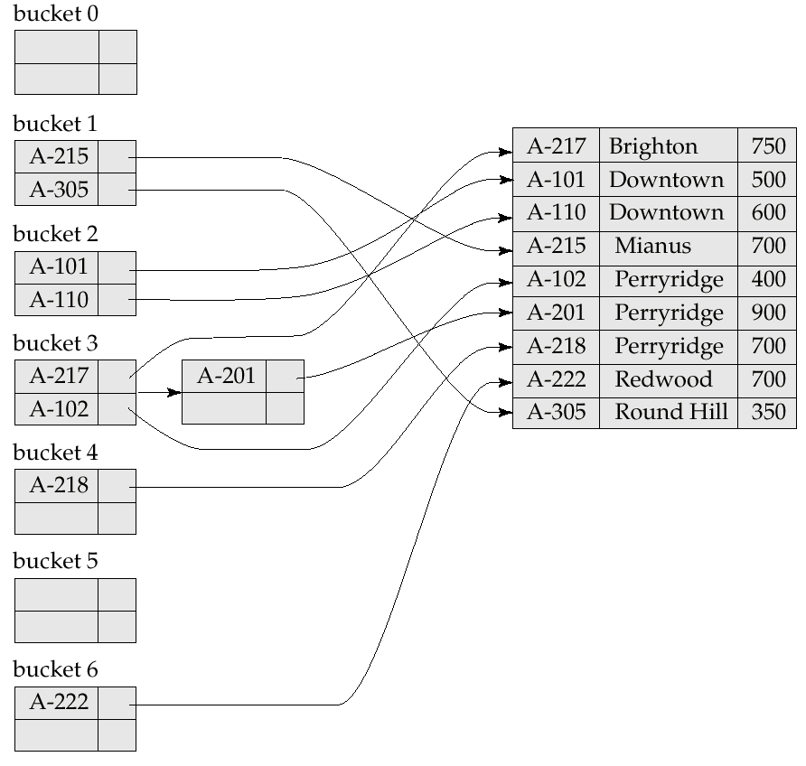
Example of Hash Index
Hash function = sum of digits in account number modulo 7
Bucket 3 is called overflow bucket

Slide 137
Deficiencies of Static Hashing
In static hashing, function h maps search-key values to a fixed set B of bucket addresses.
Databases grow with time. If initial number of buckets is too small, performance will degrade due to too much overflows.
If file size at some point in the future is anticipated and number of buckets allocated accordingly, significant amount of space will be wasted initially.
If database shrinks, again space will be wasted.
One option is periodic re-organization of the file with a new hash function, but it is very expensive.
These problems can be avoided by using techniques that allow the number of buckets to be modified dynamically.

Slide 138
Dynamic Hashing
Good for database that grows and shrinks in size
Allows the hash function to be modified dynamically
Extendable hashing – one form of dynamic hashing
Hash function generates values over a large range — typically b-bit integers, with b = 32.
At any time use only a prefix of the hash function to index into a table of bucket addresses.
Let the length of the prefix be i bits, 0 ≤ i ≤ 32.
Bucket address table size = 2^{i.} Initially i = 0
Value of i grows and shrinks as the size of the database grows and shrinks.
Multiple entries in the bucket address table may point to the same bucket.
Thus, actual number of buckets is < 2^{i}
The number of buckets also changes dynamically due to coalescing and splitting of buckets.

Slide 139
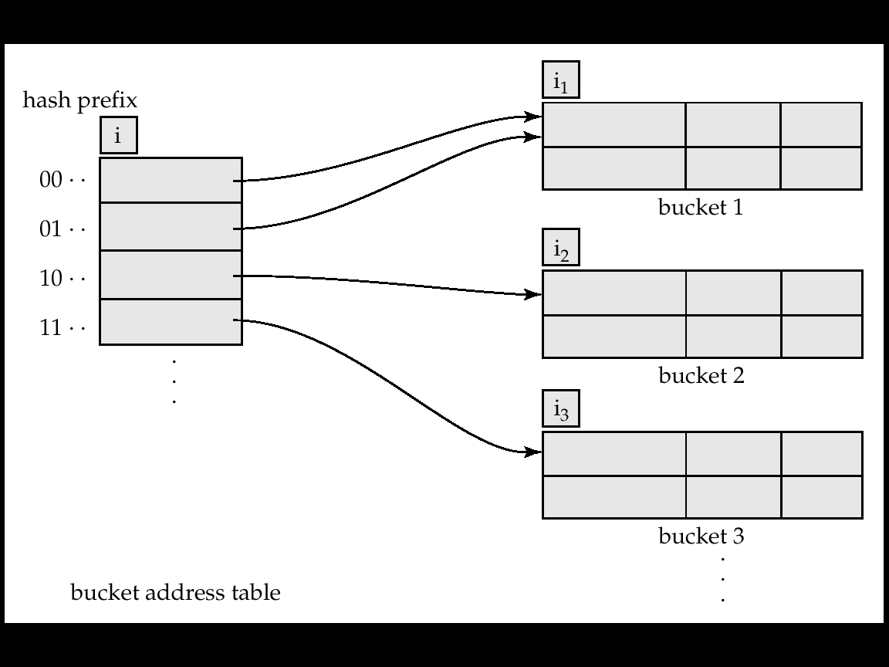
General Extendable Hash Structure
Length of prefix,
i = 2 bits
Size of table = 2^{i} = 4
Each bucket is associated with an integer giving the length of the common hash prefix. In this structure, i₂ = i₃ = i, whereas i₁ = i – 1
The number of bucket address table entries that point to bucket j is 2^{(i-ij)}
(see next slide for details)

Slide 140
Use of Extendable Hash Structure
Each bucket j stores a value i_{j}; all the entries that point to the same bucket have the same values on the first i_{j} bits.
To locate the bucket containing search-key K_{j}:
1. Compute h(K_{j}) = X
Use the first i high order bits of X as a displacement into bucket address table, and follow the pointer to appropriate bucket
To insert a record with search-key value K_{j}
Follow same procedure as look-up and locate the bucket, say j.
If there is room in the bucket j insert record in the bucket.
Else the bucket must be split and insertion re-attempted (next slide.)
Overflow buckets used instead in some cases (will see shortly)

Slide 141
Updates in Extendable Hash Structure
To split a bucket j when inserting record with search-key value K_{j}:
If i > i_{j} (more than one pointer to bucket j)
allocate a new bucket z, and set i_{j} and i_{z} to the old i_{j} + 1.
make the second half of the bucket address table entries pointing to j to point to z
remove and reinsert each record in bucket j.
recompute new bucket for K_{j} and insert record in the bucket (further splitting is required if the bucket is still full)
If i = i_{j} (only one pointer to bucket j)
increment i and double the size of the bucket address table.
replace each entry in the table by two entries that point to the same bucket.
recompute new bucket address table entry for K_{j} Now i > i_{j} so use the first case above.

Slide 142
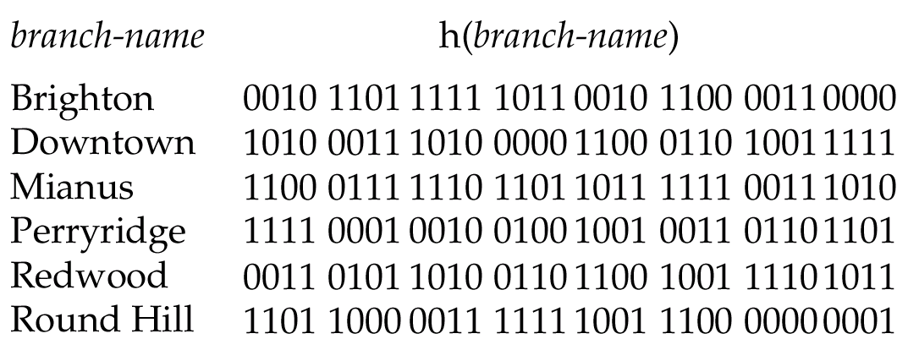
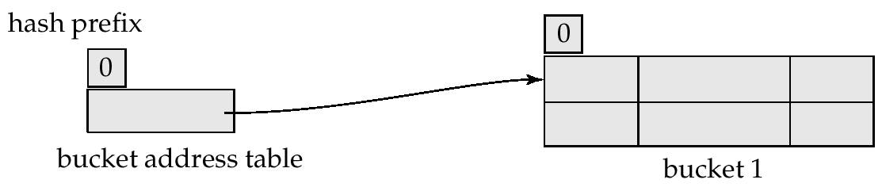
Use of Extendable Hash Structure: Example
Initial Hash structure, bucket size = 2

Slide 143
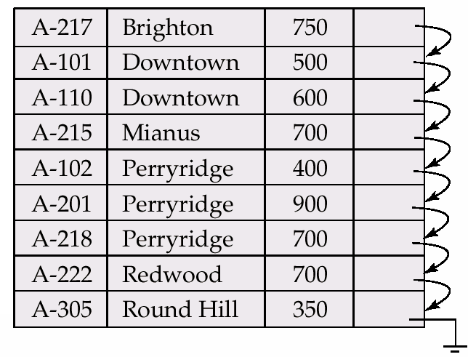
Sample Account file

Slide 144
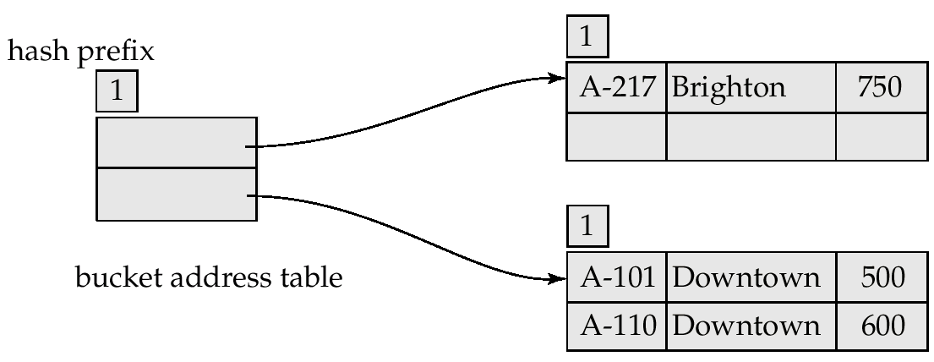
Example (Cont.)
Hash structure after insertion of one Brighton and two Downtown records
0
1

Slide 145
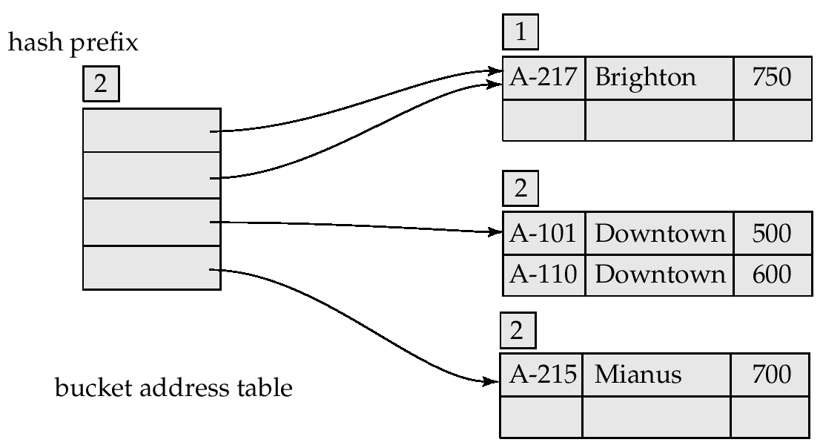
Example (Cont.)
Hash structure after insertion of Mianus record
00
01
10
11

Slide 146
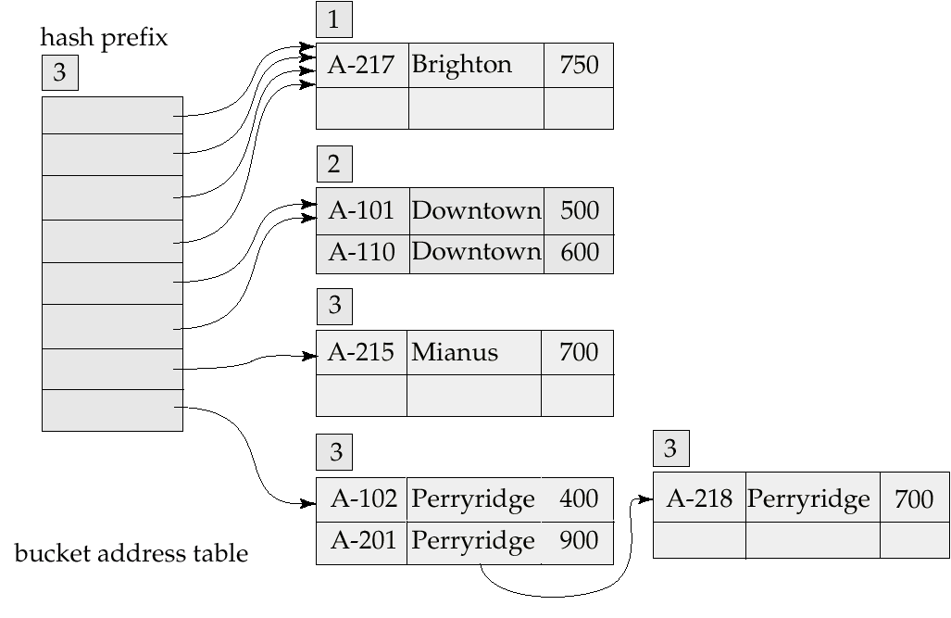
Example (Cont.)
000
001
010
011
100
101
110
111
Hash structure after insertion of three Perryridge records

Slide 147
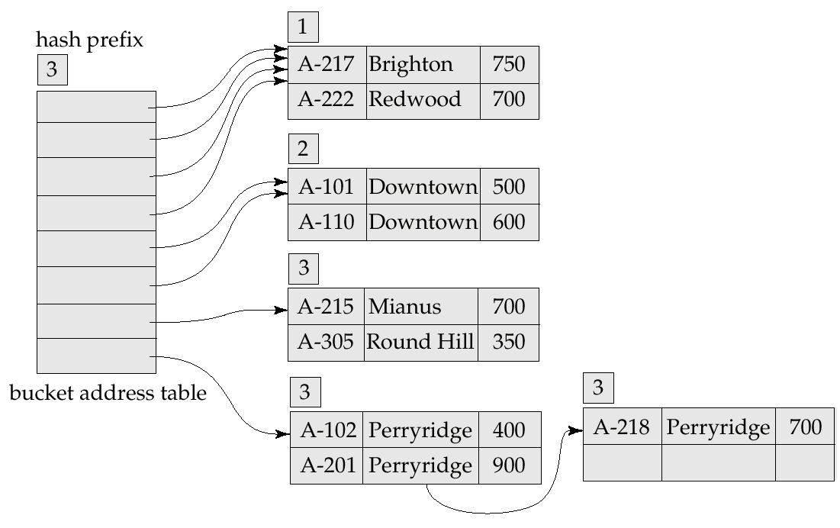
Example (Cont.)
Hash structure after insertion of Redwood and Round Hill records
000
001
010
011
100
101
110
111

Slide 148
Extendable Hashing vs. Other Schemes
Benefits of extendable hashing:
Hash performance does not degrade with growth of file
Minimal space overhead
Disadvantages of extendable hashing
Extra level of indirection to find desired record
Bucket address table may itself become very big (larger than memory)
Need a tree structure to locate desired record in the structure!
Changing size of bucket address table is an expensive operation
Linear hashing is an alternative mechanism which avoids these disadvantages at the possible cost of more bucket overflows

Slide 149
Comparison of Ordered Indexing and Hashing
Issues need to be considered for a wise choice of file organization and indexing techniques:
Cost of periodic re-organization
Relative frequency of insertions and deletions
Is it desirable to optimize average access time at the expense of worst-case access time?
Expected type of queries:
Hashing is generally better at retrieving records having a specified value of the key.
If range queries are common, ordered indices are to be preferred

Slide 150
Index Definition in SQL
Create an index
create index <index-name> on <relation-name> (<attribute-list>)
E.g.: create index b-index on branch(branch-name)
Use create unique index to indirectly specify and enforce the condition that the search key is a candidate key.
Not really required if SQL unique integrity constraint is supported
To drop an index
drop index <index-name>

