Slide 1
Course Contents
Introduction
Linked Lists
Stacks and Queues
Trees
Graphs
Searching and Sorting Techniques

Slide 2
What is Data Structure?
Data structure is the way to store and organize data in order to facilitate access and modification
OR
The logical or mathematical model of a particular organization of data is called data structure.
Notes:
Data structure : conceptual and concrete ways to organize data for efficient storage and manipulation

Slide 3
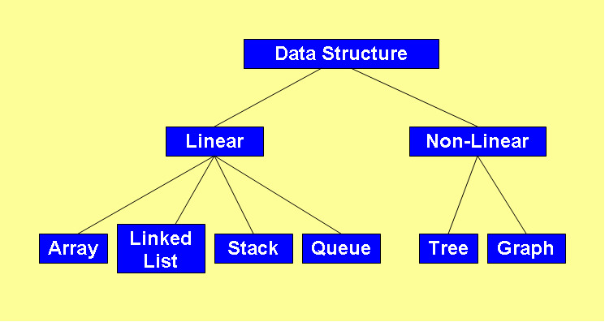
Classification of Data Structure

Slide 4
Programmer’s considerations
How to store data in computer’s memory?
Whether the method works for a hundred file cards? A thousand ? A million?
Whether the method permits quick insertion or deletion?
Whether it allows for fast searching?
Notes:
● How would you store the data in your computer’s memory?
● Would your method work for a hundred file cards? A thousand? A million?
● Would your method permit quick insertion of new cards and deletion of old ones?
● Would it allow for fast searching for a specified card?
● Suppose you wanted to arrange the cards in alphabetical order. How would you sort them?

Slide 5
Pointers
main( )
{
int i = 3;
int *j;
j=&i;
printf(“\nAddress of i = %u”, &i);
printf(“\nAddress of i = %u”, j);
printf(“\nAddress of j = %u”, &j);
printf(“\nValue of j = %d”, j);
printf(“\nValue of i = %d”, i);
printf(“\nValue of i = %d”, *(&i));
printf(“\nValue of i = %d”, *j);
}
Output:
Address of i = 6485
Address of i = 6485
Address of j = 3276
Value of j = 6485
Value of i = 3
Value of i = 3
Value of i = 3

Slide 6
Structures in C
A structure gathers together different atoms of information that form a given entity ➔ structure combines dissimilar data types into a single entity
E.g. Book is described as title, author, call number, publisher, number of pages, date of publication, price etc.

Slide 7
Structures - Example
main()
{
struct account
{
int no;
char name[15];
float balance;
};
struct account a1, a2, a3;
printf(“\nEnter account nos., names and balances\n”);
scanf(“%d %s %f”, &a1.no, a1.name, &a1.balance);
scanf(“%d %s %f”, &a2.no, a2.name, &a2.balance);
scanf(“%d %s %f”, &a3.no, a3.name, &a3.balance);
printf(“\n%d %s %f”, a1.no, a1.name, a1.balance);
printf(“\n%d %s %f”, a2.no, a2.name, a2.balance);
printf(“\n%d %s %f”, a3.no, a3.name, a3.balance);
}
a1.no a1.name a1.balance
4001 4003 4018
Structure Name
375 Sameer\0 1234.55
Structure Elements
Structure Variables

Slide 8
Array of Structures
main()
{
struct account
{
int no;
float balance;
};
struct account a[10];
int i, acn;
float bal;
for (i=0; i<=9; i++)
{
printf(“\nEnter account no. and balance: ”);
scanf(“%d %f”, &acn, &bal);
a[i].no = acn;
a[i].balance = bal;
printf(“\n%d %f”, a[i].no, a[i].balance);
}
}
a[0].no a[0].balance a[1].no a[1].balance a[9].no a[9].balance
4001 4003 4007 4009 4055 4057
375 1234.55 405 2446.60 ---- 209 6489.75

Slide 9
Structures – Points to Remember
One structure can be nested within another structure
struct part
{
char type;
int qty;
};
struct vehicle
{
char maruti[20];
struct part bolt;
}
struct vehicle v;
v.bolt.qty = 300;

Slide 10
Designing Recursive Algorithms
Rules
First, determine the base case
Then determine the general case
Combine the base case and the general cases into an algorithm

Slide 11
Direct Vs Indirect Recursion
Direct recursion occurs when a function or method invokes itself
Indirect recursion occurs when a function or method invokes another function or method, eventually resulting in the original function or method being invoked again

Slide 12
Hanoi Strategy (Generalization)
General strategy for moving N disks from the source peg to the destination peg:
1. Move the topmost N − 1 disks from the source peg to
the extra peg [General Case] A → B
2. Move the largest disk from source peg to destination
peg [Base Case] A → C
3. Move N − 1 disks from the extra peg to the destination
peg [General Case] B → C
12
Notes:
The rules imply that smaller disks must be “out of the way” to move larger disks from one peg to another

Slide 13
Recursive Solution
13
This strategy lends itself to a recursive solution
Step 1 and 3 are the same problems over and over again: move a stack of disks
– the problem size is reduced each time;
– what’s referred to as the destination and extra peg may change each time
The base case for this problem occurs when we want to move a “stack” that consists of only one disk. This step can be accomplished without recursion.

Slide 14
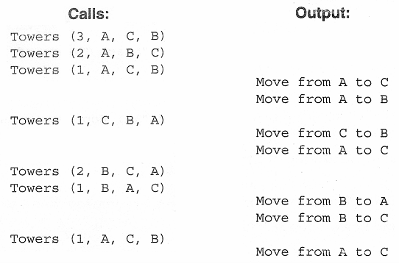
Towers of Hanoi – C Implementation
/* Test Towers of Hanoi */ /* Recursive approach */
#include<stdio.h>
void towers(int n, char source, char dest, char extra);
void main(void)
{
int numDisks;
printf("Please enter number of disks: ");
scanf("%d", &numDisks);
printf("\n\nStart Towers of Hanoi\n\n");
towers(numDisks, 'A', 'C', 'B');
printf("\n\nEnd");
}
void towers(int n, char source, char dest, char extra)
{
static int step = 0;
printf("Towers (%d %c %c %c)\n", n, source, dest, extra);
if (n==1) /* Base case */
printf("\t\t\t Step %3d: Move from %c to %c\n",++step, source, dest);
else /* General case */
{
towers (n-1, source, extra, dest);
printf("\t\t\t Step %3d: Move from %c to %c\n",++step, source, dest);
towers (n-1, extra, dest, source);
}
}
14

Slide 15
Linked Lists
[Module – 2]
WCE - SY (CSE) – CS 212: Data Structures and Files
Subject Teacher: Smriti Bhandari

Slide 16
What to Study?
Concept of linked organization
Singly linked list
Doubly linked list
Circular linked list
Operations
Insertion, deletion, inversion, concatenation, Computation of length, traversal on linked list
Representation & manipulations of polynomials using linked lists
16

Slide 17
Ways to store the data
Arrays
Linked Lists

Slide 18
Linked Lists
Linear collection of data elements called nodes, where the linear order is given by means of pointers
Each node is divided into two parts:
Part 1 : contains information / data
Part 2 : called link field, contains address of the next node in the list

Slide 19
Implementation of Linked Lists
Static Implementation
Using Parallel arrays
Using Array of Structures
Dynamic Implementation

Slide 20
Static Implementation Using Parallel Arrays
Easiest way of implementation
Start=9 ➔ info[9]=‘S’ (first node)
Successor[9]=6 ➔ info[6]=‘O’ (second node)
Successor[6]=5 ➔ info[5]=‘N’ (third node)
Successor[5]=2 ➔ info[2]=‘G’ (fourth node)
Successor[2]=-1 ➔ illegal index value ➔ end of list
Index | Info |  | Successor
0
1
2 | G |  | -1
3
4
5 | N |  | 2
6 | O |  | 5
7
8
9 | S |  | 6
Start

Slide 21
Static Implementation Using Array of Structures
# define MAXNODES 100
struct nodetype
{
int info; /* Information field of node */
int next; /* Pointer to its successor */
}
struct nodetype node[maxnodes];
[Note: next node is represented by an array index]

Slide 22
Linked List
A linear data structure to store data elements
Each node contains two parts:
Part 1: contains information / data
Part 2: contains the address of the next node
(pointer / link)
Elements that are logically adjacent need not be physically adjacent in the memory

Slide 23
Linked List
Basic Operations
Insertion / addition
Deletion
Retrieval
Traversal
Reverse

Slide 24
Algorithm – Insert List Node
Algorithm insertNode (start, pPre, dataIn)
Insert data into a new node in the list
pPre is pointer to data’s logical predecessor
dataIn contains data to be inserted
allocate (pNew)
set pNew data to dataIn
if (pPre NULL)
Adding before first node or to empty list
set pNew link to start
set start to pNew
else
Adding in middle or at end
set pNew link to pPre link
set pPre link to pNew
end if
return true
end insertNode

Slide 25
Algorithm – Delete List Node
Algorithm deleteNode (start, pPre, pLoc, dataOut)
Deletes data from list and returns it to calling module
pPre is a pointer to predecessor node
pLoc is a pointer to node to be deleted
dataOut is variable to receive deleted data
move pLoc data to dataOut
if (pPre NULL)
Deleting first node
set start to pLoc link
else
Deleting other nodes
set pPre link to pLoc link
end if
recycle (pLoc)
end deleteNode

Slide 26
Algorithm – Search Ordered List
Algorithm searchList (start, pPre, pLoc, target)
Searches list and passes back address of node containing target and its logical predecessor
pPre is a pointer to predecessor node
pLoc is a pointer to current node
target is the key being sought
set pPre to null
set pLoc to start
loop (pLoc not null AND target > pLoc key)
set pPre to pLoc
set pLoc to pLoc link
end loop
if (pLoc null)
Set return value
set found to false
else
if (target equal pLoc key)
set found to true
else
set found to false
end if
end if
return found
end searchList

Slide 27
Linked List ADT Implementation
Generic
typedef struct node
{
void* dataPtr;
struct node* link;
} NODE;
E.g. Integer
typedef struct node
{
int data;
struct node* link;
}NODE;
OR
struct node
{
int data;
struct node* link;
};

Slide 28
Doubly Linked List
Two-way list : One can move in either directions from L to R or from R to L
Each node has three parts:
info field : contains data
next pointer field : contains location of the next node (forward pointer)
prev pointer field : contains location of the preceding node (backward pointer)

Slide 29
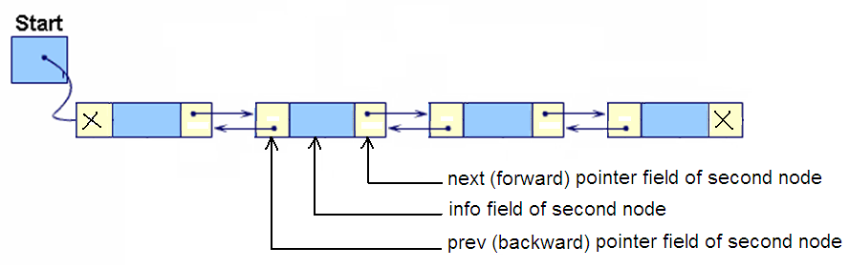
Doubly Linked List

Slide 30
Doubly Linked List
Algorithm insertDbl (start, dataIn)
Insert data into a doubly linked list
dataIn contains the data to be inserted
Return true if successful, false otherwise
Locate insertion point in list
allocate new node
move dataIn to new node
if (pPre is null)
Inserting before first node or into empty list
set new node prev pointer to null
set new node next pointer to start
set start to new node
else
Inserting into middle or end of the list
set new node next pointer to pPre next pointer
set new node prev pointer to pPre
end if
if (pPre next not null or new node next not null)
Inserting in middle of list – point successor to new
set successor prev to new node
end if
set pPre next to new node
return true
end insertDbl

Slide 31
Doubly Linked List - ADT
Struct dblNode
{
int data;
struct dblNode *prev;
struct dblNode *next;
};

Slide 32
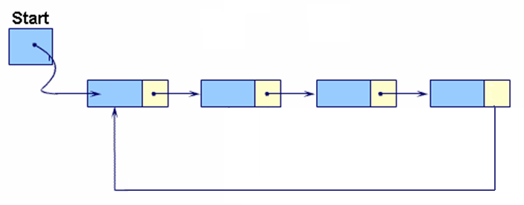
Circular Linked Lists
In Circular linked list, the last node’s link points to the first node of the list

Slide 33
From any point in the list, it is possible to reach any other point in the list
Circular linked list does not have a first and last node (Establish first and last node by convention)
Circular linked list can be used to represent a stack or a queue

