Slide 1
Database Engineering
Notes:
A database-management system (DBMS) is a collection of interrelated data and a set of programs to access those data. The collection of data, usually referred to as the database, contains information relevant to an enterprise. The primary goal of a DBMS is to provide a way to store and retrieve database information that is both convenient and efficient.
Database systems are designed to manage large bodies of information. Management of data involves both defining structures for storage of information and providing mechanisms for the manipulation of information. In addition, the database system must ensure the safety of the information stored, despite system crashes or attempts at unauthorized access. If data are to be shared among several users, the system must avoid possible anomalous results.
Because information is so important in most organizations, computer scientists have developed a large body of concepts and techniques for managing data. These concepts and technique form the focus of this subject.
The first chapter briefly introduces the principles of database systems.

Slide 2
Drawbacks of File-processing system
Data redundancy and inconsistency
Multiple file formats, duplication of information in different files
Difficulty in accessing data
Need to write a new program to carry out each new task
Data isolation — multiple files and formats
Integrity problems
Integrity constraints (e.g. account balance > 0) become part of program code
Hard to add new constraints or change existing ones
2
Notes:
• Data redundancy and inconsistency. Since different programmers create the files and application programs over a long period, the various files are likely to have different formats and the programs may be written in several programming languages. Moreover, the same information may be duplicated in several places (files). For example, the address and telephone number of a particular customer may appear in a file that consists of savings-account records and in a file that consists of checking-account records. This redundancy leads to higher storage and access cost. In addition, it may lead to data inconsistency; that is, the various copies of the same data may no longer agree. For example, a changed customer address may be reflected in savings-account records but not elsewhere in the system.
• Difficulty in accessing data. Suppose that one of the bank officers needs to find out the names of all customers who live within a particular postal-code area. The officer asks the data-processing department to generate such a list. Because the designers of the original system did not anticipate this request, there is no application program on hand to meet it. There is, however, an application program to generate the list of all customers. The bank officer has now two choices: either obtain the list of all customers and extract the needed information manually or ask a system programmer to write the necessary application program. Both alternatives are obviously unsatisfactory. Suppose that such a program is written, and that, several days later, the same officer needs to trim that list to include only those customers who have an account balance of $10,000 or more. As expected, a program to generate such a list does not exist. Again, the officer has the preceding two options, neither of which is satisfactory. The point here is that conventional file-processing environments do not allow needed data to be retrieved in a convenient and efficient manner. More responsive data-retrieval systems are required for general use.
• Data isolation. Because data are scattered in various files, and files may be in different formats, writing new application programs to retrieve the appropriate data is difficult.
• Integrity problems. The data values stored in the database must satisfy certain types of consistency constraints. For example, the balance of a bank account may never fall below a prescribed amount (say, $25). Developers enforce these constraints in the system by adding appropriate code in the various application programs. However, when new constraints are added, it is difficult to change the programs to enforce them. The problem is compounded when constraints involve several data items from different files.

Slide 3
Data Abstraction
Physical Level - This is the lowest level of data abstraction. It describes how data is actually stored in database. You can get the complex data structure details at this level
Logical Level - This is the middle level of 3-level data abstraction architecture. It describes what data is stored in database
View Level - Highest level of data abstraction. This level describes the user interaction with database system.
3
Notes:
For the system to be usable, it must retrieve data efficiently. The need for efficiency has led designers to use complex data structures to represent data in the database. Since many database-systems users are not computer trained, developers hide the complexity from users through several levels of abstraction, to simplify users’ interactions with the system:

Slide 4
At physical level these records can be described as blocks of storage (bytes, gigabytes, terabytes etc.) in memory. These details are often hidden from the programmers. At the logical level these records can be described as fields and attributes along with their data types, their relationship among each other can be logically implemented. The programmers generally work at this level because they are aware of such things about database systems.
At view level, user just interact with system with the help of GUI and enter the details at the screen, they are not aware of how the data is stored and what data is stored; such details are hidden from them.

Slide 5
Introduction and Database Modeling using ER Model
[Module – 1]
WCE - TY (CSE) – CS 307: Database Engineering
Subject Teacher: Dr. Smriti Bhandari

Slide 6
Database Modeling using Entity -Relationship Model
Entity Sets
Relationship Sets
Mapping Constraints
Keys
E-R Diagram
Design Issues
Extended E-R Features
Specialization
Generalization
Aggregation
Design of an E-R Database Schema
Reduction of an E-R Schema to Tables
6

Slide 7
Entity Sets
A database is modeled as:
a collection of entities,
relationship among entities
An entity is an object that exists and is distinguishable from other objects
Example: specific person, company, event, plant
Entities have attributes
Example: people have names and addresses
An entity set is a set of entities of the same type that share the same properties.
Example: set of all persons, companies
7
Notes:
Each entity has a value for each of its attributes. For instance, a particular customer entity may have the value 321-12-3123 for customer-id.
For each attribute, there is a set of permitted values, called the domain, or value set, of that attribute. The domain of attribute customer-name might be the set of all text strings of a certain length. Similarly, the domain of attribute loan-number might be the set of all strings of the form “L-n” where n is a positive integer.

Slide 8
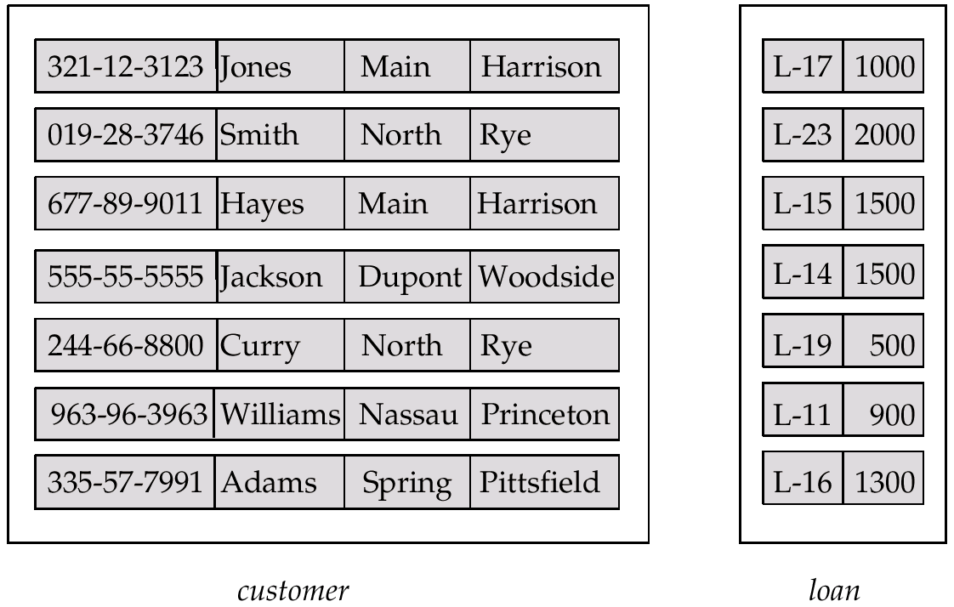
Entity Sets customer and loan
customer-id customer- customer- customer- loan- amount name street city number
8
Notes:
A database thus includes a collection of entity sets, each of which contains any number of entities of the same type.
Each entity can be described by a set of (attribute, data value) pairs, one pair for each attribute of the entity set. For example, a particular customer entity may be described by the set {(customer-id, 677-89-9011), (customer-name, Hayes), (customer-street, Main), (customer-city, Harrison)}

Slide 9
Attributes
An entity is represented by a set of attributes, that is descriptive properties possessed by all members of an entity set
Domain – the set of permitted values for each attribute
Example:
customer = (customer-id, customer-name, customer-street, customer-city) loan = (loan-number, amount)
9
Notes:
• Simple and composite attributes. In our examples thus far, the attributes have been simple; that is, they are not divided into subparts. Composite attributes, on the other hand, can be divided into subparts (that is, other attributes). For example, an attribute name could be structured as a composite attribute consisting of first-name, middle-initial, and last-name.
• Single-valued and multivalued attributes. The attributes in our examples all have a single value for a particular entity. For instance, the loan-number attribute for a specific loan entity refers to only one loan number. Such attributes are said to be single valued. There may be instances where an attribute has a set of values for a specific entity. Consider an employee entity set with the attribute phone-number. An employee may have zero, one, or several phone numbers, and different employees may have different numbers of phones. This type of attribute is said to be multivalued.
• Derived attribute. The value for this type of attribute can be derived from the values of other related attributes or entities. For instance, let us say that the customer entity set has an attribute loans-held, which represents how many loans a customer has from the bank. We can derive the value for this attribute by counting the number of loan entities associated with that customer. As another example, suppose that the customer entity set has an attribute age, which indicates the customer’s age. If the customer entity set also has an attribute date-of-birth, we can calculate age from date-of-birth and the current date. Thus, age is a derived attribute. In this case, date-of-birth may be referred to as a base attribute, or a stored attribute. The value of a derived attribute is not stored, but is computed when required.
An attribute takes a null value when an entity does not have a value for it.

Slide 10
Attribute Types
Simple and composite attributes
Single-valued and multi-valued attributes
E.g. multivalued attribute: phone-numbers
Derived attributes
Can be computed from other attributes
E.g. age, given date of birth
10

Slide 11
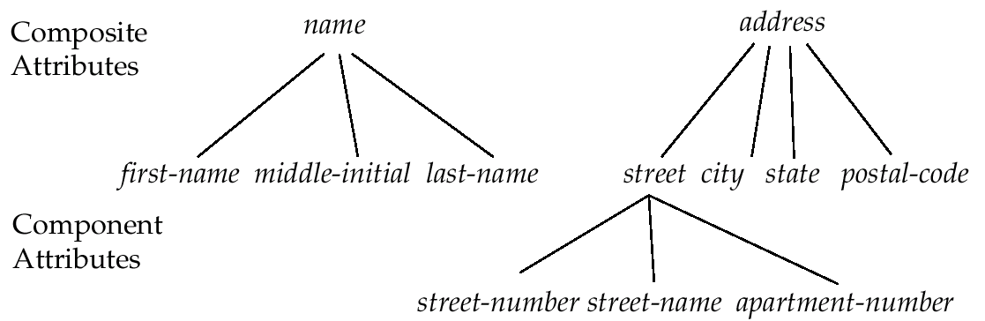
Composite Attributes
11

Slide 12
Relationship
A relationship is an association among several entities
Example:
Hayes depositor A-102 customer entity relationship set account entity
12

Slide 13
Relationship Sets
A relationship set is a set of relationships of the same type. Formally, it is a mathematical relation on n ≥ 2 entities, each taken from entity sets
If E₁, E₂,…,E_{n} are entity sets, then a relationship set R is a subset of
{(e₁, e₂, … e_{n}) | e₁ ∈ E₁, e₂ ∈ E₂, …, e_{n} ∈ E_{n}} where (e₁, e₂, …, e_{n}) is a relationship
The association between entity sets is referred to as participation; that is, the entity sets E₁, E₂, . . .,E_{n} participate in relationship set R.
13

Slide 14
Mapping Cardinalities
Express the number of entities to which another entity can be associated via a relationship set.
Most useful in describing binary relationship sets.
For a binary relationship set the mapping cardinality must be one of the following types:
One to one
One to many
Many to one
Many to many
14

Slide 15
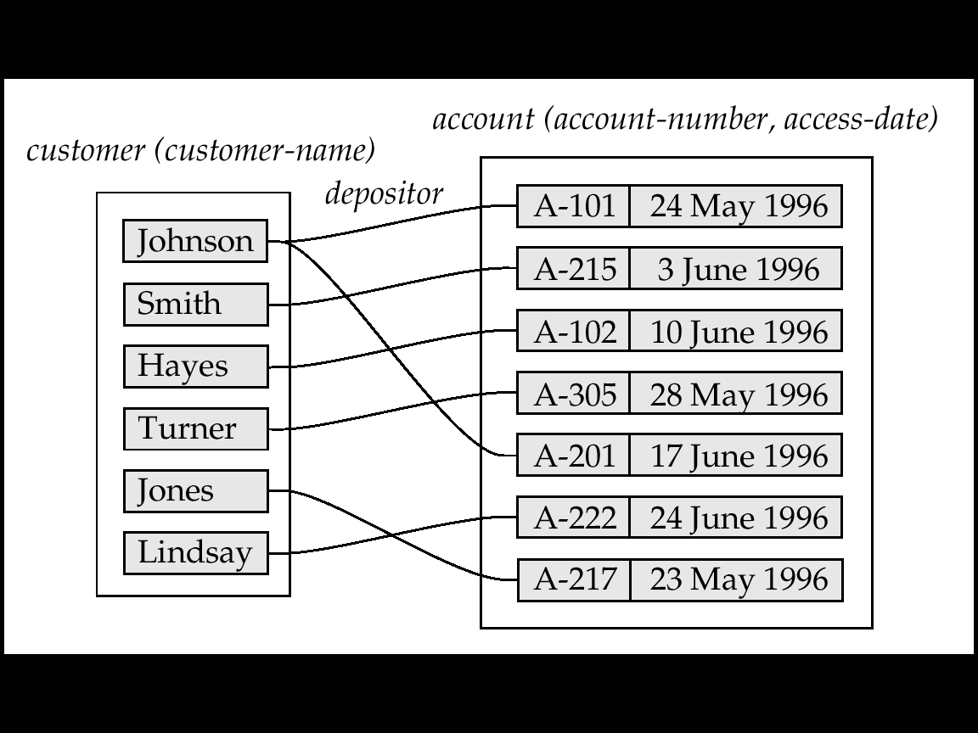
Mapping Cardinalities affect ER Design
Can make access-date an attribute of account, instead of a relationship attribute, if each account can have only one customer
i.e., the relationship from account to customer is many to one, or equivalently, customer to account is one to many
15

Slide 16
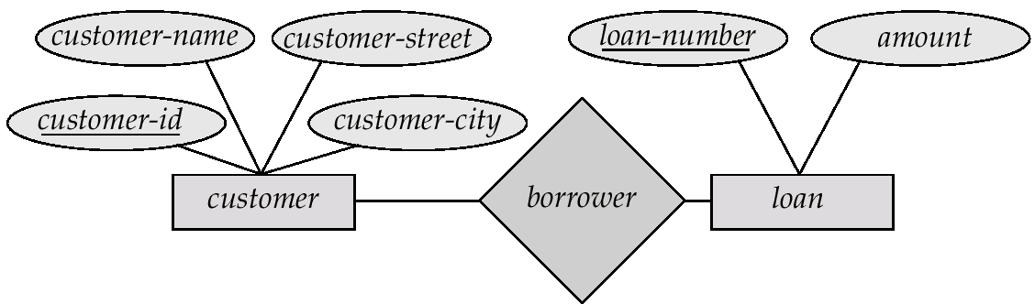
E-R Diagrams
Rectangles represent entity sets.
Diamonds represent relationship sets.
Lines link attributes to entity sets and entity sets to relationship sets.
Ellipses represent attributes
Double ellipses represent multivalued attributes.
Dashed ellipses denote derived attributes.
Underline indicates primary key attributes
16

Slide 17
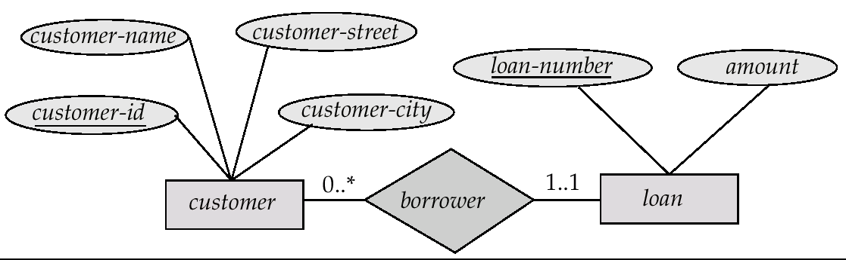
Alternative Notation for Cardinality Limits
Cardinality limits can also express participation constraints
Customer can have zero or more loans
Each loan must have exactly one associated customer
Minimum value of 1 => total participation of entity set in the relationship set
Maximum value of 1 => entity participates in at most one relationship
Maximum value * => no limit
1..* => double line
17

Slide 18
Keys
Key is used to identify a set of attributes that suffice to distinguish entities from each other. Keys uniquely identify the entity
A super key of an entity set is a set of one or more attributes whose values uniquely determine each entity
customer_id is super key of customer
Customer_id and customer_name is superkey of customer
A candidate key of an entity set is a minimal super key
customer-id is candidate key of customer
account-number is candidate key of account
Although several candidate keys may exist, one of the candidate keys is selected to be the primary key. The primary key should be chosen such that its attributes are never, or very rarely changed
18

Slide 19
Extended E-R Features
Specialization
Generalization
Aggregation

Slide 20
Specialization
Top-down design process; we designate subgroupings within an entity set that are distinctive from other entities in the set.
These subgroupings become lower-level entity sets that have attributes or participate in relationships that do not apply to the higher-level entity set.
Depicted by a triangle component labeled ISA (E.g. customer “is a” person).
Attribute inheritance – a lower-level entity set inherits all the attributes and relationship participation of the higher-level entity set to which it is linked.
20

Slide 21
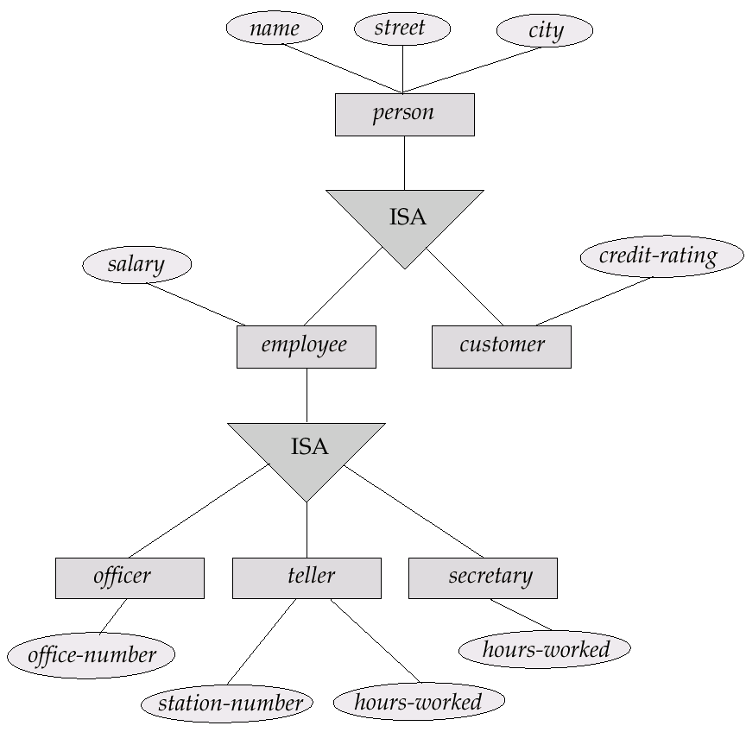
Specialization Example
21

Slide 22
Generalization
A bottom-up design process – combine a number of entity sets that share the same features into a higher-level entity set.
Specialization and generalization are simple inversions of each other; they are represented in an E-R diagram in the same way.
The terms specialization and generalization are used interchangeably.
22

Slide 23
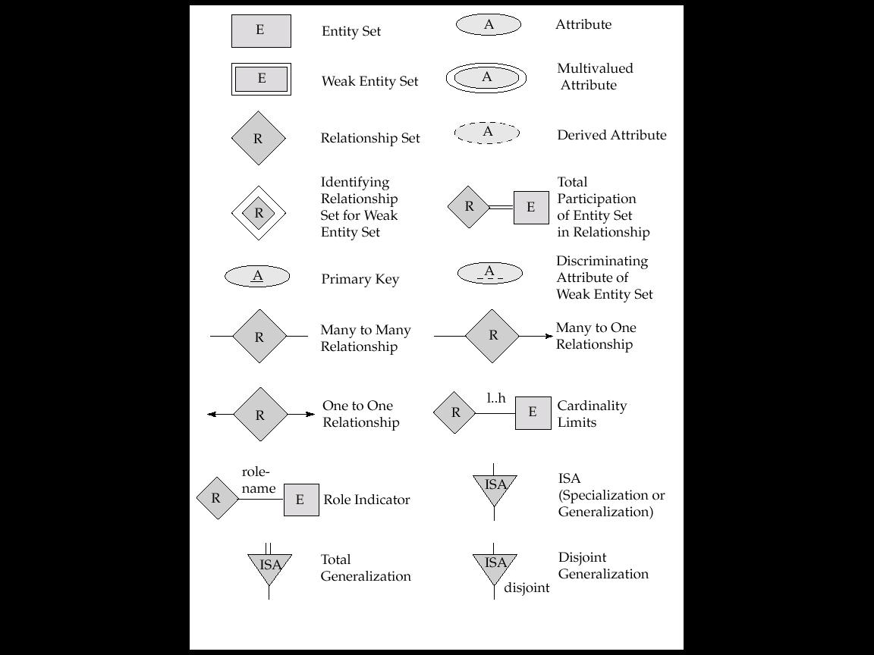
Summary of Symbols Used in E-R Notation
23

Slide 24
Summary of Symbols (Cont.)
24

Slide 25
Database design for Banking Enterprise
Data Requirements
The bank is organized into branches. Each branch is located in a particular city and is identified by a unique name. The bank monitors the assets of each branch.
Bank customers are identified by their customer-id values. The bank stores each customer’s name, and the street and city where the customer lives. Customers may have accounts and can take out loans. A customer may be associated with a particular banker, who may act as a loan officer or personal banker for that customer.
Bank employees are identified by their employee-id values. The bank administration stores the name and telephone number of each employee, the names of the employee’s dependents, and the employee-id number of the employee’s manager. The bank also keeps track of the employee’s start date and, thus, length of employment.
25

Slide 26
Database design for Banking Enterprise
Data Requirements (contd.)
The bank offers two types of accounts—savings and checking accounts. Accounts can be held by more than one customer, and a customer can have more than one account. Each account is assigned a unique account number. The bank maintains a record of each account’s balance, and the most recent date on which the account was accessed by each customer holding the account. In addition, each savings account has an interest rate, and overdrafts are recorded for each checking account.
A loan originates at a particular branch and can be held by one or more customers. A loan is identified by a unique loan number. For each loan, the bank keeps track of the loan amount and the loan payments. Although a loan-payment number does not uniquely identify a particular payment among those for all the bank’s loans, a payment number does identify a particular payment for a specific loan. The date and amount are recorded for each payment.
26

Slide 27
Database design for Banking Enterprise
Entity sets designation
The branch entity set, with attributes branch-name, branch-city, and assets.
The customer entity set, with attributes customer-id, customer-name, customer-street; and customer-city. A possible additional attribute is banker-name.
The employee entity set, with attributes employee-id, employee-name, telephone-number, salary, and manager. Additional descriptive features are the multivalued attribute dependent-name, the base attribute start-date, and the derived attribute employment-length.
Two account entity sets—savings-account and checking-account—with the common attributes of account-number and balance; in addition, savings-account has the attribute interest-rate and checking-account has the attribute overdraft-amount.
The loan entity set, with the attributes loan-number, amount, and originating-branch.
The weak entity set loan-payment, with attributes payment-number, payment-date, and payment-amount.
27

Slide 28
Database design for Banking Enterprise
Relationship sets designation
borrower, a many-to-many relationship set between customer and loan.
loan-branch, a many-to-one relationship set that indicates in which branch a loan originated. Note that this relationship set replaces the attribute originating-branch of the entity set loan.
loan-payment, a one-to-many relationship from loan to payment, which documents that a payment is made on a loan.
depositor, with relationship attribute access-date, a many-to-many relationship set between customer and account, indicating that a customer owns an account.
cust-banker, with relationship attribute type, a many-to-one relationship set expressing that a customer can be advised by a bank employee, and that a bank employee can advise one or more customers. Note that this relationship set has replaced the attribute banker-name of the entity set customer.
works-for, a relationship set between employee entities with role indicators manager and worker; the mapping cardinalities express that an employee works for only one manager and that a manager supervises one or more employees. Note that this relationship set has replaced the manager attribute of employee.
28

Slide 29
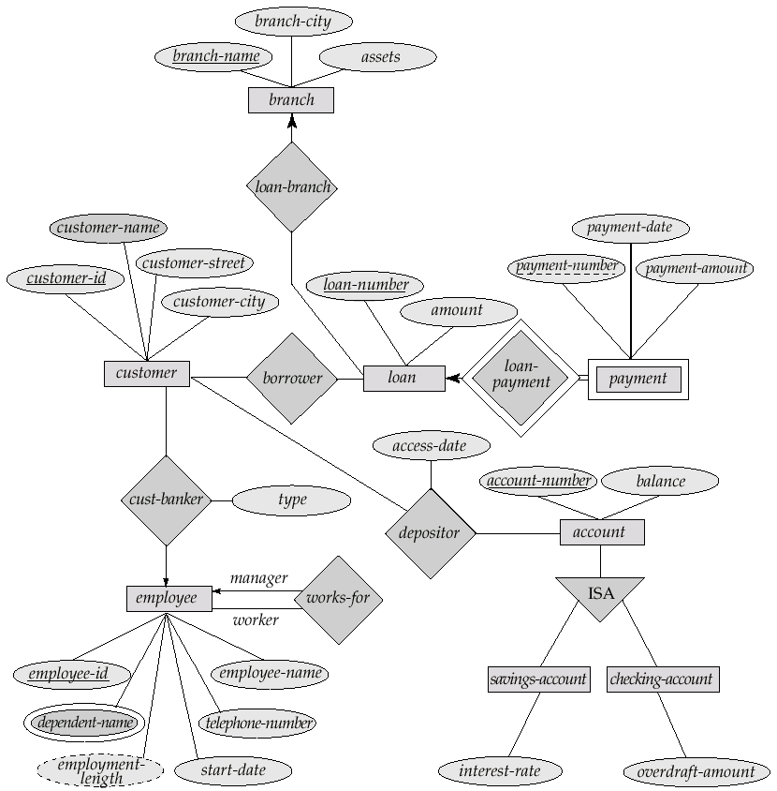
E-R Diagram for a Banking Enterprise
29

Slide 30
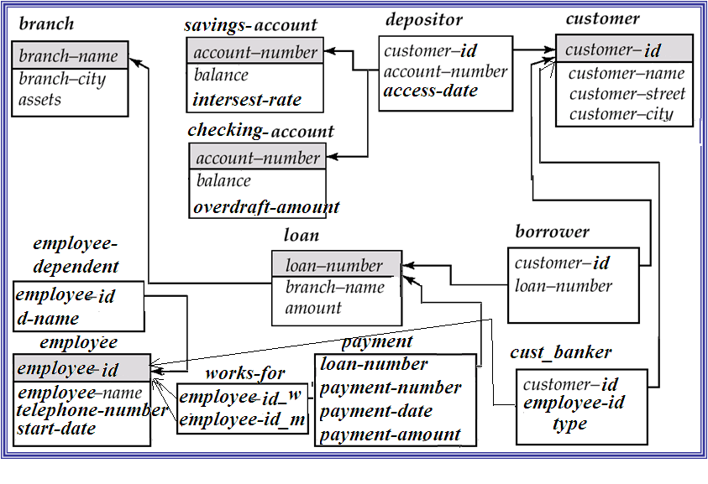
Schema Diagram for the Banking Enterprise

Slide 31
Data Modeling and SQL
[Module – 2]
WCE - TY (CSE) – CS 307: Database Engineering
Subject Teacher: Dr. Smriti Bhandari

Slide 32
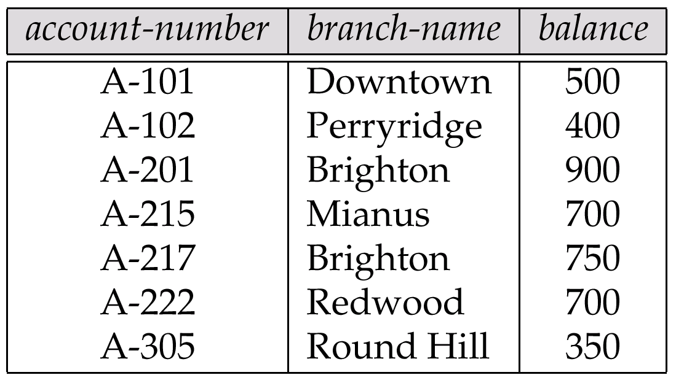
Example of a Relation
Attributes
Domain – set of permitted values for each attribute

Slide 33
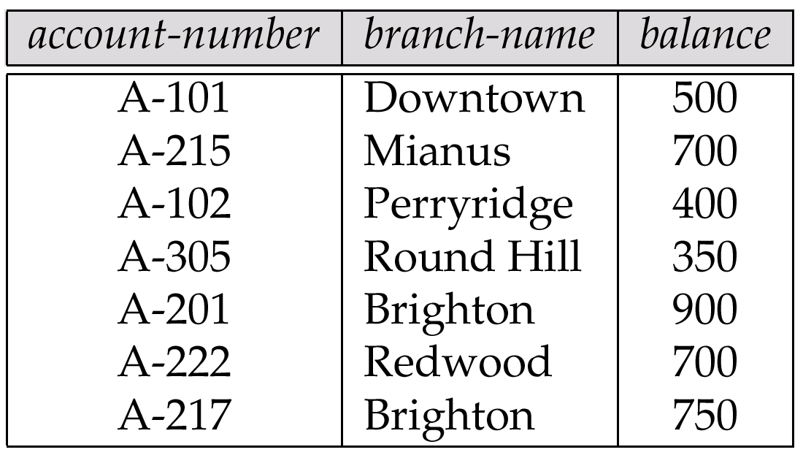
Relations are Unordered
Order of tuples is irrelevant (tuples may be stored in an arbitrary order)
E.g. account relation with unordered tuples

Slide 34
Structured Query Language (SQL)

