Slide 1
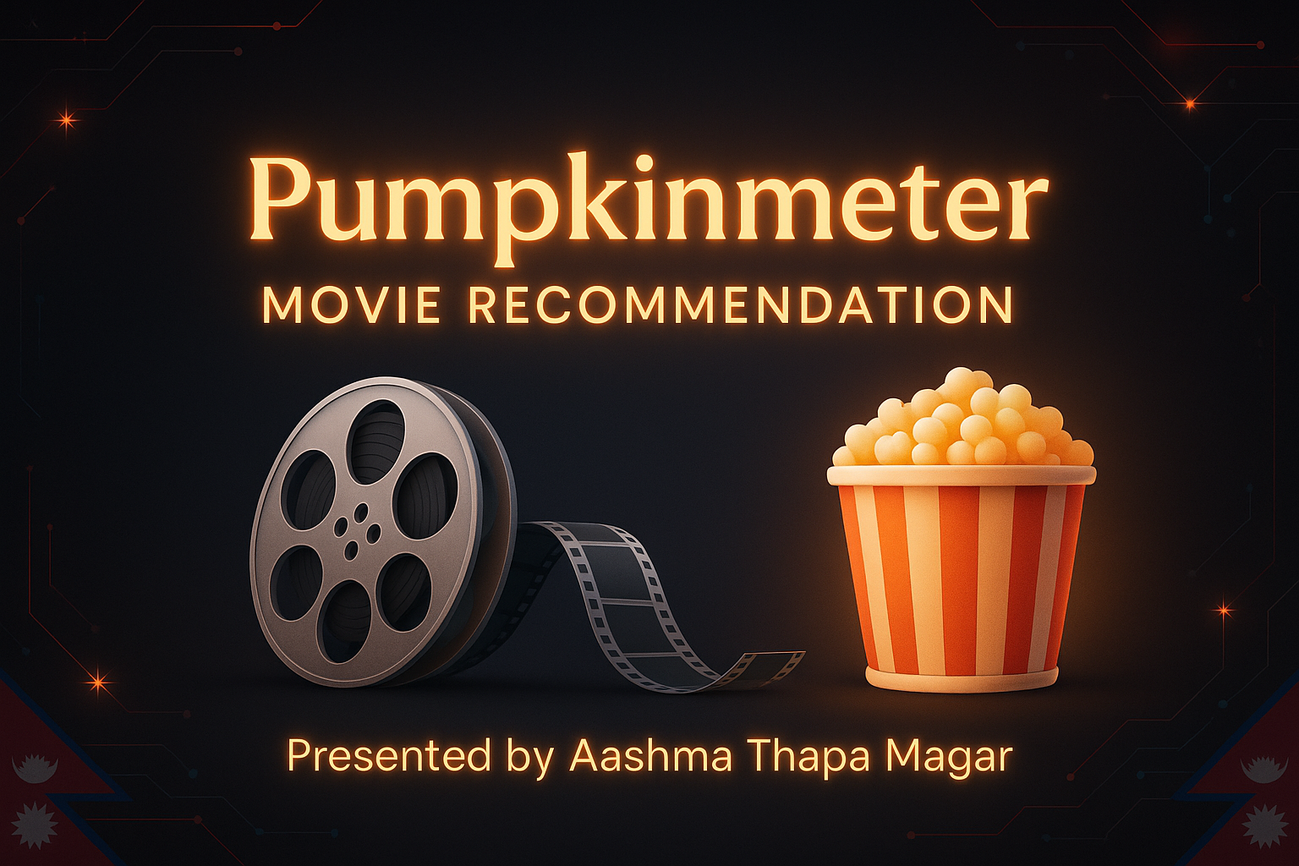

Slide 2
Business Proposal
Ripe Pumpkins, a movie review startup, aims to implement a collaborative filtering engine called 'Pumpkinmeter'.
Inspired by successful platforms like Netflix.
Goal: Use Spark ALS to recommend top movies based on user behavior.

Slide 3
Dataset Overview
Dataset: MovieLens 25M
- 27M ratings, 58K movies, 280K users
- Includes genres, tags, timestamps
Source: https://grouplens.org/datasets/movielens/

Slide 4
Method – Spark ALS Model
Technology: Apache Spark MLlib
Algorithm: Alternating Least Squares (ALS)
Tools: PySpark, Jupyter Notebook
Users manually rated 10 movies each
Two scenarios analyzed:
- Full dataset
- Filtered dataset (movies with ≥100 ratings)

Slide 5
Scenario 1 Results (User 1 & User 2)
User 1 – Ashma:
- Diverse, personalized recommendations
- Included niche and lesser-known movies
User 2 – Friend:
- Similar variety, slightly less aligned
Data: All movies with ≥25 ratings

Slide 6
Scenario 2 Results (User 1 & User 2)
Filtered Dataset: Movies with ≥100 ratings
User 1 – Ashma:
- Popular, well-rated suggestions
User 2 – Friend:
- Mainstream blockbusters
Tradeoff: More reliable, less diverse

Slide 7
Insights & Recommendations
Scenario 1: Best for returning users – high personalization
Scenario 2: Ideal for new users – trustworthy results
Recommended hybrid model: Start with Scenario 2, transition to 1
Business Impact: Better engagement and retention

Slide 8
Final Takeaways
Spark ALS scales efficiently to 27M+ records
Personalized recommendations possible with 10 ratings
Pumpkinmeter is scalable and practical for production use
Next Step: Deploy in a real-time recommender system

