Slide 1
LENDING CLUB CASE STUDY ANALYSIS
Submitted by
Aashna Behl

Slide 2
Problem Statement
We are provided with real world data of the largest online marketplace facilitating personal loans, business loans, and financing of medical procedures. Borrowers can easily access lower interest rate loans through a fast online interface.
Like most other lending companies, lending loans to ‘risky’ applicants is the largest source of financial loss (called credit loss). Credit loss is the amount of money lost by the lender when the borrower refuses to pay or runs away with the money owed. In other words, borrowers who default cause the largest amount of loss to the lenders. In this case, the customers labelled as 'charged-off' are the 'defaulters'.
The goal is to identify the risky applicants based on the EDA techniques and share the recommendations for the same.

Slide 3
Analysis Approach
- Clean the data
- Understand Patterns of each variable individually.
- Understand Patterns of multiple variables with each other.
- Give recommendations based on the patterns.

Slide 4
Univariate Analysis
Analysis done for both categorical and numerical features.
- Higher loan amounts have higher defaulters.
- Higher grade and Sub Grade loans have higher number of defaulters.
- Verification Process does not seem to be effective, since unverified borrowers are the highest defaulters.
- Educational , Renewable energy and Small Business Loans are risky
- Borrowers Public Record Bankruptcies and/or derogatory Public records are risky
Any sort of delinquency is risky.
More enquiries are risky.

Slide 5
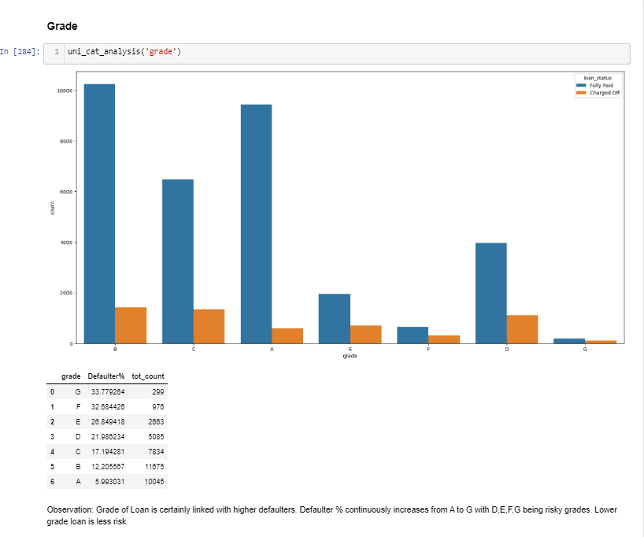

Slide 6
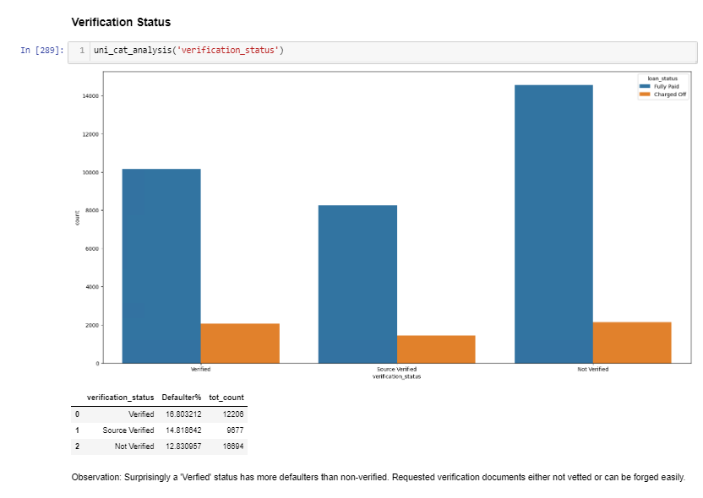

Slide 7
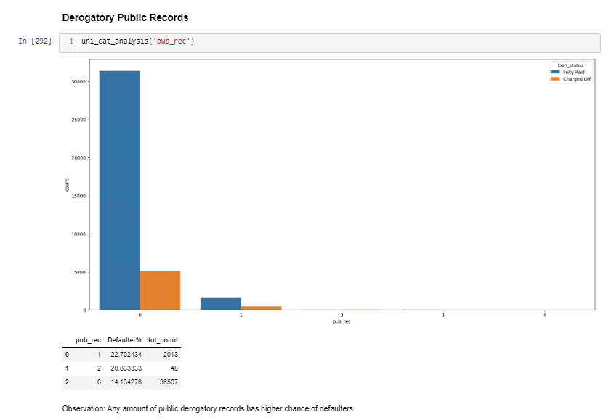

Slide 8
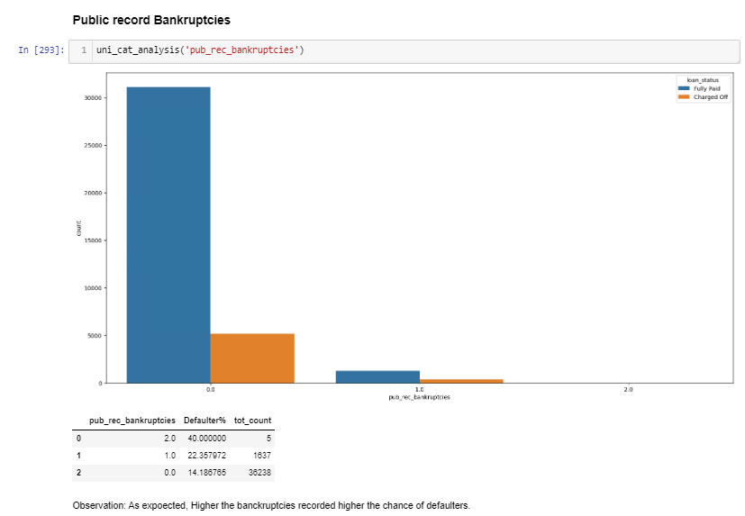

Slide 9
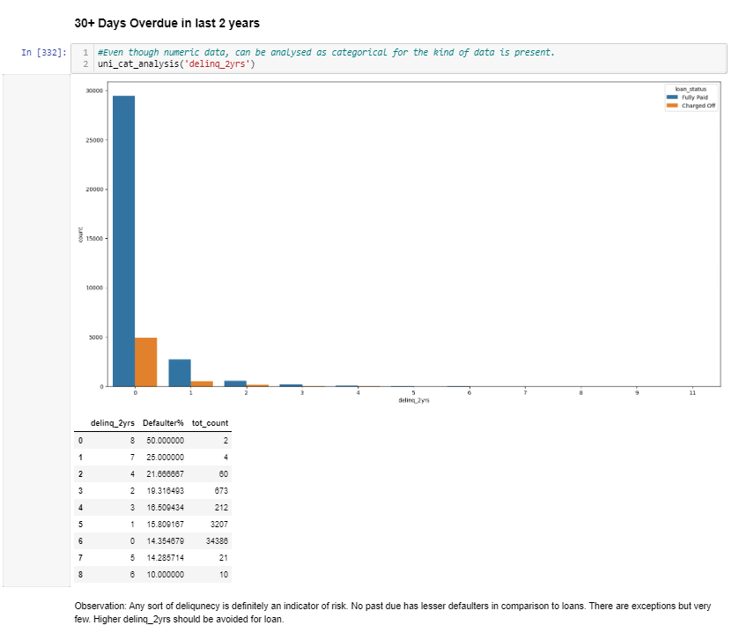

Slide 10
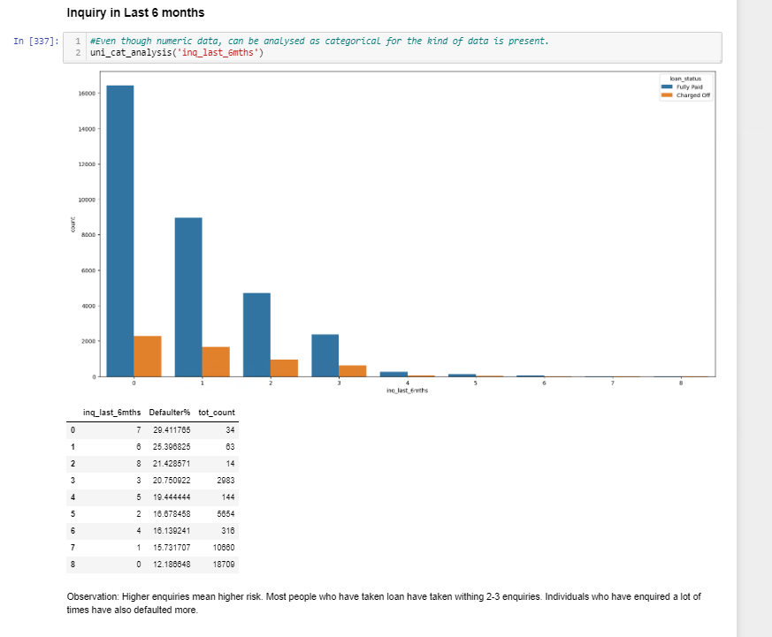

Slide 11
Bivariate Analysis
Home improvement , Renewable energy loans and house loans are higher in higher income groups.
House loans are safer in higher grades but riskier in lower grades.
Car Loans, Credit card loans and small business loans are risky in December.
4 states WT, MT, UT and TN are risky. Credit card loans have the highest risk in these states, and higher income groups interestingly are more risky in these states.

Slide 12
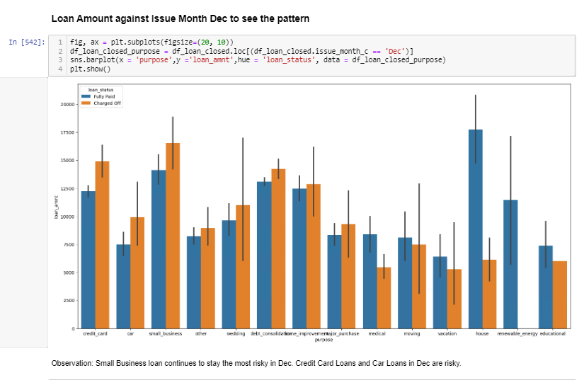

Slide 13
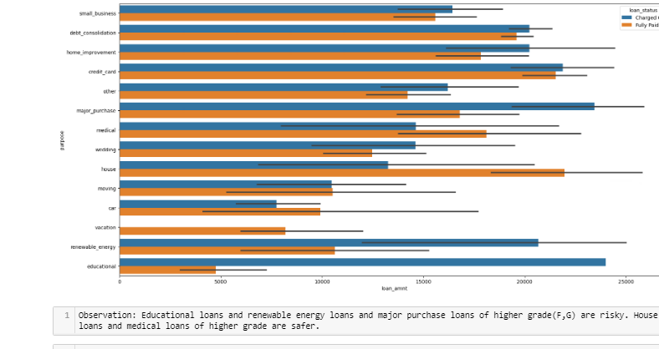

Slide 14
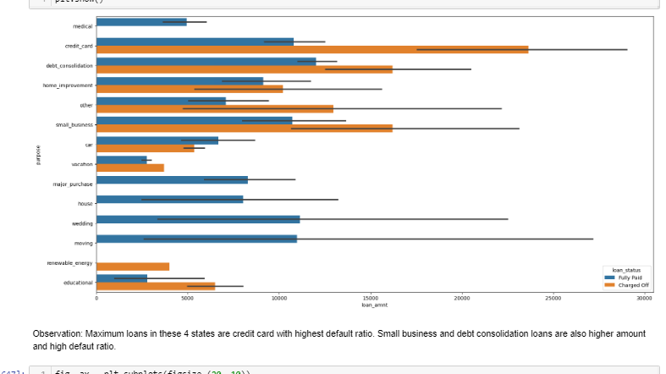

Slide 15
Summary
Make verification status stringent.
Check for public record bankruptcies and derogatory public records
High debt to income ratio risky.
Check credit card loans in WY, MT, UT, TN
Missing employment records risky.
Any delinquency is high risk.
High number of inquiries are high risk.

