Slide 1
Big Data Final Project
Flight Rate Prediction
Team members:
Aashritha Dodda(S559361)
Sai Prashanth Volete(S559234)
Maheshwar Punyam(S559173)
Venkateshwar Reddy Potlolla(S555897)
Parvathaneni Karthik(S559449)

Slide 2
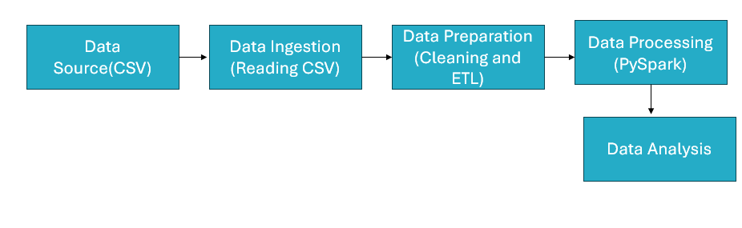
Project Architecture

Slide 3
Goals Achieved
GOAL 1: To calculate the average fare for each airline
GOAL 2: To determine the number of flights operated by each airline.
GOAL 3: To identify the number of fares for each airline that are more than the median fare of that airline’s flights.
GOAL 4: To determine the minimum fare for each route.
GOAL 5: How does the number of ticket purchases vary over time? Are there specific days or months when ticket purchases peak?
GOAL 6: To find the average fare for each unique route, sorted from highest to lowest.
GOAL 7: To identify any preferences among passengers for specific airlines, routes, or departure times.

Slide 4
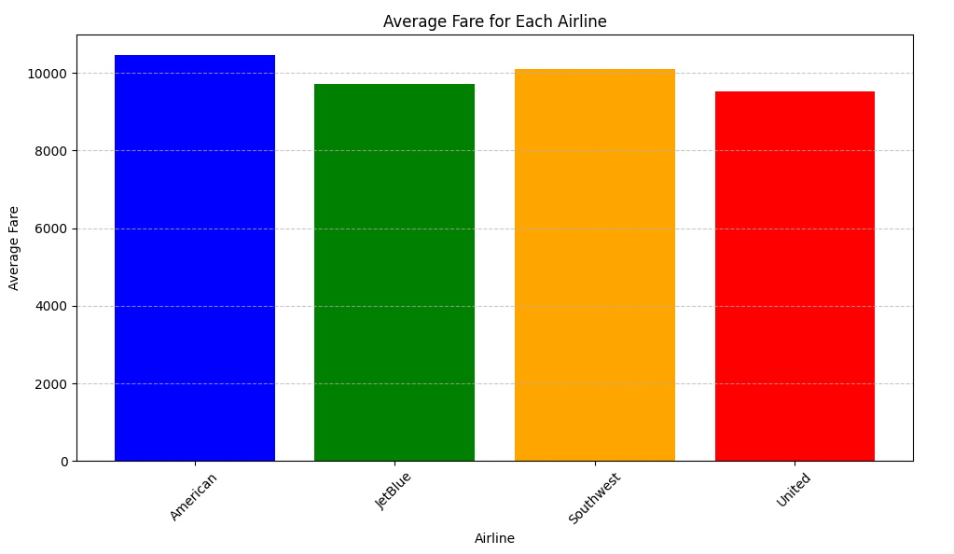
Goal-1:
To calculate the average fare for each airline

Slide 5
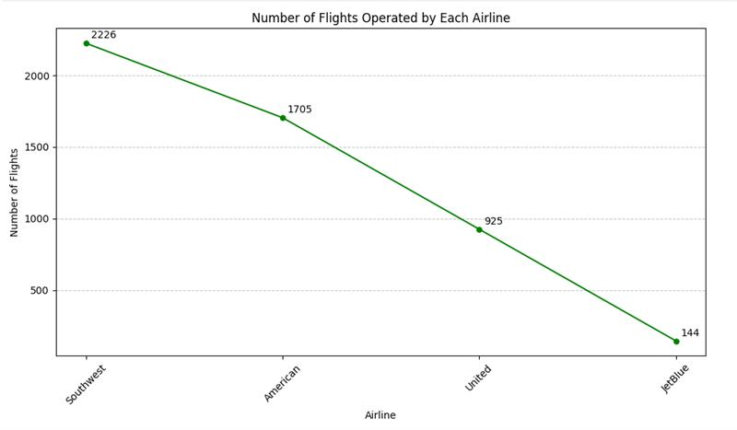
Goal-2:
To determine the number of flights operated by each airline.

Slide 6
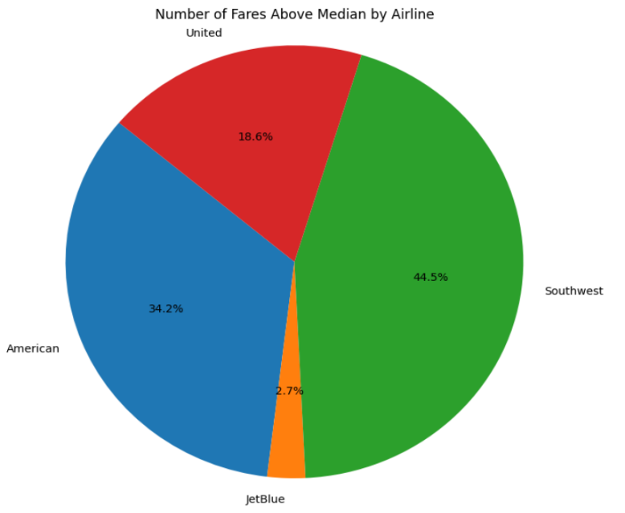
Goal-3:
To identify the number of fares for each airline that are more than the median fare of that airline’s flights.

Slide 7
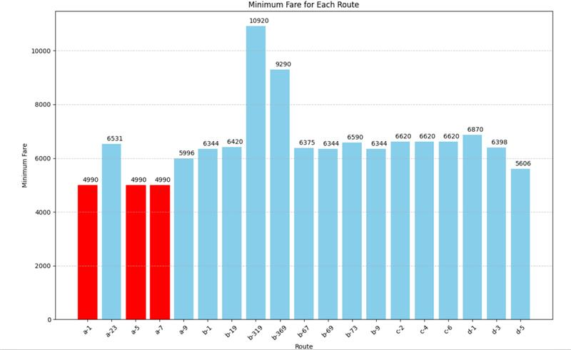
Goal-4:
To determine the minimum fare for each route.

Slide 8
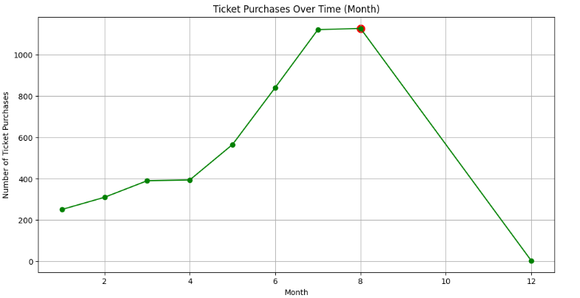
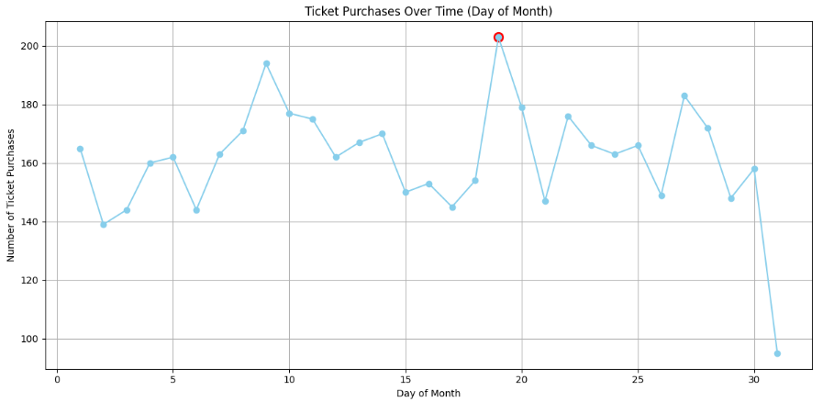
Goal-5:
How does the number of ticket purchases vary over time? Are there specific days or months when ticket purchases peak?

Slide 9
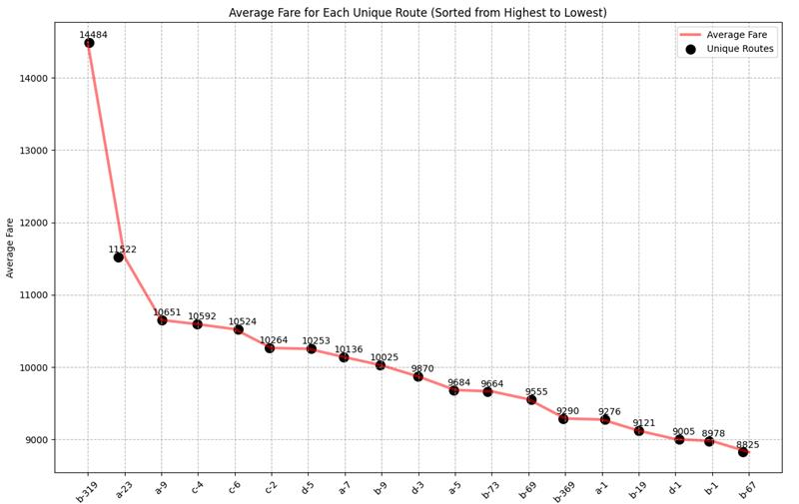
Goal-6:
To find the average fare for each unique route, sorted from highest to lowest.

Slide 10
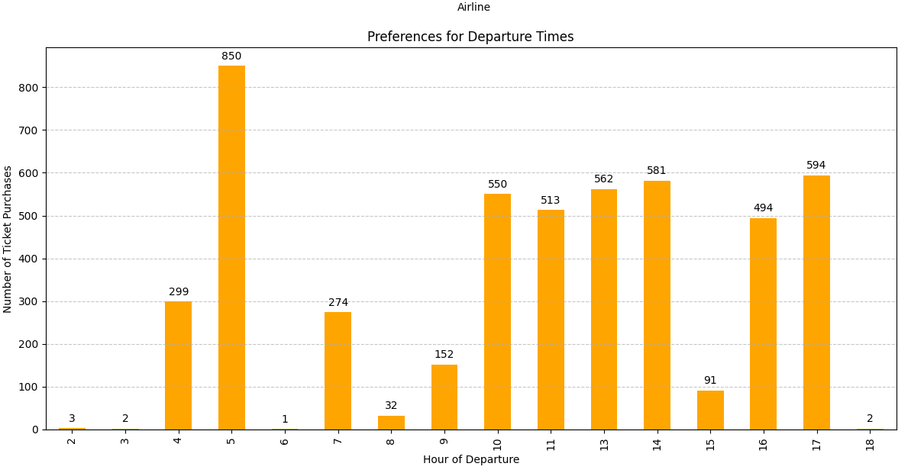
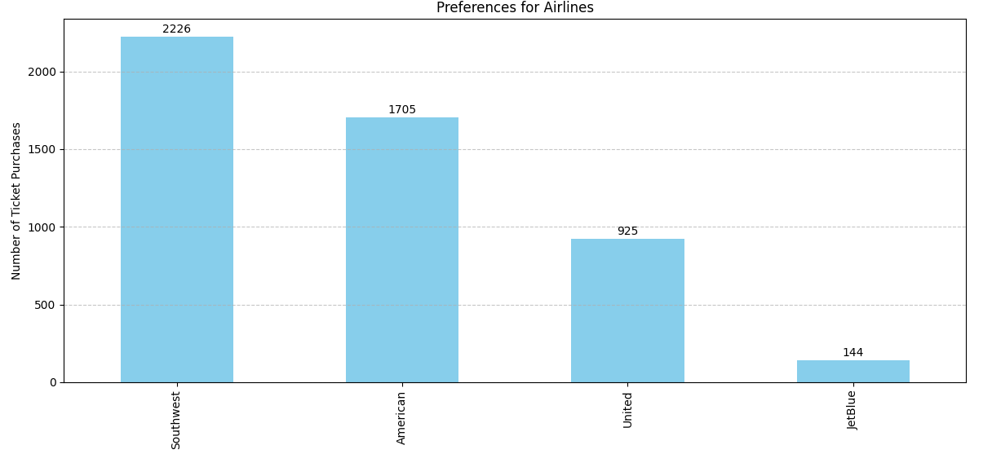
Goal-7:
To identify any preferences among passengers for specific airlines, routes, or departure times.

Slide 11
Issues Faced
Data parsing errors
Encoding and delimiter issues
Null handling complexities
Memory and performance constraints

Slide 12
Conclusion
The analysis reveals a competitive airline industry with varied fare distributions, where Southwest leads in operations, possibly indicating market dominance. American Airlines stands out with higher fares, contrasting with Southwest's popularity among passengers, particularly during evening hours. These insights inform strategic decisions in pricing, route planning, and marketing to enhance competitiveness and passenger satisfaction.

Slide 13

Thank you

