Slide 1
Lung Cancer Prediction Using Machine Learning
Aashritha Goud Marupalli 700764122
Bhavani Bhimavaram 700752330
Rohini Muniganti 700762192
Jahnavi Kandi 700758103

Slide 2

Abstract
Lung cancer remains one of the most life-threatening diseases globally due to late-stage diagnosis.
This project leverages supervised machine learning algorithms to predict the likelihood of lung cancer in individuals based on survey responses.
The dataset includes demographic information and symptoms-related features. Various models including Logistic Regression, Decision Tree, Random Forest were trained and evaluated.
The project focuses on preprocessing techniques, model training, performance evaluation, and selecting the best classifier to assist in early detection and potential life-saving interventions.

Slide 3
Project Objective
To develop a machine learning-based predictive model for early detection of lung cancer using survey data. The aim is to evaluate and compare multiple classification algorithms to identify the most accurate model for diagnosing lung cancer based on patient symptoms and history.

Slide 4
Tools & Libraries used:
Python (Jupyter Notebook environment)
Pandas – for data handling and manipulation
Matplotlib, Seaborn – for Data Visualizations
Scikit-learn – for model building and evaluation
LabelEncoder, StandardScaler – for Data preprocessing

Slide 5
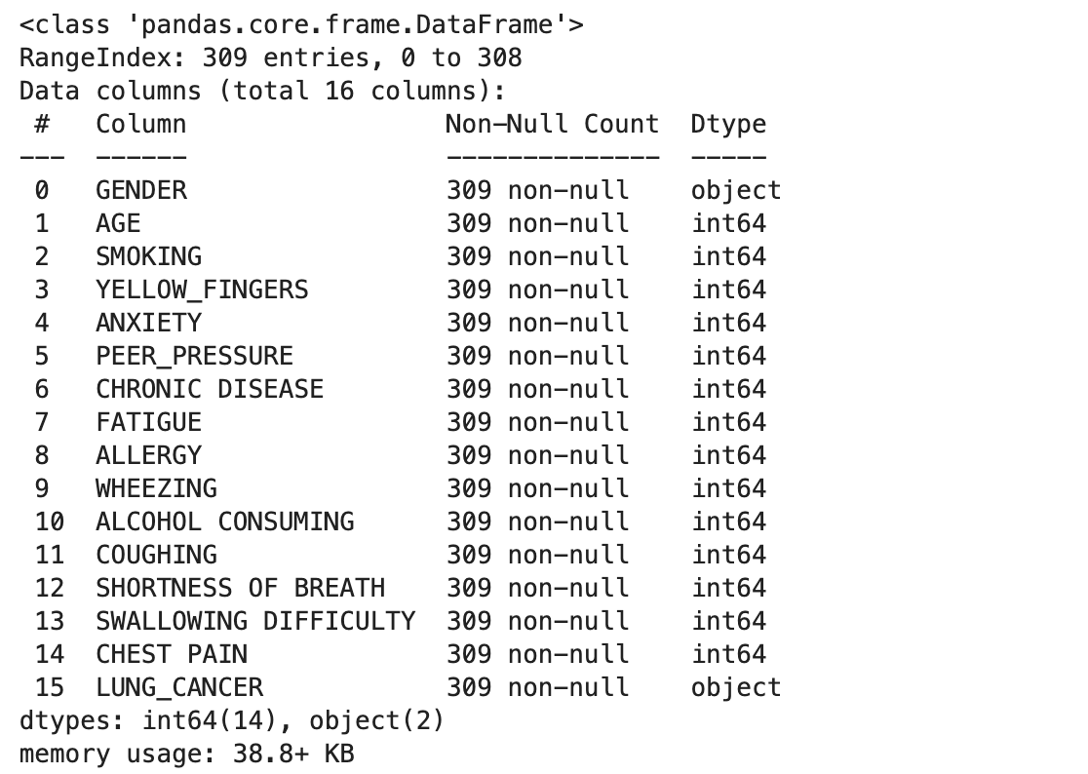
Data Set & Feature Overview
The dataset was loaded from a CSV file named survey lung cancer.csv
Key Features:
Lifestyle Habits: SMOKING, ALCOHOL CONSUMING, PEER_PRESSURE
Symptoms & Conditions: YELLOW_FINGERS, COUGHING, CHEST PAIN, SHORTNESS OF BREATH, FATIGUE
Psychological & Medical History: ANXIETY, CHRONIC DISEASE, ALLERGY
Target Variable:
Lung Cancer presence= YES Lung Cancer Absence =NO

Slide 6
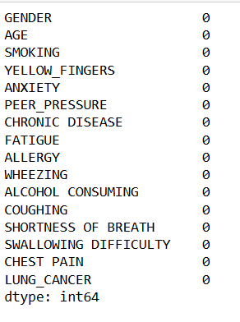
Data Preprocessing
Stripped leading whitespace from column names.
Converted categorical values to binary using Label Encoding (1 = Yes, 0 = No).
Removed null values to ensure clean input for model training.
Eliminated duplicate records to avoid bias in prediction

Slide 7
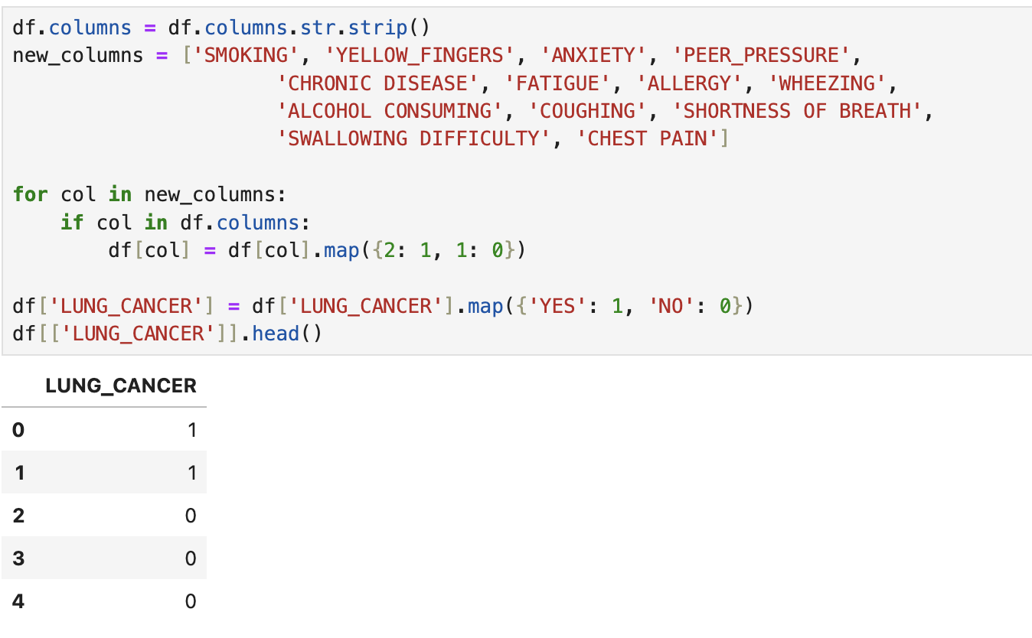
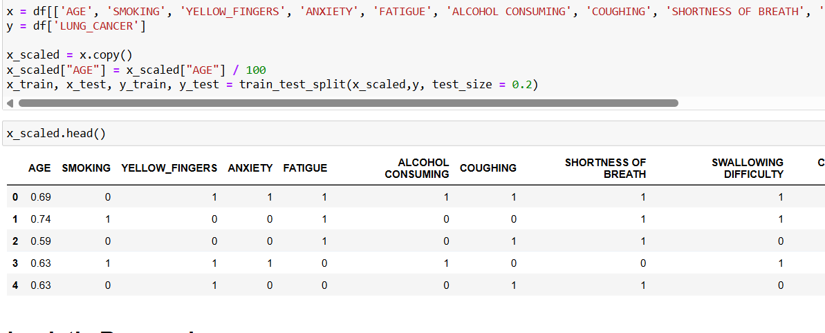
Data Preprocessing
Data Manipulation Data Scaling

Slide 8
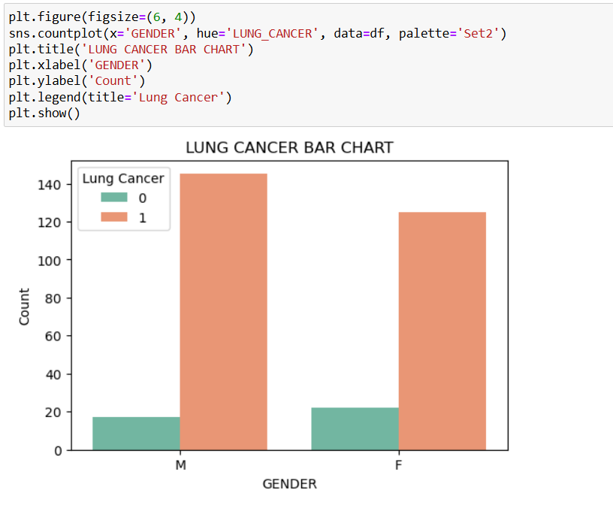
Exploratory Data Analysis (EDA)
To identify patterns, correlations, and trends in the dataset that could influence lung cancer predictions
Gender vs Lung Cancer:
Count plots show the distribution of lung cancer cases across different genders.

Slide 9
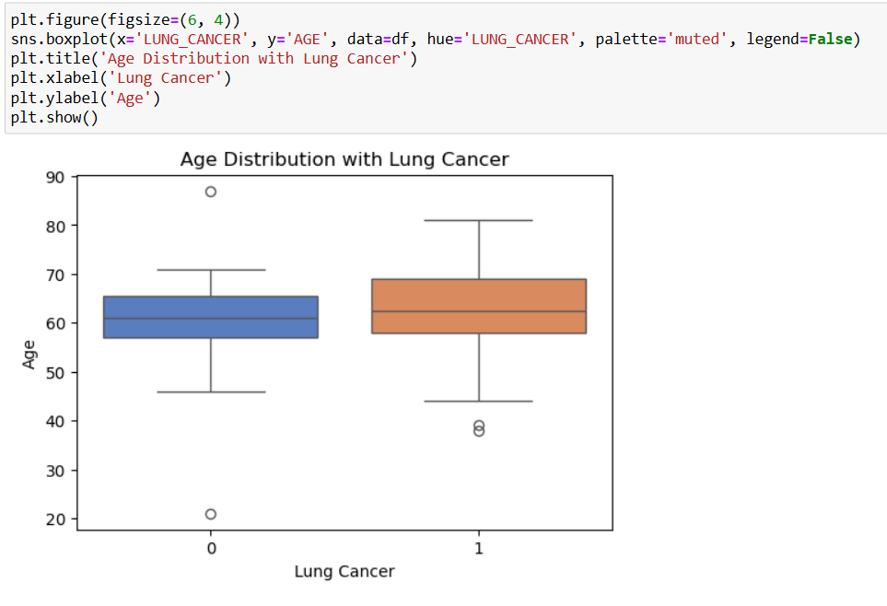
Exploratory Data Analysis (EDA)
To identify patterns, correlations, and trends in the dataset that could influence lung cancer predictions
Age Factor:
Box plots reveal a higher tendency of lung cancer occurrence in certain age ranges.

Slide 10
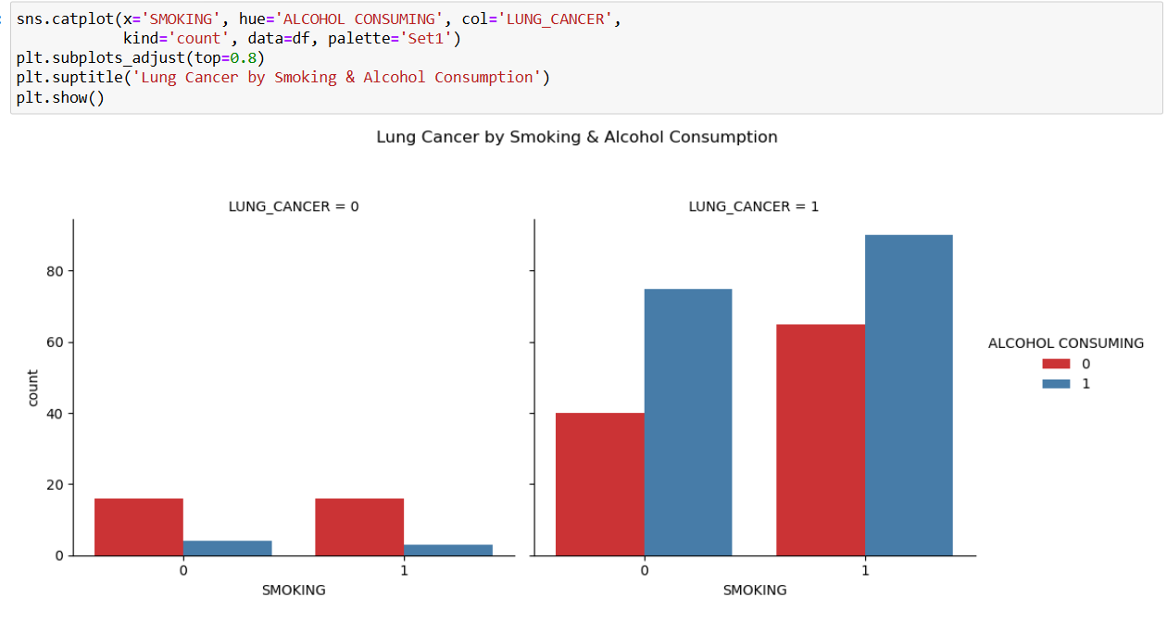
Exploratory Data Analysis (EDA)
To identify patterns, correlations, and trends in the dataset that could influence lung cancer predictions
Lifestyle Correlations:
Smokers and alcohol consumers show a significantly higher risk of lung cancer.
A categorical plot visualizes the combined influence of smoking and alcohol consumption on lung cancer cases.

Slide 11
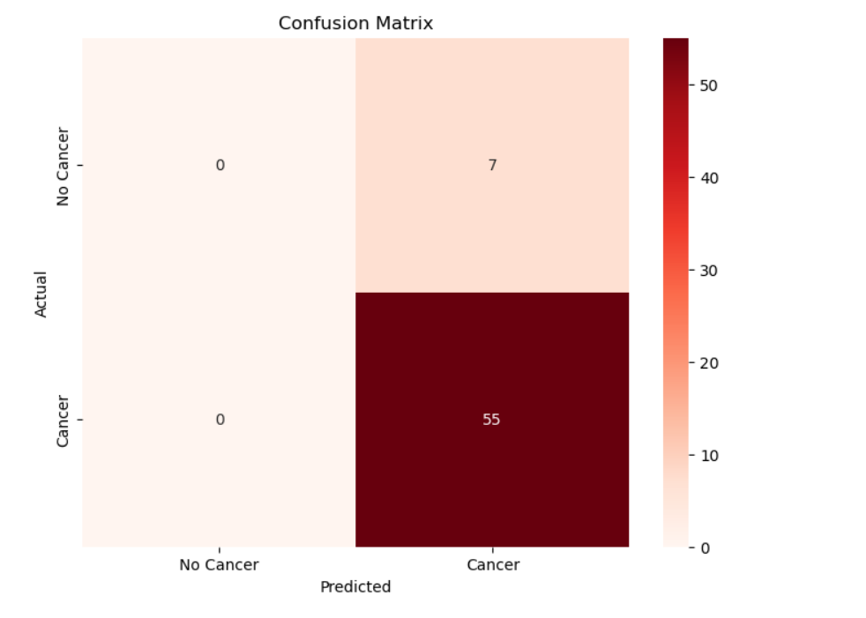
EDA
A confusion matrix was used to evaluate the performance of classification models by comparing predicted labels against actual labels. It provides insights into true positives, false positives, true negatives, and false negatives, helping assess model accuracy and error types.

Slide 12
Machine Learning Models & Methodology
Methodology:
The dataset was preprocessed by encoding categorical variables and removing null/duplicate entries.
Features and labels were split into training and testing sets using an 80:20 ratio.
Standardization was applied where necessary to improve model performance.
Each model was trained, evaluated, and compared using metrics like accuracy, precision, recall, F1-score,
and confusion matrix.

Slide 13
Machine Learning Models & Methodology
Models Implemented:
Logistic Regression: A baseline linear classifier ideal for binary outcomes.
Decision Tree Classifier: Non-linear model that splits data based on feature thresholds.
Random Forest Classifier: Ensemble of decision trees for improved generalization.

Slide 14
Evaluation Metrics & Results
To evaluate and compare model performance, the following metrics were calculated:
Accuracy: Overall how often the model is correct.
Precision: Of all predicted positives, how many were truly positive (reduces false positives).
Recall: Of all actual positives, how many were correctly predicted (reduces false negatives).
F1 Score: A balanced metric combining both precision and recall.

Slide 15
Results Summary:
Model | Accuracy | Precision | Recall | F1 Score
Logistic Regression | ~0.8871 | ~0.8983 | ~0.9815 | ~0.9381
Decision Tree | ~0.8548 | ~0.8814 | ~0.9630 | ~0.9204
Random Forest | ~0.8548 | ~0.8814 | ~0.9630 | ~0.9204
Decision Tree provided interpretable results but had slightly lower performance than ensemble methods.
Random Forest performed the best after hyperparameter tuning, also showed improved and stable results
Logistic Regression, after tuning with GridSearchCV, with the highest accuracy and balanced precision/recall.

Slide 16
Conclusion
Key Takeaways:
Successfully built a lung cancer prediction system using machine learning techniques on survey-based health data.
Applied Logistic Regression, Decision Tree, and Random Forest classifiers for binary classification.
After hyperparameter tuning, Logistic Regression delivered the highest performance across all key evaluation metrics.
The models were evaluated using accuracy, precision, recall, F1-score, and confusion matrix, ensuring reliable performance analysis.
Overall Impact:
This project demonstrates the potential of ML in assisting early-stage lung cancer detection using simple, accessible survey features.
It can support healthcare professionals with a quick, preliminary screening tool — especially in resource-constrained settings.
---------------------------------------------Thank You-------------------------------------------------

