Slide 1


media
DECODING THE 2026
TAMIL NADU ASSEMBLY ELECTION
Domain: Media & Politics

Slide 2
COVERING 3 MAJOR STORIES
THE GEOGRAPHIC STORY
THE FLIP STORY
THE TURNOUT STORY

Slide 3
THE GEOGRAPHIC STORY
— “Where was political power concentrated?”

Slide 4
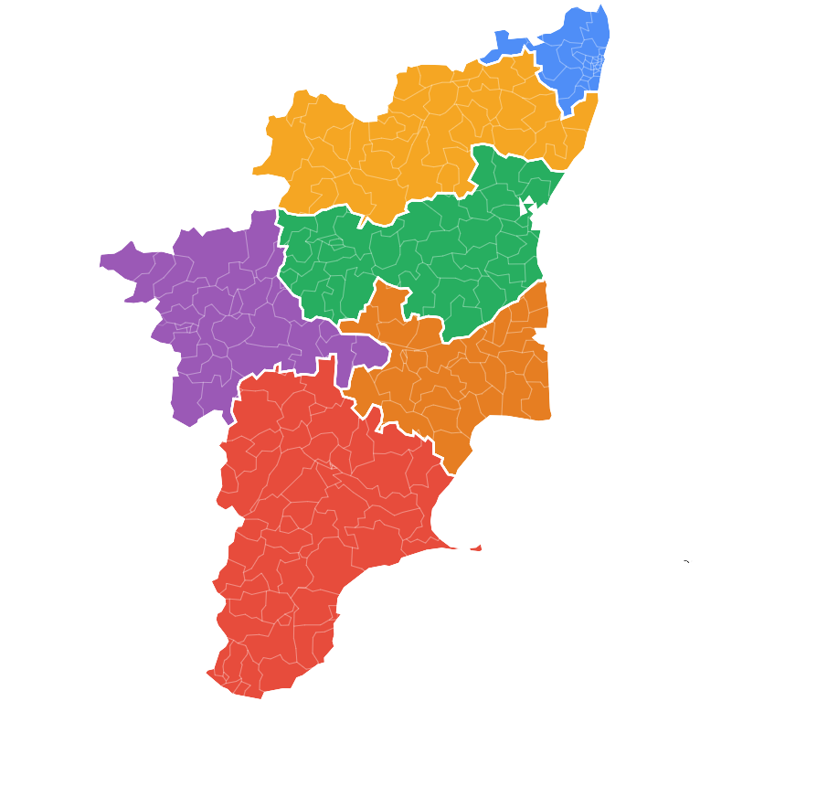
Chennai Metro
North
32 seats
37 seats
Central
Kongu
41 seats
33 seats
Delta
33 seats
South
58 seats

Slide 5
WINNING PARTIES OVERVIEW
⟶

Slide 6
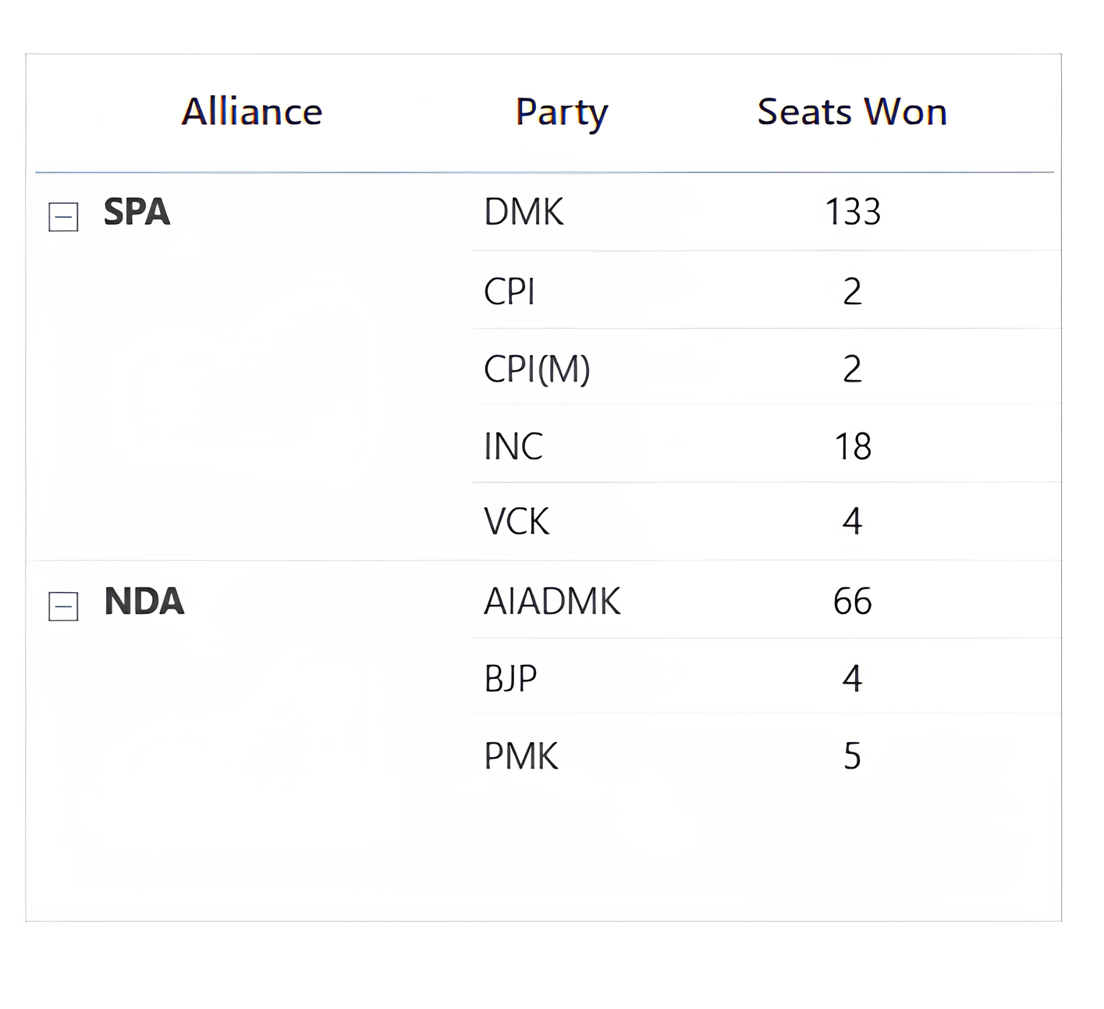
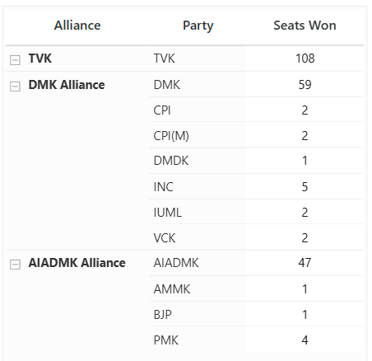

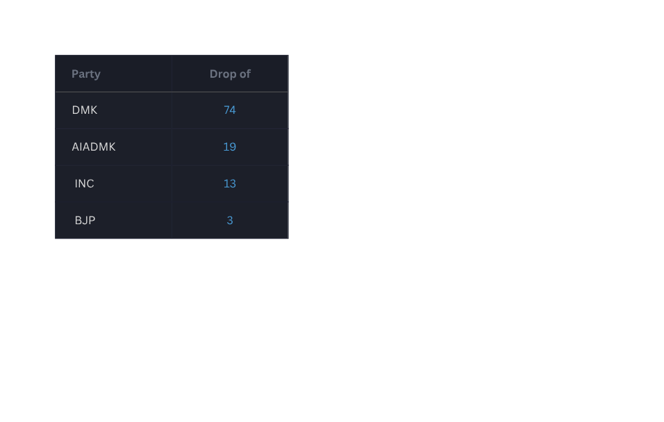
Note: To form a government in Tamil Nadu, a party or alliance must secure a majority of 118 seats out of the total 234 constituency seats.
2021 :
2026 :
Party-wise Seat Decline (2021–2026)
TVK
159
73
75
53

Slide 7
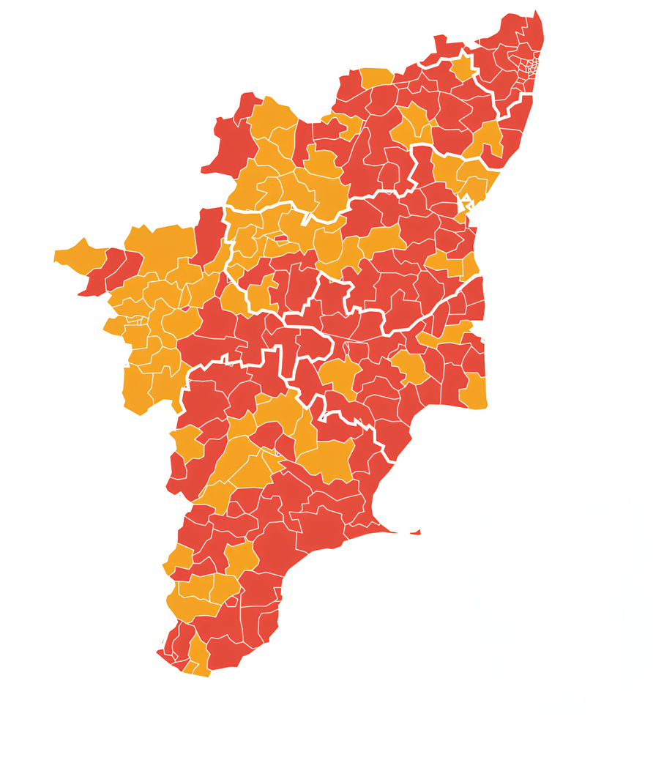

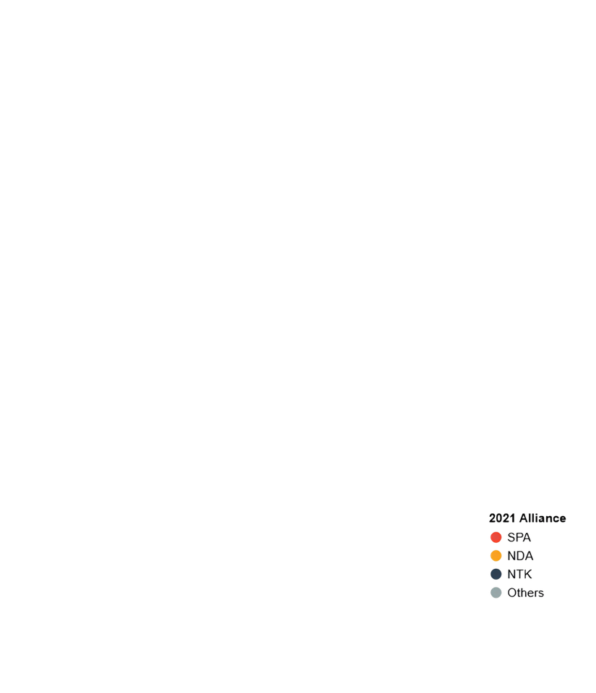
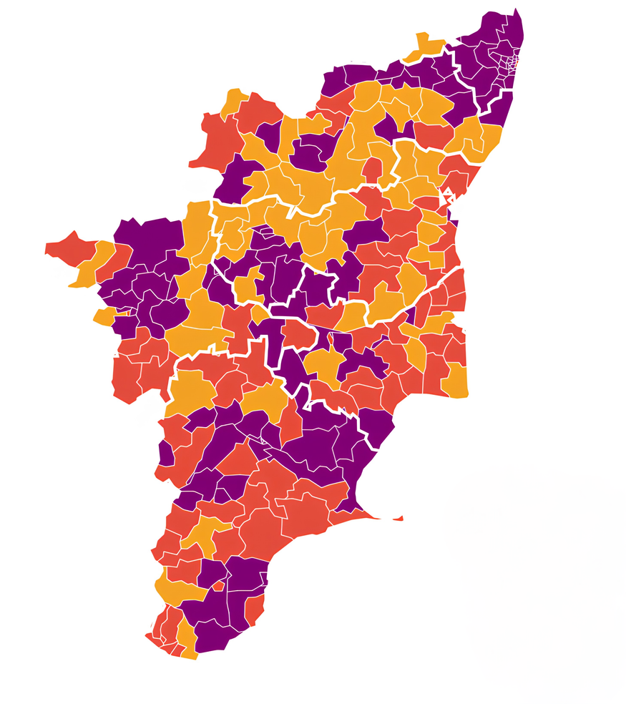
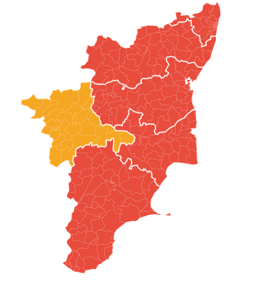
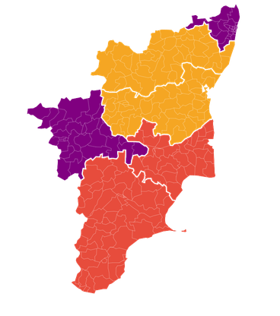
TN 2021 RESULTS
TN 2026 RESULTS
DMK Alliance
North
Chennai Metro
TVK
North
Chennai Metro
AIADMK Alliance
DMK Alliance
AIADMK Alliance
Central
Central
Kongu
Delta
Kongu
Delta
South
South
ALLIANCE LEVEL
Major Highlights:
Strong regional dominance by DMK+ in 2021 election across 5 regions, AIADMK+ retains strength in Kongu Belt.
By 2026, the political map became more fragmented, rise of TVK, increasing regional competition.

Slide 8
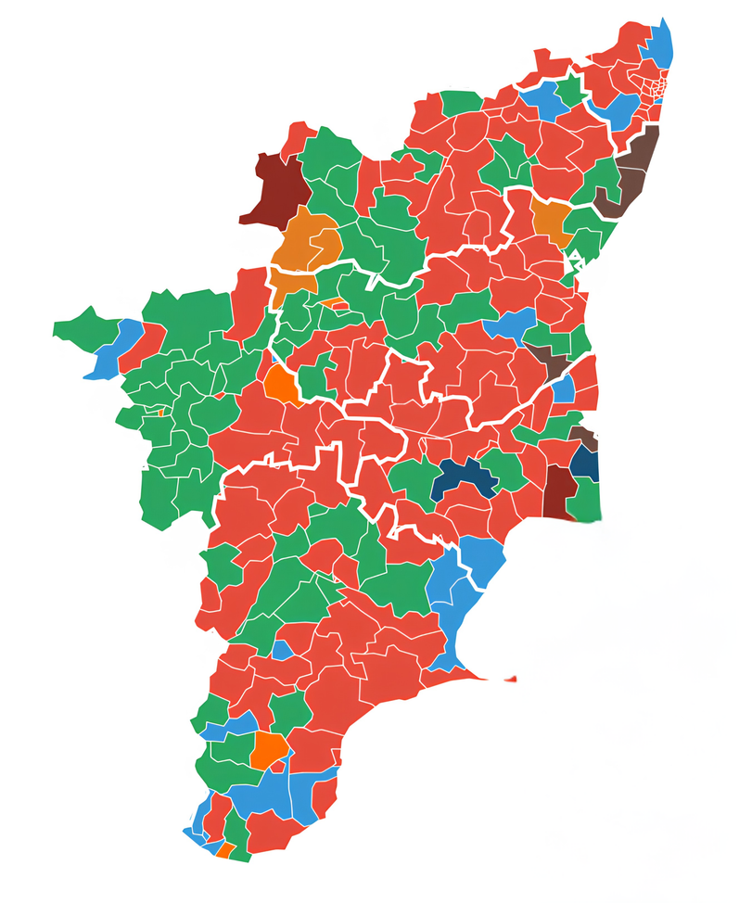
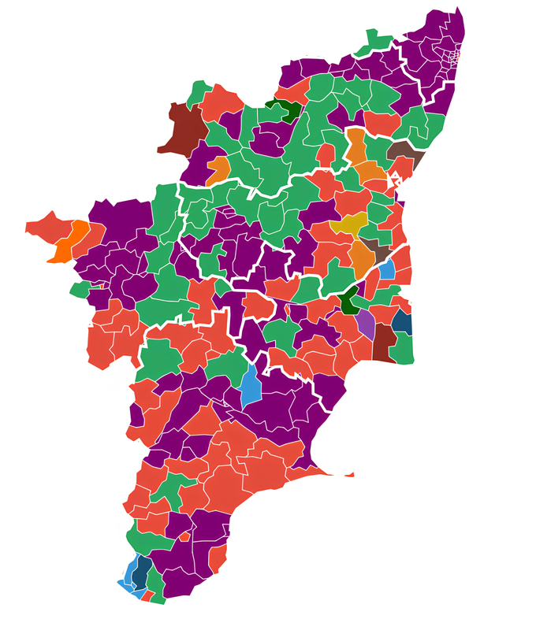
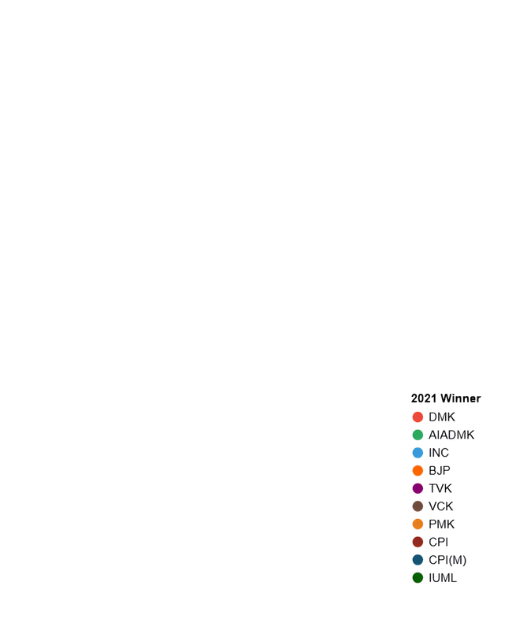
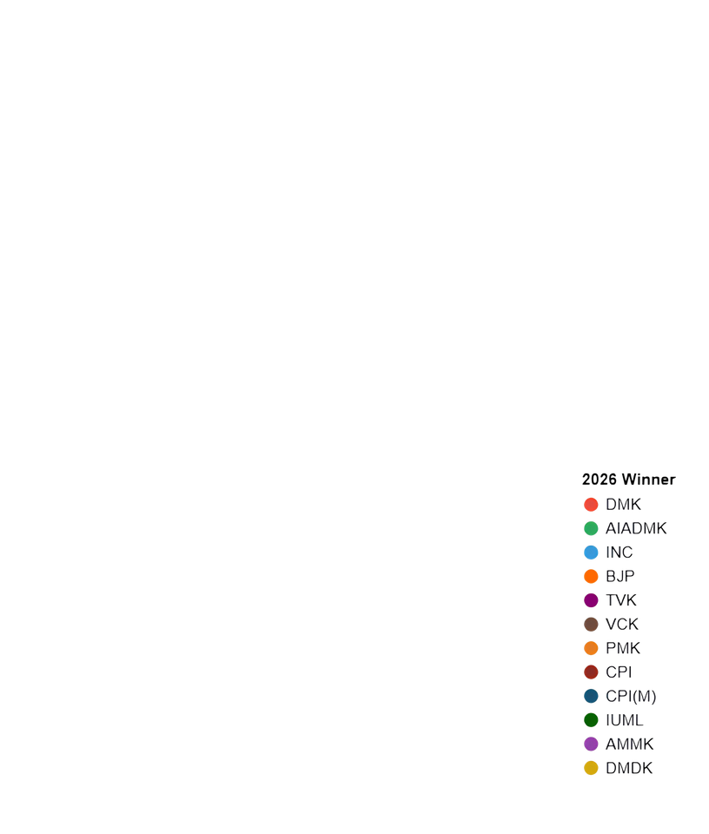
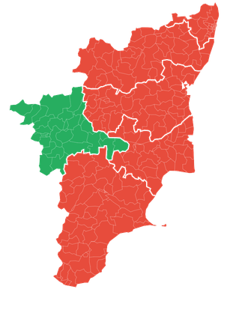
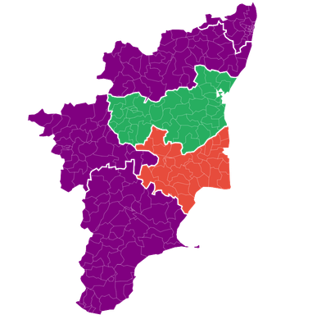
TN 2021 RESULTS
TN 2026 RESULTS
North
Chennai Metro
North
Chennai Metro
Central
Central
Kongu
Delta
Kongu
Delta
Parties
Parties
South
South
PARTY LEVEL
Major Highlights:
At the party level as well, the majority-winning map largely remained similar to 2021, with DMK continuing to dominate most regions.
In the 2026 election, TVK emerged as the dominant party in the Chennai Metro, North, Kongu, and South regions, while DMK secured the majority of constituencies in the Central region and AIADMK led in the Delta region.

Slide 9
THE FLIP STORY
— “How did political control change?”

Slide 10
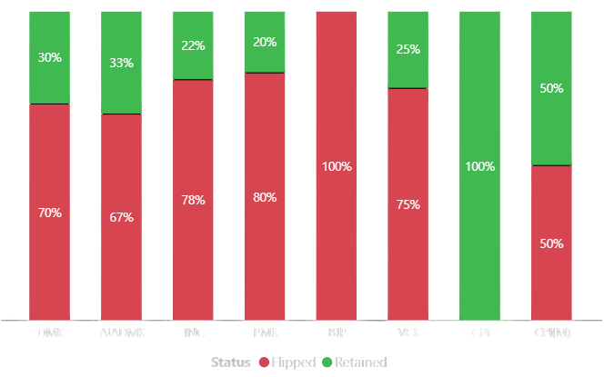

PARTY RETENTION AND FLIP STATUS (2021–2026)
4
1
1
40
22
1
4
2
14
4
3
93
44
1
Major Highlights:
DMK able to retain its 40 constituencies, most of the constituencies get flipped of DMK flipped to other parties.
AIADMK also able to retain 33 % of its constituencies.
Mostly all the parties faces heavy loss in their seats from 2021 to 2026 elections.

Slide 11
THE TURNOUT STORY
— “How actively did people participate?”

Slide 12
People who voted
Turnout % =
X
100
Total Eligible Voters
73.6 %
85.1 %
2021
2026
The 2026 election was driven not only by party competition, but also by unprecedented voter participation and engagement.

Slide 13
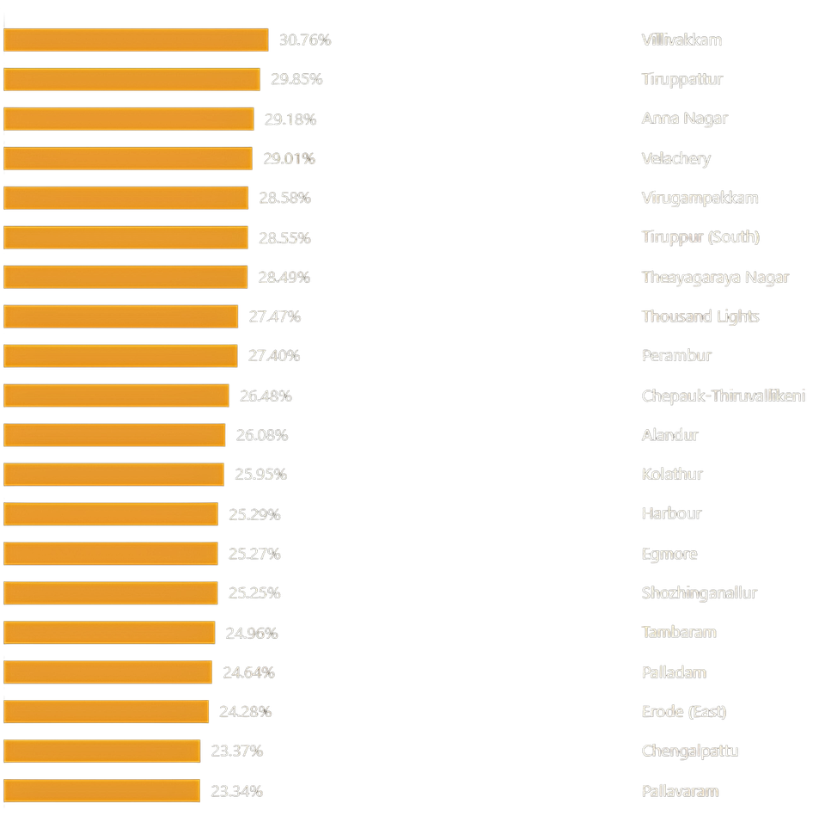
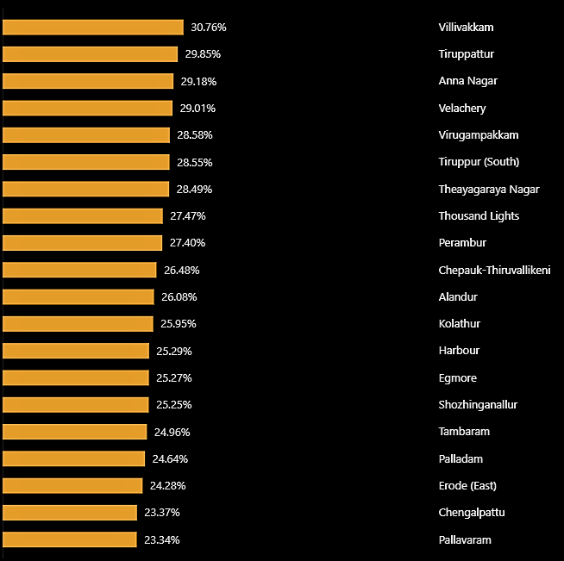
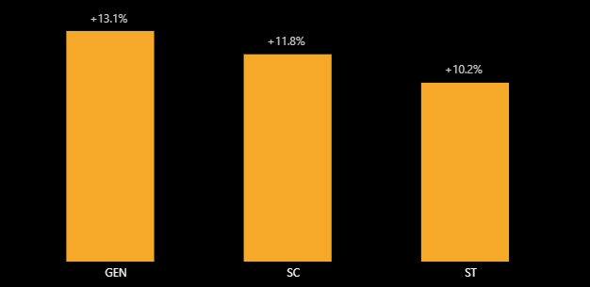
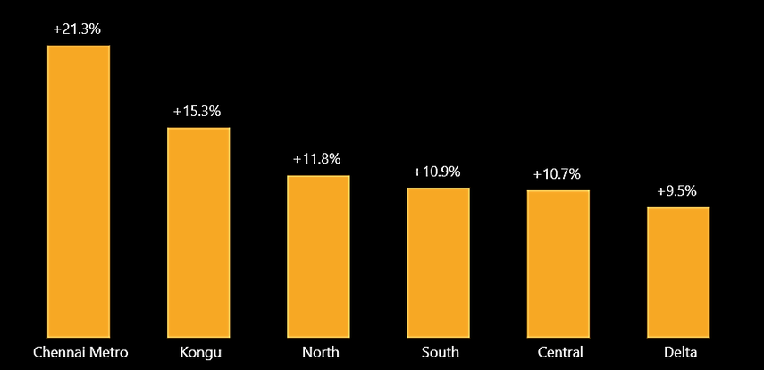
TOP 20 Constituencies
Reservation Category Pattern
Region Pattern
with largest increase in Turnout
Major Highlights:
Increased Turnout
Constituency
These constituencies with the high turnout increase showed signs of stronger electoral competition and higher political engagement.

Slide 14
Region Pattern
TOP 20 Constituencies
Reservation Category Pattern
Major Highlights:
with largest increase in Turnout
The increase in voter turnout varied across regions and reservation categories, indicating different levels of electoral participation across the state.
Increased Turnout
Constituency

Slide 15
Reservation Category Pattern
Region Pattern
TOP 20 Constituencies
Major Highlights:
with largest increase in Turnout
The increase in voter turnout varied across regions and reservation categories, indicating different levels of electoral participation across the state.
Increased Turnout
Constituency

Slide 16
KEY INSIGHTS TAMIL NADU ELECTION ANALYSIS
• The 2026 results introduced a new distribution of seats, with TVK securing 108 constituencies and winning the highest number of seats among all parties.
• The election recorded a historic constituency flip rate. Out of 234 constituencies, 163 changed their winning party between 2021 and 2026, resulting in a flip rate of approximately 70.1% — the highest among recent Tamil Nadu Assembly elections.
• Tamil Nadu recorded its highest-ever voter turnout of 85.1% in 2026, reflecting a significant increase in electoral participation compared to previous elections.
• The geographic analysis showed a substantial reshaping of the electoral map, with different parties leading across different regions, highlighting the evolving regional distribution of political support.

Slide 17
THANK YOU

