Slide 1

Plantix Retail App Case study
Presented By : Aastha Jain

Slide 2
Agenda
Introduction
About the case study
All about the dataset
Graphical analysis of a business queries.
Conclusion

Slide 3

Introduction
Plantix is a mobile crop advisory extension workers app for farmers, extension workers and gardeners combining artificial intelligence and the expertise of leading research institutions around the globe. Millions of customers use Plantix in order to identify diseases and nutrient deficiencies affecting their crops. Plantix Partner app allows retailers to order supplies online.

Slide 4
About the Case Study
CASE STUDY have been provided a dataset contains 3 csv files for July 2021 and July 2022 to analyse the performance of an app through these business queries –
Growth Of The Business
Performance Of App
Growth Of User Base
Top-selling Products In Each Of The Two Years
Find Out Biggest Problem Of The July 2021 Data

Slide 5
“Data are just summaries of thousands of stories – tell a few of those stories to help make the data meaningful.”
— Chip and Dan Heath

Slide 6
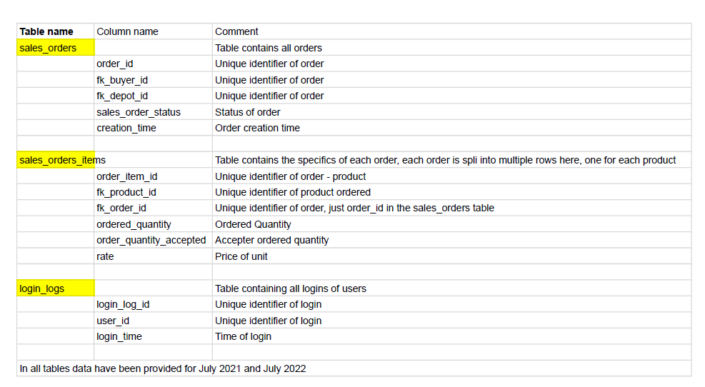
All about dataset
dataset contains 3 csv files -
login_logs table - contains information about users logging in
sales orders table - contains information about orders made and
sales_orders_items - contains the specifics of each order

Slide 7
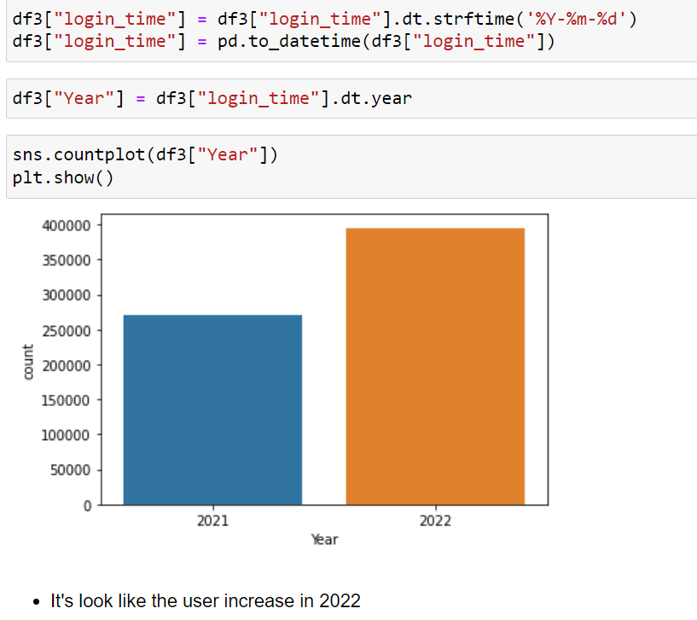
Overall Growth Of The Business

Slide 8
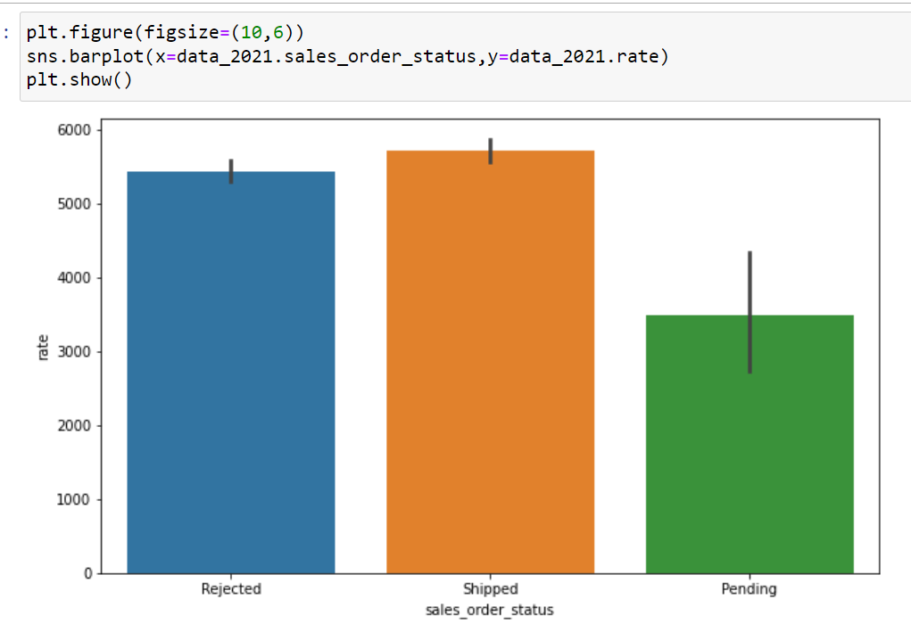
Sales Performance @ Year 2021.

Slide 9
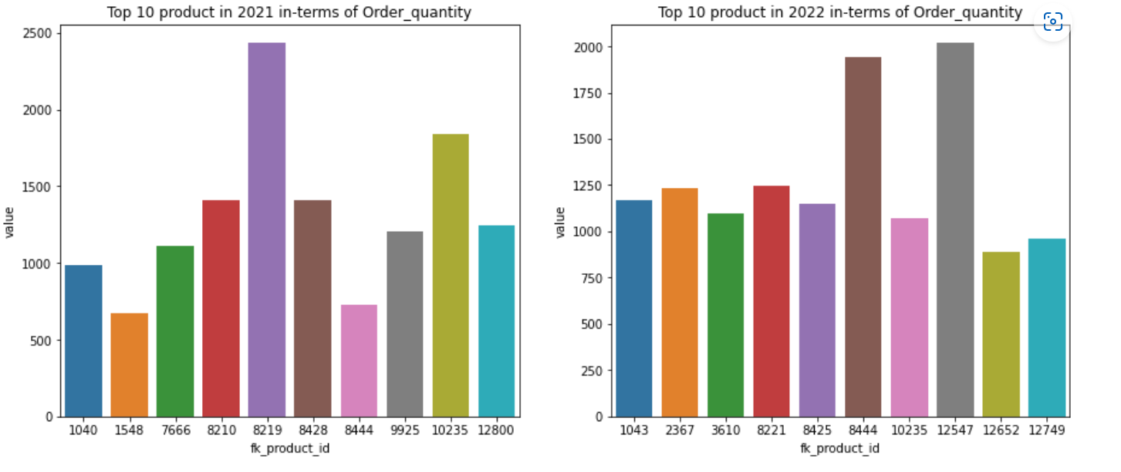
Top-selling Products In Each Of The Two Years

Slide 10
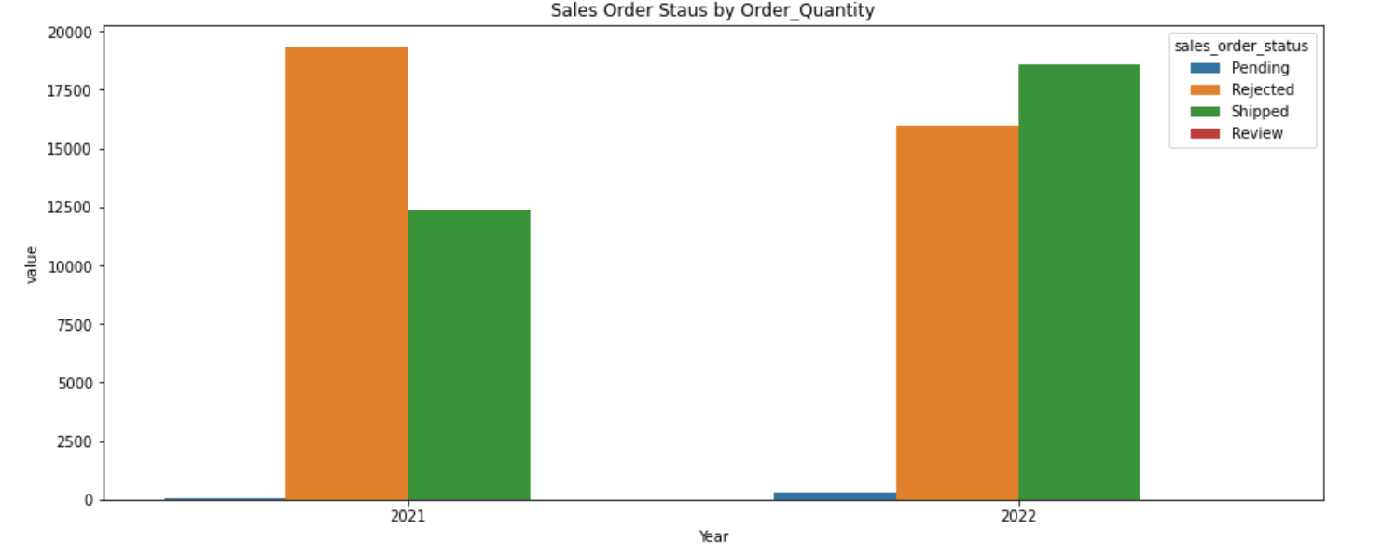
Overall Sales Order Status

Slide 11
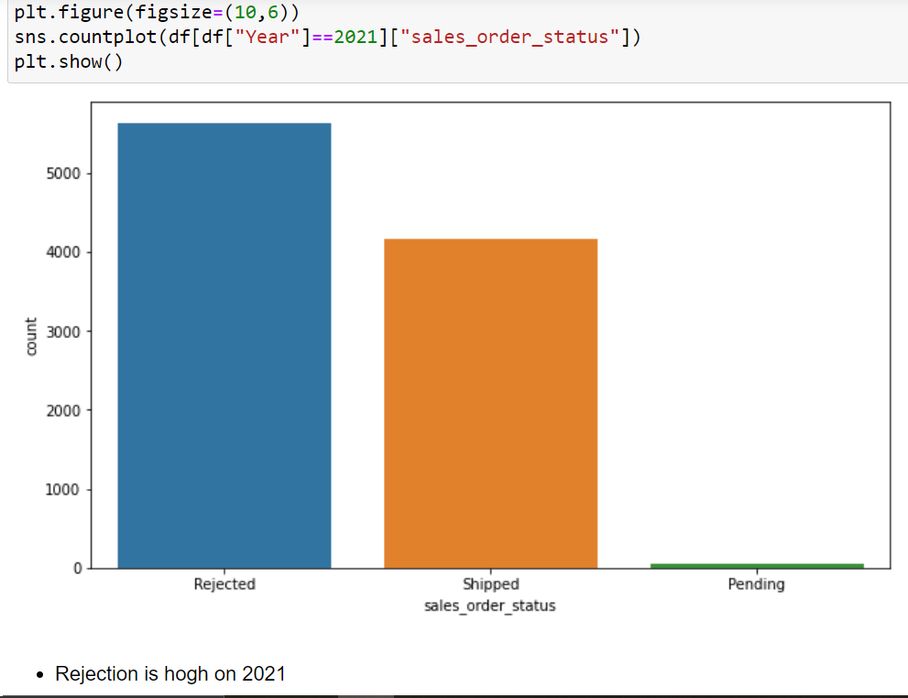
Sales Order Status

Slide 12
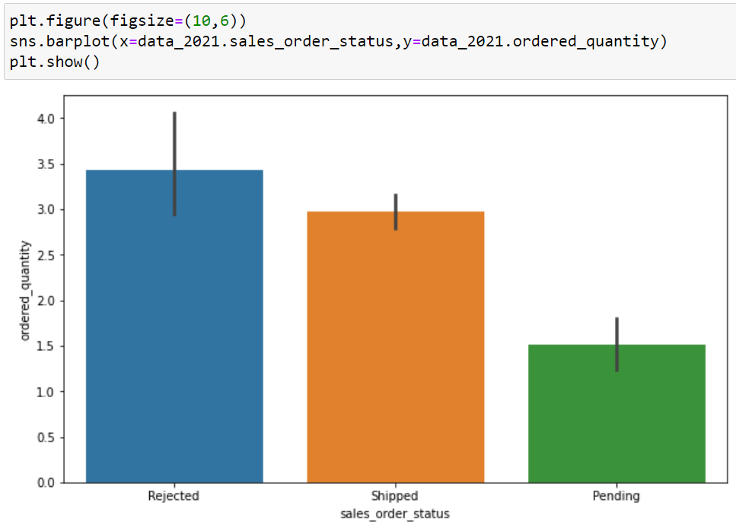
Quantity Order Status @ Year 2021

Slide 13
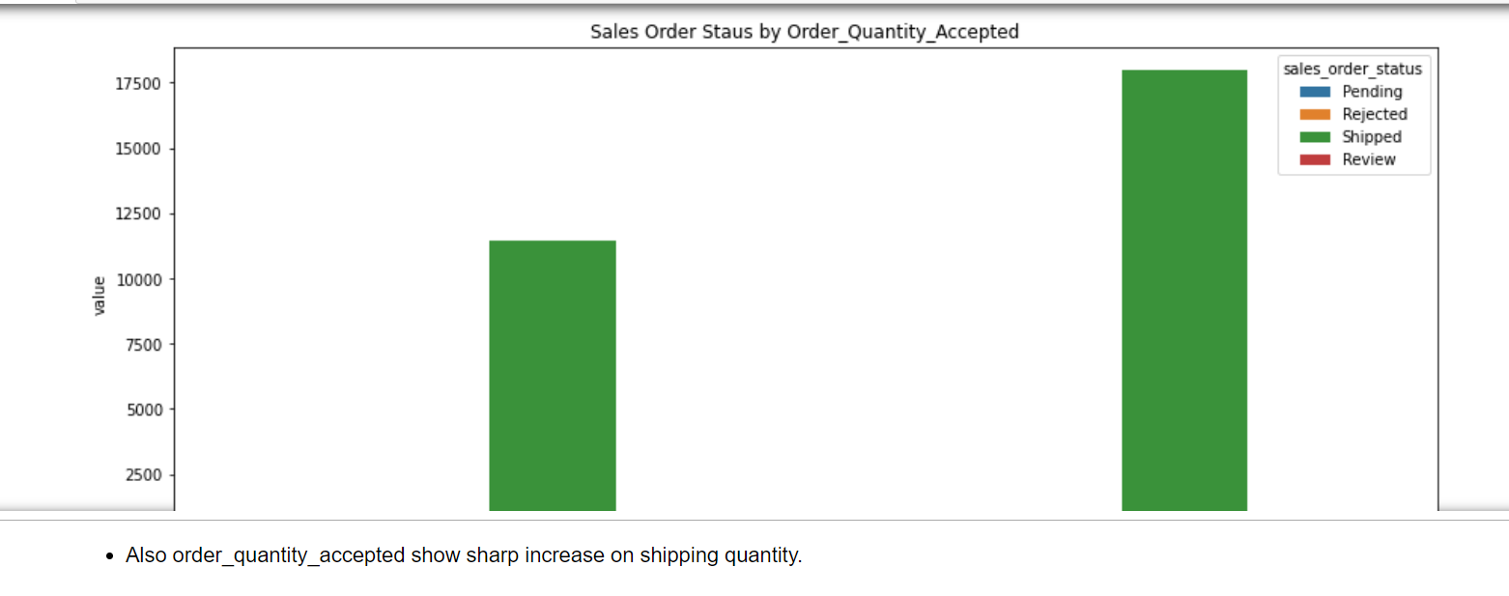
Sales Growth Of An Order Acceptance

Slide 14
Conclusion
After analyzing the given data insights tells that
In July 2021 rejection rate of sales orders was extremely high i.e. 57% which is seems decreased a bit in July 2022 although by 6% but still is high, may be reason is customers were not satisfied with services or AI model couldn’t able resolve customer’s problem. May be the reason where app can’t detect problem of customers which leads to pile up the order unresolve(pending) and ultimately customers left with dissatisfaction and reject the order.
There is overall growth in terms of product shipped is 42%
There is increase in Growth of user base by 31.35%
product_id – “8219” was the top selling product For the year 2021.
product_id – “12547” followed by product_id – “8444” was the most selling product in year 2022.
login frequency increased the overall growth of customers base.

Slide 15
Thanks!
ANY QUESTIONS ?
You can find me at: ashu.aasthajain@hotmail.com
Your feedback will be more valueable.

