Slide 1
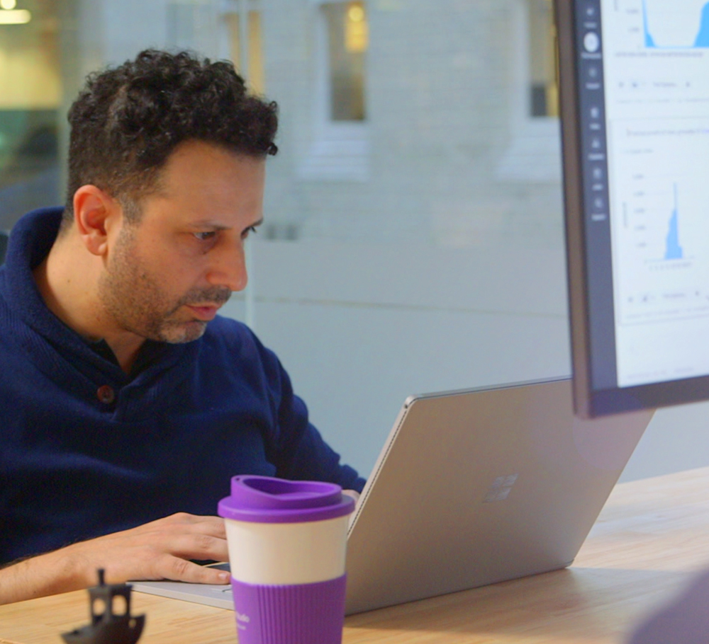

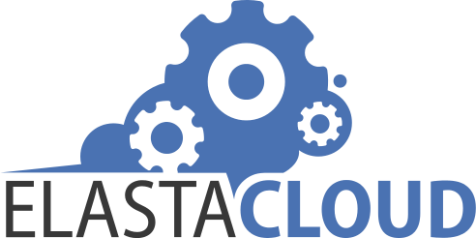
Data science consultancy transforms the future of UK energy—and its own business—with Azure Machine Learning
Elastacloud, a London-based data science consultancy, wanted to combine AI, advanced analytics, and machine learning to promote more profitable low-carbon energy production in the United Kingdom. So, it used Microsoft Azure Machine Learning to build and run the Elastacloud Energy BSUoS Forecast service, an AI-powered web service that helps energy providers avoid incurring energy-balancing fees imposed by national energy authorities. Now providers can better predict energy prices and help create a smarter energy system, while Elastacloud transforms its business.
Microsoft Azure
Azure Kubernetes Service (AKS)
Azure Machine Learning
35,000 employees
Partner Professional Services
United Kingdom
Notes:
https://customers.microsoft.com/en-us/story/elastacloud-partner-professional-services-azure-machine-learning

