Slide 1
Medisys: Comprehensive Health Tracking System
Empowering Individuals and Families with Health Insights

Slide 2
Aims
To provide real-time health monitoring and data insights for individuals and their families
To encourage healthy lifestyle through personalized reminders
To improve accessibility for all users
To save time and effective communication via the application
To encourage timely medicine intake for better results
To provide an easy way to manage prescriptions
To provide a centralized place for all clinic visited
To provide emergency support in case of emergencies
To prescribe medicines to patients effectively and quickly
To manage all doctors and nurses for effective workflow
Better management of appointments
Monitoring the users to analyze the effectiveness of the clinic

Slide 3
Objectives
Designing and building user-friendly clean and simple interface for all users to track their health status like heart rate, blood pressure, sugar level, etc.
Developing a notification and reminder that alerts users about their daily habits.
Integrating voice guidance for elderly individuals and for people with low digital awareness.
Having secure and centralized place for all medical records for effective user for the future including hospital visited, medicines intake, etc.
Testing the application with diverse groups of individuals for effectiveness and proper usage
Implementing proper security for the data and strict usage of medical data inside the application
Integrating 15 days re-login feature for better security.
Implementing an emergency feature for extreme cases
Proper user (doctors, nurses) management for the clinic admin
Data analysis regarding the health of the individuals/patient to calculate the success rate of the clinic
Safe buying and selling of the medicines using online payment like (E-sewa, Khalti, PayPal, Stripe)

Slide 4
Initial Research
Effect of Color in Different Surroundings
Blues and greens promoting calmness and
55% people White perceived as the color of clean
Blue as comforting atmosphere for healing
Medicinal Reminders
Natural Cycle
Body Rythms
Metabolism
Chronotype
Cardacian Rythms

Slide 5

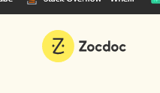

Initial Research
Medisys aims to provide a better healthcare platform by analysing similar systems and providing the missing features accordingly
My chart
https://www.mychart.org/
ZocDoc
https://www.zocdoc.com/
Doctor on Demand
https://doctorondemand.com/
HealthMate

Slide 6
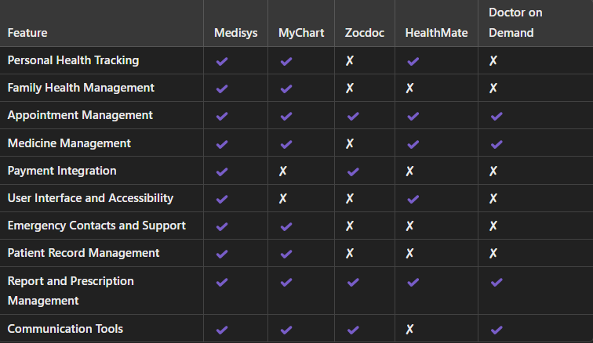

Slide 7
Features
Timely Medicine Reminders
Family and Personal Health Status Management
Clinic Management
Appointments Bookings
Prescriptions and Report Mangement
Records and Logs of Health Records
Visualization of patients data
Medicinal transactions

Slide 8
Future Scope
adding treatment suggestion according to the past data of the user
Deploying a IoS and Android version of the web application
Add doctor and nurse attendance or staff tracking

Slide 9
Conclusion
Hence Medisys provides not only healthcare tracking but effective log and a centralized place for all personal and family health data which can be beneficial for long term tracking while also making hospital and clinic visits less difficult and much more effective.

