Slide 1
Minor Project (21BMP302L)
Review 1
A Presentation
On
“Mechanical Abduction Braces for Cogenital Clubfoot Disorder”
Presented By : Aasif Mehmood RA2311013010014 Tarunika Manoranjan RA2311013010024 Deva Ganesh RA2311013010030 | Project Guide: Dr Shabeeb Ahmed

Slide 2
Introduction
Talipes equinovarus (cogenital clubfoot): A Birth deformity where the foot
Twists inward and downward.
If not treated, it leads to mobility restrictions and lifelong disability.
Standard treatment: Ponseti method (casting + prolonged bracing).
Issue with existing braces: Rigid, costly, uncomfortable, and poorly designed
, causing poor compliance and relapse.
Clinical need: A brace that allows controlled abduction and dorsiflexion while
ensuring comfort.

Slide 3
Aim
To design and develop a mechanical abduction brace for congenital clubfoot
using a gear-based adjustment mechanism and a lightweight metal rod
structure that is more comfortable, ergonomic, and cost-effective than the
existing braces, ensuring better treatment outcomes.

Slide 4
Objectives
Incorporate Gear Mechanism
Redesign Connecting Bar (Metal Rod)
Improve Ergonomics and Comfort
Enhance Compliance

Slide 5
Literature Review
No. | Author (Year) | Study Title / Focus | Methodology | Key Findings | Limitations
1 | Butt et al. (2023) | Retrospective analysis of Ponseti outcomes | Single-center patient outcomes review | Successful correction across clubfoot types | Retrospective, limited generalizability (MDPI)
2 | Farrar et al. (2022) | Dynamic unilateral brace cohort | Retrospective cohort study | 88% compliance, lower recurrence | Small, non-randomized cohort (arXiv)
3 | Zapparoli & Volpon (2025) | Unilateral UNIC-Brace vs double abduction brace | Prospective non-randomized study | UNIC-Brace: 17.2% failure vs 41.3% | Not randomized, institutional design (PubMed)
4 | Aroojis et al. (2021) | SMART sensor-integrated brace prototype | Pre-clinical prototype evaluation | Feasible remote brace monitoring | Prototype stage, lacks clinical data (PubMed)
5 | Agarwal (2022) | Review: sensor-based brace monitoring | Literature review | Sensors can reduce relapse by ~40% | Early studies, limited clinical validation (PubMed)

Slide 6
6 | Factors in recurrence (2024) | Scoping review of relapse factors | PubMed/Embase scoping review | Non-compliance, severity, age affect relapse | Review, not intervention-based (PubMed)
7 | Ferreira dos Santos et al. (2024) | Ponseti in myelomeningocele clubfoot | Systematic review | 93% immediate correction, 62% relapse | Focused on special cases, small data (PubMed)
8 | Gupta & Agarwal (2021) | Bracing trends in 2021 | Concept review | Highlights design comfort, compliance issues | Review only, non-empirical (Jaypee Digital)
9 | BMC study (2013–12) | Manipulation + above-knee brace (no tenotomy) | Prospective follow-up | 93% corrected in 3–6 months | No tenotomy group only; older study (BioMed Central, PubMed)
10 | Kadhum (2019) | Biomechanics of Ponseti method | Applied biomechanics study | Describes mechanical corrections and outcomes | Not a recent trial; technical focus (Wiley Online Library)

Slide 7
Methodology
Gear Mechanism: Simple gears for angle adjustment (abduction 60–70° affected, 40–45° unaffected;
dorsiflexion 10–15°). Easy to adjust without removing the brace.
Connecting Bar: Lightweight aluminum/stainless rod with EVA padding for comfort.
Ergonomics: Padded orthotic shoes, breathable lining, quick-release system, lightweight build.
Compliance: Dynamic hinge for limited motion, reduced discomfort, better long-term use.

Slide 8
List of Required Sources
Structural Parts:
Aluminum or Stainless Steel rods (lightweight, durable)
Orthotic shoe base (custom-fit)
EVA foam padding for comfort
Velcro straps and quick-release buckles
Hinges & connectors (3D printed / machined)
Worm gear + spur gear set for angle adjustment
Tools and Equipment
CAD Software (SolidWorks / Fusion 360 / AutoCAD)
3D Printer (for connectors, shoe parts, housings)

Slide 9
Timeline
Phase | Duration | Activities
Literature Review & Problem Analysis | 2 weeks | Review existing designs, compliance issues
Design & Modeling | 3 weeks | CAD modeling, simulation, material selection
Prototype Fabrication | 4 weeks | Manufacturing and assembly of the brace
Testing & Evaluation | 3 weeks | Comfort, adjustability, and durability tests
Final Optimization & Report | 2 weeks | Refinement, documentation, and presentation

Slide 10
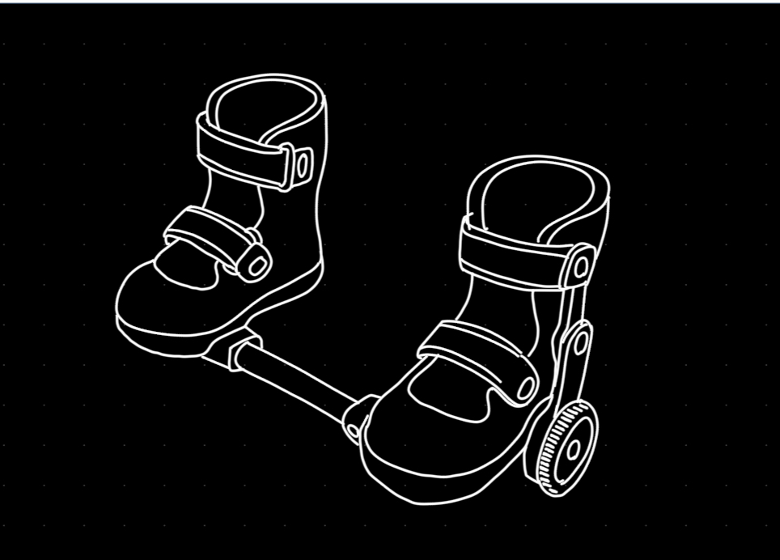
Expected Outcome
A brace prototype with a gear system to set the correct
foot angles.
Light metal rod with padding for strength and
comfort.
Pressure sensors to check if the brace is worn and for
how long.
Microcontroller to record wear-time and give simple
feedback.
Comfortable and easy for children to use daily.
Better compliance → lower risk of relapse.
Low-cost design that can be made locally.
Final report with CAD models, photos, tests,
and results.

Slide 11
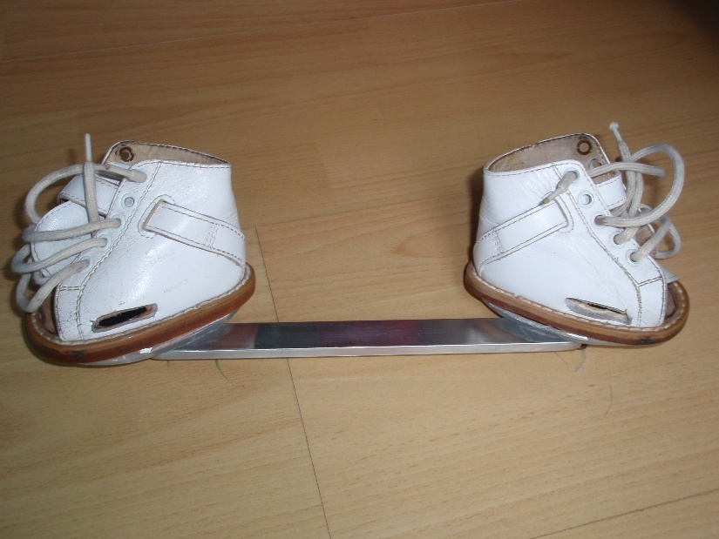
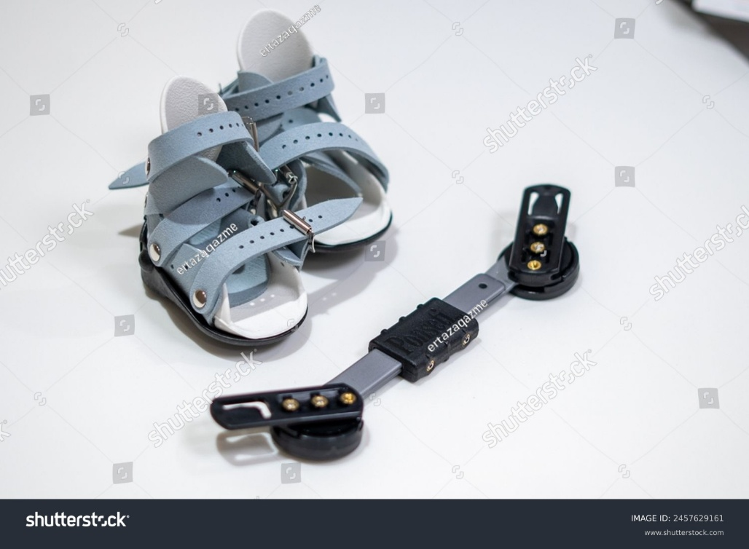
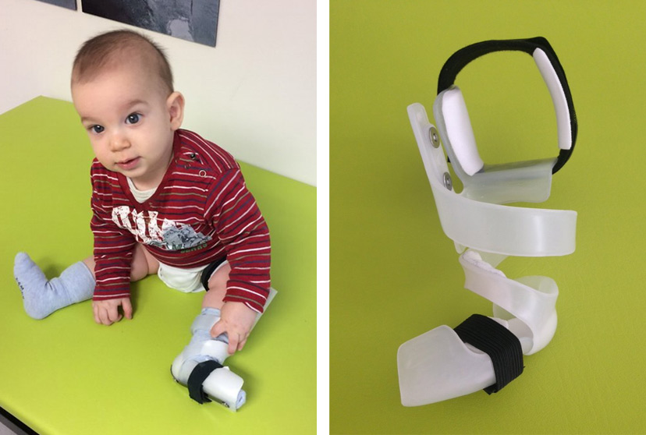
Different types of braces are Available
Denis Browne bar
Dynamic Braces
Ponseti Brace

Slide 12
References
https://my.clevelandclinic.org/health/diseases/16889-clubfoot
https://pmc.ncbi.nlm.nih.gov/articles/PMC10480528/
https://www.hss.edu/health-library/conditions-and-treatments/the-ponseti-method-for-clubfoot-correction

Slide 13
Portfolio Link
https://tarunikamanoranjan.github.io/Clubfoot/

Slide 14
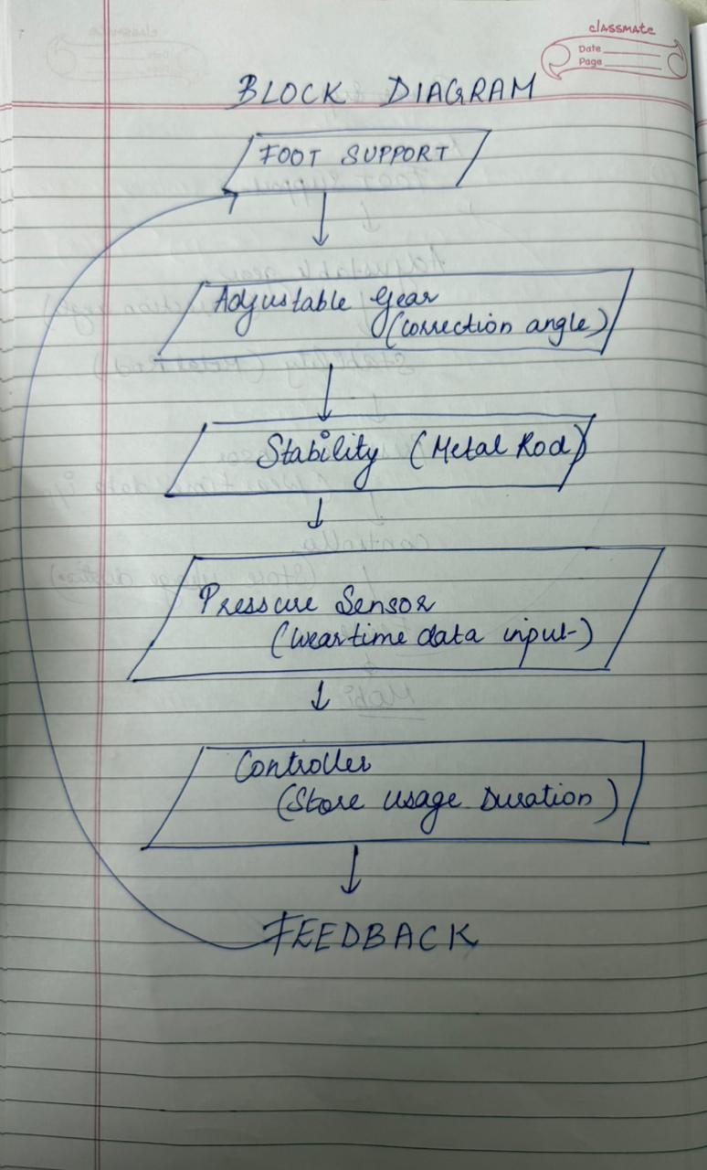
Block Diagram

Slide 15
Thank You

