Slide 1

Topic-Branch
Submitted By: Aasif Ali
Employee Id : 1643

Slide 2
Branch
A branch is a pointer to a specific commit.
A branch represents an independent line of development.
It is too common to hear the words such as the branch of a tree, branch of a bank, a branch of science, etc.

Slide 3
A Git project can have more than one branch. These branches are a pointer to a snapshot of your changes.ect can have more than one branch.
These branches are a pointer to a snapshot of your changes.
When you want to add a new feature or fix a bug, you spawn a new branch to summarize your changes.

Slide 4
Branch in Git is similar to the branch of a tree. Analogically, a tree branch is attached to the central part of the tree called the trunk.
While branches can generate and fall off, the trunk remains compact and is the only part by which we can say the tree is alive and standing.

Slide 5
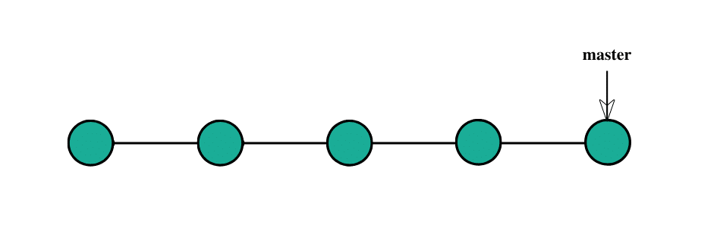
We can also say that branches create another line of development in the project. The primary or default branch in Git is the master branch (similar to a trunk of the tree).

Slide 6
Git Branch Commands
git branch - Display a list of the local branches in Git
repository.
The git branch command allows you to create, list, rename and delete branches.
git branch -a - Display a list of both local branches and remote
branches in your Git repository.

Slide 7
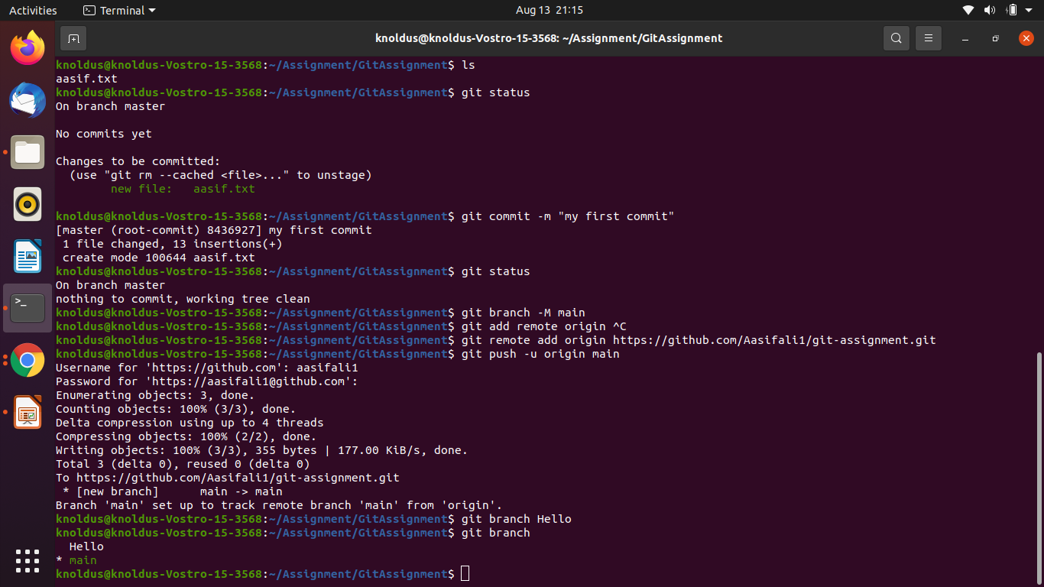
Git Branch Commands
Create Branch-
You can create a new branch with the help of the git branch command. This command will be used as:

Slide 8
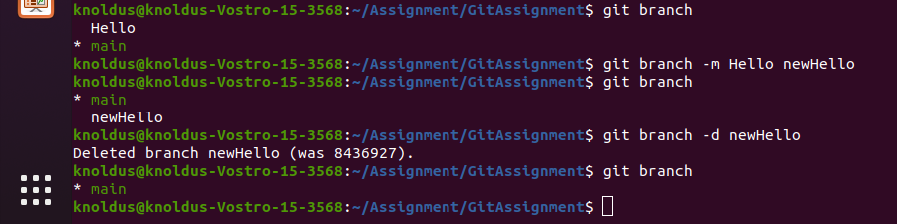
Git Branch Commands
git branch -D <branch-name> - Delete a local Git branch with unmerged changes.
git branch -m <branch-name> <new-branch-name> - Rename a Git branch.

Slide 9
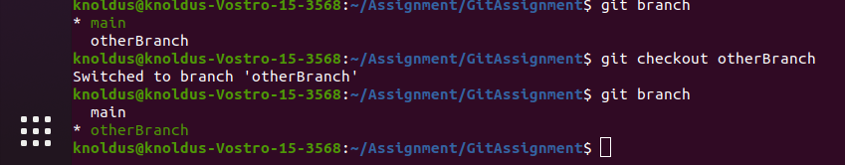
Git Branch Commands
Switch Branch- Git allows you to switch between the branches without making a commit. You can switch between two branches with the git checkout command. To switch between the branches, below command is used:

Slide 10
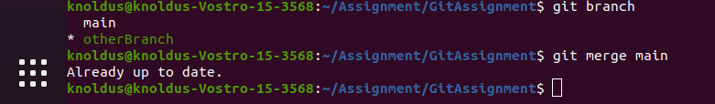
Git Branch Commands
git merge <branch-name> - Merge changes from one branch into the branch you currently have checked out.

Slide 11
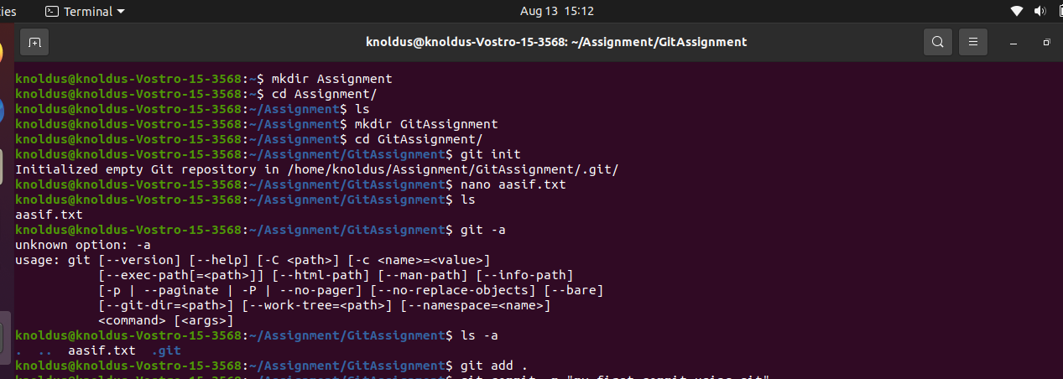
Screenshot

Slide 12
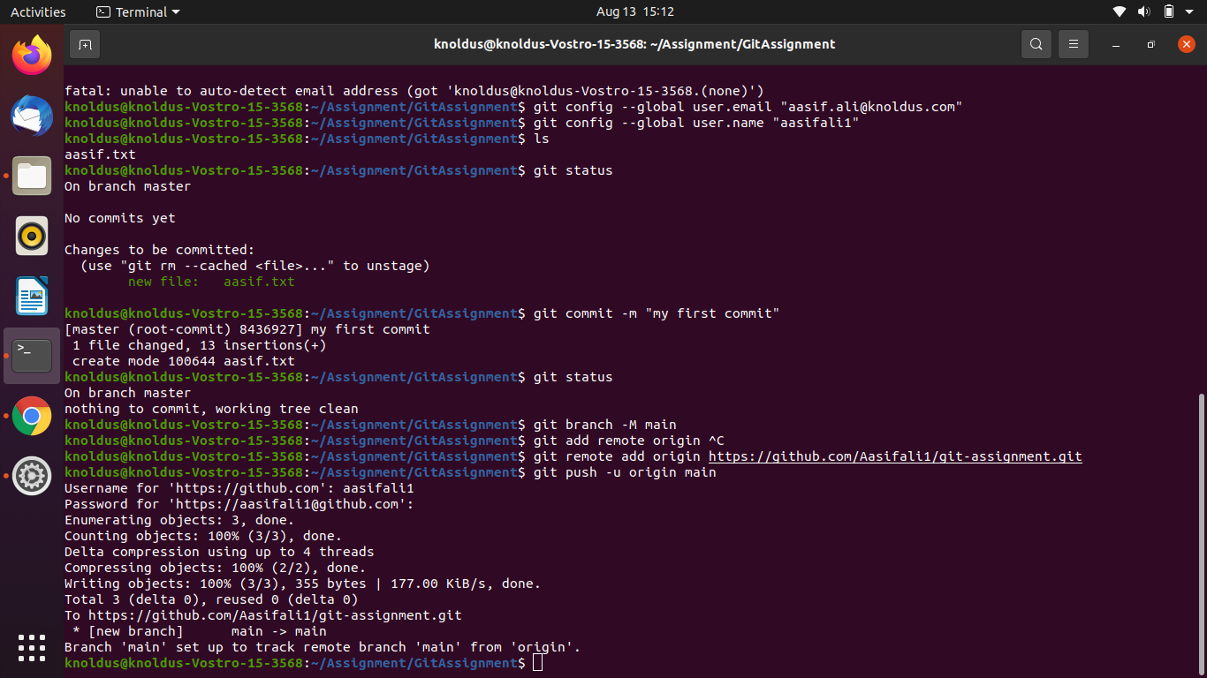
Screenshot

