Slide 1
ZenQuest - Design Sprint Artifacts
Milestone 4 | Team BO2 - TFC
Group Members:
Hamza Saeed 21i-0671
Aasir Farrukh 21i-0375
Qazi Mohib-Un-Nabi 21i-2532

Slide 2
ZenQuest: Interactive Stress-Reduction Game
Team TFC - Spring 2025 Milestone 4
Transforming stress management into a rewarding experience

Slide 3
HMW Questions
How might we make stress management so quick students use it even during deadlines?
How might we appeal to analytical-minded tech students?
How might we ensure exercises can be used discreetly in classrooms/libraries?
How might we demonstrate mindfulness effectiveness with metrics?
How might we design activities for debugging frustration?

Slide 4
Crazy 8's Sketches
Qazi's Sketches:
"Presentation Power-Up" - Confidence building mini-game for pre-presentation anxiety
"Metrics Dashboard" - Business-style analytics for mindfulness practice
"Five Senses Quickcheck" - Grounding exercise disguised as a game
"Stress Ball Simulator" - Interactive stress ball with haptic feedback
"Breathing Pacer" - Visual pattern matching game tied to breath control
"Achievement Unlocked" - Business-themed rewards system
"Discrete Mode Toggle" - One-touch switch to classroom-appropriate interface

Slide 5
Crazy 8's Sketches
Aasir's Sketches:
"Stress Metrics Dashboard" - Visualization of stress reduction progress with achievement unlocks
"Quick Relief Selector" - UI for rapidly accessing context-specific stress relief based on current activity
"Focus Flow" - Mini-game where calm breathing controls game character movement through obstacles
"Zen Garden Code Editor" - Visual representation of code as plants that grow with breathing exercises
"Achievement Tree" - Visual growth representing mindfulness progress
"Emergency Calm Button" - One-touch activation for immediate guided relief

Slide 6
Crazy 8's Sketches
Hamza's Sketches:
"Time Match" - Activity selector based on available time (1-5 minutes)
"Breathing Bubble" - Interactive bubble that expands/contracts with breath
"Stress Type Selector" - UI for choosing specific academic stressor to address
"Progress Galaxy" - Star-based visualization of practice consistency
"Mindful Coding Companion" - Sidebar tool that detects frustration and suggests breaks
"Quick-Switch Activities" - Swipe interface for rapidly changing techniques
"Challenge Calendar" - Daily mindfulness challenges with streak rewards
"Context Detector" - System that suggests appropriate exercises based on location/time

Slide 7
Crazy 8’s – Top Voted Ideas
Emergency Calm Button (6 votes)
Stress Metrics Dashboard (5 votes)
Breathing Bubble Game (6 votes)
Stress Type Selector (7 votes)
Classroom Stealth Mode (5 votes)

Slide 8
Solution Sketches
Aasir: ZenQuest Emergency Toolkit - A comprehensive solution focused on providing immediate relief for specific academic stressors
Hamza: MindfulMetrics (progress dashboard) - A data-driven approach focusing on engagement through progress visualization
Mohib: Context-Aware Calm (environment-adaptive) - A solution emphasizing adaptability to different academic environments

Slide 9
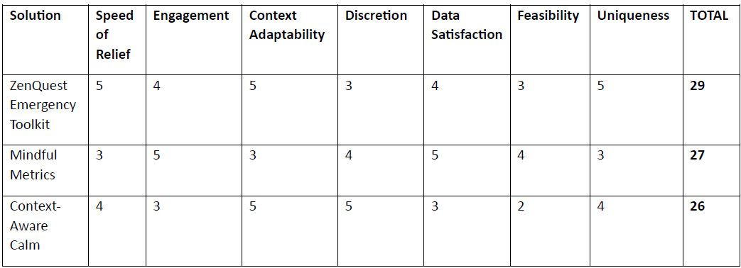
Decision matrix

Slide 10
Final Direction
We decided to move forward with a hybrid solution that combines the strengths of "ZenQuest Emergency Toolkit" and elements from the other solutions. The core concept will focus on:
Emergency relief tools optimized for specific academic stressors (from Solution 1)
Strong metrics and progress visualization to maintain engagement (from Solution 2)
Discreet modes for different contexts (from Solution 3)

Slide 11
Next Steps
Based on the results of our design sprint, our next steps will be to:
Create low-fidelity prototypes of the key interfaces for the hybrid solution
Develop a testing plan to validate our concepts with users
Prioritize features for an MVP that focuses on the emergency toolkit
Begin development of high-fidelity mockups for core features
Plan user testing sessions to refine the concept further

Slide 12
Thank You!

