Slide 1

CHAT Application and Analytical Dashboard
AI-Powered Power Plant Information System
By:
Aasiya Ankali
Anjana K Raj

Slide 2
Agenda
1. Problem Statement
2. Solution Overview
3. System Architecture
4. Technology Stack
5. Flow Chart
6. Key Features
7. Demo
8. Results & Metrics
9. Future Enhancements

Slide 3
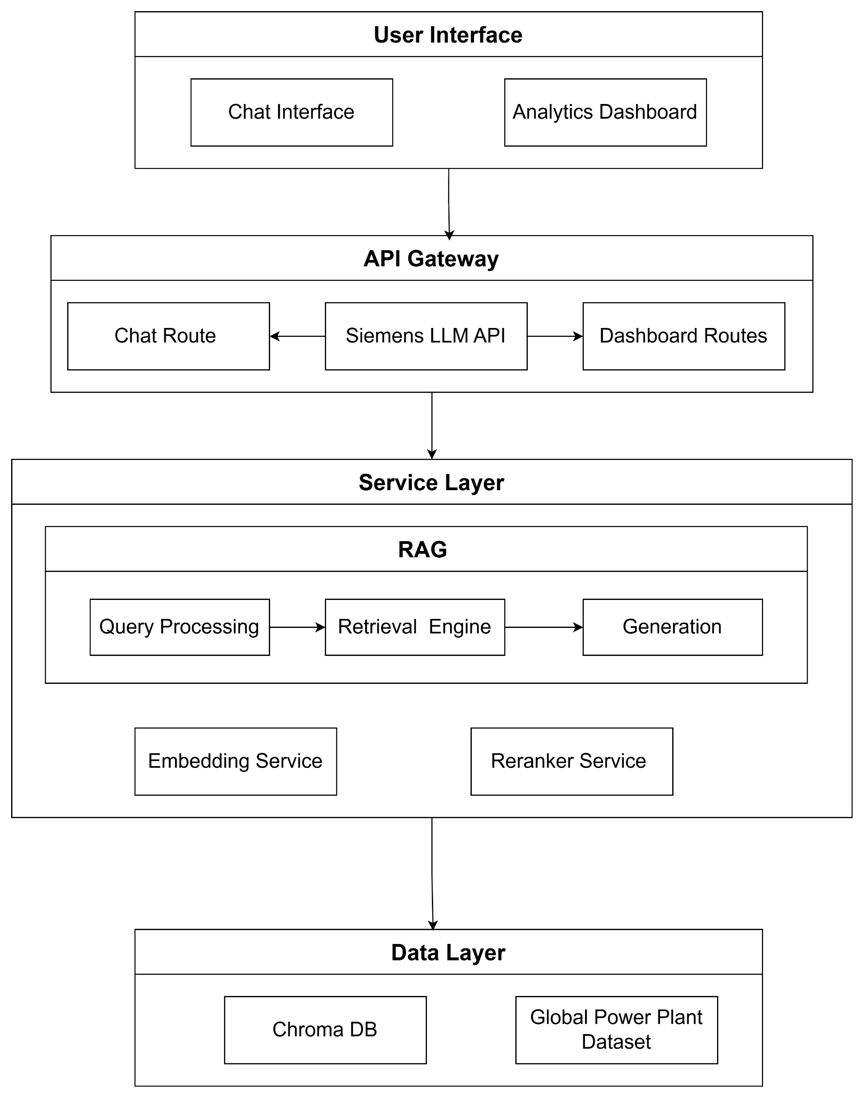
Architecture Diagram

Slide 4
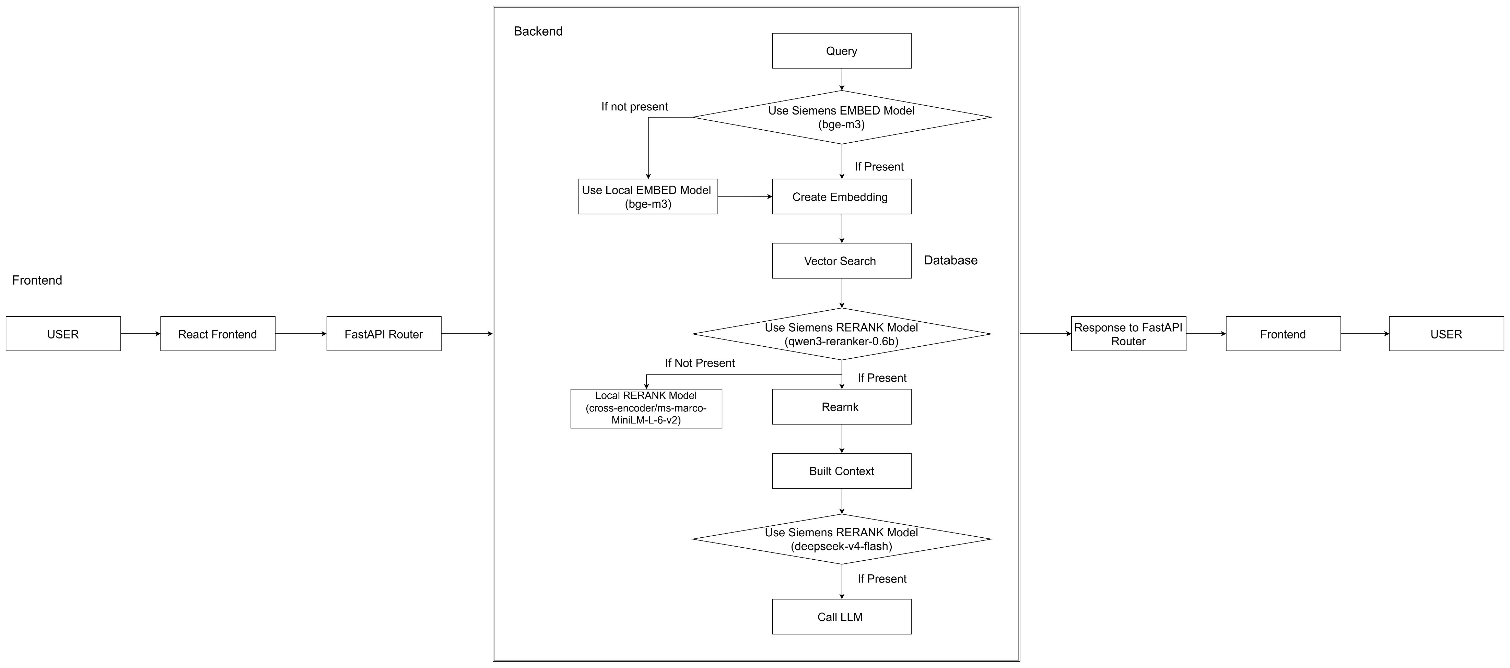
Flow Chart

