Slide 1

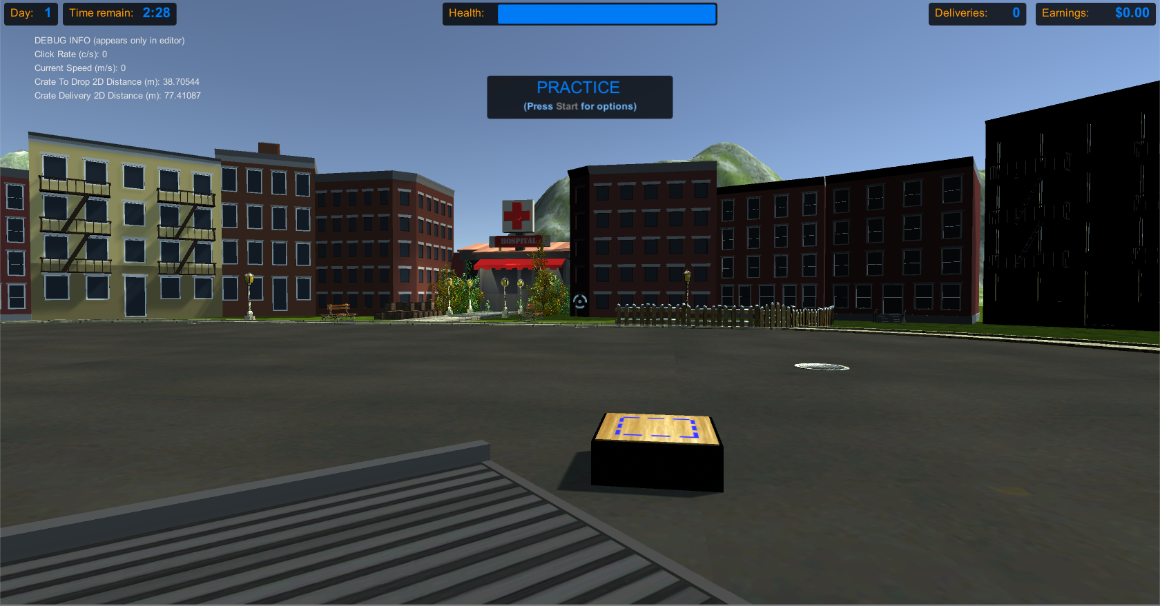
Virtual Reality in Experimental Economics
Capstone Project: Computer Science
Aaska Shah, Kerala Brendon, Nolan Slade, Vyome Kishore, supervised by Dr. Jacques Carette and Dr Stephanie Thomas
Dept. of Computing and Software
McMaster University, Hamilton, Canada
What: develop virtual reality environments, as an extension of previous work done by the McMaster Decision Science Laboratory, to carry out experimental economics research.
Why: gain insight into how participants make decisions when they are impaired.
McMaster Decision Science Laboratory (McDSL)
Research Project
Simulations where the participant completes a basic task.
Participants are paid cash for successful task completions.
Participants will be virtually impaired and required to choose between methods of treatment.
Simulation features requested by McDSL:
Created for an HTC Vive virtual reality system.
Scale to the Vive-quipped testing room.
Extensive customization of configuration variables.
Existing Simulation:
Task: move crates from a pile to the target block

