Slide 1

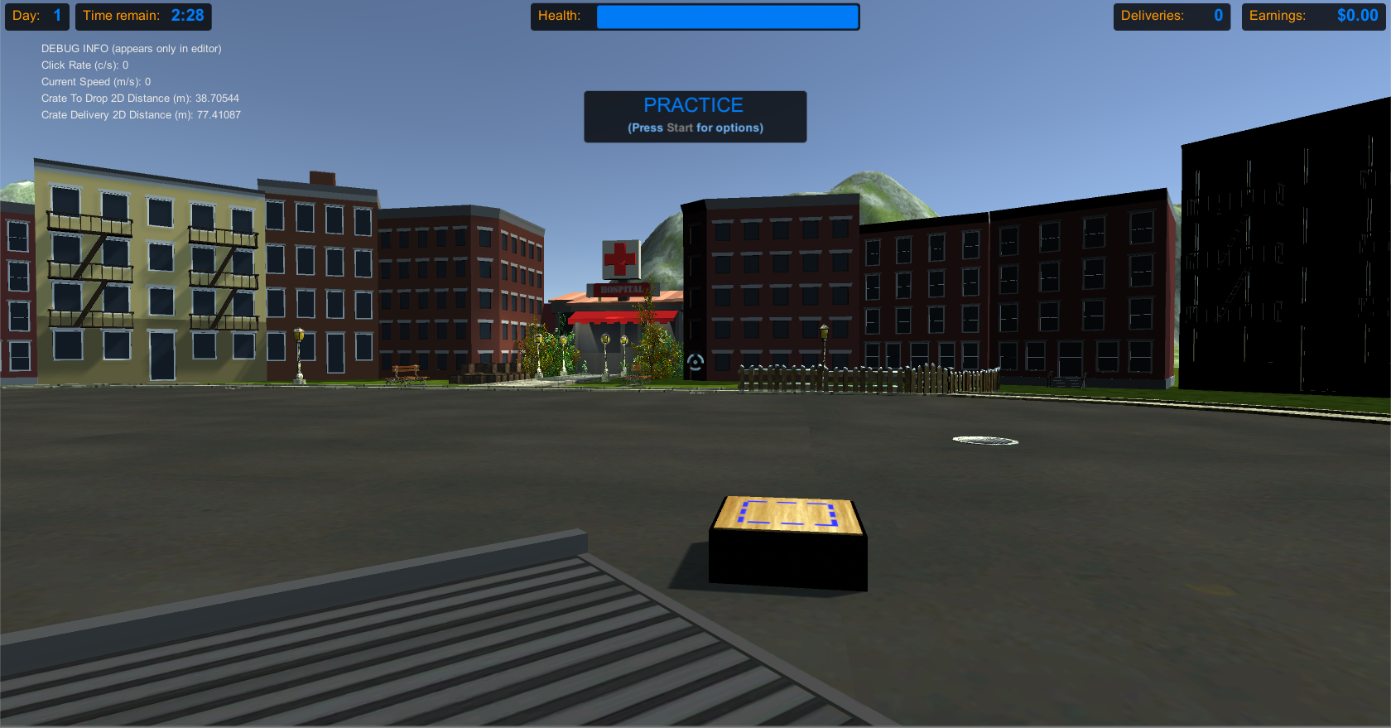
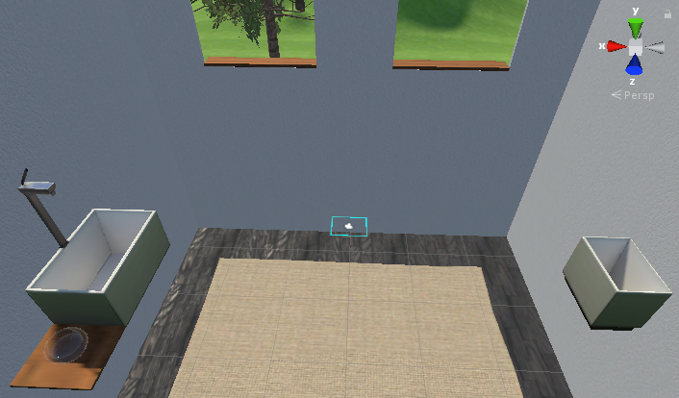
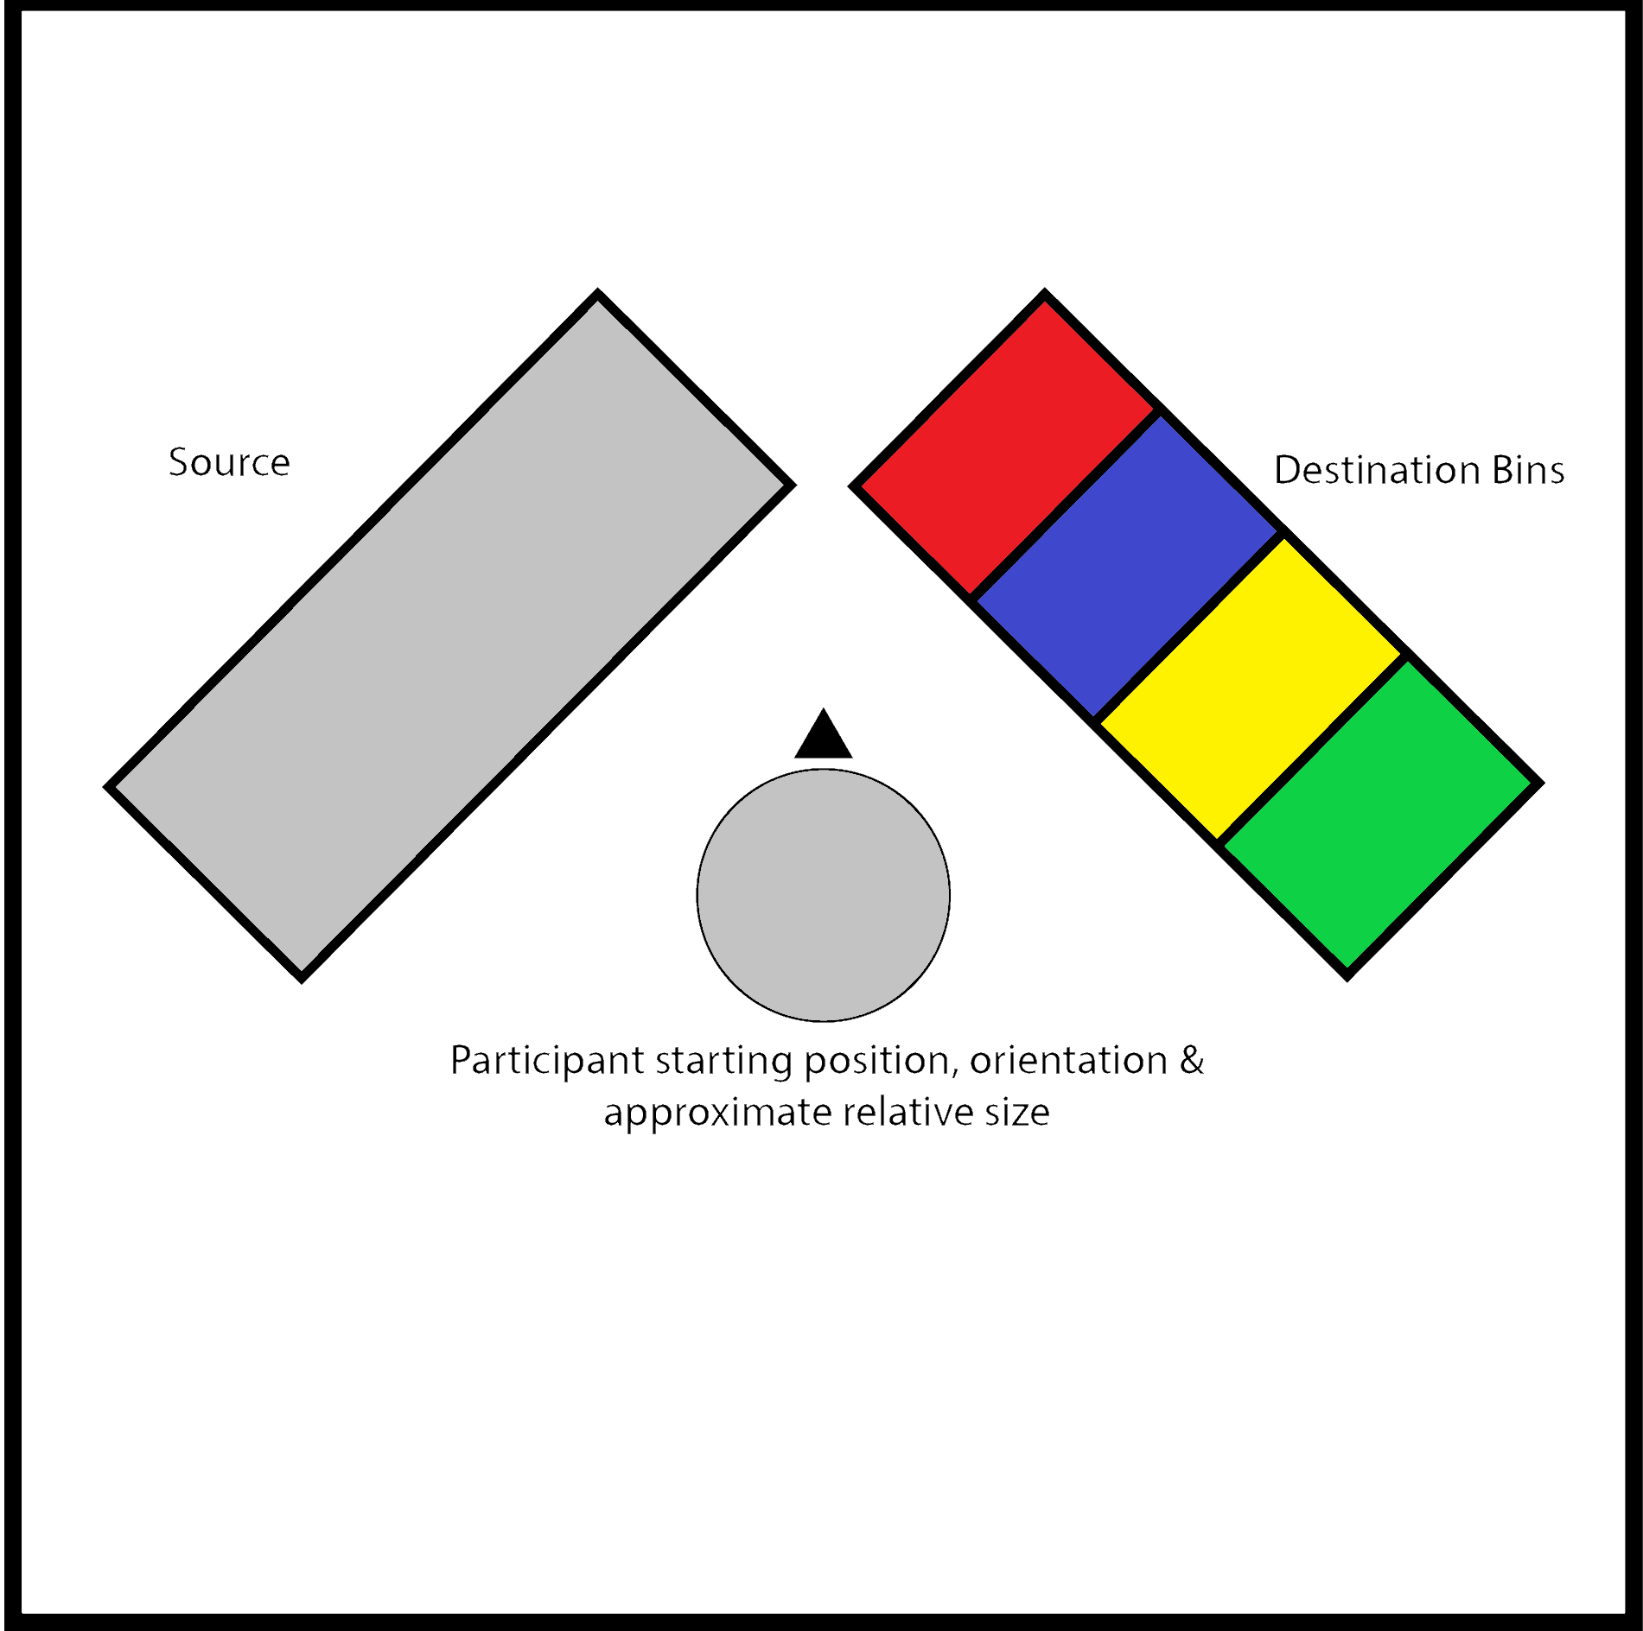
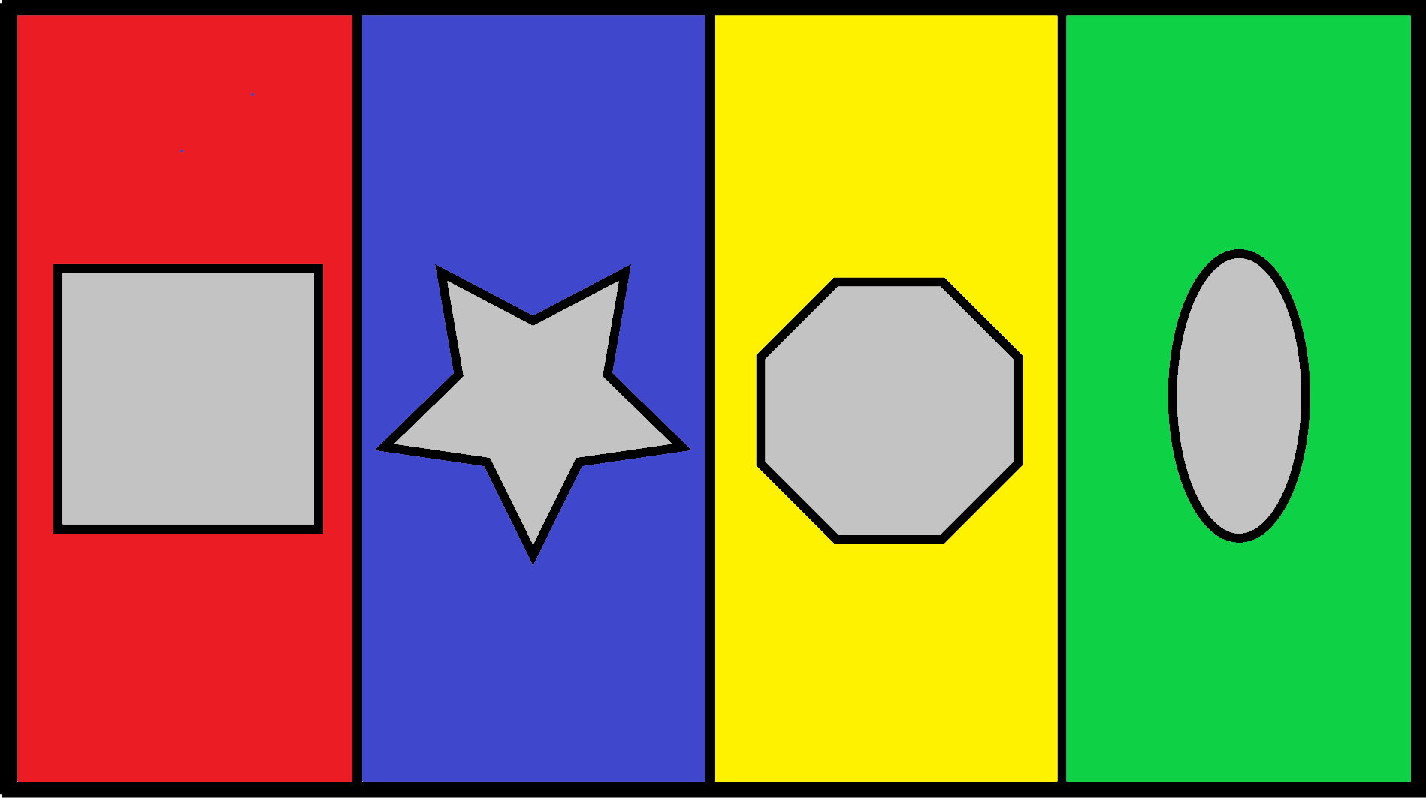
Virtual Reality in Experimental Economics
Capstone Project: Computer Science
Aaska Shah, Kerala Brendon, Nolan Slade, Vyome Kishore
Supervised by Dr. Jacques Carette and Dr Stephanie Thomas
McMaster University, Hamilton, Canada
Motivation: gain insight into how participants make decisions when they are impaired.
Problem: difficult to simulate a physical impairment in a real environment.
Solution: develop a viable alternative using virtual reality simulations.
.
McMaster Decision Science Laboratory (McDSL) Research Project
The Premise:
Virtual simulations involving the completion of some basic task.
Participants are paid cash for successful task completions.
Participants will be virtually impaired and required to choose between methods of treatment.
New Simulation features requested by McDSL:
Designed for an HTC Vive virtual reality system.
Scale to a Vive-equipped testing room.
Offer extensive customization through configuration variables.
Summary of Configuration Variables:
Impairment types and their intensities.
Treatment methods, costs, and effectiveness.
Simulation temporal structure and overall duration.
Original Simulation: move crates from a pile to the target block.
Our Contribution: VR-Ready Simulations
Simulation One:
Simulation Two:
Task: repeatedly transport a volume of liquid between a source and destination using a single hand-carried vessel.
Goal: maximize amount of liquid that successfully reaches the destination
Task: sort three-dimensional shapes into separate containers by passing them through their respective filters.
Goal: maximize total number of shapes sorted into the correct container.
Simulation One: proposed virtual environment.
Simulation Two: proposed environment layout & sample filters.
Sound Interesting?
Acknowledgements
Tweet us what you think of our project, and/or to participate in experimental trials, hashtag #MacCSCapstone:
@CapstoneMcDSL
Please tag our coordinator in your tweet, Dr. Christopher Anand: @DrCKAnand
Trials will likely be scheduled in February 2019.
David Cameron: Manager, McMaster Decision Science Laboratory
Neil Buckley: Associate Professor, York University
Courtney Sheppard: IT Advisor, McMaster Decision Science Laboratory

