Slide 1
Application of Virtual Reality in Experimental Economics
Aaska Shah, Kerala Brendon, Nolan Slade, Vyome Kishore
Supervised by Dr Stephanie Thomas & Dr Jacques Carette

Slide 2



Duncan’s Dilemma
Chronic hip pain has impacted his ability to earn a living as a construction worker
His condition could be significantly improved through surgery
Ontario: 6 to 8 month wait time for a free operation
USA: costs $30 000, but could be done in a week
What will Duncan do?
What does that decision mean?
Notes:
Duncan is a middle-aged construction worker in rural Ontario, who is in dire need of a hip replacement. He has a family to support, and he’s struggling to get through each day on the job. His pain is having a direct impact on his ability to earn a living, and he’s decided that it’s time to get the surgery he needs.
In rural Ontario, it’s possible he could be waiting as long as 8 months to receive surgery; but, at least he wouldn’t have to pay for it out of pocket.
Another option on the table is to drive down to the states and pay a sizeable amount of cash in order to receive the surgery almost right away.
How would Duncan arrive at his final decision? It effectively comes down to a simple question, but one that’s quite difficult to answer: what dollar figure is Duncan’s health worth?
When he makes his decision – what does that mean?

Slide 3
McMaster Decision Science Laboratory (McDSL)
Empirical research into human decision making.
Research addressing issues of funding and financing in health care.
Notes:
This brings us to the work of the McDSL,
Their theory:
- His decision tells us how much he values his health
- We can use this information to address issues of funding and financing in health care.
But how do we get this information? That’s where we come in.
- doing controlled experiments can bring us closer to understanding Duncan’s decision
NEED DUNCAN THUMBS UP

Slide 4
Basic Experiment
Measurable Effort Task
Payment per completion of task
Introduce a functional limitation to completion of the task
Offer an option to obtain treatment for a cost
Notes:
Let’s start with a bit of historical context behind these controlled experiments:
- They revolve around the completion of an ‘Effort Based Task’ : Repetitive task that requires little learning
- The gold-standard ‘Effort-Based Task’ experiment involves stuffing envelopes with letters. For every stuffed envelope, the participant would be given some reward in form of payment.
The next step is to introduce some kind of hindrance to their ability to complete the task. We call this ‘an impairment’.
Within the context of envelope stuffing, a simple impairment would be to force the participant to wear a pair of gloves.
As a result, they lose some amount of dexterity (that can be seen as a component of their overall health), which makes completing the task, and subsequently making money, more difficult.
After a period of stuffing envelopes both with and without gloves, they’re asked a simple question: how much would you pay in order to remove the gloves again?
The participant has a few reasons they’d consider paying: 1) the frustration that stems from loss of dexterity 2) lost revenue from slower task completion
- The amount they are willing to pay gives us a bit of insight into how much they value their dexterity. But, it’s not clear-cut: it’s much more complex.

Slide 5
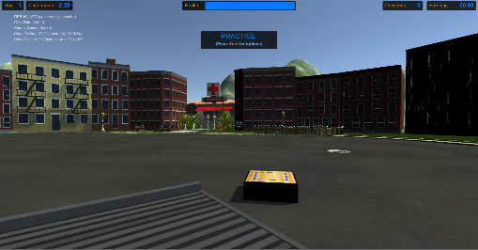
McDSL: Crate Experiment
Health is a complex subject
Effort Task: Move crates across the road
Not realistic (no internalization)
Difficult for subjects to understand
Taking envelopes a step further:
Standard computer simulation using a controller
Notes:
The McDSL wanted to modernize their experimental methods:
One way of doing this was to move to a virtual simulation
This allows for very controlled experiments and accurate data collection
In the past year, they developed what they call the ‘Crate Game’, which is a simple computer application that uses a controller.
The effort task in this experiment is to move crates from one side of the environment to the other; they’re payed for every crate
Similar to the traditional stuffing envelopes experiment, at some point, they’re faced with an impairment. In this case, the component
Of health that’s targeted is mobility. The participant’s maximum moving speed within the virtual world is reduced by some amount. Subsequently,
They’ll take a greater amount of time to deliver each crate and earn less income. They have the option to pay to alleviate this impairment.
After running experimental trials, a few issues became apparent:
It’s very difficult for the participant to internalize the impairment in this virtual world: that is, they’re not likely too feel as though THEY as a person are impaired, instead
It feels like they’re just playing a video game.
Complex interaction mechanisms and lack of instructions made it difficult to understand the environment / task at hand
Our goal this year was to tackle these issues, and provide an application that can provide useful insights / meaningful data for years to come

Slide 6
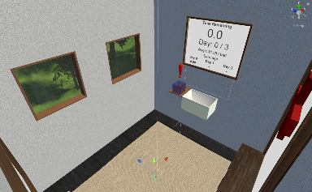
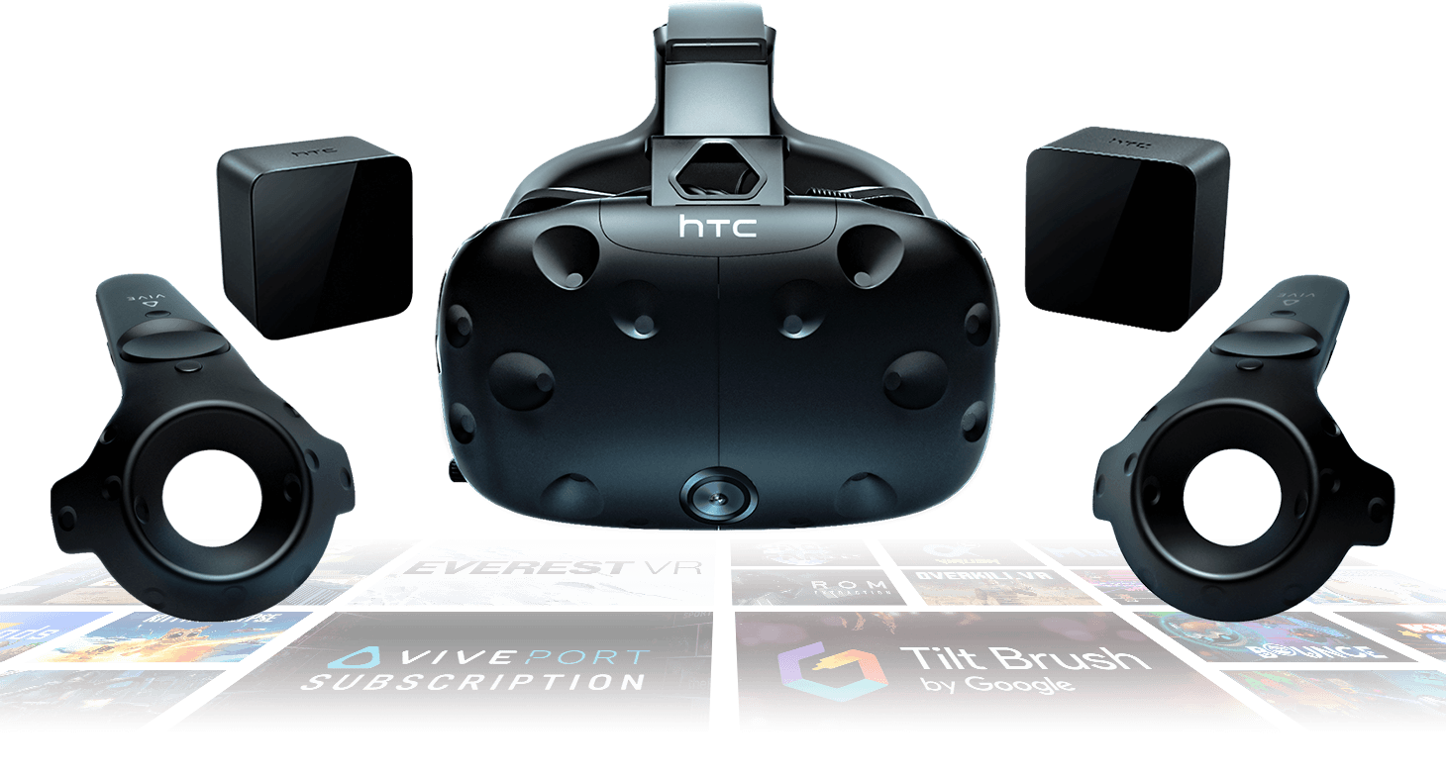

Our Contribution: SteamVR with Unity
Notes:
Our contribution to the project aimed to bring the participant into a much more immersive environment by using virtual reality. Using the lab’s HTC Vive equipment in conjunction with the Unity game engine and SteamVR, we were able to design a fully interactive and highly configurable application that the lab will be able to use for years to come to carry out their research experiments.
Using SteamVR, we track the participant’s headset and controller positions in the physical world, and translate those into the virtual world. Rather than using the commonplace teleport mechanism to move throughout the virtual world, we actually make the participant walk – the scene is measured to be almost identical to the physical room in the McDSL, with a slight buffer zone so that nobody runs into or touches the walls during the experiment.
*tour of the environment

Slide 7
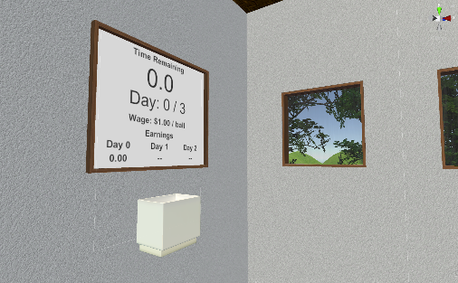
The Effort Task
Notes:
The effort-based task implemented in our application is simple: use a container to transport bouncy balls from one side of the room to the other. On one side of the room, there is an outlet pipe that dispenses balls into the participant’s bucket; on the other side, there’s a tub that they are instructed to pour the balls into.
The participant is payed some dollar amount for every ball they successfully deliver. The effort component of this task is defined by both how fast they’re able to carry out this task; that is, balls delivered per unit time, and also their spill ratio, which is essentially how careful they are being. In short, a participant with high skill exerting great effort will have a low spill ratio, and a high delivery rate.

Slide 8
Shaking Impairment
Video goes here
Notes:
The main impairment that we implemented was aimed to simulate one of the effects of Parkinson’s disease:
The virtual hands will start shaking, which makes spilling a much more likely outcome
This impairment tackles the dexterity component of their health: in their mind, they’re perfectly capable of completing the task, but physically, they’re simply not able to (or at least to full extent)
Similar to real life!
The participant’s controllers provide haptic feedback to help them internalize the impairment
We really tried to make the participant feel as though they’re suffering an impairment
The intensity of the impairment is up to the researcher, the higher they set the intensity, the more difficult completing the effort task will be

Slide 9
Fog Impairment
Video goes here
Notes:
Another component of health we chose to target was vision
- In this case, a fog is introduced within the virtual environment
- This impairment emphasizes the need to be precise: it’s not nearly as easy to see where the sink is, etc.
- It’s also extremely frustrating!
- Even if the participant is able to complete the task relatively well while impaired, they’ll be very frustrated / annoyed

Slide 10
Treatment
Video Goes here + DUNCAN TIME IS MONEY
Notes:
Regardless of which impairment is used, the researcher can choose to offer the participant an option to alleviate it – a treatment
Deciding to receive treatment involves opportunity cost: the participant will have to give something up, but in exchange, they’ll be back to full health and be able to complete the task to the best of their abilities once again
The opportunity cost can take two forms:
Like Duncan, the participant can choose to pay to receive treatment immediately - in this case, the opportunity cost is simply the money they’ll give up for the treatment
Or, they can wait a certain amount of time and then receive the treatment for free - in this case, the opportunity cost is the lost earnings they could have made in the time they spent waiting
The costs, in both of these cases, follow a functional form – determined by the researcher
They make this decision by interacting with medication bottles within the virtual scene

Slide 11
Configuration
Show example configuration file
Many elements can be changed
Temporal structure of the experiment
Impairments & when they occur
Treatment options
Notes:
Problem with making one simulation is it has a short lifespan, and can only be used for one iteration of the experiment
Configuration allows for many iterations of the experiment and a longer lifetime
Allows experiment administrators to design experiments
Things we can change
Number of days
Length of individual days
When impairments occur / what type of impairment / what strength
Variables in cost and wait functions

Slide 12
Design Considerations
Tutorial Period: ‘Day Zero’
Claustrophobia & Motion Sickness
TWO PHOTOS:
ONE OF TUTORIAL INSTRUCTION WITH BUCKETMARKER
ONE OF MODERN ART + DOOR TO EXPLAIN THOSE PARTS
Notes:
- The first thing the participant is required to complete is a tutorial period
- It can be split into two portions: unimpaired and impaired – aimed to familiarize the participant with the task, the environment, and impairments.
We also wanted to provide measures to accommodate as many participants as possible, even if they’re particularly sensitive to motion sickness, or if they tend to be claustrophobic.

Slide 13
Insights
Many important metrics persisted into a CSV file for lab analysis
PHOTO OF ZOOMED OUT EXCEL FILE HERE
Notes:
None of what we’ve discussed would help Duncan, or McDSL at all, if we didn’t collect meaningful data for the lab to analyze
There are a lot of metrics that can provide useful insights, notably:
Positioning, headset rotation (where they’re looking)
Movement speed
Amount of balls carried, delivered, spilled
Current treatment costs

Slide 14
Back to Duncan(s)…
This is an issue that stems globally across the healthcare industry
Critical insights could lead to more efficient healthcare systems in the future
PHOTOS OF STUFF
Notes:
Going back to the start of our presentation – and our persistent friend Duncan.
Duncan isn’t alone: there are many people around the world making these kinds of decisions in a wide variety of contexts
- Governing bodies and major healthcare institutions, if they knew how Duncans make these kinds of decisions (i.e. do they pay or wait, or nothing!),
Then designing an efficient healthcare system (i.e. public vs private vs combination, and what combination, at that?) that satisfies the needs of as many
As possible becomes a much simpler process.

Slide 15
Can This Go Further?
Applications can extend beyond the healthcare sector
PHOTOS OF HIGHWAY 407
Notes:
Can generalize health to be more than the health of a person, but the health of a system
Can apply the same theory to those systems, such as traffic

Slide 16
Thank you!

