Slide 1
Application of Virtual Reality in Experimental Economics
Aaska Shah, Kerala Brendon, Nolan Slade, Vyome Kishore
Supervised by Dr Stephanie Thomas & Dr Jacques Carette

Slide 2



Duncan’s Dilemma
Chronic hip pain has impacted his ability to earn a living as a construction worker
His condition could be significantly improved through surgery
Ontario: 6 to 8 month wait time for a free operation
USA: costs $30 000, but could be done in a week
What should Duncan do?
Notes:
Duncan is a middle-aged construction worker in rural Ontario, who is in dire need of a hip replacement. He has a family to support, and he’s struggling to get through each day on the job. His pain is having a direct impact on his ability to earn a living, and he’s decided that it’s time to get the surgery he needs.
In rural Ontario, it’s possible he could be waiting as long as 8 months to receive surgery; but, at least he wouldn’t have to pay for it out of pocket.
Another option on the table is to drive down to the states and pay a sizeable amount of cash in order to receive the surgery almost right away.
How would Duncan arrive at his final decision? It effectively comes down to a simple question, but one that’s quite difficult to answer: what dollar figure is Duncan’s health worth?

Slide 3
McMaster Decision Science Laboratory
Empirical research into human decision making.
Research addressing issues of funding and financing in health care.
Notes:
The problem we’re solving:
Measuring the worth of health of somebody or something.
Doing controlled experiments can bring us closer to understanding this.
Provide them a more natural experimental environment to conduct this research
Help solve Duncan’s Dilemma

Slide 4
Basic Experiment
Measurable Effort Task
Payment per completion of task
Introduce a functional limitation to completion of the task
Offer an option to obtain treatment for a cost
Notes:
Use Envelope stuffing experiment to describe above
Discuss basic idea of experiments
Simple measurable effort task: Repetitive task that requires little learning
Payment per completion of task
Introduce a functional limitation to completion of the effort task
Observe effort response to the impairment (how does the impairment affect their earnings)
Offer an option to obtain treatment for a cost
More unimpaired time means more medication cost
Single optimal time to obtain medication if participants wish to maximize earnings
Early medication choice involves a higher payment but more healthy time, later medication choice involves lower payment and less healthy time
Discuss frustration

Slide 5
Crate Experiment
Effort Task: Deliver crates to a point in the environment
Not realistic
Difficult for subjects to understand
Standard computer game using controller

Slide 6
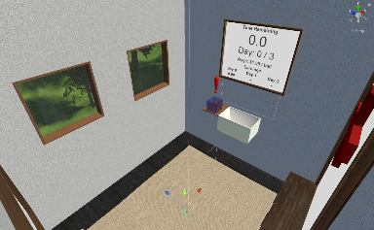
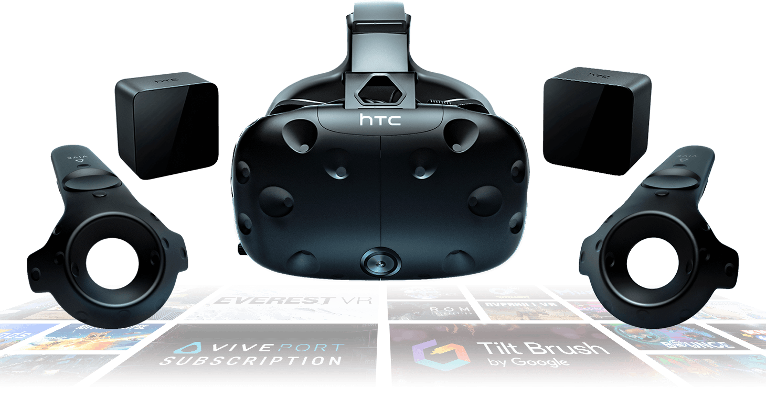

Our Contribution: SteamVR with Unity
Notes:
Our contribution to the project aimed to bring the participant into a much more immersive environment by using virtual reality. Using the lab’s HTC Vive equipment in conjunction with the Unity game engine and SteamVR, we were able to design a fully interactive and highly configurable application that the lab will be able to use for years to come to carry out their research experiments.
Using SteamVR, we track the participant’s headset and controller positions in the physical world, and translate those into the virtual world. Rather than using the commonplace teleport mechanism to move throughout the virtual world, we actually make the participant walk – the scene is measured to be almost identical to the physical room in the McDSL, with a slight buffer zone so that nobody runs into or touches the walls during the experiment.
*tour of the environment

Slide 7
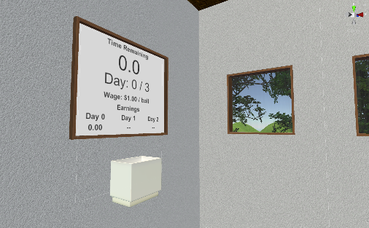
The Effort Task
PHOTO OF THEM HOLDING BUCKET + FILLING FROM PIPE HERE
Notes:
The effort-based task implemented in our application is simple: use a container to transport bouncy balls from one side of the room to the other. On one side of the room, there is an outlet pipe that dispenses balls into the participant’s bucket; on the other side, there’s a tub that they are instructed to pour the balls into.
The participant is payed some dollar amount for every ball they successfully deliver. The effort component of this task is defined by both how fast they’re able to carry out this task; that is, balls delivered per unit time, and also their spill ratio, which is essentially how careful they are being. In short, a participant with high skill exerting great effort will have a low spill ratio, and a high delivery rate.

Slide 8
Shaking Impairment
Video goes here
Notes:
Simulate Parkinson’s Disease
Impairment intensity
Haptic feedback

Slide 9
Fog Impairment
Video goes here
Notes:
Simulate a visual impairment
Intensity levels (opacity)

Slide 10
Treatment
Video Goes here
Notes:
Two options, wait or pay
Explain functions

Slide 11
Configuration
Show example configuration file
Notes:
Problem with making one simulation is it has a short lifespan, and can only be used for one iteration of the experiment
Configuration allows for many iterations of the experiment and a longer lifetime
Allows experiment administrators to design experiments
Things we can change
Number of days
Length of individual days
When impairments occur
Variables in cost and wait functions

Slide 12
Output
CSV
Position in world
Amount carrying
Amount earned
Notes:
- Mention the collection of almost any measurable data?

Slide 13
Additional Features
Tutorial Day
Claustrophobia
Motion Sickness
Notes:
Show curtains
Show door

Slide 14
Thank you!
Notes:
Can generalize health to be more than the health of a person, but the health of a system
Can apply the same theory to those systems, such as traffic
After conducting these experiments the McMaster Decision Science Laboratory can better solve Duncan’s dilemma and

