Slide 1

CURRICULUM VITAE ANALYSIS USING MACHINE LEARNING ALGORITHM
Department of Computer Science and Engineering Under The Esteemed Guidance Of Mrs . J. LAKSHMI _{M. Tech} Assoc. Professor PRESENTED BY
M.Anuhya K.Gayathri Venkata Aasritha N.Chandu Venkat sai M.Dinesh Babu M.Harshitha

Slide 2

Contents:
Abstract
Introduction
Literature Survey
Existing System
Proposed System
System Requirements
Modules and Description
System Architecture
UML Diagrams
Sample code
Output Screens
System Testing
Conclusion
Future Enhancement

Slide 3
Abstract:
We describe a system called CV analysis machine, that processes a set of given free-form textual resumes (in English for IT domain), creates a standardized profile for each candidate, and for a given job description, identifies a ranked shortlist of k candidates, along with a matching score for each.
Companies often receive thousands of resumes for each job posting and employ dedicated screeners to short list qualified applicants.
To shortlist the candidates we are using the ranking policy so the decisions will be fair.
In this, we present “PROSPECT”, a decision support tool to help these screeners shortlist resumes efficiently. Prospect mines resumes to extract salient aspects of candidate profiles like skills, experience in each skill, education details and past experience.

Slide 4
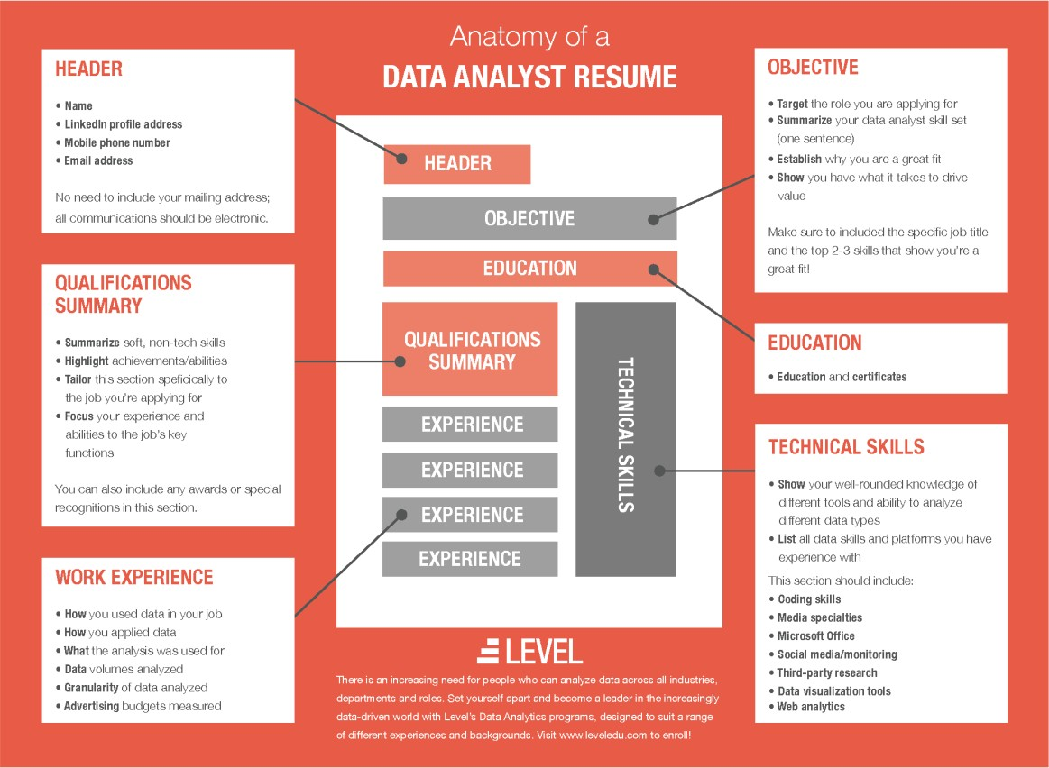
Introduction:
Personality is the most important factor which reflects an individual, which keeps on varying.
Tackling them is a tedious task for which we have implemented an approach to identify the personality and also provide with the recommendation. This will enable a more effective way to short list submitted candidate CVs from a large number of applicants providing a consistent and fair CV ranking policy, which can be legally justified.
System will rank the experience and key skills required for particular job position.
So, it will help the HR department to easily shortlist the candidate based on the CV ranking policy.

Slide 5
Literature survey:
Jenal Parmar devised a system in choosing the best candidates for open vacancies. The HR department will include the qualifications, experience, and other details required for a particular job position. The system will take the details and CV/Resume of the candidates and then shortlist the right person suitable for that job profile.
Allan Robey built a system using modern technology where it will help to pick the right candidates by using weight-age policy and an aptitude .
Sudhir Bagade says that personality plays an important role in one’s individual life.The system uses the TF-IDF algorithm to select the right candidates.
Atharva Kulkarni built a system using different machine learning algorithms for predicting the personalities of the candidates using Natural Language Processing, Random Forest achieves better accuracy than remaining algorithms such as KNN, Logistic Regression, Support Vector Machine, and Naive Bayes.
VVCET-CSE The system will predict the personality based on the ranking policy.
Afroja Khatun Monalisa built a model using the Random Forest Algorithm, Support Vector Machine, and Weighted Majority Voting algorithm.

Slide 6
Existing System:
The candidates will register themselves with the required details in the CV form and upload the documents for verifying the authenticity of the information provided in the CV registration form.
In order to apply for a job the candidates needs to be eligible for that job by satisfying all the requirements as stated by the recruiter.
If a candidate applies for a specific job, the system checks whether the candidate meets all the requirements/parameters as specified by the recruiter.
If the Candidate meets the requirements then the online test will be conducted on personality questions as well as aptitude questions. After completing the online test, candidate can view their own test results.
The system would then derive and rank the candidates who were eligible for the job. The rank of each candidate acts as a score of how well the candidate’s profile meets the specifications of the recruiters as well as cumulative score of the the aptitude test.
The recruiter could also analyze the personality of the candidate based on the result of the personality test. So, based on CV, aptitude test and the personality test the candidate would be selected.

Slide 7
Disadvantages of Existing System:
This system requires large memory space as it stores data related to CV’s.
Requires an active internet connection.
May provide inaccurate results if data not entered properly.
To verify all the candidates forms it takes more time.
There is a huge workload on the human resource department to select the right candidate for a particular job profile which in turn would provide experts workforce for the organization from a large pool of candidates.

Slide 8
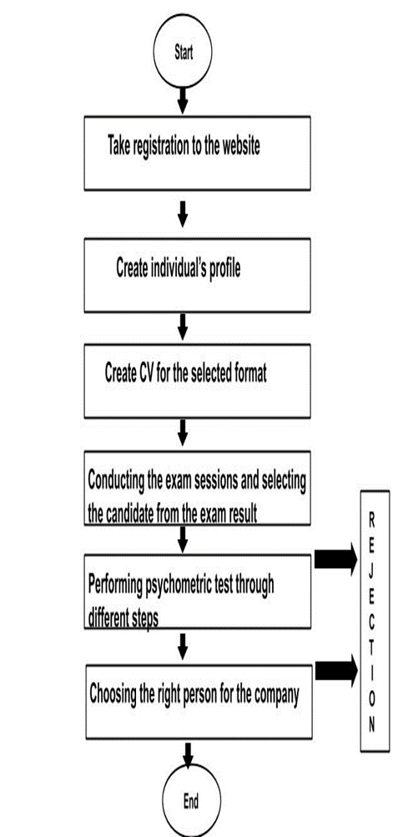
Proposed System:
The proposed system will enable a more effective way to
short list submitted candidate CVs from a large
number of applicants providing a consistent and fair CV
ranking policy. This can be legally justified.
System will rank the experience and key skills required
for a particular job position than system will rank the CV’s
based on the experience and other key skills which are
required for particular job profile.
This system will help the HR department to easily shortlist
the candidate based on the CV ranking policy.

Slide 9
Advantages of proposed system:
This system employs a machine learning algorithm namely “Logistic Regression” which helps to choose fair decisions to recruit a suitable candidate.
It has the potential to transform research and assessment in personality psychology. Algorithms can handle vast datasets, including thousands of attributes, without succumbing to collinearity issues. Moreover, ML algorithms are highly efficient in recognizing patterns in datasets that humans cannot even perceive.
It does not consume more time to identify the personalities.
This predictive personality makes the recruiters understand if a candidate will be a top performer and fit to the culture of the company easily.

Slide 10
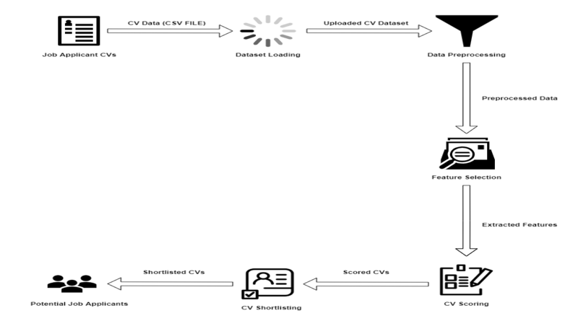
System Architecture:

Slide 11
Requirements Specifications:
Hardware Requirements:
Processor : Intel I5 Core
Hard disk :1TB
RAM :8GB or above
Software Requirements:
Operating System :Windows 10 or above
Coding language :Java SWINGS,AWT
IDE :NETBEANS 15

Slide 12
Design Algorithm:
In this section we state the machine learning algorithm (TF-IDF) for CV analysis. The TF-IDF Algorithm is used to find out the important keywords in a document/CV. Below, we give the working of TF-IDF in detail.
Step 1: Calculate TF (Term Frequency)
Term Frequency (TF) - Number of times a keyword appeared in a document is calculated by Term Frequency.
TF (‘keyword’) =number of times ‘keyword’ appears in document /Total number of keywords in the document. Here, the term ‘keyword’ signifies any job specific skill which the algorithm is searching for.
Step 2: Calculate IDF (Inverse Document Frequency) value.
The problem of rare and frequent words is resolved.
This helps our system to give more priority to the required word or skills.
IDF sets the log value=1 for the required CV as per skill sets and log value=0 for the unwanted CV.
IDF (‘keyword’) =log (total number of CV/Number of document with term ‘keyword’)
Step 3: Calculate TF-IDF weight
Weight= TF (‘keyword’)*IDF (‘keyword’)
Higher the weight, more relevant is the CV and lower the weight, less or no relevance of the CV for the selection process. This step returns the CV with highest and lowest weight values which is further useful for classification.

Slide 13
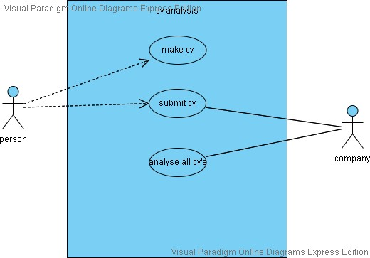
UML DIAGRAMS:
USE CASE DIAGRAM:
Unified Modeling Language (UML) is a type of behavioral diagram defined by and created from a Use-case analysis.Its purpose is to present a graphical overview functionality provided by a system in terms of actors, their goals (represented as use cases), and any dependencies between those use cases.

Slide 14
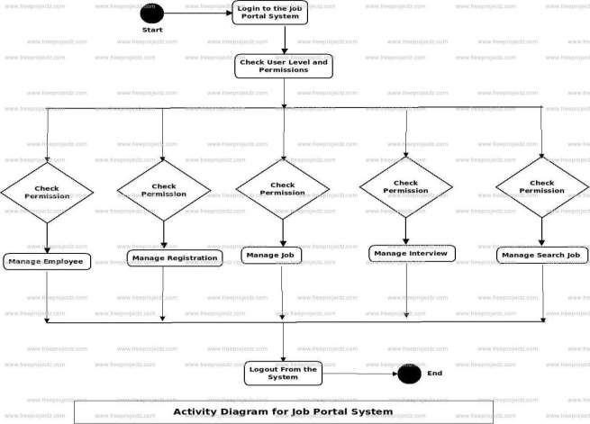
Activity diagram:
Activity diagrams are graphical representations
of workflows of stepwise activities
and actions with support for choice,
iteration and concurrency.
In the Unified Modeling Language, activity
diagrams can be used to describe the business
and operational step-bystep workflows of
components in a system.An activity diagram
shows the overall flow of control.

Slide 15
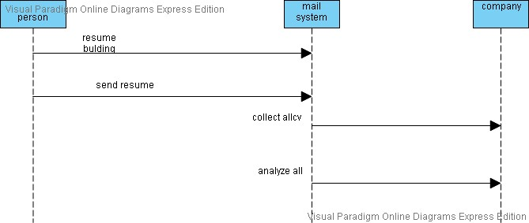
Sequence Diagram: A sequence diagram is a type of interaction diagram because it describes how and in what order a group of objects works together.

Slide 16
THANK YOU

