Slide 1

CURRICULUM VITAE ANALYSIS USING MACHINE LEARNING ALGORITHM Department of Computer Science and Engineering Under The Esteemed Guidance Of Mrs . J. LAKSHMI _{M. Tech} Assoc. Professor PRESENTED BY
M.Anuhya (20NE1A05A1) K.Gayathri Venkata Aasritha (20NE1A0571) N.Chandu Venkat sai (20NE1A05B3) M.Dinesh Babu (20NE1A0597) M.Harshitha (20NE1A0595)
M.ANUHYA | 20NE1A05A1
K.GAYATHRI VENKATA AASRITHA | 20NE1A0571
N.CHANDU VENKAT SAI | 20NE1A05B3
M.DINESH BABU | 20NE1A0597
M.HARSHITHA | 20NE1A0595

Slide 2

Contents:
Introduction
Abstract
Existing System and Proposed System
System Architecture
Design Algorithm
Implementation Code
Output Screenshots

Slide 3
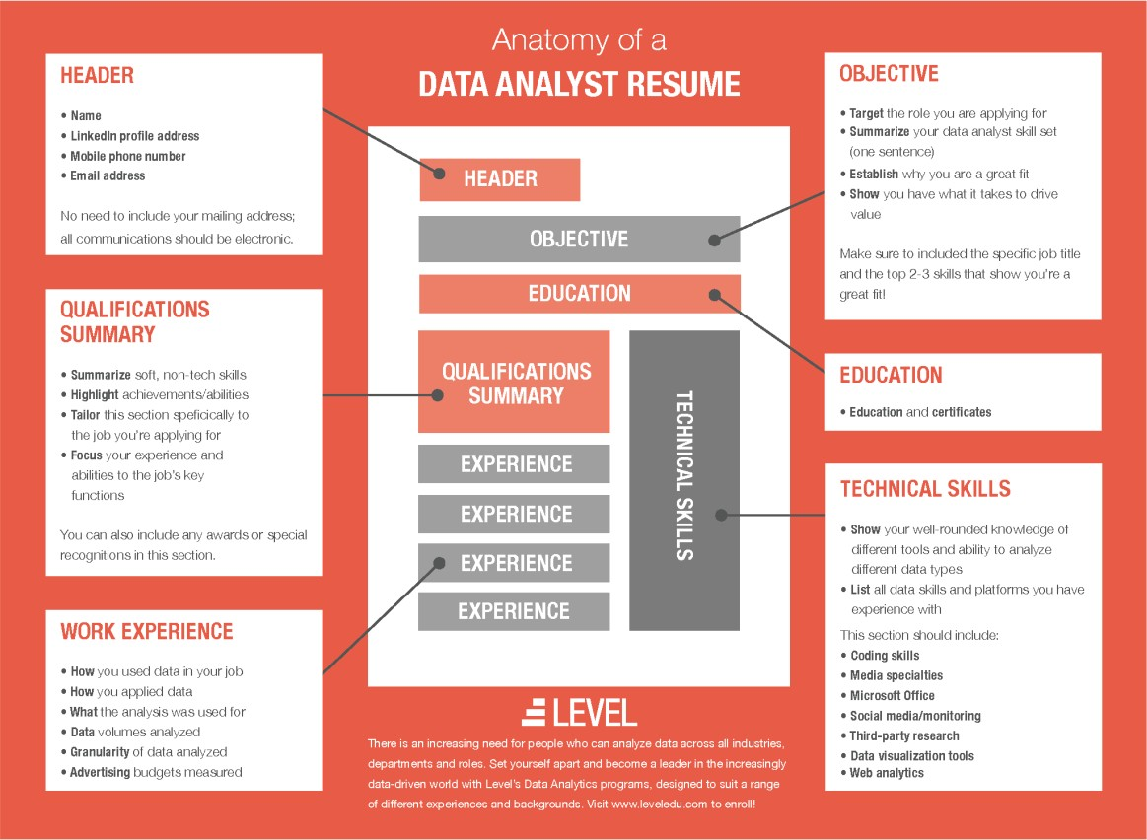
Introduction:
Personality is the most important factor which reflects an individual, which keeps on varying.
Tackling them is a tedious task for which we have implemented an approach to identify the personality and also provide with the recommendation. This will enable a more effective way to short list submitted candidate CVs from a large number of applicants providing a consistent and fair CV ranking policy, which can be legally justified.
System will rank the experience and key skills required for particular job position.
So, it will help the HR department to easily shortlist the candidate based on the CV ranking policy.

Slide 4
Abstract:
We describe a system called CV analysis machine, that processes a set of given free-form textual resumes (in English for IT domain), creates a standardized profile for each candidate, and for a given job description, identifies a ranked shortlist of k candidates, along with a matching score for each.
Companies often receive thousands of resumes for each job posting and employ dedicated screeners to short list qualified applicants.
To shortlist the candidates we are using the ranking policy so the decisions will be fair.
In this, we present “PROSPECT”, a decision support tool to help these screeners shortlist resumes efficiently. Prospect mines resumes to extract salient aspects of candidate profiles like skills, experience in each skill, education details and past experience.

Slide 5
Existing System:
The candidates will register themselves with the required details in the CV form and upload the documents for verifying the authenticity of the information provided in the CV registration form.
In order to apply for a job the candidates needs to be eligible for that job by satisfying all the requirements as stated by the recruiter.
If a candidate applies for a specific job, the system checks whether the candidate meets all the requirements/parameters as specified by the recruiter.
If the Candidate meets the requirements then the online test will be conducted on personality questions as well as aptitude questions. After completing the online test, candidate can view their own test results.
The system would then derive and rank the candidates who were eligible for the job. The rank of each candidate acts as a score of how well the candidate’s profile meets the specifications of the recruiters as well as cumulative score of the the aptitude test.
The recruiter could also analyze the personality of the candidate based on the result of the personality test. So, based on CV, aptitude test and the personality test the candidate would be selected.

Slide 6
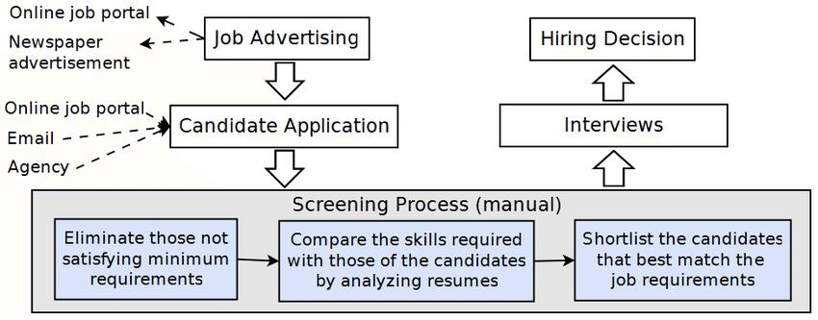

Slide 7
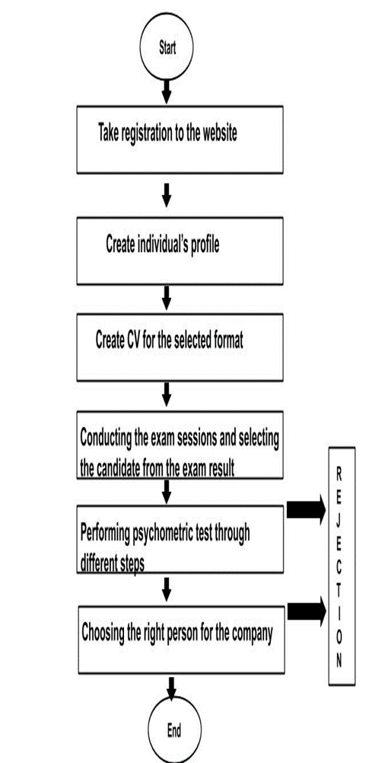
Proposed System:
The proposed system will enable a more effective way to
short list submitted candidate CVs from a large
number of applicants providing a consistent and fair CV
ranking policy. This can be legally justified.
System will rank the experience and key skills required
for a particular job position than system will rank the CV’s
based on the experience and other key skills which are
required for particular job profile.
This system will help the HR department to easily shortlist
the candidate based on the CV ranking policy.

Slide 8
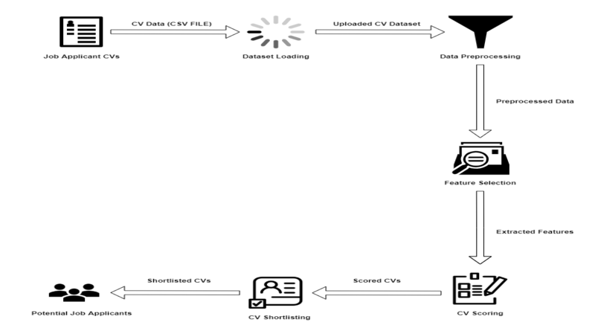
System Architecture:

Slide 9
Design Algorithm:
In this section we state the machine learning algorithm (TF-IDF) for CV analysis. The TF-IDF Algorithm is used to find out the important keywords in a document/CV. Below, we give the working of TF-IDF in detail.
Step 1: Calculate TF (Term Frequency)
Term Frequency (TF) - Number of times a keyword appeared in a document is calculated by Term Frequency.
TF (‘keyword’) =number of times ‘keyword’ appears in document /Total number of keywords in the document. Here, the term ‘keyword’ signifies any job specific skill which the algorithm is searching for.
Step 2: Calculate IDF (Inverse Document Frequency) value.
The problem of rare and frequent words is resolved.
This helps our system to give more priority to the required word or skills.
IDF sets the log value=1 for the required CV as per skill sets and log value=0 for the unwanted CV.
IDF (‘keyword’) =log (total number of CV/Number of document with term ‘keyword’)
Step 3: Calculate TF-IDF weight
Weight= TF (‘keyword’)*IDF (‘keyword’)
Higher the weight, more relevant is the CV and lower the weight, less or no relevance of the CV for the selection process. This step returns the CV with highest and lowest weight values which is further useful for classification.

Slide 10
Sample code:
Importing the packages:
import java.awt.Graphics;
import java.awt.Image;
import java.awt.RenderingHints;
import java.awt.event.*;
import java.awt.event.MouseAdapter;
import java.awt.event.MouseEvent;
import javax.swing.*;
import java.io.*;
import java.text.DecimalFormat;
import java.util.Arrays;
import java.util.logging.Level;
import java.util.logging.Logger;
import javax.swing.border.BevelBorder;
import javax.swing.border.Border;
import javax.swing.filechooser.FileSystemView;

Slide 11
Login details:
loginb = new JButton("LOG IN");
loginb.setBounds(450, 500, 100, 30);
loginb.setForeground(Color.WHITE);
loginb.setBackground(Color.BLACK);
ImageIcon logini = new ImageIcon("C:\\Users\\--\\Downloads/a.jpg");
loginl = new JLabel();
loginl.setIcon(logini);
loginl .setBackground(Color.decode("#8ae6a2"));
loginl.setBounds(0, 0, 1200, 700);
loginl.add(password);
loginl.add(userid);
loginl.add(userid);
loginl.add(password);
loginl.add(loginb);
login = new JPanel();
login.setBounds(0, 0, 1200, 700);
login.setLayout(null);
login.add(loginl);

Slide 12
Viewing the data:
viewone = new JButton("VIEW");
viewone.setFont(new Font("sarif", Font.BOLD, 20));
viewone.setBackground(Color.decode("#8ae6a2"));
viewone.setForeground(Color.yellow);
viewone.setBounds(110, 0, 200, 40);
viewone.setBorder(null);
viewone.addMouseListener(new MouseAdapter() {
@Override
public void mouseEntered(MouseEvent me) {
viewone.setBorder(mb1b);
viewone.setBackground(Color.CYAN);
viewone.setForeground(Color.BLUE);
}
@Override
public void mouseExited(MouseEvent me) {
viewone.setBorder(BorderFactory.createEmptyBorder());
viewone.setBackground(Color.decode("#8ae6a2"));
viewone.setForeground(Color.yellow);
}
});

Slide 13
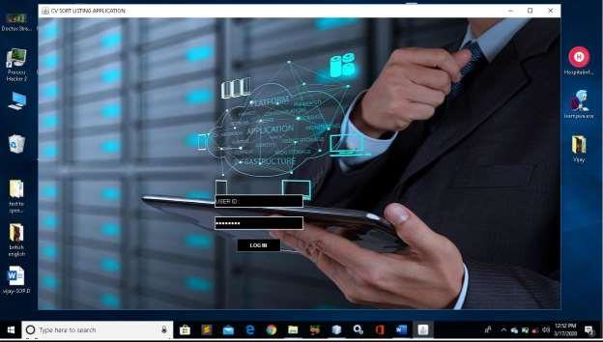
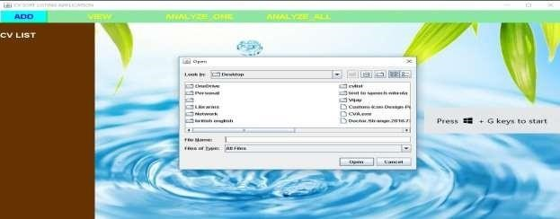
OUTPUT SCREENS:
ADMIN LOGIN
FILE CHOOSER

Slide 14
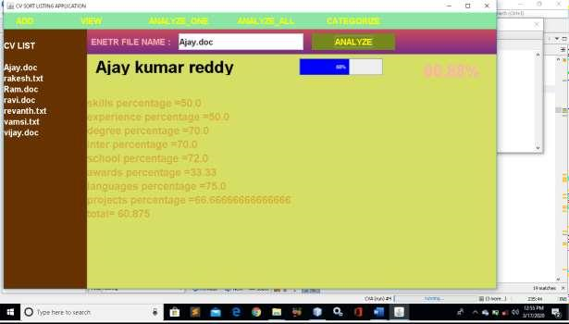
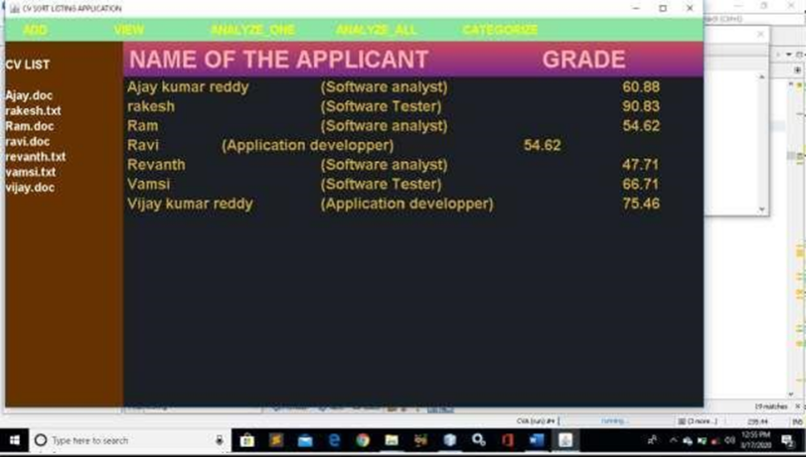
ANALYZE ONE CV
ANALYZE ALL

Slide 15
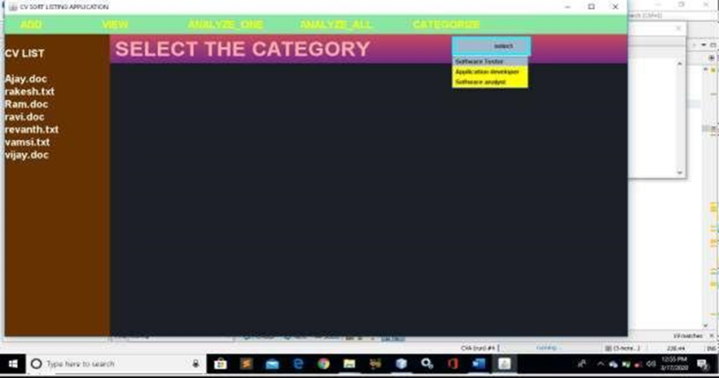

CATEGORIZE
READ THE CONTENT

Slide 16
THANK YOU

