Slide 1
STUDENT RECORD MANAGEMENT SYSTEM(SRMS)
CODING SKILLS

Slide 2
GROUP MEMBERS:
NAME OF THE STUDENT | REGISTRATION NUMBER
S.AKHILA | AP24110010389
T.MOHANA | AP24110010390
V.AKSHAYA | AP24110010436
D.MOUNIKA | AP24110010437
V.AASRITHA | AP24110010443

Slide 3
INTRODUCTION
The Student Record Management System is a simple computer-based application designed to store, manage, and update student data efficiently . Instead of writing everything on paper, the SRMS helps maintain all student details in an organized and error-free way.

Slide 4
Project Overview
This project focuses on creating a small database for students.
It allows adding, updating, deleting, and viewing student information.
The project is built using C++ and follows basic file handling concepts.
It acts as a mini version of a real-world student information system used in schools and colleges.

Slide 5
Objectives
To store student information securely
To access records quickly
To reduce manual paperwork
To understand file handling in C++
To build a beginner-level database system

Slide 6
Features of the System
Add new student record
View all student records
Search for a student
Update existing details
Delete a student record
Save data permanently using files

Slide 7
Technologies Used
Programming Language: C++
Concepts Used:
Classes & Objects
File Handling
Functions
Loops & Conditions
Environment: VS Code / Dev C++ / CodeBlocks

Slide 8
System Workflow
User runs the program
Menu appears (Add, Display, Search, Update, Delete)
User selects an option
System performs the chosen action
Data gets saved in a file

Slide 9
Project Modules
Add Record Module – stores new student information
Search Module – finds student by roll number
Modify Module – edits existing details
Delete Module – removes a student from the file
Display Module – shows all students

Slide 10
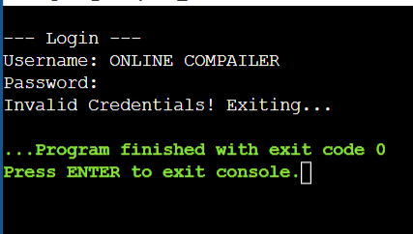
Sample Output Screenshot

Slide 11
Credentials
For demonstration:
Username: admin
Password: 12345

Slide 12
Procedure to Run the Project
1) Open VS Code/IDE
2) Install GCC compiler (MinGW)
3) Save the file as srms.cpp
4) Compile using terminal:
→ g++ srms.cpp -o srms
5) Run the program:
→ ./srms
6) Use the menu to test all features

Slide 13

ADVANTAGES
Fast and easy data access
Reduces human errors
Saves time and paperwork
Data stays safely stored in files
LIMITATIONS
No GUI (text-based only)
Cannot handle very large databases
No data encryption
Does not support multiple users

Slide 14
Future Enhancements
Add a graphical user interface
Use a real database (MySQL)
Add login for students & staff
Provide cloud storage
Generate automatic report

Slide 15
Conclusion
The Student Record Management System helps store and manage student data in an organized way.
It is simple, fast, and useful for understanding real-world data handling with C++.
This project improves knowledge of OOP, file handling, and software development basics.

Slide 16
THANK YOU

