Slide 1


Bank of Baroda Hackathon - 2022
Technology Partner
Your Team Name : TechDreams
Your team bio :
Date : 18/09/22
A team of enthusiastic and hardworking students passionate to innovate and explore their abilities.

Slide 2
Problem Statement?
It’s never been more crucial for companies(post-Covid era) to ensure their call centers — and their call center teams — are operating at an optimal level of efficiency. But call centers are also cost centers, and they can be complicated to set up and run. They demand a lot of technology, both hardware and software, and a reliable and extensive phone system. To provide employers the ability to improve service quality and an unparalleled opportunity to monitor and as well as enhance a variety of service metrics from call times, efficiency, employee performance and customer satisfaction. Overall the goal is to smoothen the process of collecting and analyzing customer data to unearth valuable insights about a particular service organization's performance. Insights from the analyzed data can also help businesses ensure their call centers are routing calls to the right places. This not only helps to smooth the customer experience, but it also can drive a higher first call resolution (FCR) rate and it creates more opportunities for call center agents to convert customer service calls to sales.

Slide 3
User Segment & Pain Points
Regular customers(although it may vary accordingly) are going to our advertiser segment because their satisfaction is paramount, since in competitive industries, it’s getting harder to stand out through products or services alone. You need to be the best in customer experience so customers will remember and keep going back to you. And to be the best, you need to have a customer-first culture that’s driven by data and analytics. Major criteria's which are gong to be focused are as such:
First Response Time (FRT)
First Contact Resolution (FCR)
Average Speed of Answer (ASA)
Average Handle Time (AHT)
Call Volume
Average Waiting Time

Slide 4
Pre-Requisite
In the existing models of call center analytics, the main paradigm focusses on the speech-to-text translation following which involves sentiment analysis, language detection and various other analysis. The existing models lack the focus on the customer feedback and ratings. We propose to combine the existing models with the customer feedback and ratings in order to reach a more concrete conclusion. The existing models might fail whilst parsing for key phrases if a phrase is used in another sense that might not coincide with the conclusion that the analysis draws. Here comes the feedback and the rating system into play for rescue. The conclusion will not only depend on the extractions made from the call but they can be made concrete using the direct feedback from the customer. Furthermore, if the call relates to a specific subject then special executives that are specialized in the subject of concern will be brought forward to interact with the customer.

Slide 5
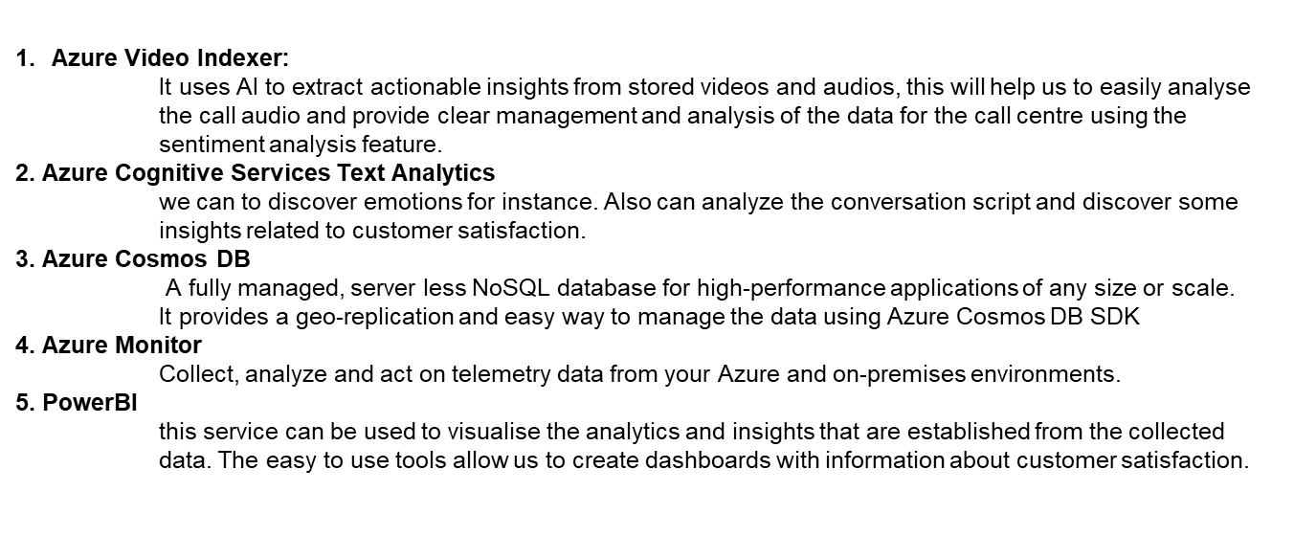
Azure tools or resources
Some of the Azure tools that will be used in our project are;

Slide 6
Key Differentiators
Differentiators:
Tracking agent performance
Improving customers satisfaction
Act on customers data in real time
The use of call centers are fine imperative aspects of businesses. They improve the services and relationships with customers and provide effective communication. The pandemic has been a great transformation agent. It has made brands aware that they can’t compete without investing in latest technologies some of which are powered by AI.In our solution we are using Intelligent Call Routing. It is expected that the use of intelligent call routing will grow massively in coming years as it dynamically maps the right agent to the caller based on certain parameters like CSAT score, language skills and call intent. The Digital tools (QA) will be used which are integrated with real-time analytics (voice, text, chats, messages) and other sources. We can further extend our business through leveraging it with AI- based technologies and provide excellent services and most importantly customer experience will be excellent.

Slide 7
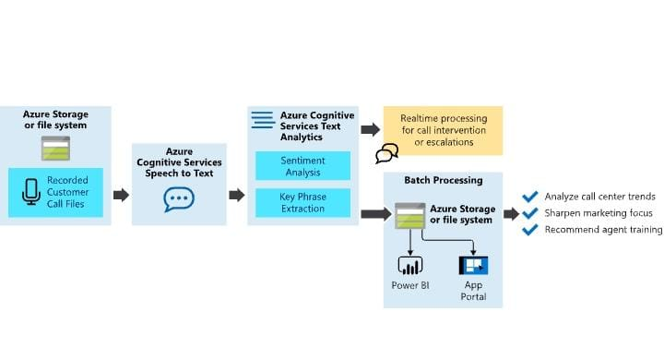
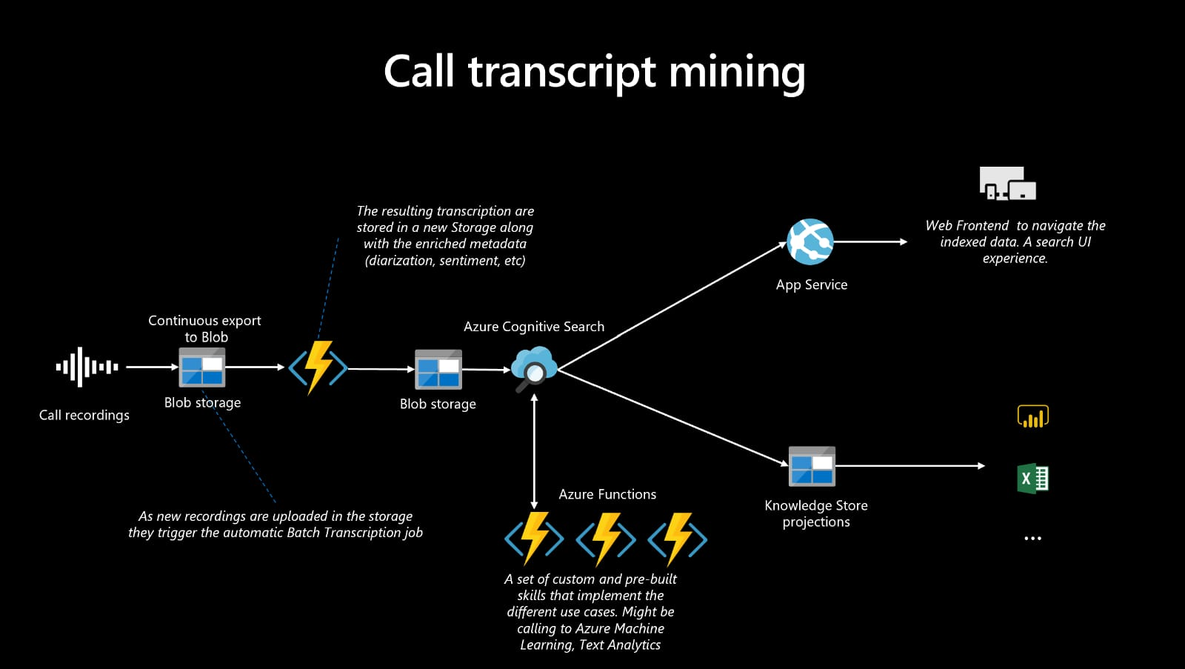
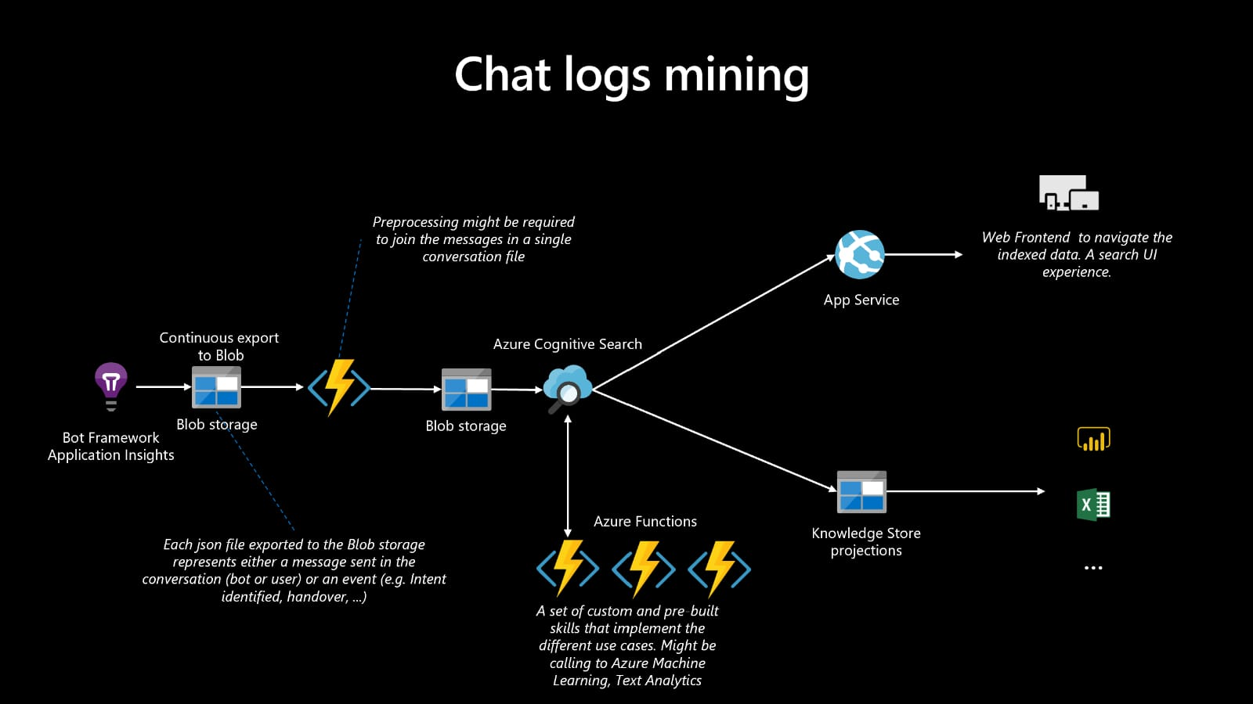
GitHub Repository Link & supporting diagrams, screenshots, if any
https://github.com/Aastha-star/Call-center-analytics-solution

Slide 8
Thank You
Anusha Kommuru
Aastha Gupta
Aditya Kumar
Manvi Chauhan

