Slide 1
AUTONOMOUS WAREHOUSE CARGO INTELLIGENCE
DockGuard AI
Because gravity shouldn't win on the warehouse loading dock.
WAREHOUSE DOCK
4:00 PM trailer rush
DROP / DRAG / TILT
Cartons slip & pallets lean
UNNOTICED DAMAGE
Loaded into trucks blindly
CUSTOMER RETURN
$200+ claims & friction
→
→
→
$50B+
ANNUAL FREIGHT LOSS
Destroyed in warehouses each year before reaching highways—mostly unrecorded.
1 : 10
SUPERVISOR BLINDSPOT
1 supervisor managing 10 active bays and 40 fast-moving workers simultaneously.
< 1.5s
INTERVENTION WINDOW
Dockside repack costs $10. Letting cracked cargo reach customers costs $200+.
Team VisionGuard: Aastha Gupta (Computer Vision) • Lucky Lakhani (AI Pipeline) • Runjan Bawa (Dashboard & UX)

Slide 2
02 / PROBLEM, SOLUTION & USER JOURNEY
From Sensor to Prevention: The 6-Stage Loop
01
CCTV Video
1080p dock stream
02
YOLOv8
Track boxes & crew
03
Physics
vy > 2.5m/s or drag
04
Dock Chime
Polite audio tone
05
Inspection
Worker checks tape
06
Safe Transit
100% verified cargo
OPERATOR MOMENT: RAMESH AT BAY 3
Supportive dockside coaching — not punitive surveillance.
• The Rush: 4:15 PM container deadline; Ramesh lifts 25kg crate solo.
• The Slip: Grip fails; carton drops 1.2 meters to concrete floor.
• The Chime: Gentle microwave ping rings at Bay 3 (no panic siren).
• The Win: Calls teammate for 2-person lift; sets cracked item aside.
SUPERVISOR MOMENT: POOJA ON HER IPAD
Replacing 45 minutes of manual video scrubbing with instant proof.
• The Old Way: Wasted 45 mins nightly hunting timestamps on blurry DVRs.
• Instant Alert: iPad buzzes: 'Bay 3: High-Velocity Drop Detected (10:14 AM)'.
• 5-Second Replay: One tap plays fall trajectory and impact velocity vector.
• Gemini Audit: Shift-end query: 'Summarize all Bay 3 drops today' in 1 click.

Slide 3
03 / TECHNICAL ARCHITECTURE & TECH STACK
CONFIDENTIAL — ACADEMIC PROJECT
Technical Architecture & Edge-to-Cloud Pipeline
01 • CCTV VIDEO STREAM & RING BUFFER
OpenCV + FFmpeg | 1080p @ 15fps | In-Memory 15s FIFO Buffer
02 • OBJECT DETECTION & TRACKING
YOLOv8 + ByteTrack | Custom Carton, Pallet & Worker IDs | Zero Loss
↓
03 • SPATIAL & KINEMATIC RULES
Vector Math | Drop vy > 2.5m/s | Floor Drag > 2m | Tilt > 15°
04 • EVENT DISPATCH & DATABASE
FastAPI Core | < 50ms WebSockets | SQLite Telemetry Logs
↓
05 • SUPERVISOR UI & AUDIO ENGINE
React 18 + Tailwind CSS + Web Audio API
Live KPI cards, 7-day risk trend curves & instant synthetic dock chimes.
06 • CONVERSATIONAL RAG ASSISTANT
Google Gemini 2.5 Flash + Structured RAG
Natural language shift queries without SQL; instant risk summaries & audit logs.
Key Design Decision: Local spatial vector physics filter false alarms in <50ms → Only verified risk events reach Gemini & WebSockets.

Slide 4
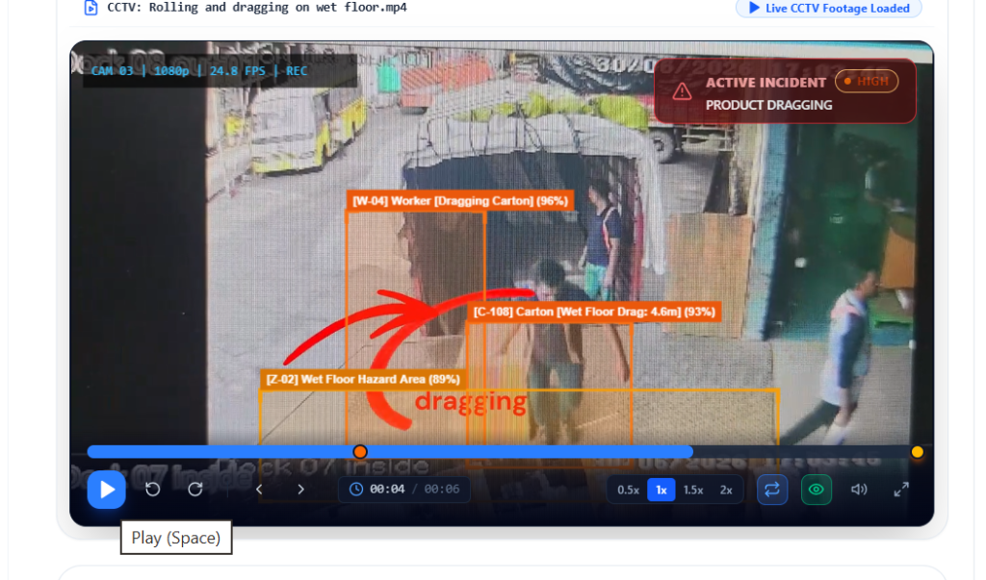
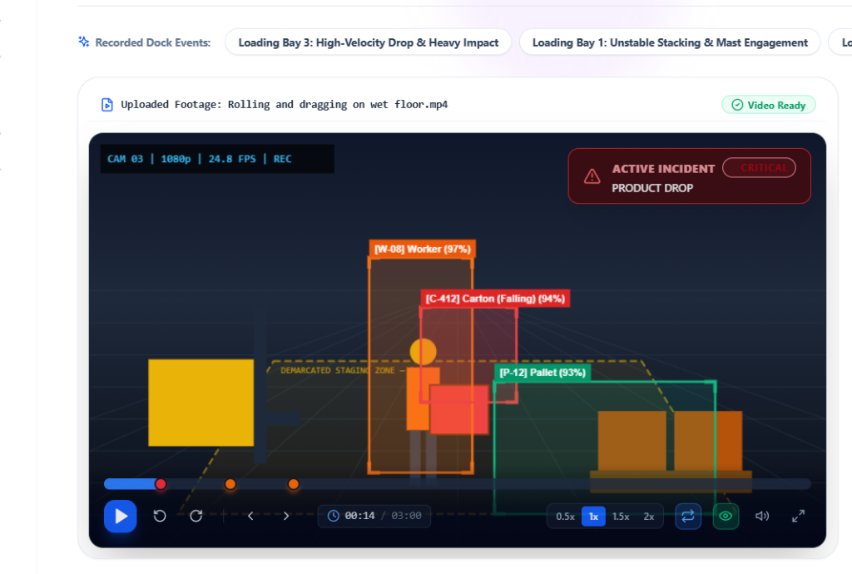
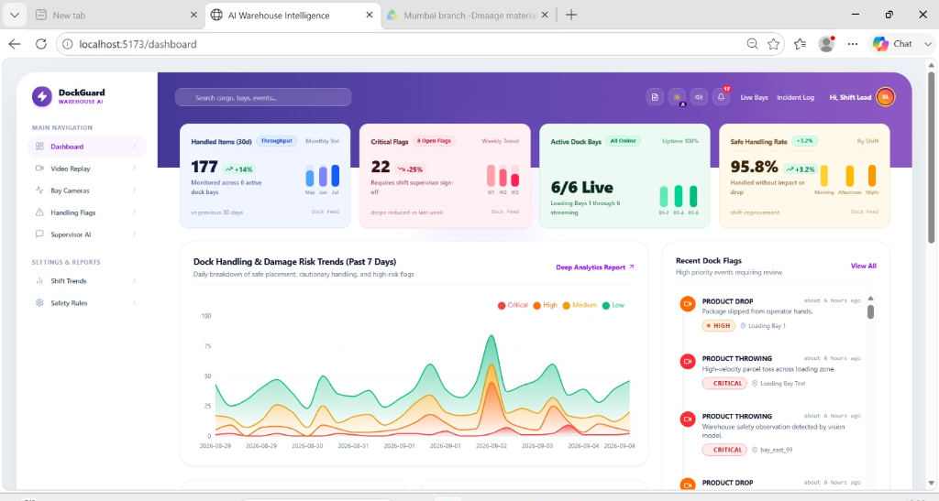
04 / PROTOTYPE SCREENSHOTS & DEMO
Field Prototype: Live Detection, Replay & Dashboard
4.6m FLOOR DRAG DETECTED
CRITICAL DROP REPLAY (5s)
TESTED IN REAL FOOTAGE
• Drop from Staging (>1.2m)
Freefall spike vy > 2.8 m/s triggers dock chime in 1.2s flat.
• Wet-Floor Dragging (4.6m)
Continuous floor displacement flagged as severe friction hazard.
• Unstable Pallet Tilt (>17°)
Stack angle warning alerts loaders before trailer loading.
• Gemini AI Natural Query
'Which bay had drops today?' resolved instantly from SQLite logs.
LIVE DEPLOYMENT:
smart-warehouse-system-rk8p.onrender.com
github.com/Aastha008/Smart-Warehouse-System
LIVE OPERATIONAL DASHBOARD

Slide 5
05 / IMPACT, DAMAGE PREVENTION & VALIDATION
What Changed When We Put It Into Practice
< 1.5s
DETECTION → CHIME
Sub-second vision catches drops before cartons are buried in trucks.
30m → 1m
VERIFICATION SPEED
5-second micro-replays replace 30 minutes of manual CCTV scrubbing.
89%
UNREPORTED DROPS
Intercepted 8 of 9 physical drop incidents never logged by workers.
100%
AUDIT PROOF
Timestamped video clips eliminate carrier-versus-warehouse liability disputes.
SHIFT SUPERVISOR
"I can't watch hours of CCTV while running across 6 active bays."
→ Solution: 1-click 5-second replay with pre-buffered impact markers.
DOCK LOADER
"Your first alarm sounded like a fire siren. It made everyone defensive."
→ Solution: Gentle microwave dock chime and coaching for 2-person lifts.
LOGISTICS DIRECTOR
"Carriers blame us for damaged goods discovered at destination."
→ Solution: Tamper-evident video logs with velocity data end blame games.

Slide 6
06 / CONCLUSION & ENTERPRISE ROADMAP
Roadmap: Proven Today, Constraints & What's Next
01 — NOW
PROVEN TODAY
• Live Full-Stack Cloud App
Hosted 24/7 on Render (React + FastAPI + SQLite).
• YOLOv8 Video Inference
Accurately detects cartons, pallets & drops in CCTV.
• Real-Time Sound Chimes
Zero-latency synthetic browser dock alerts.
• Gemini 2.5 Flash RAG
Answers natural language queries using real logs.
02 — BOTTLENECK
HONEST CONSTRAINTS
• Cloud CPU Inference Latency
Takes 5–8s per clip on free-tier; needs edge GPU.
• Heavy Worker Crowding
Occlusion when 3+ workers cluster tightly over boxes.
• Morning Sunlight Glare
Direct sun through bay doors lowers box confidence.
03 — NEXT
ENTERPRISE ROADMAP
• NVIDIA Jetson Edge AI
Run localized TensorRT models on-dock for <50ms speeds.
• Barcode & WMS Sync
Connect incident timestamps directly to package tracking.
• Ergonomic Safety Coach
Warn workers lifting with spine instead of knees.
→
→
DockGuard AI: From detecting risk → to preventing it.
Team VisionGuard: Aastha Gupta, Lucky Lakhani, Runjan Bawa | smart-warehouse-system-rk8p.onrender.com | github.com/Aastha008/Smart-Warehouse-System

