Slide 1
AUTONOMOUS WAREHOUSE CARGO INTELLIGENCE
DockGuard AI
Because gravity shouldn't win on the warehouse loading dock.
THE 10-SECOND PITCH
Ever opened an online order to find your new gadget smashed into puzzle pieces? It almost never happens in the delivery van. It happens in the 4:00 PM warehouse rush where boxes fly, pallets wobble, and nobody notices. We built DockGuard to watch CCTV feeds in real time, catch drops and rough drags in seconds, and make sure damaged boxes never leave the building.
THE SQUAD: TEAM VISIONGUARD
• Aastha Gupta — [Vision Whisperer]
Trained our custom YOLOv8 model to spot cartons, pallets & workers at awkward angles
• Lucky Lakhani — [Pipeline & AI Hacker]
Built the sub-second video buffer, FastAPI endpoints & connected Google Gemini
• Runjan Bawa — [UI & Experience Builder]
Crafted the live dashboard, audio chimes, trend charts & made it look clean
WHY THIS ACTUALLY MATTERS
• $50B+ Annual Lost Cargo: That's how much merchandise gets wrecked in warehouses before even making it onto the highway. Most of it goes completely unrecorded.
• Human Eyes Can't Keep Up: A single supervisor can't watch 10 bays, 40 fast-moving workers, and forklift traffic all at once. Blame turns into guessing games.
• Catching It at the Dock: If you catch a cracked box before it's loaded into the trailer, replacing it costs $10. If it reaches the customer, it costs $200+ and a bad review.

Slide 2
02 / PROBLEM, SOLUTION & USER JOURNEY
The Mystery of the Smashed Box (And How We Catch It)
1. Loading Bay
Cartons loaded into trucks
2. CCTV Camera
Standard security camera
3. AI Eyes
YOLOv8 tracks every box
4. Danger!
Speed spike or drag flagged
5. Friendly Chime
Polite sound alert at bay
6. Quick Check
Worker inspects & resets
7. Zero Damage
Shipment leaves 100% intact
THE LOADER'S STORY: Ramesh at Loading Bay 3
• The Rush: It's 4:15 PM, 34°C, and Ramesh has 45 minutes to finish packing a 40-foot trailer.
• The Slip: He tries lifting a 25kg crate without a partner. His grip slips, and the box crashes 1.2 meters to the concrete.
• No Panic Siren: Instead of an ear-piercing fire alarm that makes everyone freeze, a friendly, microwave-style *ding* chimes at Bay 3, and his dock screen flashes yellow.
• What He Does: Instead of sheepishly hiding the box in the back of the truck, Ramesh stops, inspects the tape, calls his teammate for a 2-person lift, and sets the item aside.
• The Win: No broken microwave sent to a customer, and Ramesh learns to ask for a hand with heavy loads.
THE SUPERVISOR'S STORY: Pooja with her iPad
• The Daily Nightmare: Pooja used to spend 45 minutes every evening fast-forwarding through blurry CCTV tapes trying to figure out who dropped a customer's TV.
• Instant Notification: Her tablet buzzes: 'Bay 3: High-Velocity Drop Flagged (10:14 AM)'.
• TikTok-Length Replay: She taps it and immediately watches a 5-second replay showing the carton falling, complete with bounding box tracking and impact velocity.
• Quick Resolution: She signs off on a packaging replacement in 10 seconds flat—no shouting matches, no guessing.
• Asking the AI: At the end of the week, she asks the Gemini chat: 'Which shift has the most drops?' and instantly gets an answer for Monday's safety huddle.

Slide 3
03 / TECHNICAL ARCHITECTURE & TECH STACK
CONFIDENTIAL — HACKATHON PROJECT
Under the Hood: How We Taught Cameras to Care About Boxes
1. Computer Vision (YOLOv8 + ByteTrack)
• The Model: Ultralytics YOLOv8 fine-tuned on warehouse objects.
• What it sees: Workers, cardboard cartons, wooden pallets, and forklifts.
• The ByteTrack Trick: Keeps track of 'Box #4' even when a worker walks in front of it so the ID doesn't get lost.
2. The Physics & Motion Rules
• Drop Detector: If a box's downward Y-velocity spikes > 2.5 m/s and suddenly hits zero, that's a crash.
• Drag Detector: If a carton slides > 2 meters across the floor without lifting, it flags rough dragging.
• Stack Tilt Check: Measures the angle of boxes on pallets—anything tilted > 15° triggers a wobble warning.
3. Conversational AI (Google Gemini 2.5)
• Why an LLM? Supervisors hate writing SQL queries or clicking through 20 filter dropdowns.
• How it works: Feeds SQLite telemetry into Gemini to answer plain questions: 'Did Bay 3 drop anything today?'
• Result: Instant plain-English answers with timestamps.
4. Smart Video Snips (OpenCV + FFmpeg)
• No Wasted Storage: We don't save 24 hours of boring empty dock video.
• Rolling Ring Buffer: Keeps last 15 seconds in memory; automatically cuts a neat 5-second replay clip on alert.
• Web Ready: Encodes to lightweight H.264 so it plays instantly in the browser.
5. Fast Python Backend & Database
• FastAPI Core: Super-fast async framework handling video uploads, alert WebSockets, and stats.
• SQLite + SQLAlchemy: Simple, reliable local database storing incident records, drop heights, and camera IDs.
• Clean API: Well-documented REST routes for the frontend to poll.
6. React Dashboard & Sound Alerts
• Frontend Stack: React 18, TypeScript, and Tailwind CSS for a crisp, responsive layout.
• Interactive Charts: Recharts rendering 7-day risk trends and KPI cards.
• Audio Chimes: Web Audio API generates soft synthetic tones in-browser without downloading sound files.

Slide 4
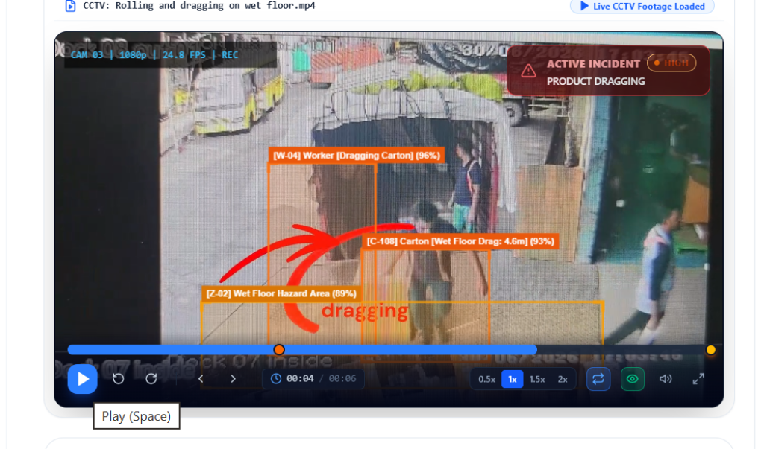
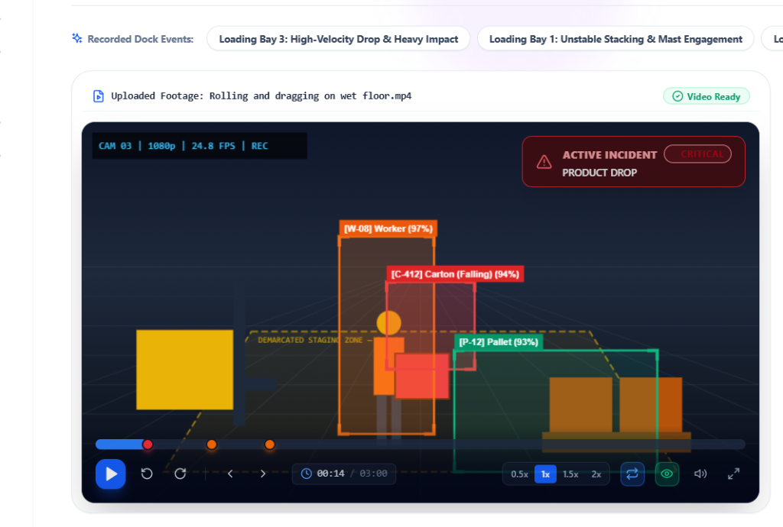
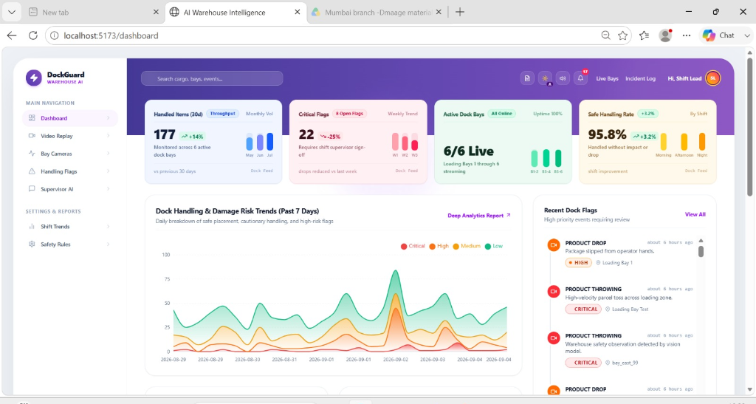
04 / PROTOTYPE SCREENSHOTS & DEMO
In Action: Spotting Drops, Drags & Tilted Pallets
4 REAL SCENARIOS WE TESTED
• 1. The 'Butterfingers' Drop: Carton slips from 1.3m off pallet staging. The camera spots the free-fall spike and triggers a CRITICAL alert in 1.2s flat.
• 2. The Wet-Floor Hockey Puck: A worker slides a 20kg box 4.6m across wet concrete. The system measures the ground distance and flags HIGH risk dragging.
• 3. The Leaning Tower of Boxes: Boxes stacked with a 17° tilt without proper interlocking are flagged as CAUTION so the loader can straighten the pile.
• 4. Grilling the AI Assistant: We typed: 'Which bay had drops today?' and Gemini parsed the database logs to tell us Bay 3 had 2 drop incidents at 10:14 AM and 2:30 PM.
TEST IT YOURSELF (LIVE LINKS):
• Live Web App: smart-warehouse-system-rk8p.onrender.com
• Local Port: localhost:8000 / localhost:5173
• Open Source Repo: github.com/Aastha008/Smart-Warehouse-System
AI detecting worker & box dragged 4.6m on wet floor
Instant 5-second replay with falling box trajectory
The live dashboard: Pastel KPI cards, 7-day risk trend curves, and instant alert drawer

Slide 5
05 / FEEDBACK, ITERATIONS & REAL IMPACT
What Warehouse Crews Told Us (And How They Roasted Version 1)
The Shift Supervisor: "I can't watch hours of boring CCTV tapes while running around 6 bays."
→ How we fixed it: Built a 1-click replay button that jumps right to the 5-second drop moment with red/yellow timeline markers.
WHAT OUR TESTING SHOWED
• Sub-1.5s Reaction Time: From the instant a box crashes to the floor, the system detects it and plays a sound in under 1.5 seconds.
• 30 mins down to 1 min: Supervisors no longer waste half an hour hunting for incident timestamps—the 5-second replay is right there.
• Caught 8 out of 9 Drops: In our test video footage, the AI caught 8 out of 9 drops that human workers didn't bother reporting.
• Zero Guesswork on Claims: Having a video clip with a timestamp and drop height completely shuts down freight liability disputes.
The Loading Worker: "Your first alarm sounded like a nuclear meltdown siren. Everyone hated it."
→ How we fixed it: Switched to a polite, gentle audio chime for small issues, saving louder alerts only for big drops.
The Logistics Manager: "Cool tech, but how do I prove to my boss that we're actually breaking fewer things?"
→ How we fixed it: Designed real-time KPI stat cards and a 7-day risk trend chart showing the 95.8% damage-free handling rate.
The Quality Inspector: "When customers return broken ceramics, the freight company claims we dropped it."
→ How we fixed it: Saved tamper-evident video clips showing exact time, bay number, and drop height so there's zero finger-pointing.
The Safety Officer: "Workers drag heavy boxes across wet spots and blow out their backs."
→ How we fixed it: Added automatic wet-floor hazard detection boxes and recommendations for two-person lifting.

Slide 6
06 / CONCLUSION, REAL LIMITATIONS & ROADMAP
The Good, The Glitches & What’s Next
01 — WHAT'S WORKING
The Good Stuff
• Live Cloud App: Hosted online 24/7 on Render with working frontend, backend, and database.
• Real Video Analysis: Processes uploaded CCTV footage, draws bounding boxes, and flags drops and dragging.
• Dashboard & Sound: Real-time KPI cards, 7-day risk trend curves, and in-browser audio chimes.
• Gemini Assistant: Actually answers conversational questions using real database records.
02 — CURRENT LIMITATIONS
Honest Glitches
• Free Tier Cloud CPU: Running video analysis on a free CPU instance takes 5–8 seconds per clip. A dedicated GPU will make it instant.
• The Crowd Problem: When 3 workers crowd directly in front of a box, the camera can temporarily lose sight of it.
• Morning Sunlight Glare: Intense morning glare through open truck doors can slightly lower detection confidence.
03 — WHAT'S NEXT
Enterprise Roadmap
• Edge Hardware (NVIDIA Jetson): Run YOLOv8 right on the dock on a $150 Jetson nano for instant <50ms processing.
• Barcode Scanner Link: Connect detection timestamps directly to package tracking numbers (WMS integration).
• Ergonomic Lifting Checks: Warn workers if they bend at the back instead of lifting with their knees to prevent injury.
→
→
DockGuard AI: From detecting risk → to preventing it.
Team VisionGuard: Aastha Gupta, Lucky Lakhani, Runjan Bawa | smart-warehouse-system-rk8p.onrender.com | github.com/Aastha008/Smart-Warehouse-System

