Slide 1
Enhancing the Safety and Authenticity of Online Discussions on Social Media Platforms with AI
Presented by: Group B1: Metrics
Supervised by: Mr. Kai Kugler
Group Members:
Aastha Shreya
Donya Sheikhi
Farhan Ali Arshad
Muhammad Ahmed
Shivang Sinha
Syed Huzaifa Ali

Slide 2
Introduction
Social media revolutionized communication but poses risks like fake news and online threats.
These issues harm societal trust, safety, and quality of discourse.
Existing detection systems address these challenges separately, missing their interconnected nature.
Goal: Leverage transformer-based models (e.g., BERT) to create unified detection systems for these challenges.

Slide 3
Problem Statement
Key Challenges:
Fake news manipulates public opinion and polarizes communities.
Online threats foster hostility and degrade the quality of discourse.
These issues often overlap but are studied separately.
Limited comparison of transformer models (e.g., encoder, decoder, hybrid) for these tasks.
Objective:
Address these gaps by exploring unified detection methods.

Slide 4
Research Questions
Q1: How does the performance of separate BERT models trained individually on fake news and threat datasets compare to a single BERT model trained unified on both datasets and which approach yields better results for combined detection tasks?
Q2: What are the conclusions be drawn from the combined detection of fake news and threats? How can it contribute to improving societal safety, fostering informed public engagement, and enhancing the quality of social media?
Q3: What are the trends in different transformer models (Encoder, Decoder, Hybrid) while detecting online threats & fake news detection?

Slide 5
Literature Review
Fake News Detection: Studies like DeFaktS dataset highlight transformer models (e.g., BERT) for fine-grained detection.
Threat Detection: Transformer models effectively identify hate speech and toxicity.
Social Media Safety: Semantic networks provide insights into harmful behavior modeling.
Gap: Overlap of fake news and threats remains under-explored

Slide 6
Objectives
Model Comparison:
Compare separate vs. unified BERT models for detecting fake news and threats.
Optimization:
Investigate efficiency, accuracy, and reduced computational overhead of unified models.
Societal Impact:
Measure the impact of improved detection on safety and awareness.
Trends Analysis:
Explore encoder, decoder, and hybrid transformer models.

Slide 7
Scope of Fake News Detection Metrics
Semantic Inconsistency: Identifying contradictions or logical errors in the content to flag unreliable posts.
Polarization: Detecting narratives that frame issues in divisive terms, such as friend vs. foe.
Vagueness: Analyzing indirect expressions or hedging words that make content unclear or unreliable.
Authenticity and Referencing: Measuring the use of credible references and contextualized sources versus false or absent citations.

Slide 8
Scope of Threat Detection Metrics
Toxicity: Identifying harmful and aggressive language.
Cyberbullying: Detecting language explicitly or implicitly targeting harm toward individuals or groups.
Insults: Recognizing disrespectful or degrading comments.
Identity Hate: Identifying hate speech targeted toward identity attributes such as race, religion, or gender.

Slide 9
Methodology
Input Data Collection and Preprocessing:
Data Sources:
Social media platform datasets will be used, integrating fake news datasets (e.g., DeFaktS) and harmful content datasets (e.g., toxicity, hate speech, threats).
Preprocessing:
Tokenization and cleaning of text to remove noise (e.g., special characters, URLs, and stop words).
Annotate data for binary outputs: Fake News (1 or 0) and Threats (1 or 0).
Extract linguistic and semantic features, focusing on key indicators like semantic inconsistency, polarization, and vagueness.
Model Training Approaches:
Separate Models:
Train individual BERT models for fake news and threats detection, fine-tuning them on specific datasets.
Unified Multi-task Model:
Use shared encoder layers in a multitask BERT model, focusing on task-specific outputs for fake news and threats.
Comparison Metrics:
Evaluate models using accuracy, F1-score, precision, and recall.

Slide 10
Transformer Architecture Exploration:
Experiment with encoder-based (BERT), decoder-based (GPT), and hybrid models to compare performance.
Output Generation:
Binary outputs for each task:
Fake News Detection: Fake (1) or Not Fake (0).
Threat Detection: Threat (1) or No Threat (0).
Evaluation of Combined Detection Impact:
Measure improvements in performance when fake news and threats are detected simultaneously.
Compare accuracy and efficiency between separate and unified models.
Societal Analysis:
Study how these methods improve social media safety and user interactions

Slide 11
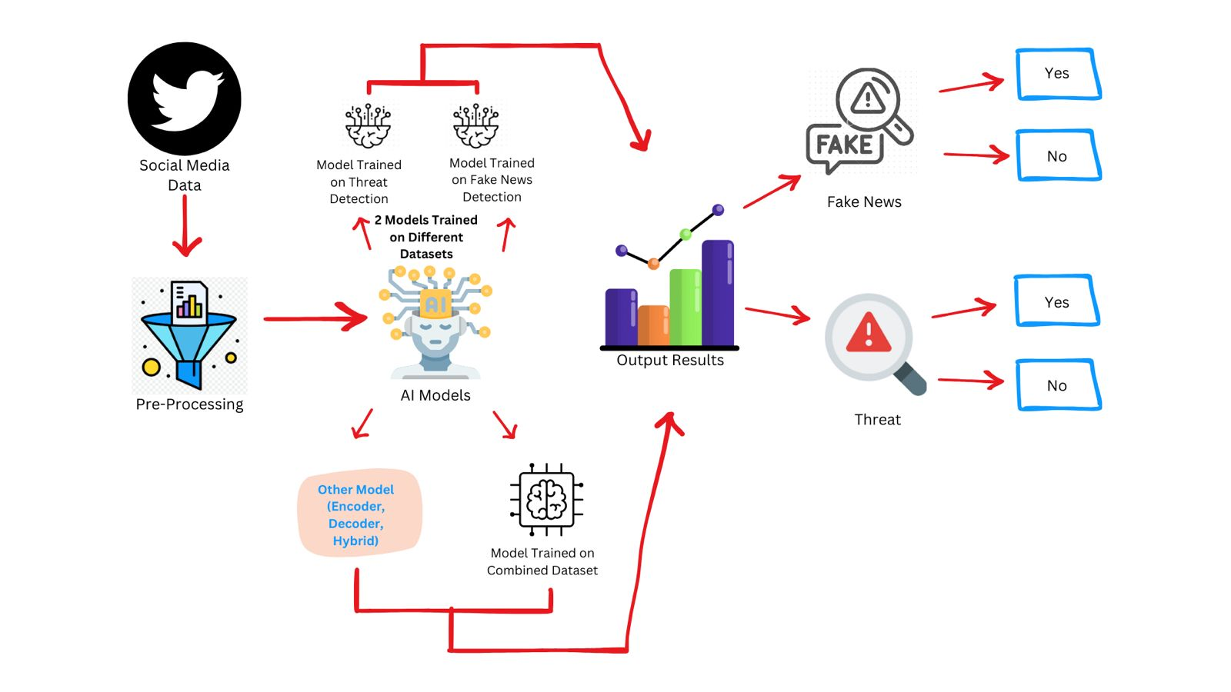
Model Framework

Slide 12
Conclusion
Unified models may outperform separate models for combined detection tasks.
Trends in transformer architectures provide new opportunities for tackling misinformation and threats.
Improved detection fosters safer digital spaces and informed public engagement.

Slide 13
References
Baly, R., Horne, B. D., & Adali, S. (2023). DeFaktS: A German Dataset for Fine-Grained Disinformation Detection through Social Media Framing. Link
Gupta, S., & Chauhan, V. (2022). Hate Speech, Toxicity Detection in Online Social Media: A Recent Survey of State of the Art and Opportunities. Link
Singh, R., & Sharma, K. (2023). Threat Modelling and Detection Using Semantic Network for Improving Social Media Safety. Link
Sazany, E. (2018). Deep learning-based implementation of hate speech identification on texts in Indonesian. Link

