Slide 1
TWON Metrics
Towards Robust Classifiers for Fake News, Hate Speech, and Toxicity
Addressing Online Harms Through Multitask Learning and Metrics-Based Evaluation
Presented by: TWON_B1 Metrics Group:
Aastha Shreya, Shivang Sinha, Farhan Ali Arshad, Syed Huzaifa Ali, Donya Sheikhi, and Muhammad Ahmed

Slide 2
Table of Content
INTRODUCTION
RESEARCH QUESTIONS
MODEL ARCHITECTURE
DATASETS
ARCHITECTURE
PROMPTING
TESTING OF UNIFIED MODEL
RESULTS
CONCLUSION
REFERENCES

Slide 3

INTRODUCTION

Slide 4
Introduction
Problem:
Online platforms face challenges:
Fake News: Manipulating public opinion.
Hate Speech: Inciting hostility.
Toxicity: Discouraging constructive discussions.
Objective: Develop a unified system with robust classifiers to detect harmful content.
Approach: Leverage transformer-based architectures to improve detection efficiency and scalability.

Slide 5
Problem Statement
Challenges:
Overlap between misinformation and harmful behaviour.
The inefficiency of separate detection models.
Lack of comparative studies on transformer models.
Our Objectives:
Evaluation
Find Metrics and datasets for fake news, hate speech, and toxicity.
Modeling
Train on each and combined datasets to reach a satisfying model.
Analyze
Test and analyze

Slide 6
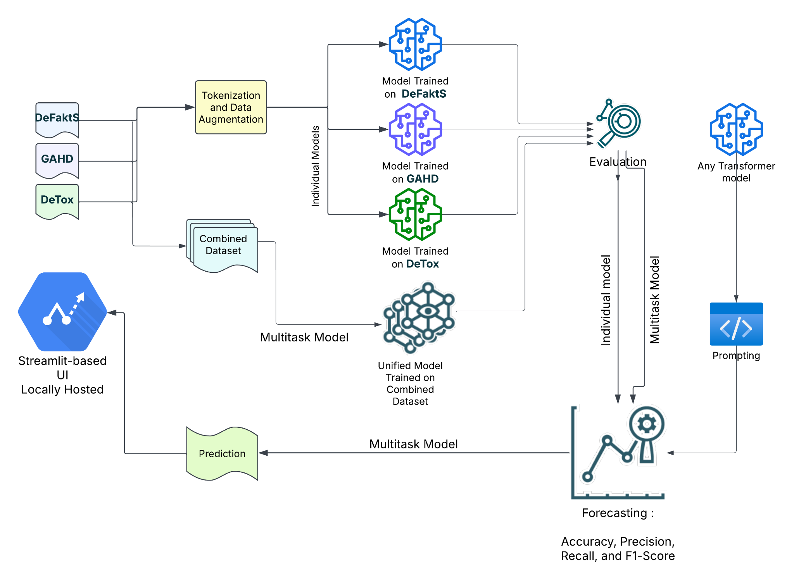
End to End Workflow

Slide 7
Research Questions
How do separate models compare to one unified model?
If we train three different transformer models—one for detecting fake news, one for hate speech, and one for toxic comments—do they work better than a single model that tries to do everything at once?
Hypotheses:
Separate models might be better because they focus on just one task and learn specific details more effectively.
A unified model might be better because it can find connections between fake news, hate speech, and toxicity, improving overall detection.
What conclusions can be drawn from the combined detection of fake news, toxicity, and hate speech? How can this contribute to fostering informed public engagement and improving the quality of social media?

Slide 8
MODEL ARCHITECTURE

Slide 9
DATASETS : For Individual Models Training
Datasets:
DeFaktS: For fake news detection.
GAHD: For hate speech.
DeTox: For toxicity.
Preprocessing:
Text normalization, tokenization, Replace URL, Resample minority class, combine & shuffle, Padding, Convert labels to integer, Drop missing values.

Slide 10
Model Training
Individual Models
Individual learning for Fake News, Hate Speech, and Toxicity detection.
Model Used : 1. distilbert-base-german-cased (DefaktS_Twitter_dataset) for Fake News.
2. xlm-roberta-base-multilingual (GAHD) for hate speech.
3. bert-base-multilingual-cased (DeTOX) for toxicity.
Evaluation Metrics: Precision, Recall, F1-score, Accuracy.

Slide 11
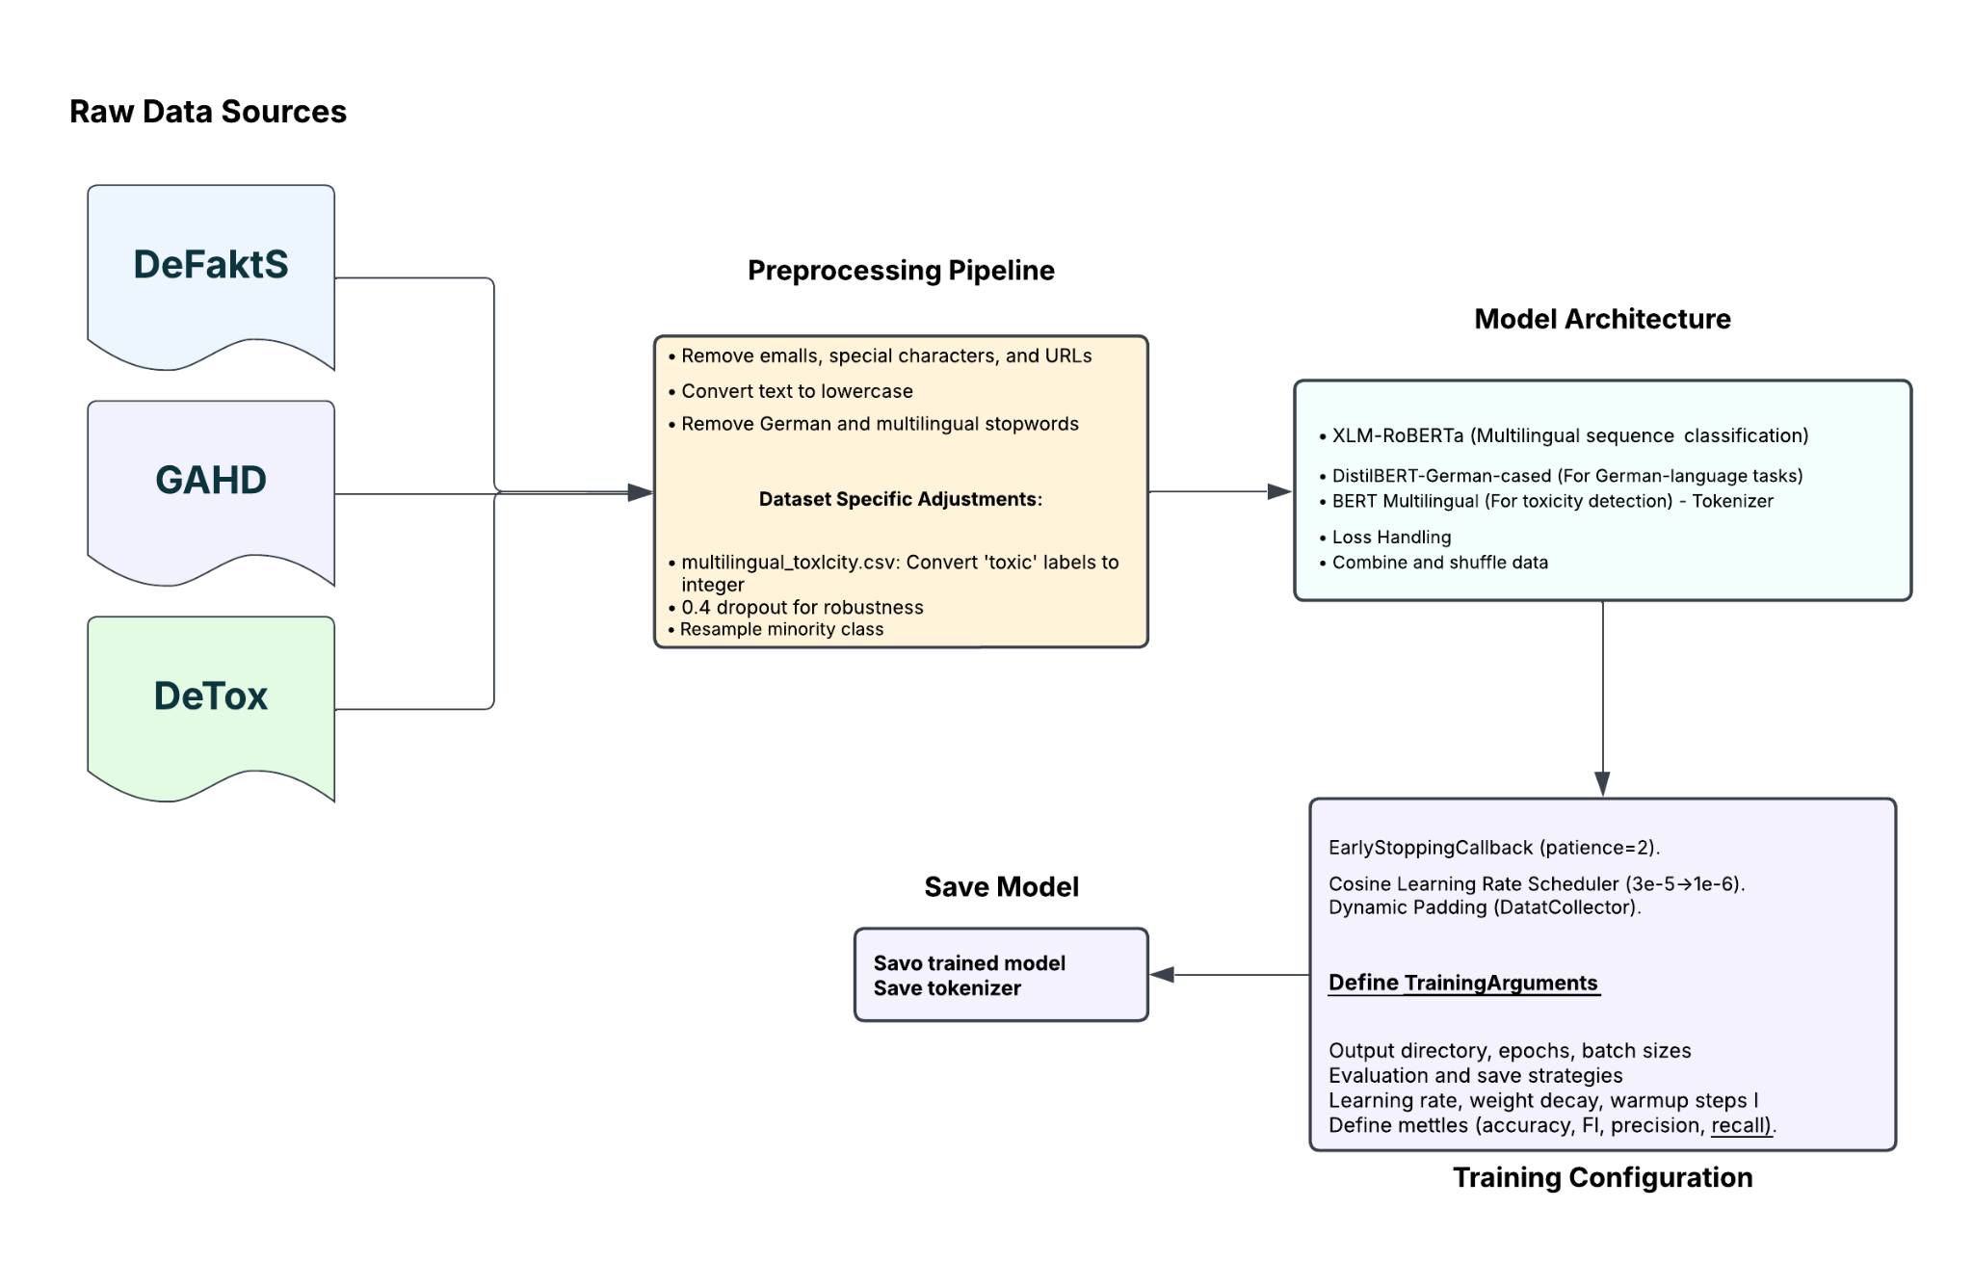
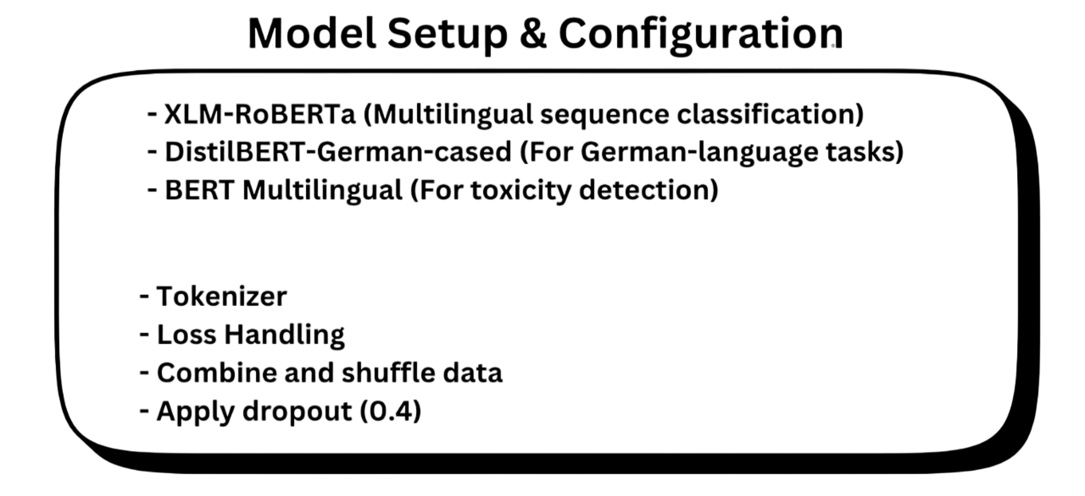
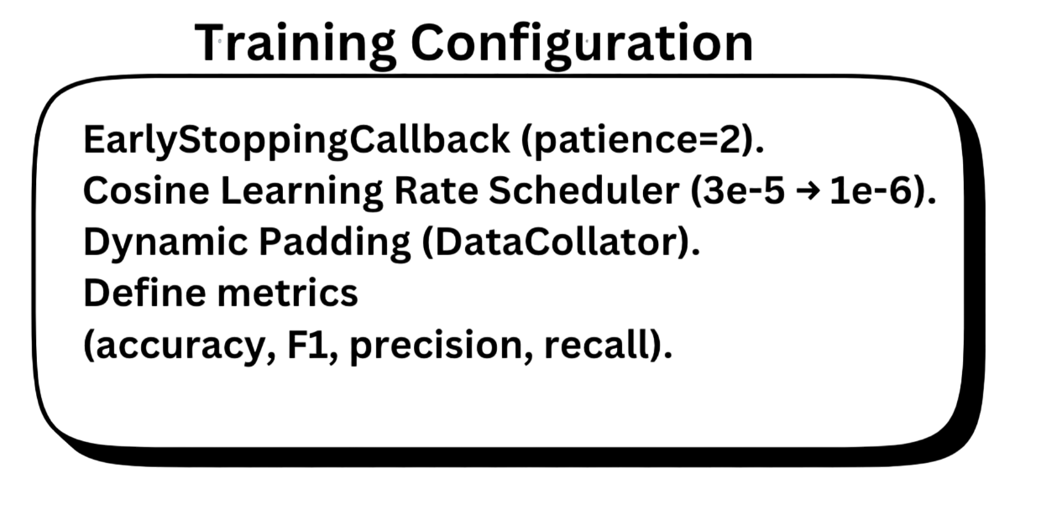
Individual Model Workflow
Notes:
Resampling Minority Class:
adding additional data to minority class to make the overall dataset equal in size to get better performance.
DataCollatorWithPadding:
A data collator's primary job is to take a batch of examples (which might be of different lengths) and prepare them for input into the model. This often involves padding shorter sequences to match the length of the longest sequence in the batch.

Slide 12
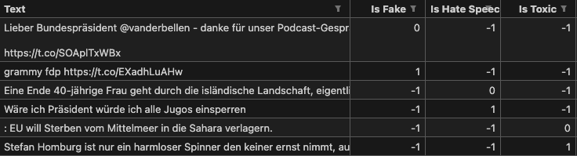
DATASET: For Unified Model
Datasets:
DeFaktS: For fake news detection.
GAHD: For hate speech classification.
DeTox: For toxicity detection.
Combined all the above dataset to create a unified dataset.
Preprocessing:
Remove emails , Convert text to lowercase, Replace Emojis, Drop rows with missing values, Convert labels to integer.

Slide 13
Model Training
Unified Model
Multi-task: Fake News, Hate Speech, and Toxicity detection.
Model Used: bert-base-german-cased model
Dataset: Combined all datasets mentioned above to create a unified dataset to classify 3 features.
Hyperparameters:
3 epochs,
Batch size 32,
Adam optimizer
Notes:
"Today, I’m introducing our multi-task learning model that simultaneously classifies text as fake news, hate speech, and toxicity."
"We begin by processing our dataset, which contains text samples along with three labels. Note that some samples may have missing labels (represented as -1) for one or two tasks."
"Using the BERT tokenizer, we convert raw text into token IDs with consistent length through padding and truncation, then split the dataset into training and testing sets."
"At the core, our model leverages a pre-trained BERT (bert-base-german-cased) to generate rich, contextual embeddings. These embeddings feed into three independent classification heads (simple feedforward layers), each specializing in one of the tasks."
"During training, we optimize three separate Binary Cross-Entropy losses—one per task—with masking to ignore missing (-1) labels, ensuring that only valid data contributes to learning. The Adam optimizer and dropout regularization help improve the model’s performance and prevent overfitting."
"We evaluate our model on accuracy and F1-score, ensuring it effectively identifies fake news, hate speech, and toxicity."

Slide 14
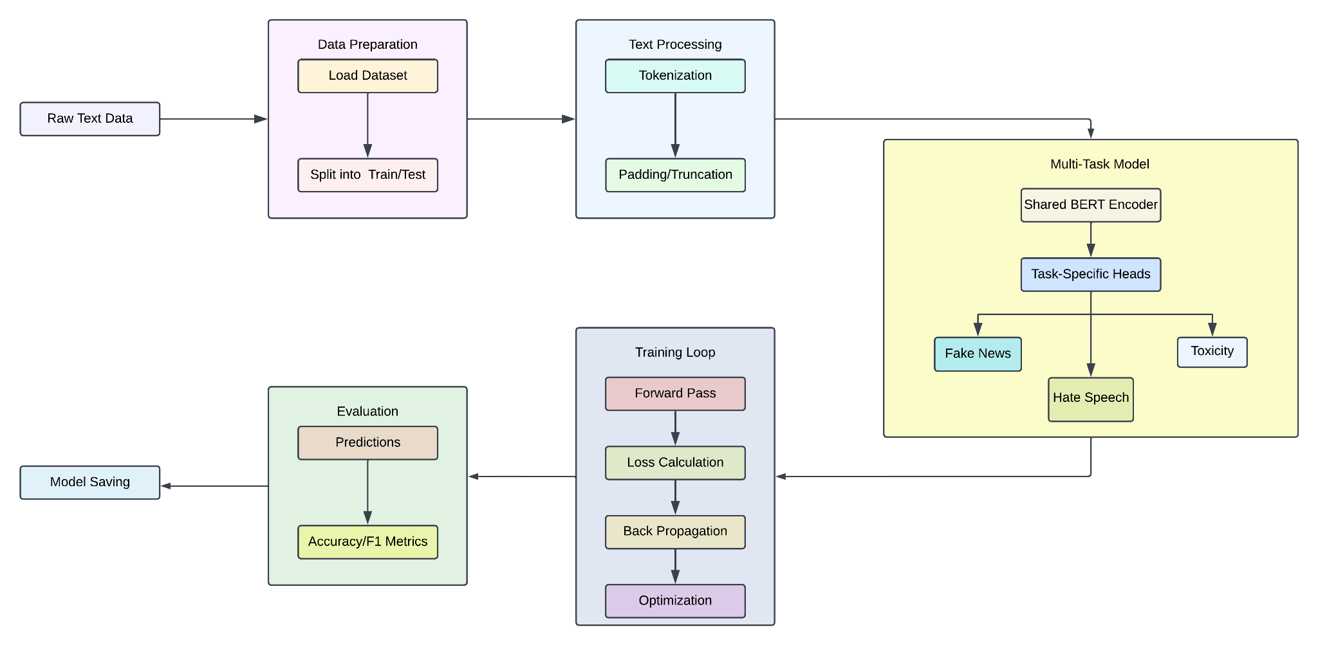
Unified Model Workflow
Notes:
"Let’s discuss why we chose a multi-task approach. Instead of training three separate models, using one shared BERT model means that all tasks benefit from a common understanding of language and context."
"This shared feature extraction allows for knowledge transfer between tasks—patterns learned from detecting hate speech or toxicity can help flag fake news, and vice versa."
"It also improves efficiency by reducing computational costs, as only one model is fine-tuned rather than three. Think of it as hiring a single chef who can prepare multiple dishes, saving both time and resources."
"In summary, our model efficiently handles multiple related tasks, leveraging BERT’s powerful language understanding and task-specific heads to deliver accurate classifications. This integrated approach not only streamlines the training process but also enhances overall prediction quality."
"The results of our experiments confirm that multi-task learning is an effective strategy for tackling the complex, interrelated challenges of fake news, hate speech, and toxicity detection."

Slide 15
Single-Task VS Multi-Task Models
Model Name | Task | Precision | Recall | F1-Score | Accuracy | Model Type
xlm-roberta-base (GAHD_Dataset) | hate_speech | 79% | 78% | 77% | 78.1% | Single-Task
distilbert-base-german-cased (DefaktS_Twitter_dataset) | fake_news | 90% | 91% | 91% | 91% | Single-Task
bert-base-multilingual-cased (multilingual_dataset) | toxicity | 88% | 88% | 88% | 88% | Single-Task
Unified Model (trained using bert-base-german-cased) | hate_speech | 76% | 73% | 74% | 76% | Multi-Task
 | fake_news | 81% | 84% | 85% | 85%
 | toxicity | 90% | 89% | 90% | 91%
Unified Model (t5-model) | hate_speech | 54% | 48% | 42% | 68% | Multi-Task
 | fake_news | 71% | 50% | 51% | 73%
 | toxicity | 45% | 49% | 40% | 51%

Slide 16
PROMPTING

Slide 17
Prompting
Note: There are altogether 6 different prompts we tried individually. One of them is listed here:
-> Role:
You are a content analyser designed to classify German-language social media posts or tweets into three categories:
Fake News, Hate Speech, and Toxicity.
- Fake News Classification: `neutral_post (0)` or `possible_fake_news (1)`
- Hate Speech Classification: `neutral_comment (0)` or `possible_hate_speech (1)`
-Toxicity Classification: `non_toxic (0)` or `possible_toxic (1)`
-> Important Guidelines
-> Examples
Notes:
Important Guidelines:
1. Focus on the Text Content: Make predictions based solely on the content and context of the text.
2. Output Restrictions: Always provide responses for all three categories strictly formatted as 0,1,0 (without spaces, extra text, or newlines). Example Output: 1,0,1
3. Overlap Between Hate Speech and Toxicity:
- If a post contains both hateful targeting of a group and general offensive language, classify it as both (1,1,1).
- If a post is only toxic (e.g., personal insults) but not group-targeted, classify it as 0,0,1.
- If a post is hateful but not generally toxic, classify it as 0,1,0.

Slide 18
Prompting Results
S.no | Model_Name | Metrics | accuracy
1 | llama3.1:8b-instruct-q6_K | fake_news | 51%
 |  | hate_speech | 57%
 |  | toxicity | 58%
2 | llama3.3:70b-instruct-q6_K | fake_news | 60%
 |  | hate_speech | 72%
 |  | toxicity | 77%
4 | mistral:7b-instruct-v0.2-q6_K | fake_news | 57%
 |  | hate_speech | 64%
 |  | toxicity | 70%
5 | phi4:latest | fake_news | 58%
 |  | hate_speech | 71%
 |  | toxicity | 68%
6 | gpt-4o mini (with zero-shot prompting) | fake_news | 40%
 |  | hate_speech | 46%
 |  | toxicity | 46%
7 | gpt-4o mini (with few-shot prompting) | fake_news | 59%
 |  | hate_speech | 79%
 |  | toxicity | 78%

Slide 19
TESTING
OF UNIFIED MODEL

Slide 20
Manual Testing Results
Only few are shown here
These are wrongly predicted
Tweets | Fake News | Hate Speech | Toxicity
Die Erde ist tatsächlich flach, alles andere ist eine Lüge der Wissenschaft. | 0 | 0 | 0
Deine Ideen sind der Grund, warum alles schiefgeht. | 0 | 0 | 0
Diese Region sollte abgeschnitten und sich selbst überlassen werden. | 1 | 0 | 0
Die Anhänger dieser Partei sind alle Idioten und gehören eingesperrt. | 1 | 0 | 1
Diese Minderheit zerstört unser Land mit ihrer Kultur. | 1 | 1 | 0
Du bist wie ein Virus, der alles zerstört, was er berührt. | 0 | 0 | 1
Diese Sprache sollte in unserem Land verboten werden. | 0 | 1 | 0
Notes:
This slide presents the testing results of our Unified Model, which was evaluated using over 70 new datasets. The goal was to classify tweets into three categories: Fake News, Hate Speech, and Toxicity. Here, I highlight some cases where the model made incorrect predictions.
Dataset Preparation:
I compiled a diverse dataset consisting of fake news, hate speech, toxicity, and neutral tweets to challenge the model.
The dataset included misinformation, discriminatory statements, offensive language, and neutral content for balanced evaluation.
Testing Method:
Each tweet was manually analyzed to determine its ground truth label.
The model’s predictions were then compared against the expected results.
Incorrect classifications were highlighted for further analysis.
Observations:
Incorrect Prediction: Not classified as toxic.
Expected Classification: Toxic.
Issue:
This tweet contains a negative and blaming statement, which can be discouraging or harmful.
It directly criticizes someone’s ideas in a demeaning way.
The model failed to detect this subtle but harmful form of toxicity.
2. Incorrect Prediction: Fake News.
Expected Classification: Hate Speech & Toxicity.
Issue:
This tweet does not contain false information, so it should not be classified as Fake News.
Instead, it uses toxic and hateful language, calling a political group "idiots" and suggesting they should be jailed.
This constitutes Hate Speech rather than misinformation.
The Unified Model performs well overall, but some misclassifications highlight the need for improvement.
The model failed to detect toxicity in subtle criticism and incorrectly labeled hate speech as fake news.

Slide 21
RESULTS

Slide 22
Key Evaluation Metrics
Model Name | Fake News Accuracy | Hate Speech Accuracy | Toxicity Accuracy
Best Single-Task | 91.1% (distilbert-base-german-cased) | 78.1% (xlm-roberta-base) | 88% (bert-base-multilingual-cased)
Best Multi-Task (Unified BERT) | 85% | 76% | 91%
Best Prompting gpt-4o- mini | 59% | 79% | 78%
Notes:
This slide presents the evaluation results of different models for Fake News, Hate Speech, and Toxicity detection.
Single-Task Models – Specialized for one task at a time. Single-Task Models achieve the highest accuracy in Fake News detection (91.1%), making them the best choice for precision-focused applications.This model perform best when focusing on one task at a time.
Multi-Task Models – Handle multiple tasks simultaneously. Multi-Task Models provide a balanced trade-off, reaching 85% Fake News accuracy, while excelling in Toxicity detection (91%), making them more efficient for broader classification tasks.The performance of the model is well across all tasks, especially Toxicity detection (91%).
Prompting-Based Models underperform in Fake News detection (59%), though they remain competitive in Hate Speech (79%) and Toxicity (78%), highlighting the need for fine-tuning. Performs better in Hate Speech detection (79%) but still needs fine-tuning.

Slide 23
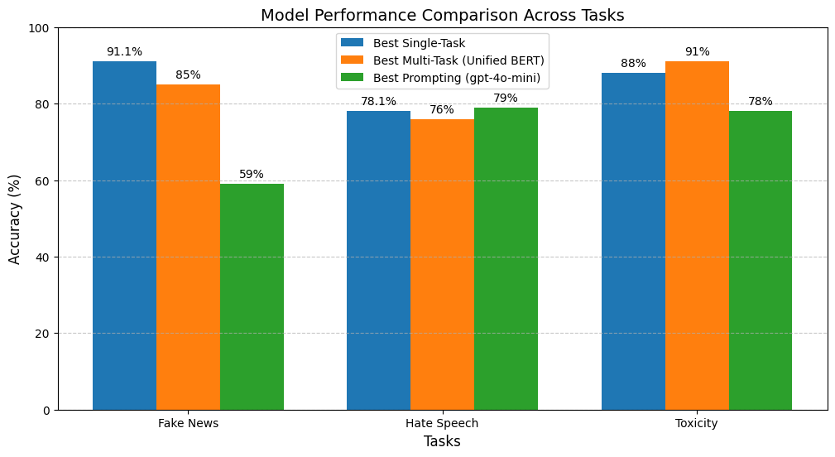
Comparison between Individual Models trained on specific dataset
Notes:
This slide compares the performance of three different models across three tasks: Fake News detection, Hate Speech detection, and Toxicity detection.
The models being compared are:
Best Single-Task Model (Blue) – Trained for one task at a time.
Best Multi-Task Model (Unified BERT) (Orange) – Trained for multiple tasks together.
Best Prompting-Based Model (GPT-4o mini) (Green) – Uses AI prompting instead of task-specific training.
Now, let's analyze their performance.
1. Fake News Detection:
The Single-Task Model performs the best with 91.1% accuracy.
The Multi-Task Model follows closely at 85%, still performing well.
The Prompting-Based Model struggles, achieving only 59% accuracy, showing that it needs more training for Fake News detection.
2. Hate Speech Detection:
The Single-Task Model achieves 78.1% accuracy, which is good.
The Multi-Task Model is slightly lower at 76%, meaning it's close in performance.
Interestingly, the Prompting-Based Model does slightly better at 79%.
3. Toxicity Detection:
The Multi-Task Model performs the best at 91% accuracy.
The Single-Task Model is close behind at 88%.
The Prompting-Based Model is the weakest in this category, with 78% accuracy.

Slide 24
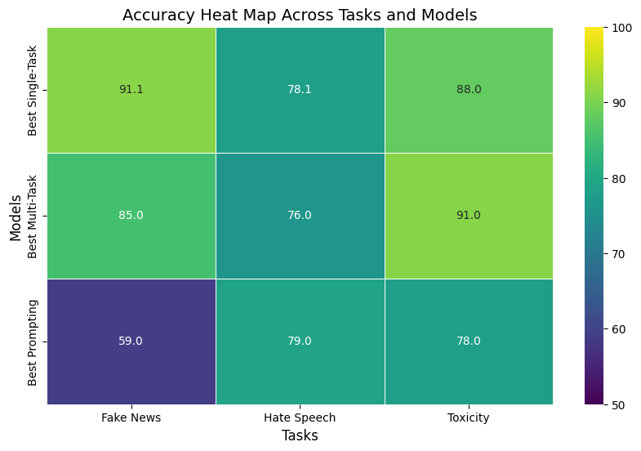
Unified Models Accuracy Comparison
Notes:
This slide shows a heatmap comparing the accuracy of three different models across three tasks: Fake News Detection, Hate Speech Detection, and Toxicity Detection.
Fake News Detection:
The Single-Task Model performs the best with 91.1% accuracy.
The Multi-Task Model is slightly lower at 85%.
The Prompting-Based Model struggles, achieving only 59% accuracy.
2. Hate Speech Detection:
The Single-Task Model achieves 78.1% accuracy, making it a strong performer.
The Multi-Task Model is slightly lower at 76%, but still close.
The Prompting-Based Model performs the best in this task with 79% accuracy.
3. Toxicity Detection:
The Multi-Task Model is the best, with 91% accuracy.
The Single-Task Model is slightly behind at 88%.
The Prompting-Based Model is the lowest in this category, with 78% accuracy.

Slide 25
Results
Key Insights:
Single-Task models excel in precision, especially for Fake News 91% accuracy detection.
Multi-Task models excel in achieving 91% accuracy in Toxicity, and a balanced to specialized models.
Prompting model achieved best in Hate Speech 79% with few shot prompting.
Prompting model with zero shot gave overall the worst results with 46% in Hate Speech & Toxicity while 40% accuracy in fake news.
Final Verdict:
Use Single-Task for accuracy, Multi-Task for efficiency, and Prompting for flexibility
Notes:
Single-Task Models are the most precise, achieving 91% accuracy in Fake News detection.
Multi-Task Models perform well overall, excelling in Toxicity detection (91%) while maintaining balanced accuracy across tasks.
Prompting-Based Models perform best in Hate Speech detection (79%) when using few-shot prompting.
However, zero-shot prompting produced the worst results, with accuracy dropping to 46% for Hate Speech & Toxicity and 40% for Fake News.

Slide 26
CONCLUSION

Slide 27
Conclusion
We built robust classifiers, achieving Accuracy - 76% Hate Speech, 85% Fake news, and 91% Toxicity and an F1-score of 74% Hate Speech, 85% fake news and 90% Toxicity. Overcoming dataset limitations, we optimized models and explored novel approaches. Despite challenges, our work advances content analysis and lays a foundation for future improvements.
Key Takeaways:
Multi-task models deliver strong performance while balancing computational efficiency.
Quality datasets are critical for achieving high performance across diverse tasks.
Combining innovative techniques with rigorous evaluation ensures robust and reliable classifiers.

Slide 28
Challenges
Missing/Masked Labels:
Inconsistent label availability (use of -1) leads to imbalanced training.
Task Interference:
Shared BERT encoder may mix conflicting signals between tasks.
Data Heterogeneity:
Merged datasets differ in annotation criteria and text style.
Computational Overhead:
Multitask setup increases memory usage and training time.
Evaluation Complexity:
Need for multi-metric analysis and careful baseline comparisons.

Slide 29
Future Work
Expand datasets to include multilingual data.
Optimize latency for real-time deployment.
Incorporate live user feedback for retraining.
Deployment: Real-world testing to evaluate impact on online discourse.

Slide 30
Team Contributions
Name | Responsibilities
Aastha Shreya | Prompting tasks, Unified Model using T5,Final PPT.
Shivang Sinha | Dataset creation for unified model, Development of Unified model creation along with prompting in gpt-4o-mini, Final PPT.
Farhan Ali Arshad | QA Testing, Mid-term Presentation,Prompt generation, Cleaning defakts dataset.
Syed Huzaifa Ali | Proposal, Development of Individual model’s, SHAP Analysis of Individual & Unified models, Final PPT.
Donya Sheikhi | Final PPT creation, Frontend, Architecture Diagram
Muhammad Ahmed | Data Collection, Preprocessing

Slide 31

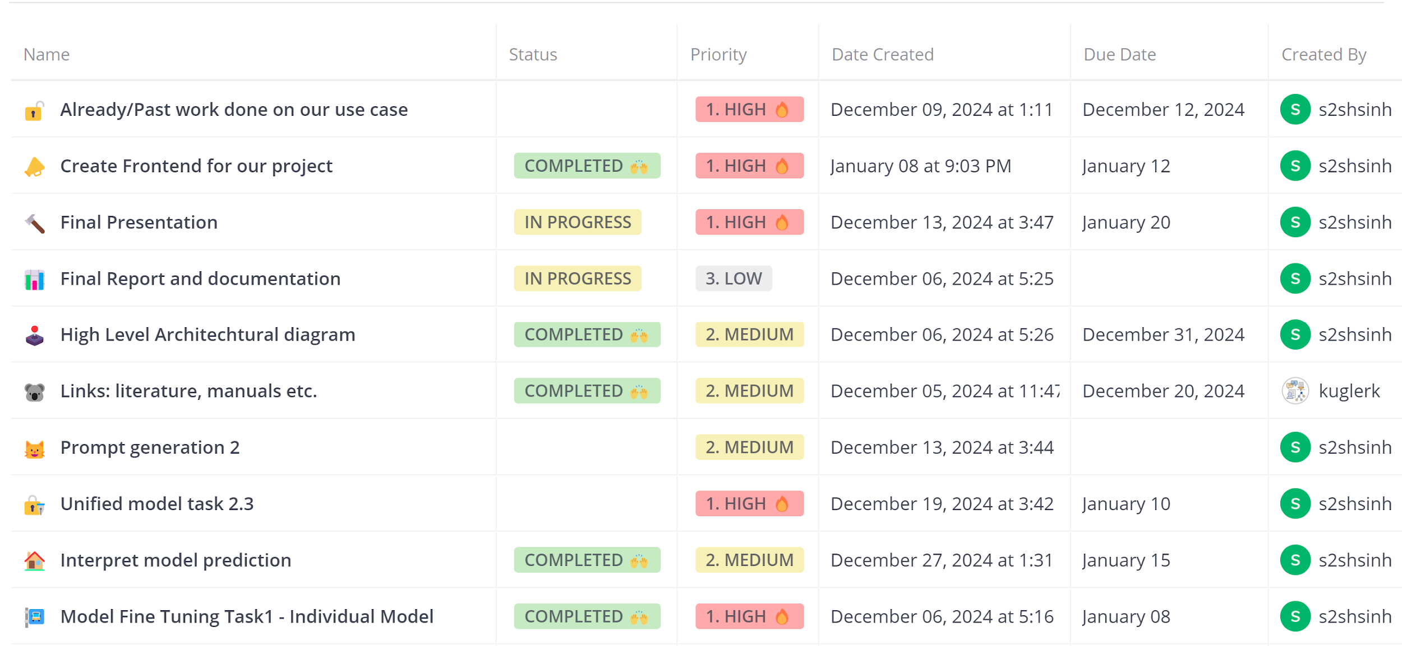
End to End Timeline Management- Mattermost Board
Just for reference

Slide 32
References
Devlin, J., Chang, M.-W., Lee, K., and Toutanova, K. (2019). BERT: Pre-training of Deep Bidirectional Transformers for Language Understanding. Proceedings of NAACL-HLT.
Reimers, N., and Gurevych, I. (2019). Sentence-BERT: Sentence Embeddings using Siamese BERT-Networks. Proceedings of EMNLP-IJCNLP.
Wulczyn, E., Thain, N., and Dixon, L. (2017). Ex Machina: Personal Attacks Seen at Scale. Proceedings of WWW.
Founta, A. M., Djouvas, C., Chatzakou, D., et al. (2018). Large Scale Crowdsourcing and Characterization of Twitter Abusive Behavior. Proceedings of ICWSM.
Powers, D. M. (2011). Evaluation: From Precision, Recall and F-Measure to ROC, Informedness, Markedness & Correlation. Journal of Machine Learning Technologies.
Kobayashi, S. (2018). Contextual Augmentation: Data Augmentation by Words with Paradigmatic Relations. Proceedings of NAACL-HLT.
Binns, R. (2018). Fairness in Machine Learning: Lessons from Political Philosophy. Proceedings of FAT.

Slide 33
Thanks For your Attention
Q&A?

