Slide 1
HOTEL MANAGEMENT
Group members~Aastha,Aashi,Aastha
In Supervision of Dr. Rakesh Ahuja

Slide 2
About project
The project,Hotel Management System is a web based application that allows the hotel manager to handle all hotel activities online.

Slide 3
HOW IT’S BENEFICIAL......
This application gives Hotel manager the power and flexibility to manage the entire system from a single online system. Hotel management project provides room booking , staff management and other necessary hotel management features.

Slide 4

Software requirement specification(srs)......

Slide 5

1. Introduction
1.1 Purpose: Handling and collecting data in a precise manner.
1.2 Intended Audience: Hotel Manager
1.3 Intended Use : Booking rooms , Bills of employees, Schedule of staff , information of hiring staff.
1.4 Scope: Work in various Government as well as private sector.

Slide 6
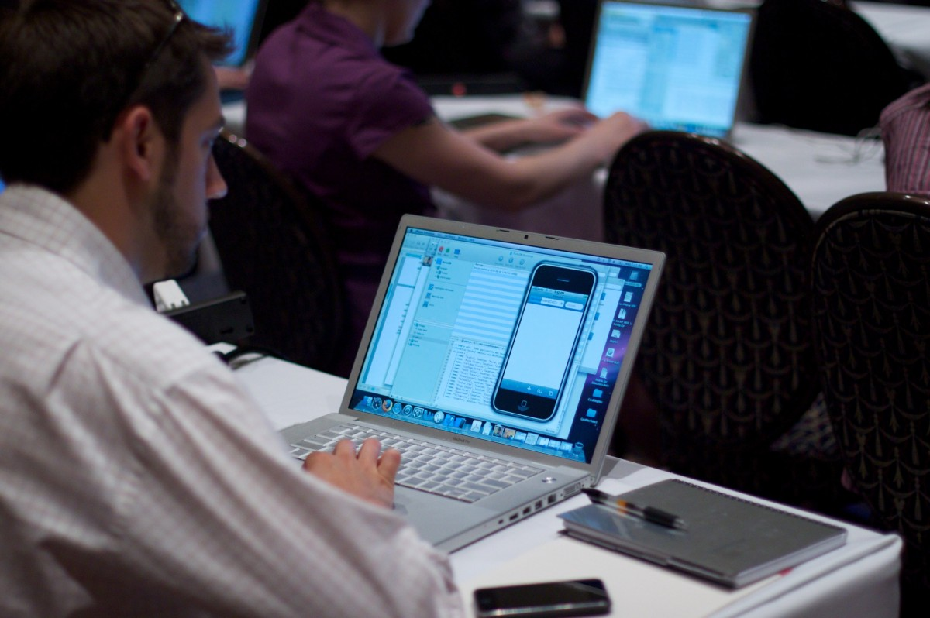
2. Overall description
2.1 User Needs: Save time and make data handling more easy.
2.2 Assumptions: Project made for decreasing burden on Hotels Staff and easy to use but employee who is handling data must know basic of python for little bit change as per requirement.

Slide 7

Software and hardwork Requirement......
Operating System : Window 11 Pro
Platform : Jupiter notebook
Language : Python
RAM : 4.00 GB
Processor : Intel(R) Core(TM)

Slide 8
Design aspect of project...
Booking()
Used for booking rooms
Rooms_info()
Used for getting information of hotel rooms
restaurant()
Used for getting detail of food
Record()
Used for getting record of guests
Payment()
Used for getting Payment detail of Guests

Slide 9
Oblique algorithm
First we call function home() in which we
have further five different function that is Booking(), Rooms_info() , restaurant() ,Payment() ,Record() ,exit().

Slide 10
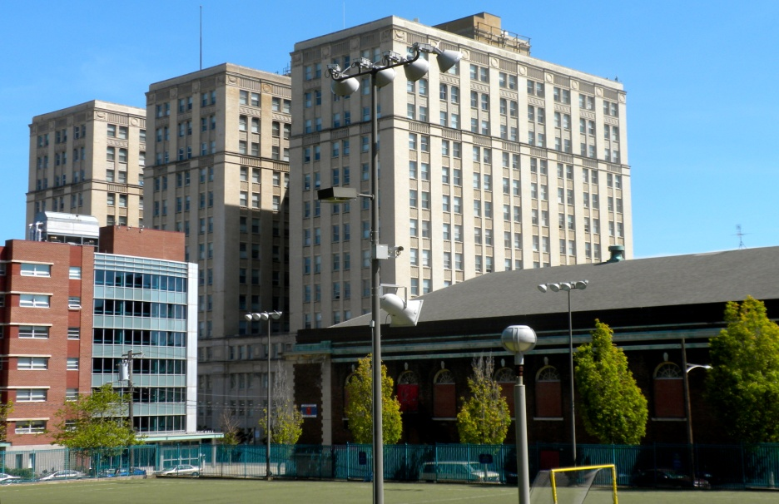
Result
Booking() function will help in booking rooms.
Room_info() function will give information of vacant rooms.
restaurant() function will give infomation about food available.
Payment() function will give Bill of guests.
Record() function will give record of guests.
exit() function will close all functions.

Slide 11
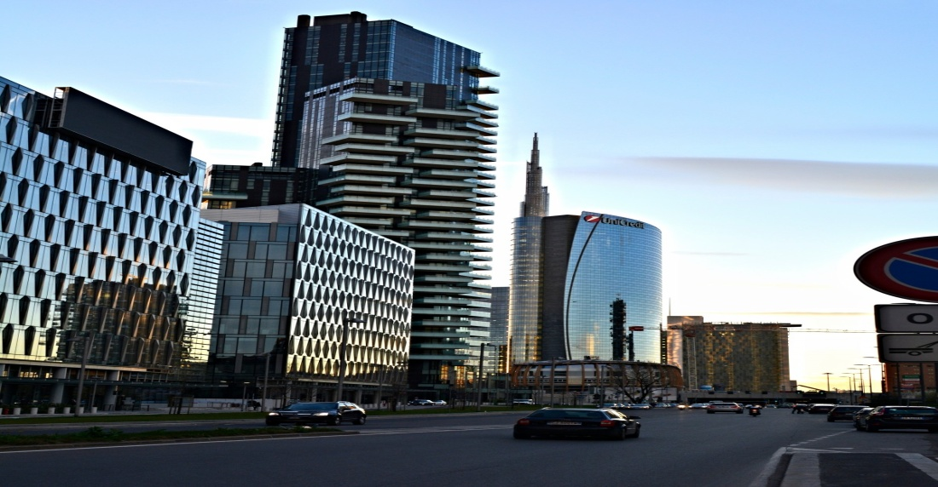
conclusion
This system is useful for both customers and managers to portable manage the hotel activities.It saves time in searching rooms,calculating payments,resources and expenses.

Slide 12
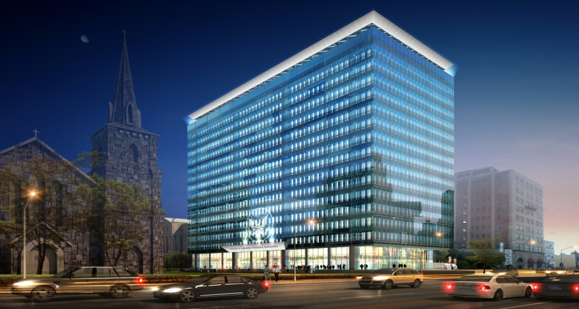
Future aspects
Hotel management features can be further enhanced by linking other branches of hotel via online.
Guest can add their reservation themselves by online reservation through a hotel websites

Slide 13
Thank you
In supervision of Dr. Rakesh Ahuja

