Slide 1
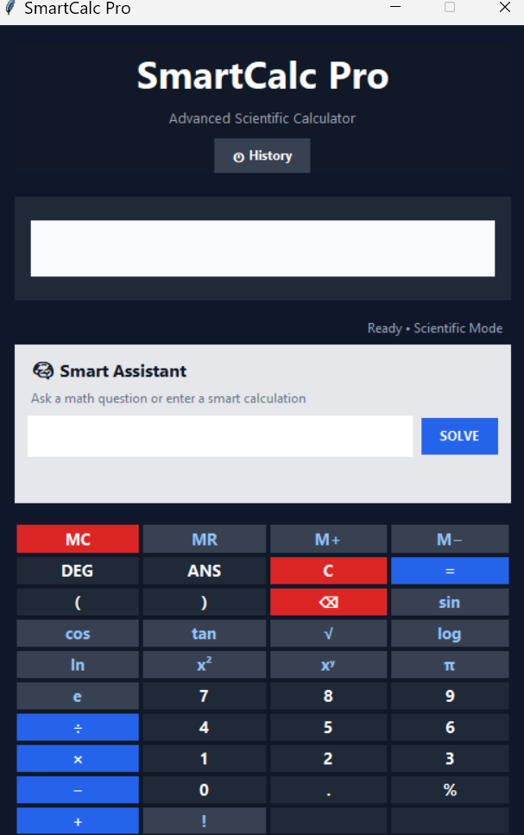
SmartCalc Pro
Subtitle: Advanced Scientific Calculator with Smart Math Assistant
Assigned By: NextHikes IT Solutions
Presented By: Aastha Sahu

Slide 2
SmartCalc Pro – Smarter Than a Regular Calculator
Performs basic and scientific calculations
Supports arithmetic, percentages, roots, powers, factorials, and trigonometry
Solves equations with step-by-step explanation
Understands natural language queries
Saves time and improves mathematical understanding

Slide 3
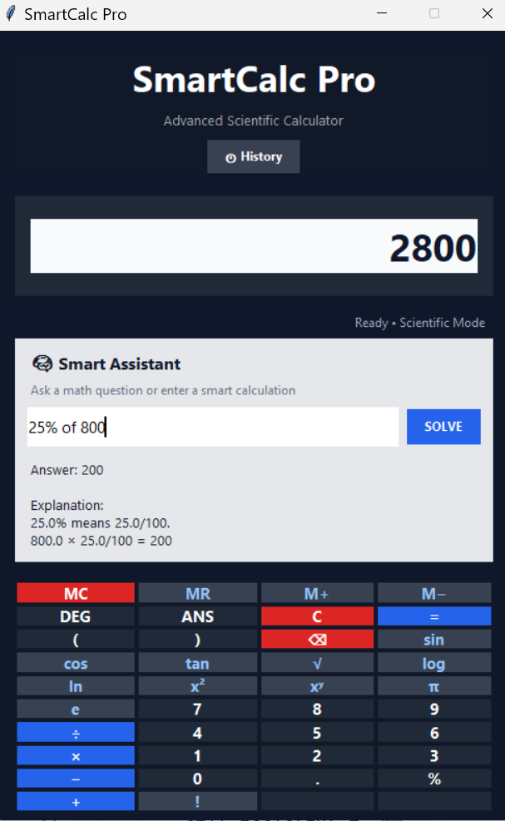
Why it is unique:
Combines calculator + assistant + explanation
User-friendly and reliable
Useful for students and practical problem solving

Slide 4
Technologies Used
Python: Python was used for logic and interface
Tkinter: Tkinter built the desktop UI
SymPy: SymPy handled scientific and symbolic calculations
unittest: unittest verified functionality and reliability
VS Code
GitHub
Windows PowerShell

Slide 5
Challenges Faced and How We Solved Them
Unsafe input handling: prevented malicious or invalid expressions
Complex math operations: used SymPy for accurate evaluation
Natural-language parsing: converted user text into mathematical expressions
Step-by-step explanation: added equation-solving logic for better understanding
User-friendly interface: designed a clean and simple calculator layout
Testing reliability: added automated tests to validate results

Slide 6
Research and AI Support
References:
Python documentation
Tkinter documentation
SymPy documentation
GitHub examples and tutorials
Mathematical problem-solving references
How AI helped:
assisted with debugging
helped understand code logic
improved problem solution approach
supported explanation writing and validation

Slide 7
Thank You
Special thanks to NextHikes IT Solutions for assigning this project
Thanks to the faculty for guidance and evaluation
Appreciation for the opportunity to build SmartCalc Pro
“SmartCalc Pro is a practical and innovative step toward building smart, educational, and user-friendly mathematical tools.”

