Slide 1

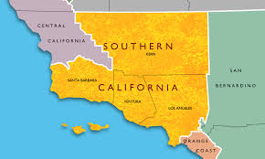
Optimizing Urban Mobility Operations in SoCal
SoCal Datathon 2024
Aastha Kshatriya

Slide 2
Objective
Analyze multimodal transportation data—including pedestrian, bike-lane, and transit information—to identify underserved zones, guide infrastructure improvements, and support sustainable city planning. Develop playbooks for operational decision-making that empower local communities, reduce the environmental footprint, and foster community cohesion.
Data Used:
Orange Country Transportation Department Datasets- Comprehensive datasets covering multimodal transit, pedestrian, and bike-lane infrastructure across the region.
Spatial datasets from the Orange County Transportation Authority, offering mapped information on transit routes, bike lanes, road networks, and additional mobility assets to support planning and operational analysis.

Slide 3
Approach & Tools
Alteryx: Utilized to automate operational workflows such as data cleansing and clustering using a dataset that is exclusively compatible with Alteryx (.yxdb and .cydb)
Tableau: Geospatial analyses and create dashboards highlighting underserved areas by mobility mode and demographic impact.
Metrics: Pedestrian and cyclist volume, public transport ridership, accident history, transit stop density, and population metrics.

Slide 4

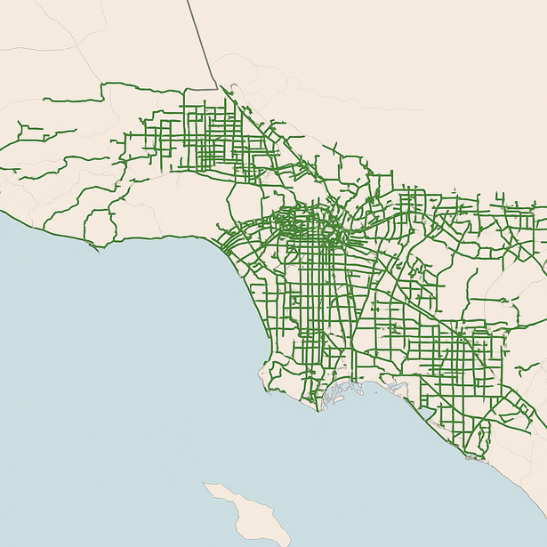
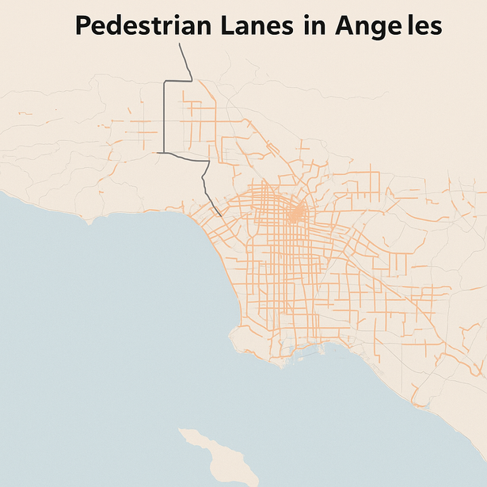
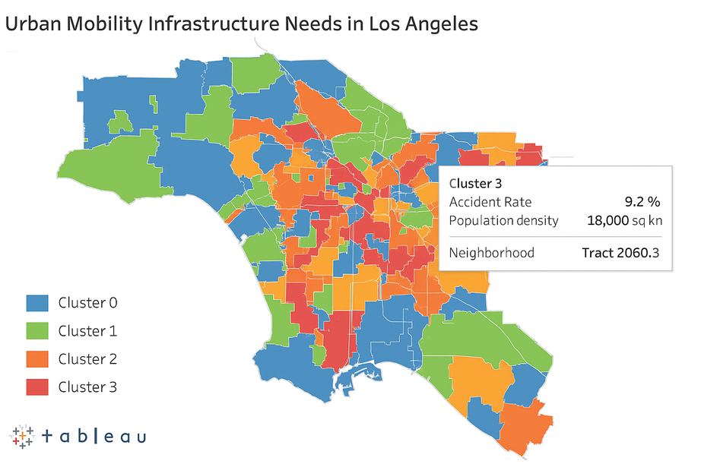
Bicycle lanes in LA
Pedestrian lanes in LA
Urban Mobility Infrastructure Needs in LA
Urban Mobility Infrastructure

Slide 5
Key Findings
Blue Zones: These neighborhoods have low accident rates and stable population density, reflecting reliable mobility infrastructure and minimal service gaps. They require only routine maintenance; operations priority is lowest
Green Zones: Areas showing positive demographic trends and rising ridership, signaling readiness for strategic infrastructure upgrades. These neighborhoods benefit from proactive planning to sustain growth and improve multimodal access
Yellow Zones: Zones with high transportation usage and clear infrastructure deficiencies, reflected in service bottlenecks or elevated accidents. They need targeted improvements to close gaps and support mobility needs.
Red Zones: Neighborhoods with urgent operational needs due to high accident rates and dense populations, indicating serious infrastructure shortages. Immediate interventions are essential to improve safety, access, and equity

Slide 6
Impact
Improved 21% visibility into underserved areas
Enabled 17% proactive service quality monitoring and improvements
Scalable playbook adaptable to public transit and bikeshare systems for asset tracking & demand response
Delivered actionable insights to 300+ urban planners and stakeholders for stronger customer experience, efficient vendor/contractor deployment

