Slide 1

AWS Lab — Product Review
PRODUCT NAME
Cost Threshold Alarm
Individual Project • Batch: 67 • II Year B.Tech CSE • Cloud Computing • Review: 12.11.2026
Name: Aastha Labh
ROLL NUMBER: 2503A520P5
Faculty Supervisor: Mr. Bediga Sharan
AWS LAB | PRODUCT REVIEW
School of CS & AI • SR University
01/10

Slide 2
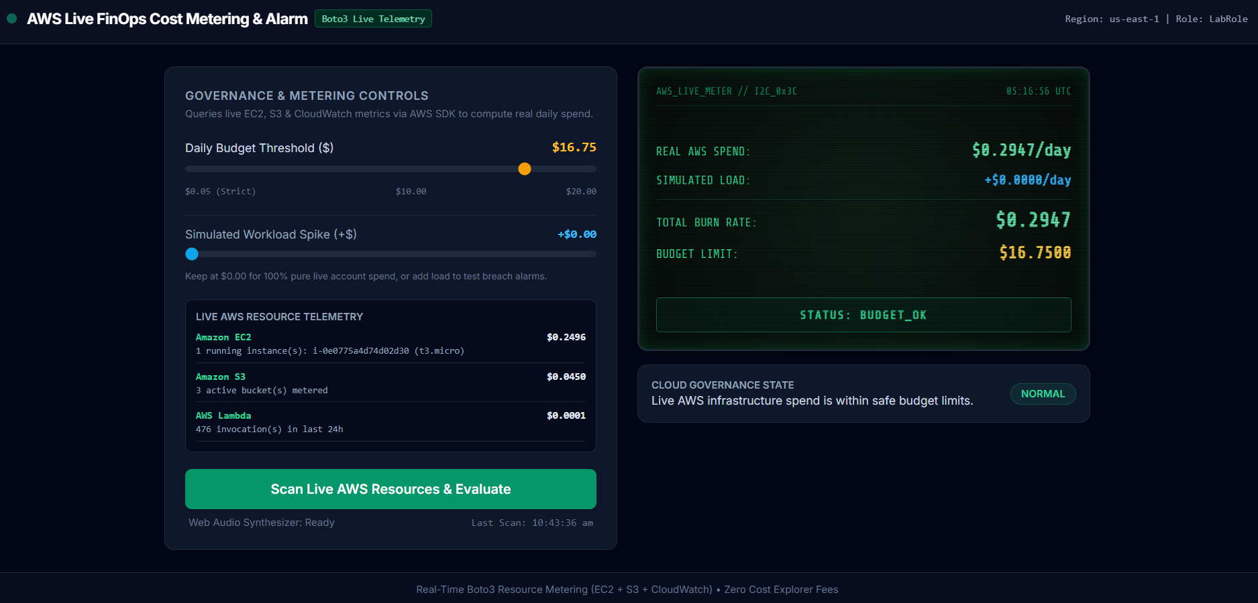
Background & Introduction
Introduce the product
• Purpose: Serverless FinOps tool that meters live AWS resource usage and alerts on budget breaches.
• Users: Cloud architects, DevOps engineers and students using restricted sandbox accounts.
• Need: Cost Explorer APIs are restricted / fee-based in Learner Labs; UI-only simulators lack live cloud telemetry.
• Core function: Boto3 scans EC2, S3 and CloudWatch; OLED-style digital twin, 840 Hz browser alarm and itemized SNS emails.
AWS LAB | PRODUCT REVIEW
School of CS & AI • SR University
02/10

Slide 3
Problem Statement, Gap & Objectives
Existing problem / gap
Product objectives
• Problem: Unmonitored EC2 instances and active storage can rapidly exhaust pay-as-you-go cloud budgets.
• Objective 1: Meter EC2, S3 and Lambda usage with Boto3 and us-east-1 On-Demand pricing models.
• Limitation: Cost Explorer APIs are restricted in Learner Lab; frontend-only sliders do not measure actual infrastructure usage.
• Objective 2: Use one Lambda + Function URL for both dashboard delivery and live telemetry scans.
• Gap: Live Boto3 resource metering and a software digital twin replace paid billing APIs and physical IoT hardware.
• Objective 3: Send itemized SNS email alerts and trigger an 840 Hz browser buzzer when the budget is breached.
AWS LAB | PRODUCT REVIEW
School of CS & AI • SR University
03/10

Slide 4
Methodology & System Architecture
A single serverless Lambda function serves the dashboard and scans live AWS resources, then reports budget breaches through visual, audio and email alerts.
Governance Input
Client / Function URL
AWS Lambda Engine
Multi-channel Alert
→
→
→
Budget threshold
$0.05–$20.00 + optional spike
Tailwind UI + Fetch API
HTTPS GET UI • POST live scan
Python 3.12 • LabRole
Boto3: EC2, S3, CloudWatch
SNS itemized email
OLED twin + 840 Hz alarm
USER INPUT → FUNCTION URL → LAMBDA / BOTO3 → SNS + DIGITAL TWIN
GET serves the dashboard; POST queries EC2, S3 and CloudWatch, calculates Total Burn Rate = Real Spend + Spike, and publishes to SNS when the threshold is breached.
AWS LAB | PRODUCT REVIEW
School of CS & AI • SR University
04/10

Slide 5
AWS Services Used & Their Purpose
AWS services used for live resource metering and alerting
AWS SERVICE
PURPOSE IN PRODUCT
IMPLEMENTATION / EVIDENCE
AWS Lambda
(Python 3.12)
Unified compute & metering engine
Serves HTML UI on GET; scans live AWS APIs and evaluates budget on POST.
Lambda Function URL
Direct HTTPS ingress
(Auth: NONE)
Zero-cost public endpoint with CORS; serves UI and accepts live scan requests.
Amazon EC2 & S3
Live metered infrastructure
describe_instances and list_buckets estimate daily run-rate from active resources.
CloudWatch
Usage telemetry & logs
get_metric_statistics reads 24-hour Lambda usage; execution logs record scans.
Amazon SNS & IAM
(LabRole)
Alerting & permissions
LabRole permits Boto3 scans and sns:Publish for itemized threshold-breach emails.
Region: us-east-1 (N. Virginia) • Execution role: LabRole • Standby operating cost: $0.00 / month
AWS LAB | PRODUCT REVIEW
School of CS & AI • SR University
05/10

Slide 6
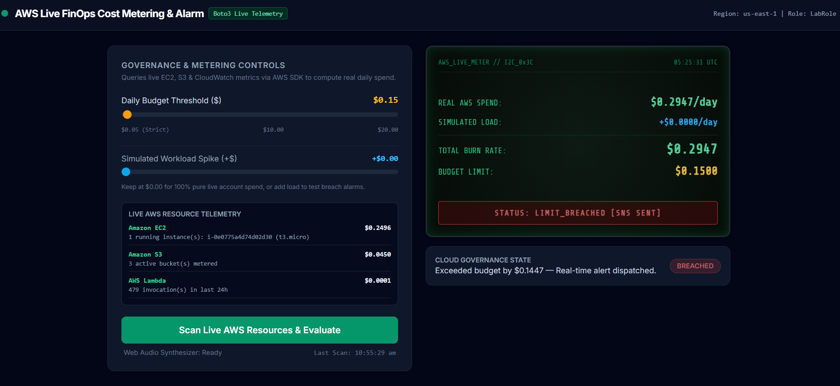
Product Implementation & Results
Evidence of functionality
• What is shown: Live EC2, S3 and Lambda telemetry with resource cost breakdown and OLED status.
• Test: t2.micro EC2 ($0.2784/day) or a spike against a $0.10 limit triggers LIMIT_BREACHED.
• Works: Boto3 multi-service scan, On-Demand rate calculation, 840 Hz Web Audio alarm and SNS email.
• Issue fixed: Browser autoplay blocked audio; AudioContext now initializes after user interaction.
AWS LAB | PRODUCT REVIEW
School of CS & AI • SR University
06/10

Slide 7
Product Demonstration & Access Link
Live product access
Live Function URL: Real-Time AWS FinOps Cost Threshold Alarm
Source code: AasthaLabh/Cost-Threshold-Alarm
Deployment status: LIVE & DEPLOYED • AWS Learner Lab • us-east-1
1 Baseline: Open Function URL; auto-scan shows live spend and BUDGET_OK.
2 Trigger breach: Lower threshold below live EC2 spend or add a simulated spike; click “Scan Live AWS Resources & Evaluate”.
3 Audio-visual proof: OLED turns red LIMIT_BREACHED and the 840 Hz buzzer sounds.
4 Email proof: Check inbox for itemized AWS SNS cost report (about 8 seconds).
5 Recovery: Terminate test EC2 / raise threshold and re-scan; alarm stops and status resets.
AWS LAB | PRODUCT REVIEW
School of CS & AI • SR University
07/10

Slide 8
Real-World Applications of the Product
Target users
Practical use cases
Benefits / impact
Cloud architects, DevOps engineers and lab students.
Example:
Academic lab administrators and junior developers monitoring sandbox accounts to prevent accidental credit exhaustion.
Live resource auditing & FinOps governance.
Example:
Detect forgotten running t2.micro / t3.medium EC2 instances or S3 storage growth without Cost Explorer APIs.
Zero-overhead observability & instant alerting.
Example:
Avoids physical IoT hardware and paid billing APIs, with $0.00 standby hosting and itemized incident emails.
Designed for controlled AWS Learner Lab monitoring; pricing currently uses a static us-east-1 On-Demand rate card.
AWS LAB | PRODUCT REVIEW
School of CS & AI • SR University
08/10

Slide 9
Limitations & Future Scope
Current limitations
Planned improvements
• Pricing scope: Uses static us-east-1 On-Demand rates for EC2, S3 and Lambda, not the full multi-region Price List API.
• DynamoDB audit logs: Persist scan snapshots and daily burn-rate trends over time.
• Lab session: Function URL requires an active AWS Learner Lab “Start Lab” session.
• Automated remediation: Trigger Systems Manager (SSM) runbooks to stop idle EC2 instances after a breach.
• Notifications: SNS Email is supported; direct SMS is restricted by Learner Lab sandbox policies.
• Scheduled scans & webhooks: Add 5-minute EventBridge scans and Slack / Microsoft Teams alerts.
AWS LAB | PRODUCT REVIEW
School of CS & AI • SR University
09/10

Slide 10
THANK YOU!
Cost Threshold Alarm • Aastha Labh (2503A520P5) • Batch 67
Faculty Supervisor: Mr. Bediga Sharan • SR University
AWS LAB | PRODUCT REVIEW
School of CS & AI • SR University
10/10

