Slide 1
Credits and grants Bdat1004-final project
Aastha Pareshbhai Patel

Slide 2
Agenda
Introduction
Project Summary
Data Acquisition and Integration
Cloud Database Storage Solution
Flask-Powered Data Application

Slide 3


Introduction
Welcome to Team Group-6's presentation. As data aficionados, we're redefining XYZ Corporation's data engagement through our innovative web application. Our expertise spans development to analytics, uniquely equipping us to address complex data challenges. Today, we present a solution that exemplifies seamless data integration, robust analytics, and dynamic visualization, all designed to empower informed decisions and growth. Discover our commitment to advancing XYZ's data potential.

Slide 4
Project Summary
XYZ Corporation commands a global presence, necessitating sophisticated data management systems for optimal performance.
Our solution captures and stores data in real-time, utilizing the cloud for unparalleled accessibility and security.
We employ continuous data processing and analysis, ensuring XYZ Corporation's data is always current and actionable.
Through interactive web-based visualizations, we transform complex data into clear, actionable insights for XYZ Corporation.

Slide 5
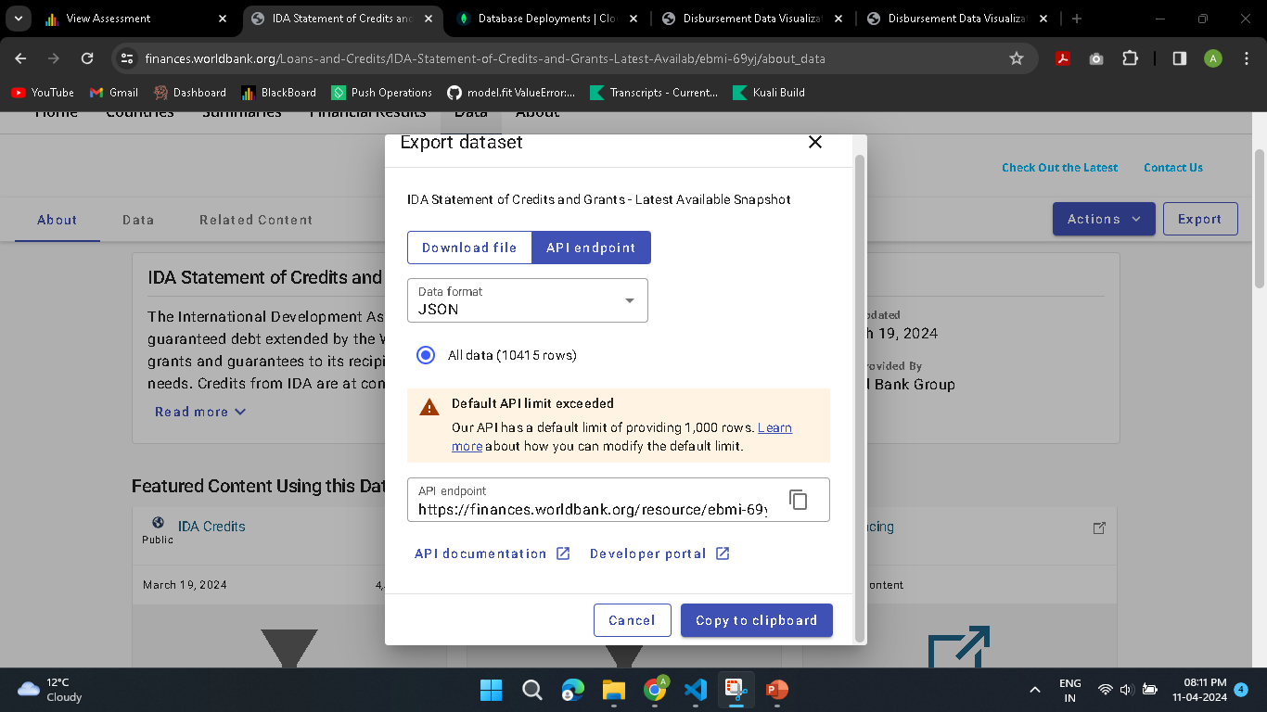

Slide 6
Data Acquisition and Integration
Our project taps into the World Bank's IDA Statement, sourcing crucial financial data for analysis.
We've programmed Python scripts for seamless, automated data fetching, ensuring efficiency..
Our system features a 24-hour batch process, consistently updating the database with the latest information.

Slide 7
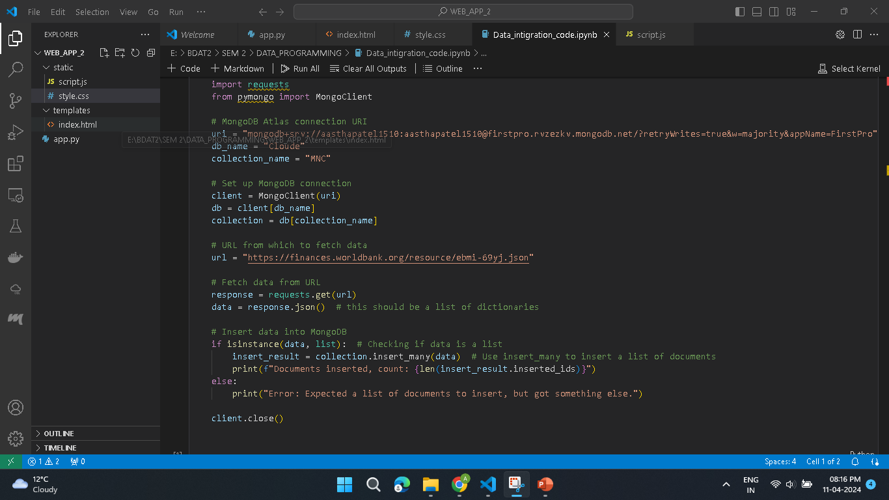

Slide 8
Cloud Database Storage Solution
We chose MongoDB for its flexibility in handling diverse datasets, which aligns perfectly with XYZ's dynamic data needs.
Our pseudo-batch process methodically refreshes the database daily, guaranteeing data timeliness and reliability.
This automated batch process is engineered to function with minimal intervention, enhancing our system's efficiency.

Slide 9
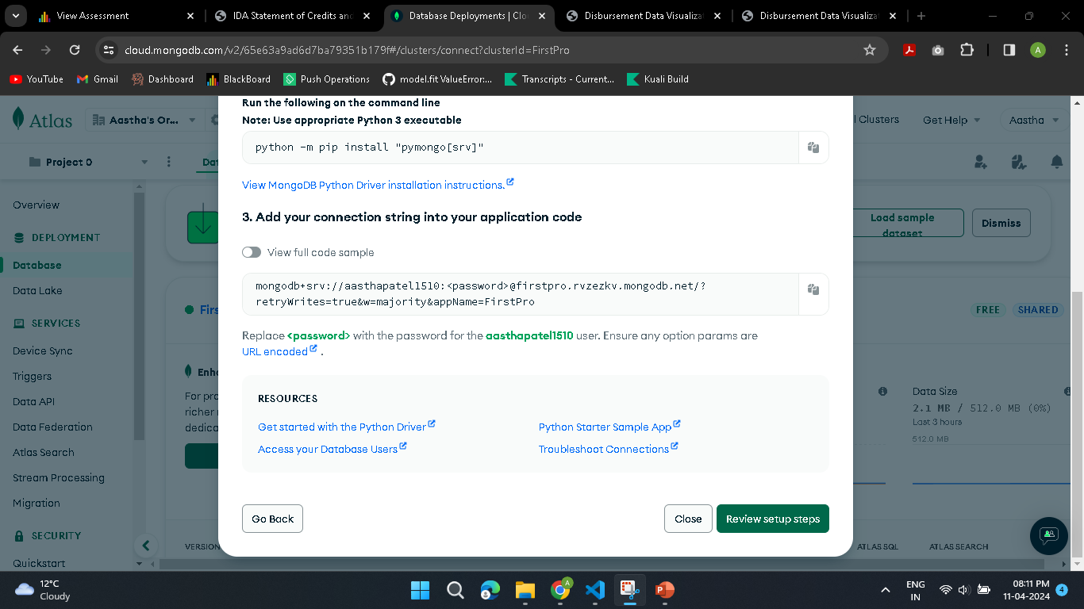

Slide 10
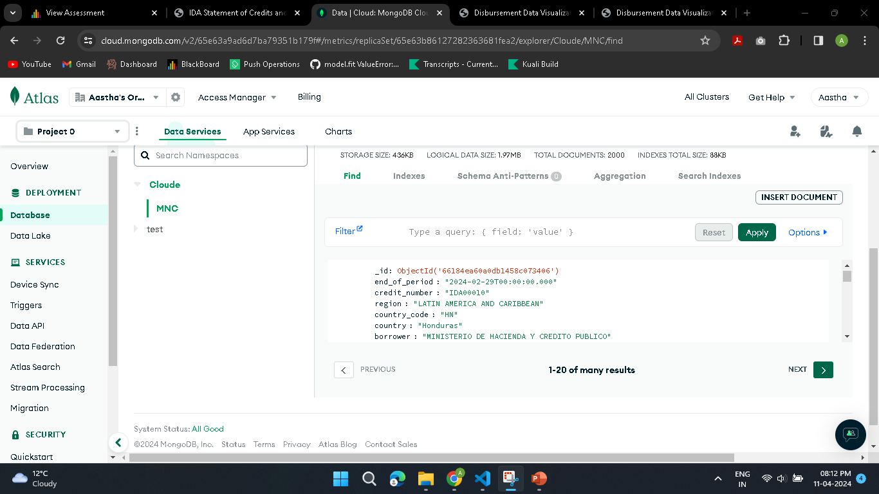

Slide 11
Flask-Powered Data Application
Flask's lightweight and modular design enables our server-side framework to be responsive and scalable.
Client-side JavaScript integration allows for real-time, dynamic representation of XYZ's data.
Google Charts are employed to transform XYZ's data into visually impactful and insightful visualizations.
Live visualization tracks disbursements over time, providing tailored insights.
Customizable views offer adaptable analysis for a broad user base.
A user-friendly interface ensures accessibility for all levels of XYZ's team.
Description of the API endpoints (Get all items, Get a range of items, Get item by ID)
Demonstration of API interaction with the cloud database
Utility and ease of access through a simple URL

Slide 12
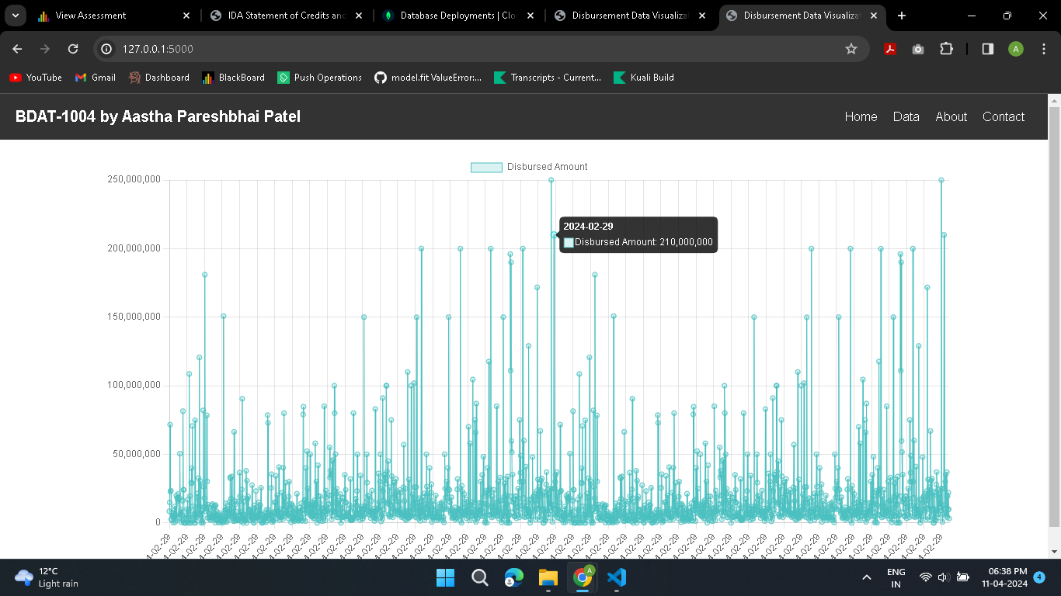

Slide 13
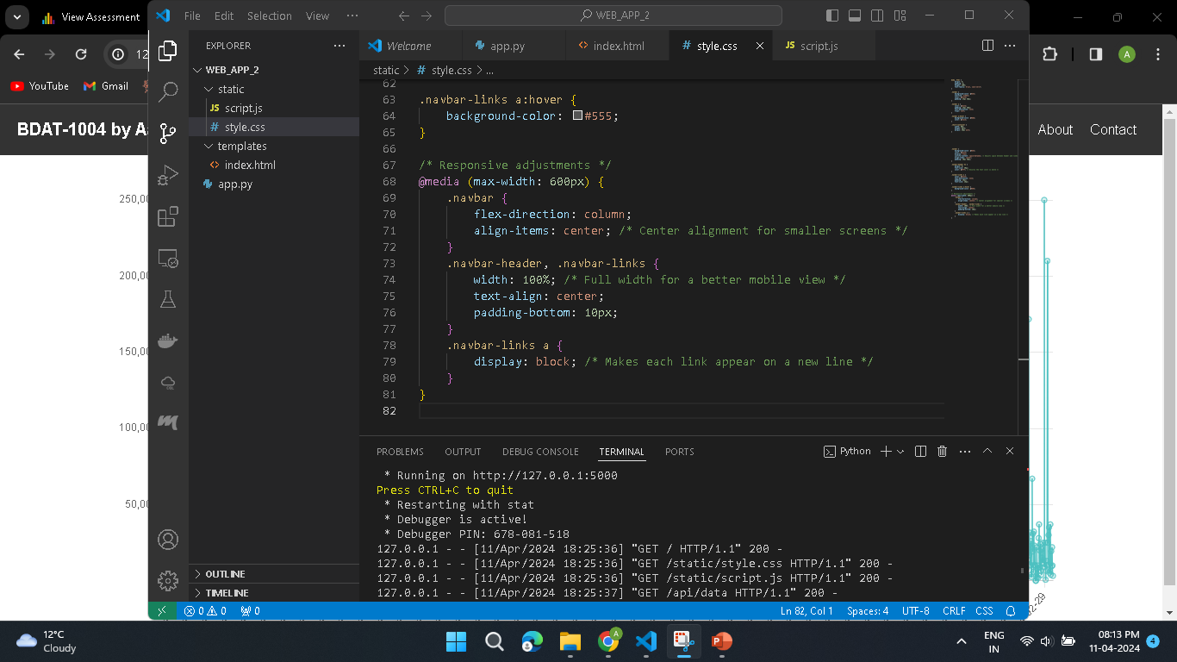

Slide 14
Fit-Gap Analysis and Enhancements
Data Synchronization: Implement real-time data streaming for immediate insights and enhanced decision-making.
Customization Capabilities: Introduce dashboard personalization for a more interactive and user-friendly data experience.
System Scalability: Upgrade to an auto-scaling cloud infrastructure to support growth and maintain performance.
Analytical Advancements: Incorporate machine learning for predictive analytics to anticipate market trends.
Security Enhancements: Strengthen systems with advanced encryption and regular security audits to protect data.
Reporting Tools: Create an inclusive reporting toolkit for accessible insights across all company roles.

Slide 15
Thank you

