Slide 1

Cryptocurrencies Dataset
PRESENTED BY
Aastha Singh - Batch - 441
Yallapragada Anusha - Batch - 440
Vinnamala Chandra Sekhar - Batch - 441

Slide 2
INTRODUCTION
Cryptocurrency has emerged as a major digital financial asset characterized by high volatility and rapid market changes. Thousands of cryptocurrencies are traded globally with varying prices, market capitalizations, and trading volumes.
This project analyzes the Top 1000 Cryptocurrencies – Real-Time Data (2025) dataset using Exploratory Data Analysis (EDA) techniques to understand market behavior, trends, and risk patterns. The dataset includes information such as current price, market capitalization, trading volume, price change percentages, and supply-related indicators.

Slide 3
DATASET OVERVIEW
Comprehensive overview of the top 1,000 cryptocurrencies by market capitalization, collected from CoinGecko API in December 2025. Includes current prices, market data, supply information, and detailed community/developer statistics for the top 100 coins.
The dataset contains 1000 rows and 30 columns representing cryptocurrency market data.
Columns include: 'id', 'symbol', 'name', 'market_cap_rank', 'current_price', 'market_cap', 'fully_diluted_valuation', 'total_volume', 'high_24h', 'low_24h', 'circulating_supply', 'total_supply', 'max_supply', 'ath', 'ath_change_percentage', 'ath_date', 'atl', 'atl_change_percentage', 'atl_date', 'price_change_24h', 'price_change_percentage_24h', 'price_change_percentage_1h', 'price_change_percentage_7d', 'price_change_percentage_30d', 'price_change_percentage_1y', 'market_cap_change_24h', 'market_cap_change_percentage_24h', 'last_updated', 'image', 'supply_utilization
Data types: 23 numerical columns (prices, market values, volumes, and percentage changes) and 7 object-type columns (id, symbol, name, image, ath_date, atl_date, last_updated).
Most object-type columns act as unique identifiers rather than true categorical features.

Slide 4
Simple description of each column in your dataset:
Id : CoinGecko unique identifier for the cryptocurrency.
Symbol : Trading symbol/ticker (e.g., BTC, ETH, BNB).
Name : Full name of the cryptocurrency.
market_cap_rank : Ranking position by market capitalization (1 = highest).
current_price : Current price in USD.
market_cap : Total market capitalization (price × circulating supply) in USD.
fully_diluted_valuation : Market cap if max supply was in circulation, in USD.
total_volume : Total 24-hour trading volume across all exchanges in USD.
high_24h : Highest price in the last 24 hours in USD.
low_24h : Lowest price in the last 24 hours in USD.

Slide 5
circulating_supply : Number of coins currently in circulation.
total_supply : Total number of coins that have been created.
max_supply : Maximum number of coins that will ever exist (null if infinite).
Ath : All-time high price in USD.
ath_change_percentage : Percentage change from all-time high (negative value).
ath_date : Date when all-time high was reached (ISO format).
Atl : All-time low price in USD.
atl_change_percentage : Percentage change from all-time low (positive value).
atl_date : Date when all-time low was reached (ISO format).
price_change_24h : Absolute price change in last 24 hours in USD.

Slide 6
price_change_percentage_24h : Percentage price change in last 24 hours.
price_change_percentage_1h : Percentage price change in last 1 hour
price_change_percentage_7d : Percentage price change in last 7 days.
price_change_percentage_30d : Percentage price change in last 30 days.
price_change_percentage_1y : Percentage price change in last 1 year.
market_cap_change_24h : Absolute market cap change in last 24 hours in USD.
market_cap_change_percentage_24h : Percentage market cap change in last 24 hours.
last_updated : Timestamp when data was last updated (ISO format).
Image : URL to cryptocurrency logo/icon image.
supply_utilization : Percentage of circulating supply vs total supply.

Slide 7
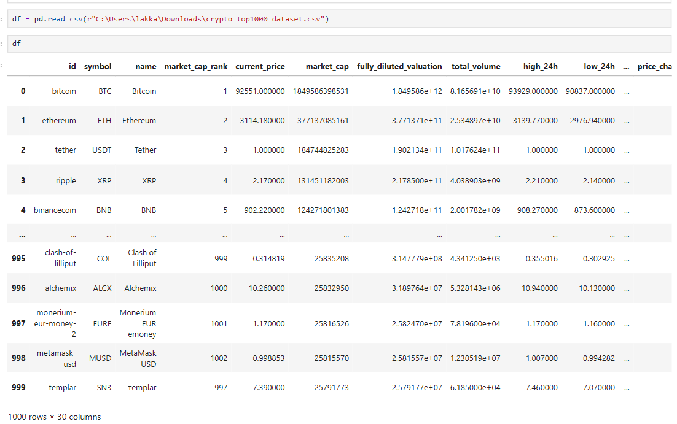
READING DATASET

Slide 8
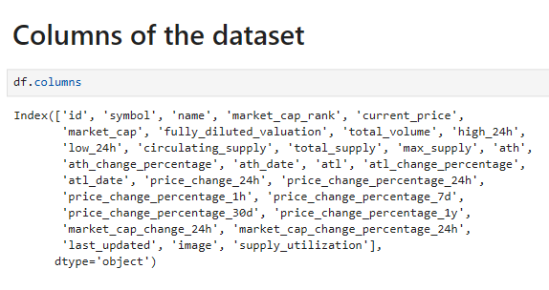
BASIC CHECKS

Slide 9
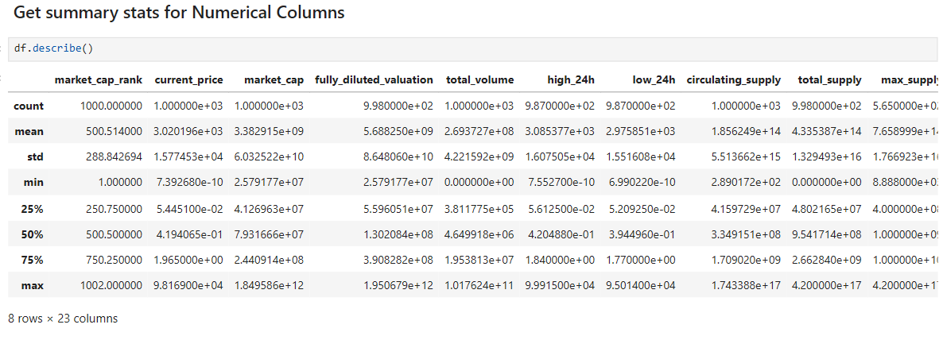
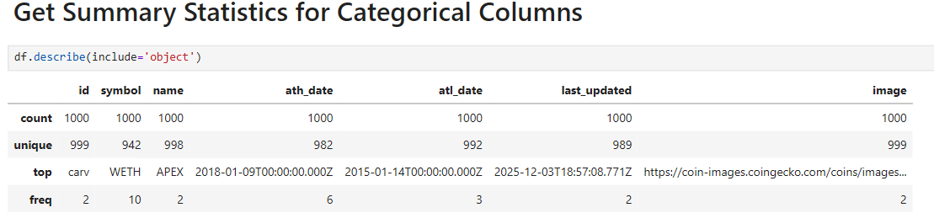

Slide 10
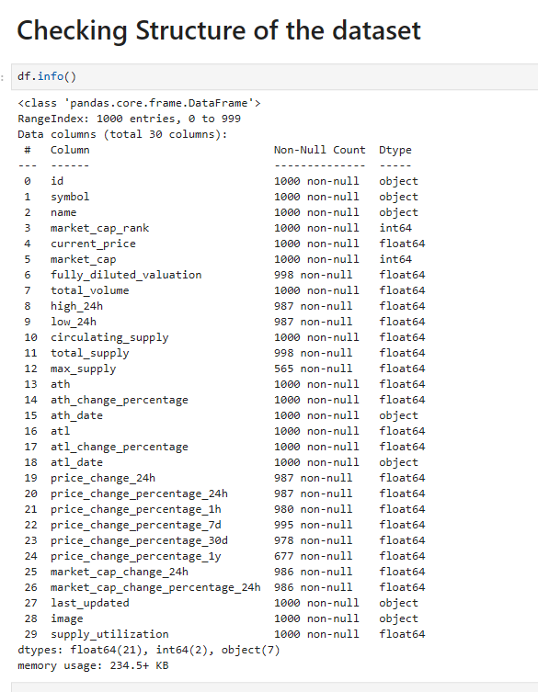

Slide 11
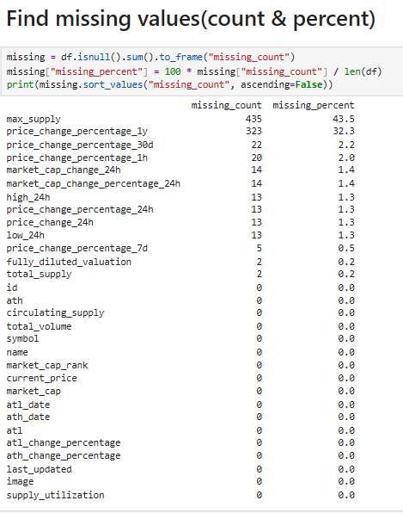
PREPROCESSING TECHNIQUES ON INDIVIDUAL COLUMNS
Missing Values:
Some columns have substantial missing data (max_supply 43.5%, price_change_percentage_1y 32.3%).

Slide 12
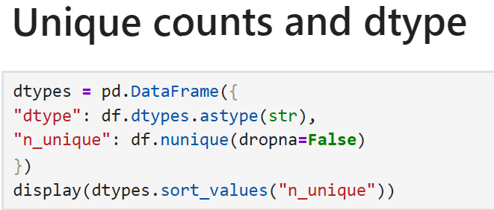
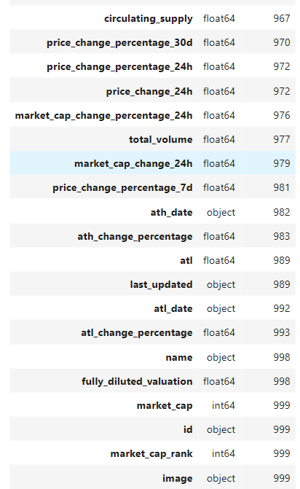
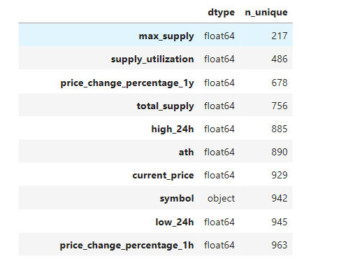

Slide 13
Category Columns Distribution
Our dataset contains columns such as: id, symbol, name, image.
These columns have hundreds of unique values, their distribution looks like:
No dominant category.
Most categories occur only once.
These columns act more like identifiers rather than useful categorical features.
Datetime Columns Stored as Text
Columns: ath_date, atl_date, last_updated.
Currently stored as strings/text, not as proper datetime format.
Need conversion to datetime for analysis and time-based operations.
Outliers
We have Some extreme value in Numeric columns like:- market_cap, current_price, total_volume,
price_change_percentage_24h, price_change_percentage_7d.
A few coins (ex: Bitcoin, Ethereum) have extremely large values compared to small-cap coins.This creates heavy right-skewed distributions.

Slide 14
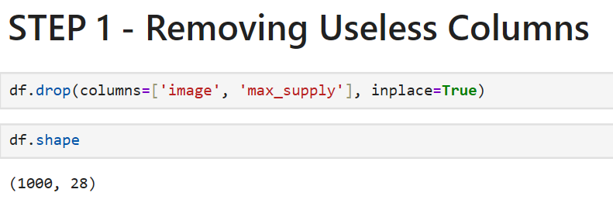
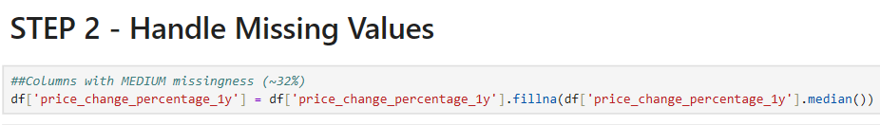
DATA CLEANING AND MANIPULATION
Contains image URLs → no analytical value
43.5% missing values → not helpful for analysis. Too incomplete.
It’s a numeric column.
Mean is not ideal due to missing values and potential outliers.
Median is used instead to fill missing values, as it is less affected by extreme values.

Slide 15
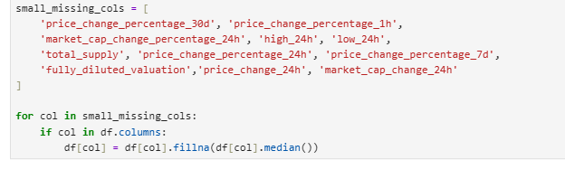
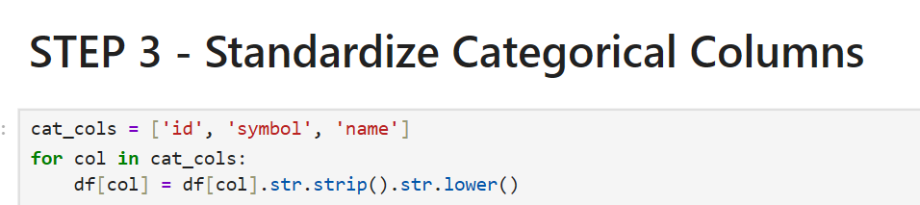
Even though they are identifiers and not categories, cleaning them (removing unwanted spaces and standardizing case) improves consistency.

Slide 16
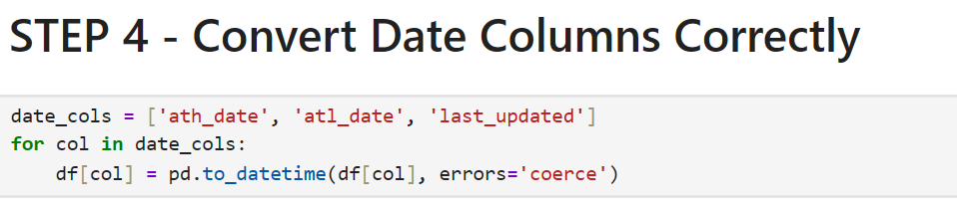
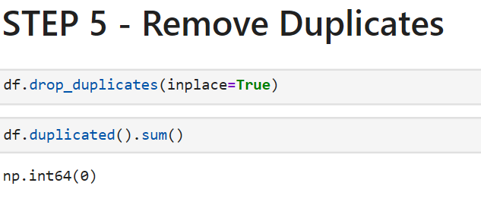
ath_date, atl_date, last_updated → converted to datetime for proper time-based analysis.
Ensures no repeated rows, maintaining data integrity.

Slide 17
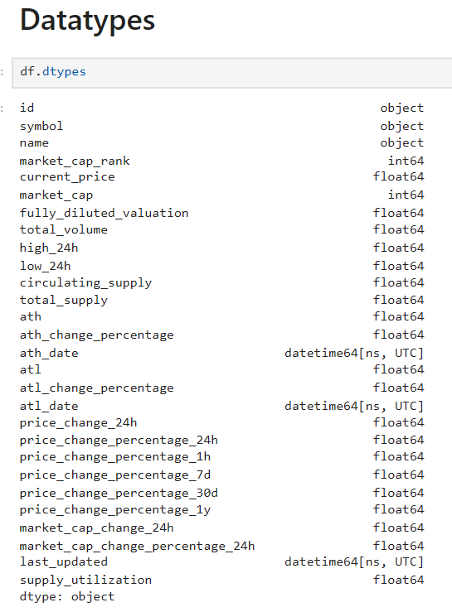
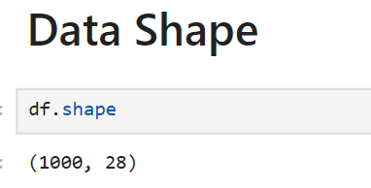
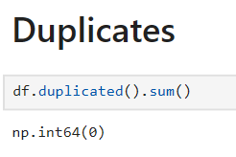
AFTER PREPROCESSING
Dataset size updated after cleaning.
Data types were verified and corrected where required.
Duplicate records were removed successfully.

Slide 18
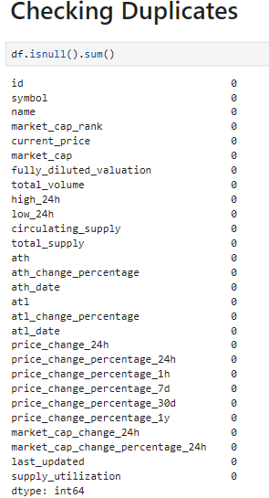
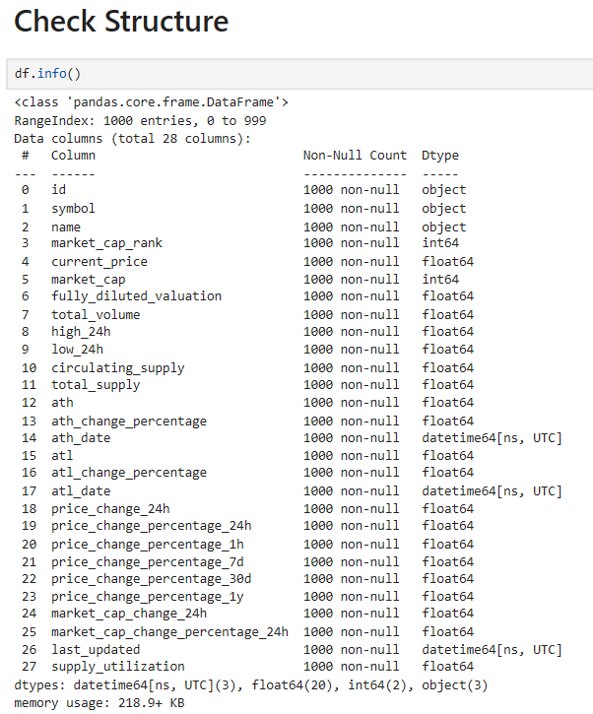

Slide 19
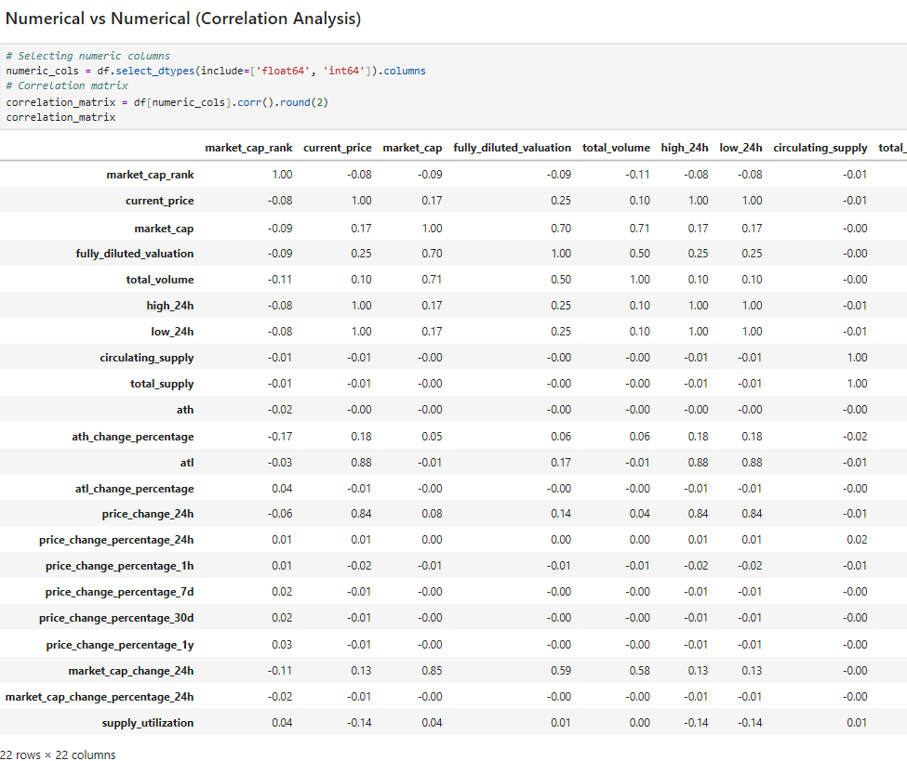
NON-VISUALIZATION ANALYSIS
Market cap strongly correlates with trading volume and fully diluted valuation.
Current price perfectly aligns with 24-hour high and low prices.
Price has weak correlation with market cap, showing supply strongly influences a coin’s size.

Slide 20
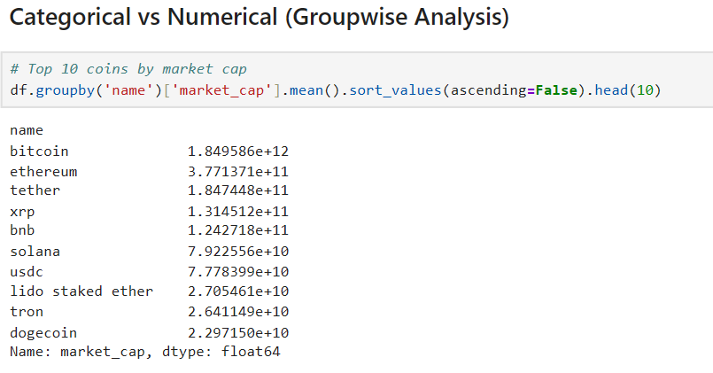
Bitcoin and Ethereum dominate the market with the highest market caps.
The top 10 coins contribute a major portion of total market valuation, showing a heavily concentrated crypto market.

Slide 21
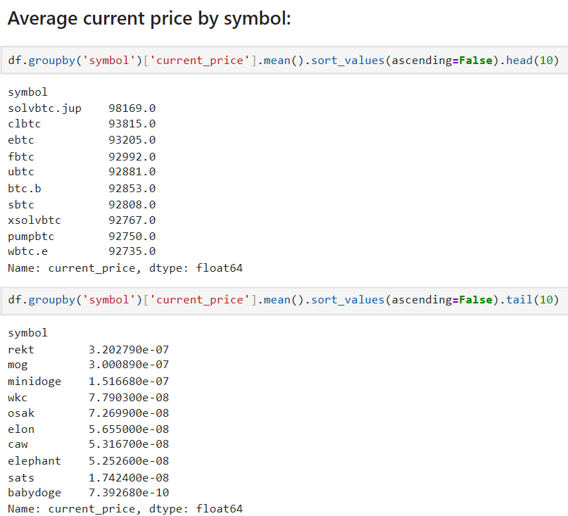
Some tokens have extremely high average prices, while many have low prices, showing wide diversity in valuation models.
High price does not always mean large market cap — supply differences matter.

Slide 22
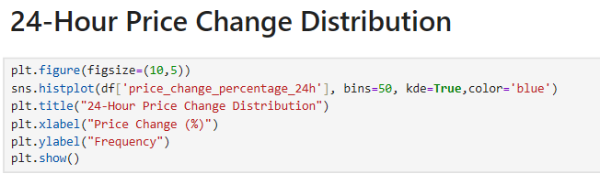
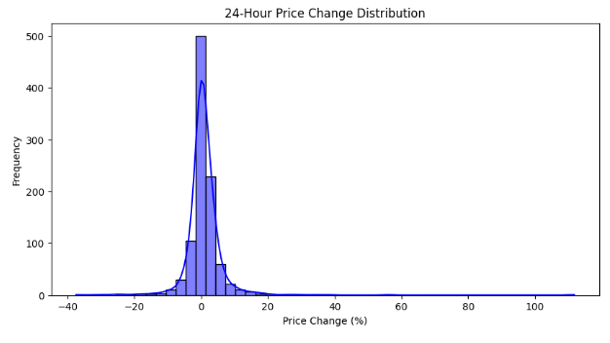
VISUALIZATIONS
UNIVARIATE ANALYSIS
Most cryptocurrencies show small price changes in 24 hours, but some coins exhibit extreme gains or losses — a sign of volatility.

Slide 23
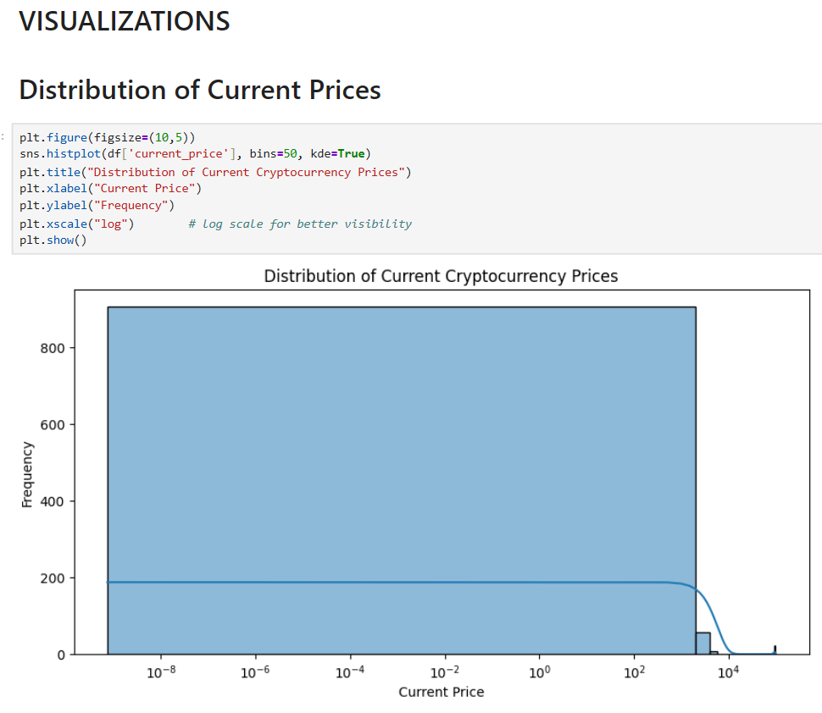
Cryptocurrency prices vary widely. Most coins have very low prices, but a few top cryptocurrencies have extremely high values. This creates a long-tail distribution, which is why the plot looks skewed to the right.

Slide 24
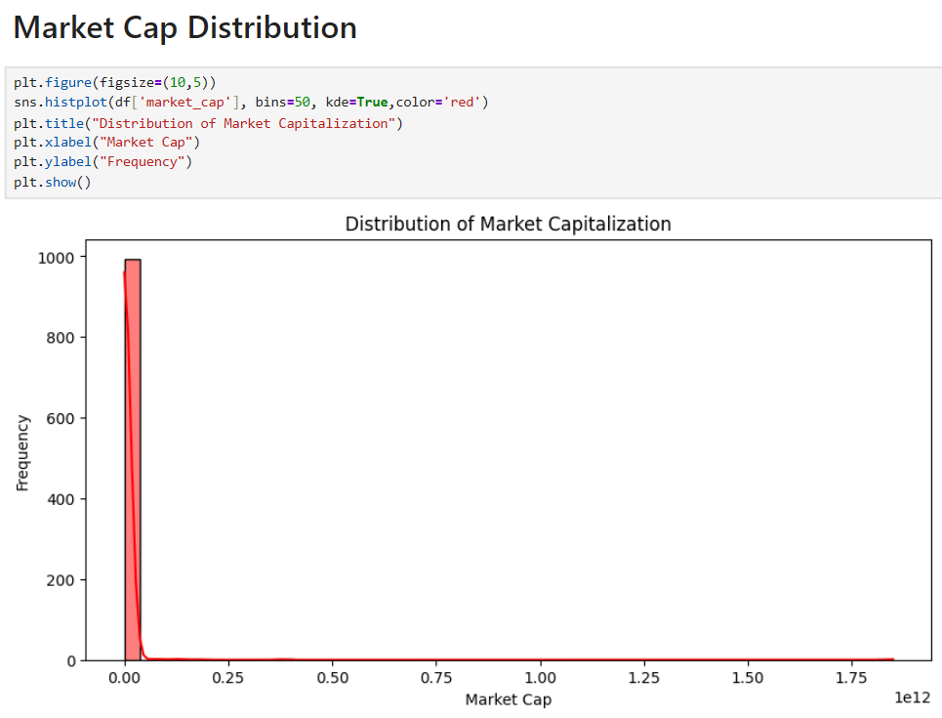
Market cap values are extremely skewed.
Only a few cryptocurrencies dominate the market (Bitcoin, Ethereum), while most coins are small-cap.

Slide 25
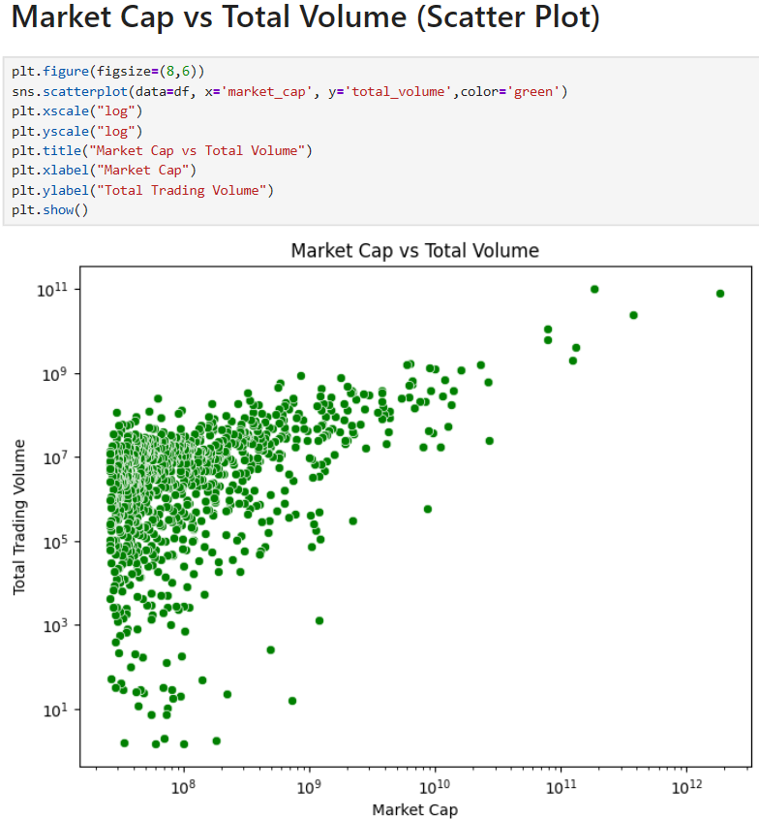
BIVARIATE ANALYSIS
There is a positive relationship between market cap and trading volume.
Larger cryptocurrencies generally have higher trading activity.

Slide 26
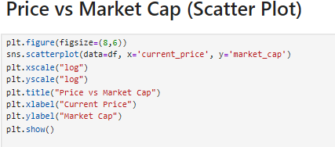
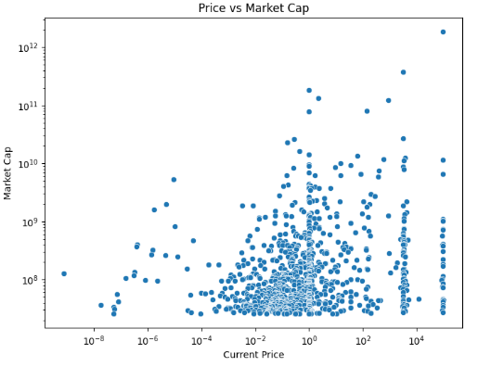
There is NO strong direct relationship between price and market cap.
Coins with low prices can have huge supplies, making market cap independent of price.

Slide 27
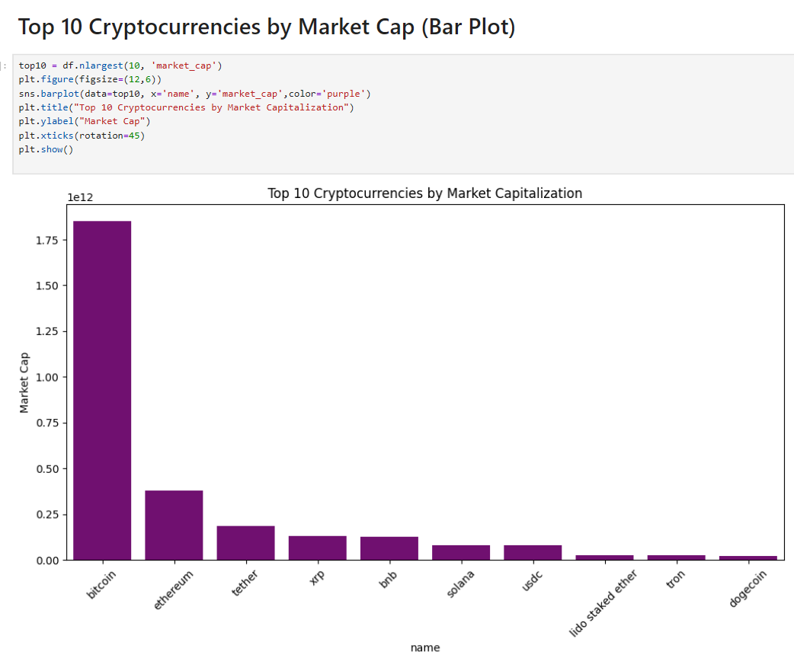
Bitcoin and Ethereum dominate the crypto market.
Other coins have significantly smaller market caps in comparison.

Slide 28
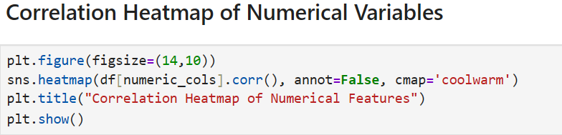
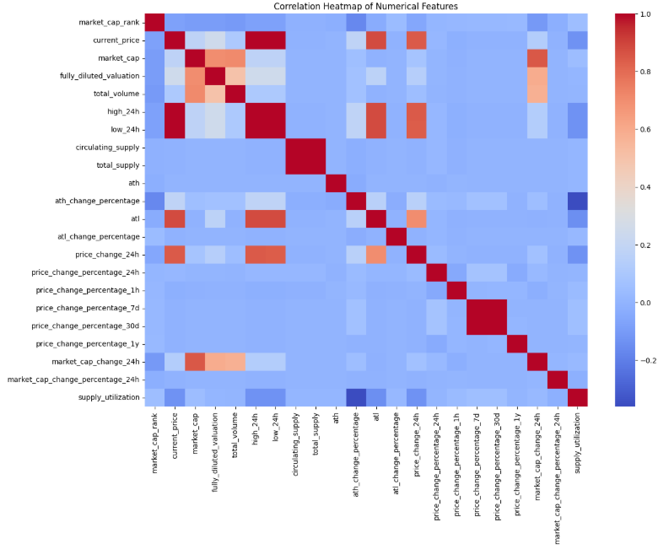
MULTIVARIATE ANALYSIS
Market capitalization strongly correlates with trading volume and fully diluted valuation, indicating higher activity in large-cap cryptocurrencies.
Current price closely aligns with 24-hour high and low prices, reflecting short-term price movements.
Weak correlation between price and market capitalization shows that token supply significantly influences a cryptocurrency’s overall value.

Slide 29
SUMMARY
CATEGORY | KEY INSIGHTS
Categorical Columns | Columns such as id, symbol, and name act as unique identifiers rather than true categorical variables, as most values occur only once.
Price Distribution | Cryptocurrency prices are highly right-skewed, with most coins priced very low, while a few coins have extremely high prices.
Market Capitalization | Market capitalization shows an extreme skewness, indicating that a few cryptocurrencies dominate the overall market value.
Trading Volume | Cryptocurrencies with larger market capitalization generally show higher trading volumes, reflecting greater liquidity and investor participation.

Slide 30
CATEGORY | KEY INSIGHTS
Correlation Patterns | Strong correlations are observed between market capitalization and total volume, as well as market capitalization and fully diluted valuation, while price shows weak correlation with market capitalization.
Price vs Market Cap | There is no direct relationship between price and market capitalization, as circulating supply plays a significant role in determining overall valuation.
Volatility (24H & 7D) | Short-term and weekly price changes show high volatility, with some cryptocurrencies experiencing extreme gains or losses.
Dominant Cryptocurrencies | Bitcoin and Ethereum dominate the market, contributing a major share of total cryptocurrency market capitalization.
Supply Utilization | Supply utilization varies widely across cryptocurrencies, indicating differences in token distribution models and maturity levels.

Slide 31
CONCLUSION
This project used Exploratory Data Analysis to examine the Top 1000 Cryptocurrencies and identify key market patterns. The analysis showed that the crypto market is highly skewed, with a few large cryptocurrencies dominating market capitalization and trading volume. It also revealed that market size depends more on circulating supply than price alone, and that cryptocurrencies exhibit high price volatility. Overall, the dataset provides valuable insights into market structure and risk, making it suitable for further analysis.

Slide 32

Thank You

