Slide 1
Mood-Based Mental Health App
Human-Computer Interaction Project
By: Aastha Adhikari – 21bcs5947
Diksha Khullar – 21bcs5962

Slide 2
Aim
Create an AI-driven system that personalizes user interfaces based on individual preferences, behavior, or context.
To create an AI-driven application that personalizes user interface and support based on user emotions detected through natural language input.

Slide 3
Tools & Technologies
Technologies Used:
Python – backend logic
Streamlit – interactive web app
HuggingFace Transformers – emotion detection model
VS Code – development environment

Slide 4
Model Used
Model:
DistilRoBERTa - Emotion Classifier (j-hartmann/emotion-english-distilroberta-base)
Pretrained for emotion classification
Fast & lightweight variant of RoBERTa
Handles multiple emotion classes

Slide 5
How It Works
System Flow:
User enters free-form text
Model detects mood/emotion
UI theme (colors/messages) dynamically adapts
Mood-specific suggestions are provided

Slide 6
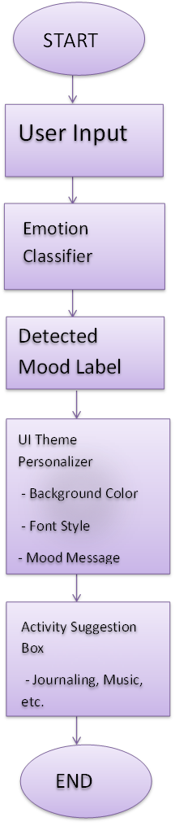
Flowchart

Slide 7
Code
# app.py
import streamlit as st
st.set_page_config(layout="wide", page_title="Mood Adaptive UI")
from transformers import pipeline
# Load sentiment/emotion classifier
@st.cache_resource
def load_classifier():
return pipeline("text-classification", model="j-hartmann/emotion-english-distilroberta-base", return_all_scores=False)
classifier = load_classifier()

Slide 8
Code continued…
# Mood to theme settings
mood_themes = {
"joy": {"bg": "#FFF9C4", "font_color": "#333", "message": "You're glowing! Keep shining 🌞"},
"sadness": {"bg": "#BBDEFB", "font_color": "#000", "message": "It's okay to feel down. Try journaling or take a deep breath 💙"},
"anger": {"bg": "#FFCDD2", "font_color": "#000", "message": "Let’s cool off with a relaxing activity 🧘‍♂️"},
"fear": {"bg": "#D1C4E9", "font_color": "#000", "message": "You're safe here. Maybe some calming music? 🎵"},
"surprise": {"bg": "#F0F4C3", "font_color": "#000", "message": "Whoa! Let’s turn this surprise into excitement! 🎉"},
"neutral": {"bg": "#ECEFF1", "font_color": "#000", "message": "Steady and balanced – a great place to be 🤍"},
}

Slide 9
Code continued…
st.title("🧠 Mood-Based Mental Health App")
st.markdown("Enter your current mood in words or describe your feelings:")
user_input = st.text_area("How are you feeling today?", placeholder="Write anything...")

Slide 10
Code continued…
if user_input:
# Get all scores
raw_scores = classifier(user_input, return_all_scores=True)[0]
scores_dict = {item['label'].lower(): item['score'] for item in raw_scores}
# Custom override logic
# Check for override based on keywords
lowered_input = user_input.lower()
if any(phrase in lowered_input for phrase in ["not feeling good", "not okay", "feeling bad", "can't", "unable", "hopeless", "sad", "tired", "late", "down"]):
mood = "sadness"
elif scores_dict.get("sadness", 0) > 0.5:
mood = "sadness"
elif scores_dict.get("anger", 0) > 0.5:
mood = "anger"
elif scores_dict.get("fear", 0) > 0.5:
mood = "fear"
else:
mood = max(scores_dict, key=scores_dict.get)
st.write("🔍 Raw scores:", scores_dict) # You can remove this after testing

Slide 11
Code continued…
# Get theme details
theme = mood_themes.get(mood, mood_themes["neutral"])
# Apply background color and font dynamically
st.markdown(
f"""
<style>
.stApp {{
background-color: {theme['bg']};
color: {theme['font_color']};
}}
.content-box {{
background: white;
padding: 1.5rem;
border-radius: 12px;
box-shadow: 0 4px 10px rgba(0,0,0,0.1);
}}
</style>
""",
unsafe_allow_html=True
)

Slide 12
Code continued…
st.markdown(f"<div class='content-box'><h3>🧘 Mood Detected: {mood.title()}</h3><p>{theme['message']}</p></div>", unsafe_allow_html=True)
# Activity Suggestion
st.markdown("### 🌟 Suggested Activity:")
if mood in ["sadness", "anger", "fear"]:
st.write("- Try a breathing exercise [Box Breathing (4-4-4-4)](https://youtu.be/FJJazKtH_9I)")
st.write("- Journal your thoughts or listen to [calming music](https://www.youtube.com/watch?v=2OEL4P1Rz04)")
elif mood == "joy":
st.write("- Share your happiness with someone 😊")
elif mood == "surprise":
st.write("- Reflect: What amazed you today?")
else:
st.write("- Continue with your daily focus tasks 📋")
else:
st.info("Write something above to detect mood and personalize your experience.")

Slide 13
Demo Output
User Input: "I am feeling very sad"
Detected Emotion: Sadness (✔️ Correct)
Raw Scores:
anger: 0.0027
disgust: 0.00036
fear: 0.0022
joy: 0.0035
neutral: 0.00054
sadness: 0.9899
surprise: 0.00069
System Response: “It’s okay to feel down. Try journaling or take a deep breath 💙”

Slide 14
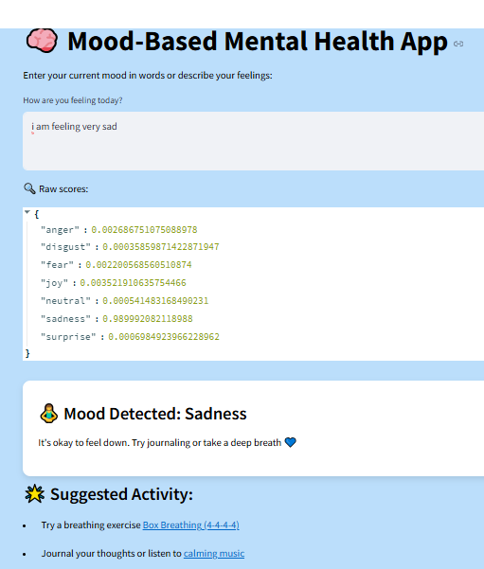
Output
Use this command to run the code:
streamlit run app.py

Slide 15
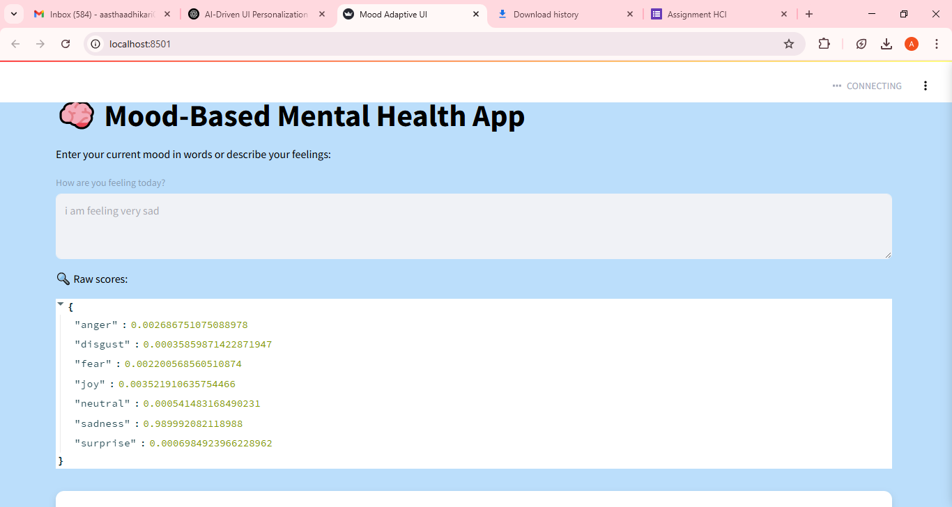
Output continued ……

Slide 16
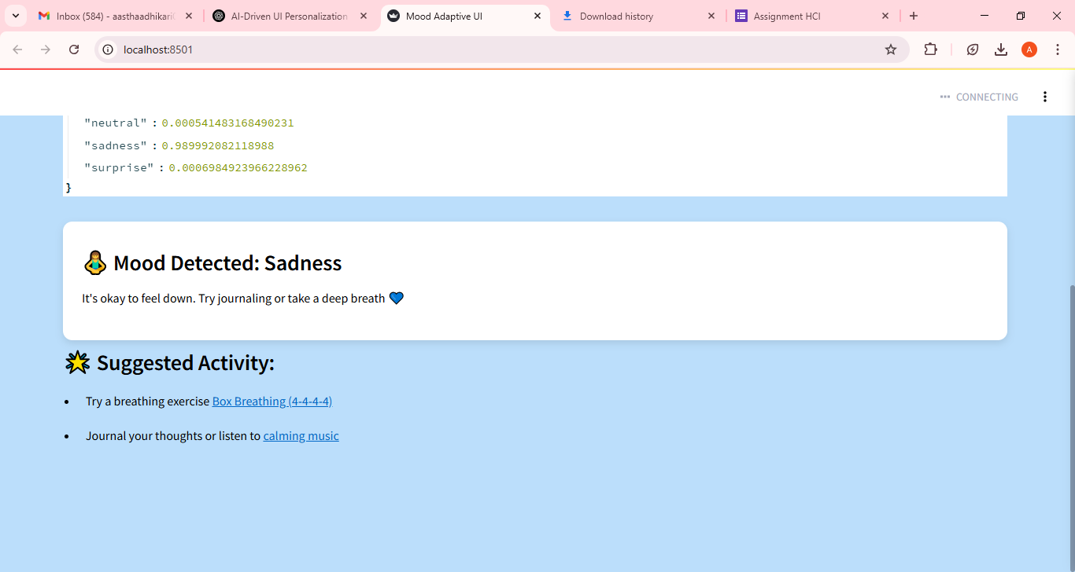
Output continued ……..

Slide 17
Limitations
known Issues:
May misclassify subtle or complex emotions
Cannot handle sarcasm, mixed moods
Fixed emotion labels only (joy, anger, etc.)

Slide 18
Future Scope
What’s Next:
Multimodal Emotion Detection: Integrate facial expressions and voice tone
Custom Training: Fine-tune with real-world mental health dataset
More Personalized UI Options

Slide 19
Conclusion
This project promotes emotional well-being by tailoring the app interface based on real-time user feelings. It bridges emotion-aware computing with personalized UI design — a novel application of HCI principles in mental health tech.

