Slide 1


Social Buzz

Slide 2


Today’s Agenda
Introduction and Project Objectives
Project Recap
Problem Statement
Team Introduction
Process
Findings and Insights
Summary
Q&A Session

Slide 3

Client: Social Buzz, a social media & content
Founded: 2010, HQ in San Francisco, 250 employees.
Project Recap
Social Buzz is a fast growing technology unicorn that need to adapt quickly to it’s global scale.
Engagement Objectives: Big data audit, IPO recommendations, content category analysis

Slide 4

But how to capitalize on it when there is so much?
Problem
Over the 100000 post per day
36,500,000 pieces of content per year!
Analysis to find Social Buzz’s top 5 most popular categories of content

Slide 5

Team Members:
Andrew Fleming: Chief Technical Architect
Marcus Rompton: Senior Principal
Astha Chourasiya: Data Analyst

Slide 6
Data Collection: Extracted and cleaned data from Social Buzz's databases.
Process
1
2
Data Analysis: Performed exploratory data analysis to understand content trends and user engagement.
Content Category Analysis: Identified the top 5 content categories with the highest aggregate popularity.
3
Big Data Audit: Evaluated Social Buzz's current big data practices.
4
IPO Preparation Prepared best practice documents and recommendations for a successful IPO.
5

Slide 7

Here are some interesting findings about Social Buzz’s categories.
Insights
16
1897
May
Reaction to ‘Animal’ Posts
Month with Most Post
Unique
Categories

Slide 8
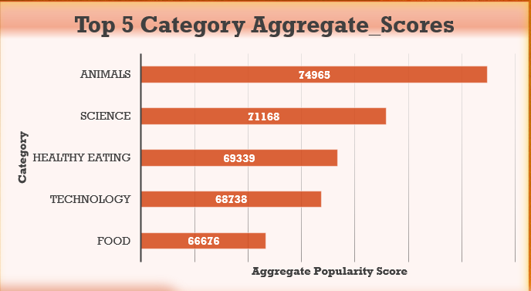

Slide 9
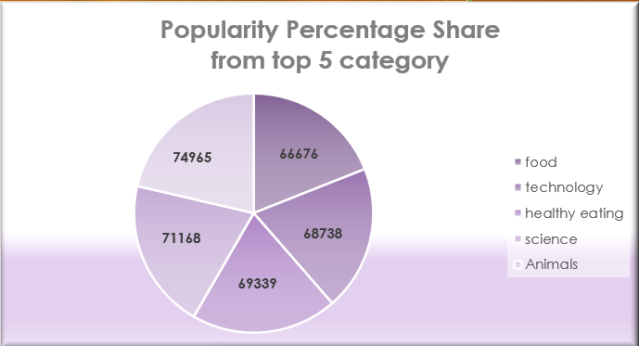

Slide 10

Analysis: : Animal and Science are the two most popular categories of content, showing that people enjoy “real-life” and “factual” content the most.
Insight:
Animal is a common theme with the top 5 categories with “Healthy Eating” ranking the highest.
Summary
Next Step:
This ad-hoc analysis is insightful, but it’s time to take this analysis into large scale production for real-time understanding of business.

Slide 11

Question and Answer Session

Slide 12
Thank you!
ANY QUESTIONS?

