Slide 1
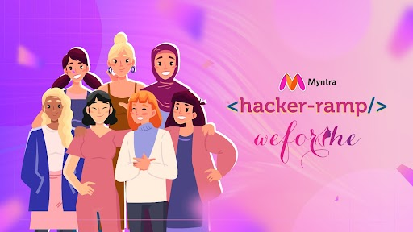
Team Name : PipInstall
Team Details: Khushi Garg Aastha Joshi Anngha C Panigrahi
I wish I could customise my hijab to be made out of kalamkari
So many design ideas but I have nowhere to display them

Slide 2

Problem Statement:-
Problems Faced :
Only 15% of content consumed by Gen Z includes traditional Indian cultural elements, compared to over 50% of content preferred by older generations.
The Fashion Design Council of India (FDCI) notes that 70% of fashion trends followed by Gen Z are influenced by Western and contemporary designs, leaving traditional prints and fabrics with less than 30% influence.
Media consumption patterns show that Gen Z prefers digital content (social media, streaming platforms), which seldom features traditional crafts and textiles
A survey conducted by the Craft Revival Trust (2019) found that only 35% of urban Indian youth could correctly identify more than three traditional textiles specific to Indian states
THEME i.e SOLUTION
Trend Generation
Engagement on a shopping platform

Slide 3
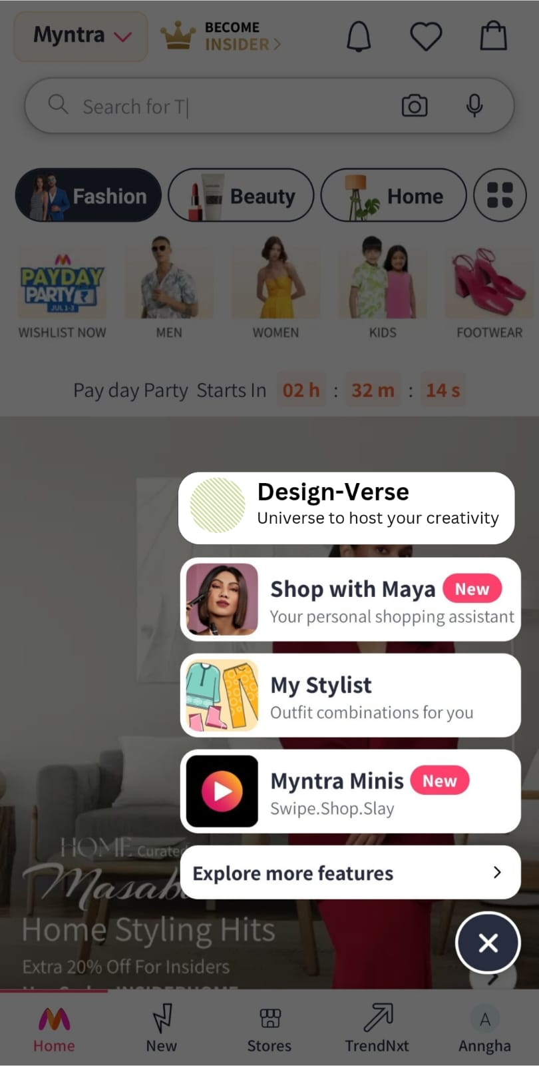
Solution: Bridging Tradition with Innovation
A Digital Platform for Designers
In an era where Gen Z often feels disconnected from traditional cultural heritage, there is a growing need to create innovative solutions that bridge this gap. Local textile traditions, such as Bandhani from Gujarat, Kalamkari from Andhra Pradesh, are rich with history and craftsmanship but risk becoming obsolete as modern fashion trends evolve.
PROPOSAL: An interactive digital platform that enables designers to showcase their work and play an AI-driven trend game to generate new prints and designs inspired by traditional local textiles.
DESIGN-VERSE
TrendWeave- Showcase Their Own Prints Fashion Roulette- AI driven Trend Game
Outfit Challenges -Where designers may compete

Slide 4
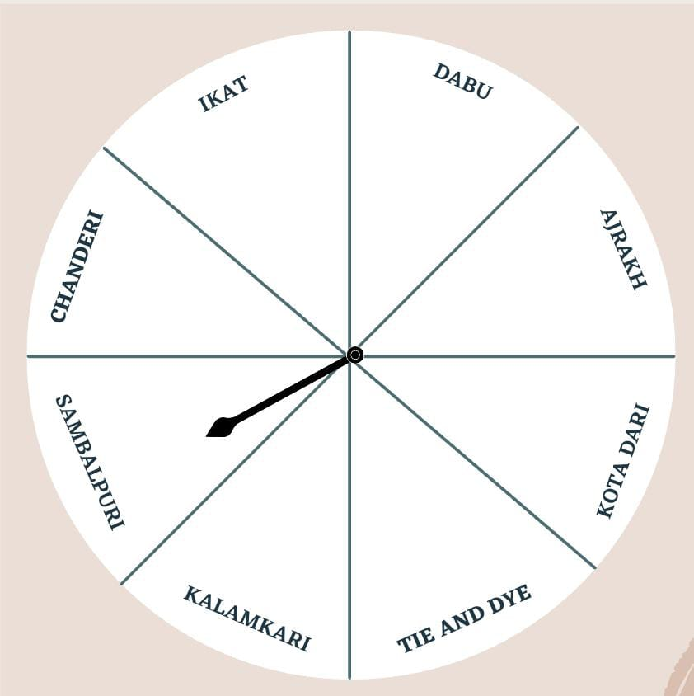
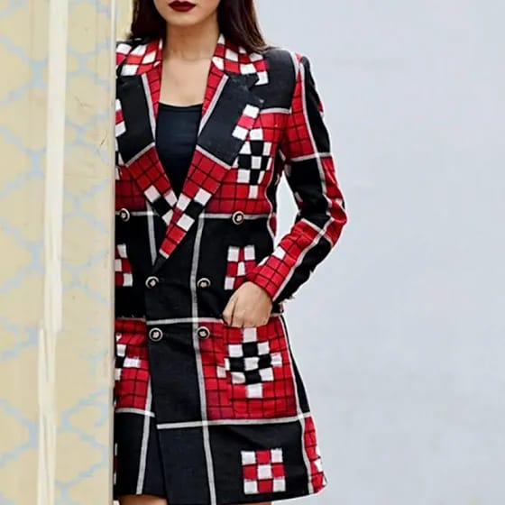
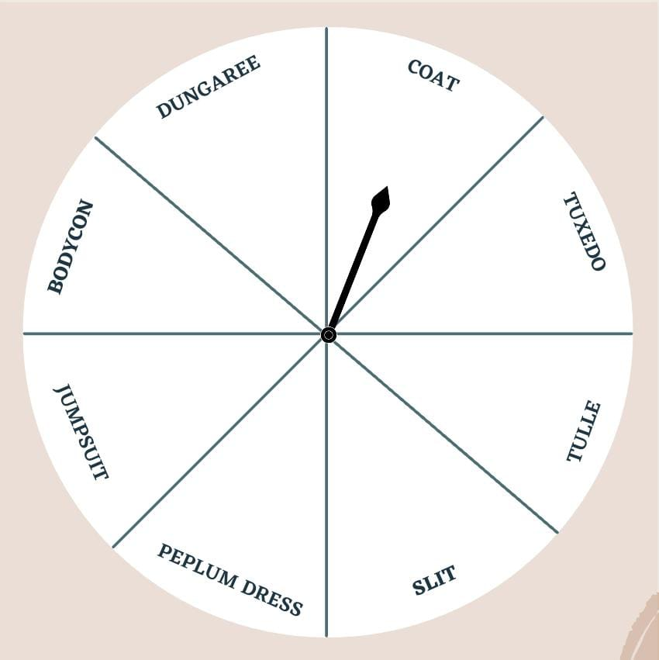


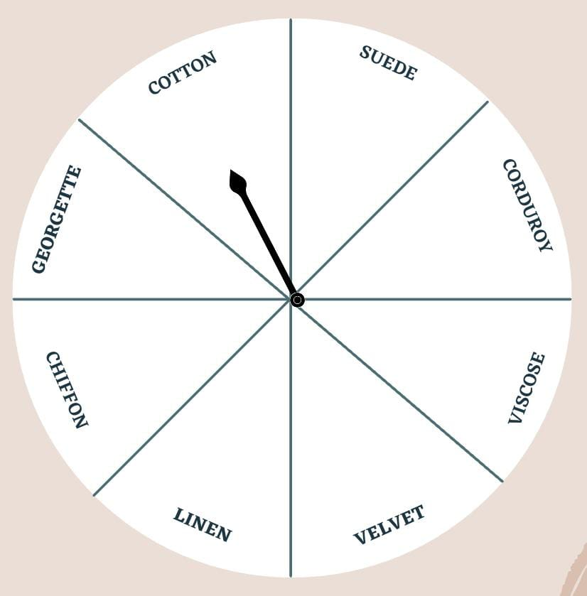
Solution:-
PROGRAM FLOW
1.FASHION ROULETTE
Three wheels run with three keywords namely containing material of the cloth,print on the cloth and names of western wear
Our AI generates an image completely new
Designers have to embrace this challenge,make it a reality
Tech Stack
Frontend: React ,JavaScript
Backend: FastAPI, Python, TypeScript, Javascript, Node JS
Express.js
Database: MongoDB
Hosting: GCP/AWS
Some Pretrained Models
AI generated Image (Example)
2.TRENDWEAVE

Slide 5
F
L
O
W
C
H
A
R
T

Slide 6
BUSINESS MODEL:-
FEATURES:-
BENEFITS:-
Affiliate Marketing: Partner with influencers or fashion bloggers for affiliate sales.
Financial Management:Cost Control: Monitor and optimize costs across all operations.
Revenue Optimization: Continuously analyze pricing strategies and adjust as per market demand.
Financial Planning: Implement robust financial planning and budgeting processes
Revenue Streams:Direct Sales: Sell products directly through the website.
Subscription Services: Offer premium membership for exclusive discounts and early access to new collections.
1. Designer Profile: Each designer can create a profile, add their bio, and showcase their portfolio of prints and designs.
2. Upload & Display: A section for designers to upload their own prints, categorized by local textile inspiration.
3. AI Trend Game: An interactive game where AI generates new print designs based on traditional textiles, which designers can use as inspiration or adapt into their own creations.
4. Outfit Challenges: Themed challenges where designers can compete with other designers and submit innovative Designs.
5. Homepage Features: A rotating showcase of top designs and prints, with special features for designers who win the outfit challenges or receive high engagement.
Preserving Heritage while fostering creativity
Enhanced exposer for budding designers leading to increased opportunities and growth
Fosters a vibrant community of designers who can interact,collaborate and compete
Appeals to GenZ
Boost in platform traffic and social media buzz
Resonates with Make in India campaign(Vocal for local)

